Slide 1
Standards Unit SS4: Evaluating Statements about Lengths and Areas
Suitable for students Level 6, or good students at Level 5?
A good first ‘Always, Sometimes Never’ activity. The general process is very well explained here.
>1 hour. I’d guess a lot more.
Paired activity.
Still camera.
This is an Always, Sometimes, Never activity in which pairs of students each make 8 mini-posters, before being collected together.
[Interestingly, I didn’t have any permanent copies of these cards made]

Slide 2
Consumable Resources Needed:
Blu-tac
Each pair needs 1 copy of Statement cards.
Each pair needs ~6 (with 2 more available) sheets of pale-green A4 paper .
Entire class needs *available* 8 sets of very large A2? posters.
Poster 1 contains all Card A mini-posters, arranged in three sections (A, S, N)
Poster 2 contains all Card B mini-posters, arranged in three sections (A, S, N)
Poster 3…
[This structure makes it easy for students to look and compare their work, and results, to others. This is a major part of the learning process]
Re-usable Resources Needed:
Still camera.
Calculators fine.
Textbooks for looking up any formula they need?
Each pair needs a copy of ‘Hint’ cards available. Or better, I just hold about 4 or 5 copies of each Hint card, and lend them out to any team struggling with a particular Statement card.

Slide 3
Consumable: Print on pale coloured card

Slide 5
Re-usable Hint Cards: Print on thick coloured card. Only 5 copies needed in total.

Slide 6
Notes to start.
Students must be pre-assigned into pairs.
Students will need a copy of Card Set A (possibly get them to curt it up – to give them time to ponder process etc.).
Will also need glue and about 6 – 8 A4 sheets.
I will need blu-tac to stick these mini-posters together on wall, or on another mega-poster.

Slide 7
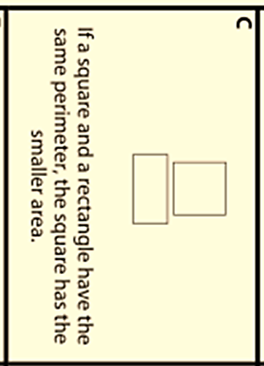
True or False?
Who thinks they know the answer?
Who is unsure?
In pairs, you’ll need to decide if each card is:
ALWAYS True, SOMETIMES True or NEVER True (i.e. FALSE)

Slide 8
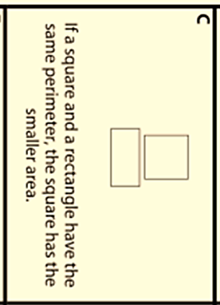
How to decide…
Step 1. Understand the problem
‘If a square and a rectangle have the same perimeter, the square has the smaller area’
Discuss what everything means.
Draw some diagrams to help.
What does ‘area’ mean? How do you calculate it?
What does ‘perimeter’ mean? How do you calculate it?

Slide 9
How to decide…
Step 2. Try some examples
Pick a square. Say 6cm x 6cm.
What’s its area?
36cm²
What’s its perimeter?
36cm²
Now pick a rectangle with the same area as the square.
2 x 18
4 x 9
etc.
What’s its perimeter?
40cm
26cm
…
Is the Statement true for this example?
Yes
Yes
…

Slide 10
How to decide…
Step 3. Decide whether you think it is true or false
You will probably begin to think that the Statement here is ALWAYS true.
[This is called a conjecture. It’s like an educated guess. But you aren’t certain it’s true]
Step 4. The crucial step! Now try to prove or disprove what you think!
Try to think of unusual examples.
What if the length of the rectangle is very, very small?
What if it is very, very big? Is the Statement still true?
Can you use algebra to prove the Statement is ALWAYS true?

Slide 11
Your turn (in pairs)
Decide if each Statement is ALWAYS, SOMETIMES or NEVER true.
Stick each Statement on a separate sheet, and write your reasoning and final decision around it.
Your names
ALWAYS
We lkhw welkr k 34 52 xx4x5234532 krlkw jelkjw wl rlwkjle w r
We lkhw welkr k wl rlwkjle w r 2 5x x4 x234x
We lkhw welkr k we krlkw jelkjw wl 432xx5 4x x2 5x 2 5x x4 x234x
We lkhw welkr k 52343 xxx3x x233x42 4435 4x x2 5x 2 5x x4 x234x
We lk5x 2 5x x4 x234x eklrjrhe jer r wl rlwkjle w

Slide 12
Tips
The Cards tend to start easier, and get a little harder (Card A easiest?).
If you really get stuck, I can give you a ‘Hint’ card.
What I’m looking for is for you to follow the 4 steps very carefully.
I do not need it to be extremely neat – just clear enough so that everyone can read it all.
Step 1. Understand the problem. Write down some notes.
Step 2. Try some simple examples. Write down your calculations.
Step 3. Decide what you think: Always, Sometimes or Never?
Step 4. The mathematician’s bit! Now really try to prove or disprove it

Slide 13
Bring each mini-poster to me when finished
Your names
ALWAYS
We lkhw welkr k 34 52 xx4x5234532 krlkw jelkjw wl rlwkjle w r
We lkhw welkr k wl rlwkjle w r 2 5x x4 x234x
We lkhw welkr k we krlkw jelkjw wl 432xx5 4x x2 5x 2 5x x4 x234x
We lkhw welkr k 52343 xxx3x x233x42 4435 4x x2 5x 2 5x x4 x234x
We lk5x 2 5x x4 x234x eklrjrhe jer r wl rlwkjle w
Check: so what do you need to do?

Slide 14
Always, Sometimes, Never?
Step 1. Make sure you both understand the problem
Draw some simple diagrams to help you.
Discuss it with your partner to check you both agree what it means.
Step 2. Try some simple examples
Is the Statement true for the simple examples?
Step 3. Decide whether you think the Card is Always, Sometimes or Never true.
This is where lots of people stop their thinking. But in Maths, we do a crucial Step 4.
Step 4. Try to prove or disprove what you think.
Try unusual examples. Or try to use algebra instead of particular numbers

Slide 15
Collect the posters for each card together,
so the examples, ideas and answers can be compared
Example collection of 3 posters all on Card A. Two pairs think the answer is ‘ALWAYS’, whilst one pair think it is SOMETIMES.
Give all students time to go around and look at others answers. Get them to select one answer they feel sure they have got correct, and (maybe) one that they now realise they got wrong.

Slide 16
Card A
Giant poster like this for each of the 8 cards
Dave & Dan
ALWAYS
Joe and Joe
SOMETIMES
We lkhw welkr k 34 52 xx4x5234532 krlkw jelkjw wl rlwkjle w r
We lkhw welkr k wl rlwkjle w r 2 5x x4 x234x
We lkhw welkr k we krlkw jelkjw wl 432xx5 4x x2 5x 2 5x x4 x234x
4x x2 5x 2 5x x4 x234x
We lkhw welkr k 34 52 xx4x5234532 krlkw jelkjw wl rlwkjle w r
We lkhw welkr k 52343 xxx3x x233x42 4435 4x x2 5x 2 5x x4 x234x
We lk5x 2 5x x4 x234x eklrjrhe jer r wl rlwkjle w
We lkhw welkr k we krlkw jelkjw
We lk5x 2 5x x4 x234x eklrjrhe jer r wl rlwkjle w
Hannah & JH
ALWAYS
We lkhw welkr k we krlkw jelkjw wl 432xx5 4x x2 5x 2 5x x4 x234x
We lkhw welkr k 34 52 xx4x5234532 krlkw jelkjw wl rlwkjle w r
We lkhw welkr k 52343 xxx3x x233x42 4435 4x x2 5x 2 5x x4 x234x
We lk5x 2 5x x4 x234x eklrjrhe jer r wl rlwkjle w

Slide 17
Who thinks they got this correct?
What was your reasoning?
Does anyone else think they have a better explanation?

