Slide 1
Beat the nation! Week 4

Slide 2
Beat the Nation: Week 4
Overview
SATs – Week 4
GCSE Foundation – Week 4
GCSE Higher – Week 4
How to find the data
The Revision Schemes of Work

Slide 3
Beat the Nation: Overview
Beat the Nation is a structure I like to use for revision lessons
I use data from the 1000s of students across the nation who have answered questions from the Revision Collection to find the most troublesome questions
I then present these questions to students in class, challenging them to:
Get the questions correct (hence, Beat the Nation!)
Predict which is the worst answered question
Predict the most popular choice of wrong answer for each question
Explain why a student may choose these answers
Think how they would help them
I can then reveal the answers (in reverse order, for drama), showcasing actual students explanations for the most popular wrong answers
My aim in doing this is to:
Expose students to questions other students find difficult and support my students with them
Help my students develop their ability to consider and explain other students’ misconceptions – a key skill required for those exam questions that require students to explain, describe, discuss, etc
If find that setting this up as “Beat the Nation” provides those students with a competitive edge a nice incentive, and also takes the pressure off a little – “well, the rest of the country is struggling with these questions, so it is no surprise I find them tough, but I might as well give them a go…”
Feel free to play around with the structure to make it work for you.
I hope you and your students enjoy this and find it useful.

Slide 4
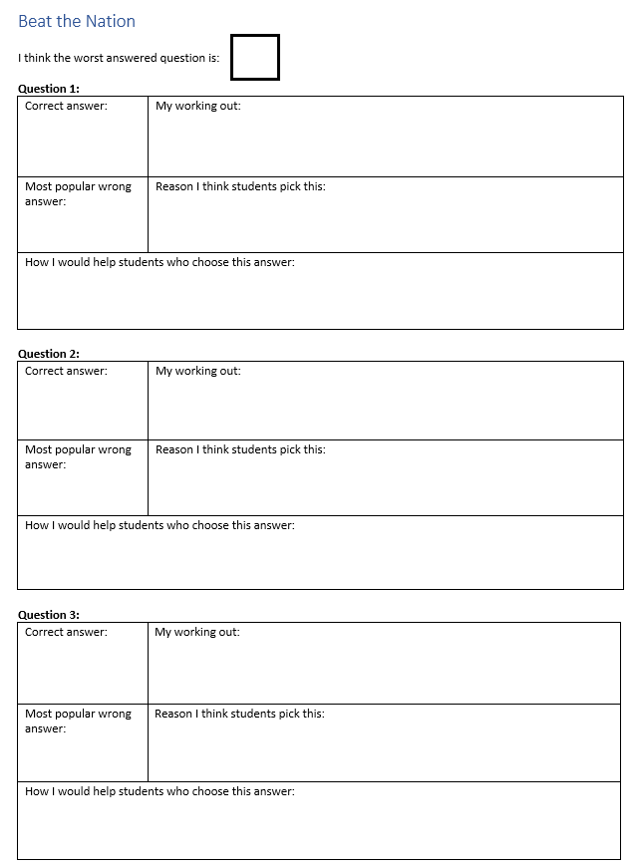

Slide 5
Beat the nation! SATs Week 4

Slide 6
1000s of students are struggling with these three questions
1. Can you get each question right?
2. Which do you think is the worst answered question?
3. What do you think is the most popular choice of wrong answer for each question?
4. Can you explain why other students might choose these wrong answers?
5. How would you help them?

Slide 7
I think it is 60 divided by three which would equal 20 . I definitely don't think that 12 x 3 would be a step because in the whole question it has nothing to do with 12 . Laila x
A
i think this because if the ratio is 2:3 and they have 60 stickers altogether then if you want to find how may he has you will have to divide by 2 or 3 to find your answer
C
Notes:
https://diagnosticquestions.com/Data/Question/33476#/All///////

Slide 8
I think the answer is 7 because if 4 turns into 20 it has been multiplied by 5 so for the denominator if we need to find the value of A you have to do the inverse so, instead you do 35 divided by 5 which will leave you with the answer 7.
C
Notes:
https://diagnosticquestions.com/Data/Question/33470#/All///////

Slide 9
I think so because if Robert eats 1/3 of the cake and there is 2/3 of a cake, then there is only 1/3 left which means that if we subtracted 1/3 from 2/3, we would get 1/3 leftover
D
because when you are solving a problem like this it wouldn't work if you did 1/3 + 2/3 or x or divide because when you + it will be 1 and 1/3 and x will be way to big and you cant divided so it has to be -
D
Because it includes the word remaining and that is vocabulary used in most subtracting questions. Also if Robert is eating it, he is eating some so it is being taken away and it is going
D
Notes:
https://diagnosticquestions.com/Data/Question/33474#/All///////

Slide 10
Beat the nation! GCSE Foundation Week 4

Slide 11
1000s of students are struggling with these three questions
1. Can you get each question right?
2. Which do you think is the worst answered question?
3. What do you think is the most popular choice of wrong answer for each question?
4. Can you explain why other students might choose these wrong answers?
5. How would you help them?

Slide 12
C
Six because there is no 6 and the mean is 6
C
because if you put them in order 6 becomes the middle and therefore is the mean
Notes:
https://diagnosticquestions.com/Data/Question/82791#/All///////

Slide 13
B
She can't add the 1 as she has already used it to take away the three with and that cam to 2
Notes:
https://diagnosticquestions.com/Data/Question/82789#/All///////

Slide 14
because you are rotating the shape around the point 180 degrees which are basically flipping the shape around the point. Point (6,1) stays in the same place on the x-axis.
B
Notes:
https://diagnosticquestions.com/Data/Question/82785#/All///////

Slide 15
Beat the nation! GCSE Higher Week 4

Slide 16
1000s of students are struggling with these three questions
1. Can you get each question right?
2. Which do you think is the worst answered question?
3. What do you think is the most popular choice of wrong answer for each question?
4. Can you explain why other students might choose these wrong answers?
5. How would you help them?

Slide 17
A
I think that you need to divide the side length by the opposite side length and then multiply it by the sine of the angle in the middle
Notes:
https://diagnosticquestions.com/Data/Question/82343#/All///////

Slide 18
Not a right angle triangle, so can’t use SOHCAHTOA. Cannot use Sine rule because don’t have 2 known opposite sides and angles. Cannot use Cosine rule because don’t have all sides.
A
Notes:
https://diagnosticquestions.com/Data/Question/82351#/All///////

Slide 19
C
Because f(x) is a function, and f(2x) is the same function but doubled and C is correct because all of the values have been doubled
A
This is the only option that simplifies to the answer i obtained after subbing in 2x into the x's in the equation
Notes:
https://diagnosticquestions.com/Data/Question/82348#/All///////

Slide 20
Beat the Nation: How to find the data
You can find poorly answered questions, the data on these, and sample student explanations for any quiz on Diagnostic Questions.
Just follow the steps in the next slides

Slide 21
Visit the Collections page

Slide 22
Choose a Collection

Slide 23
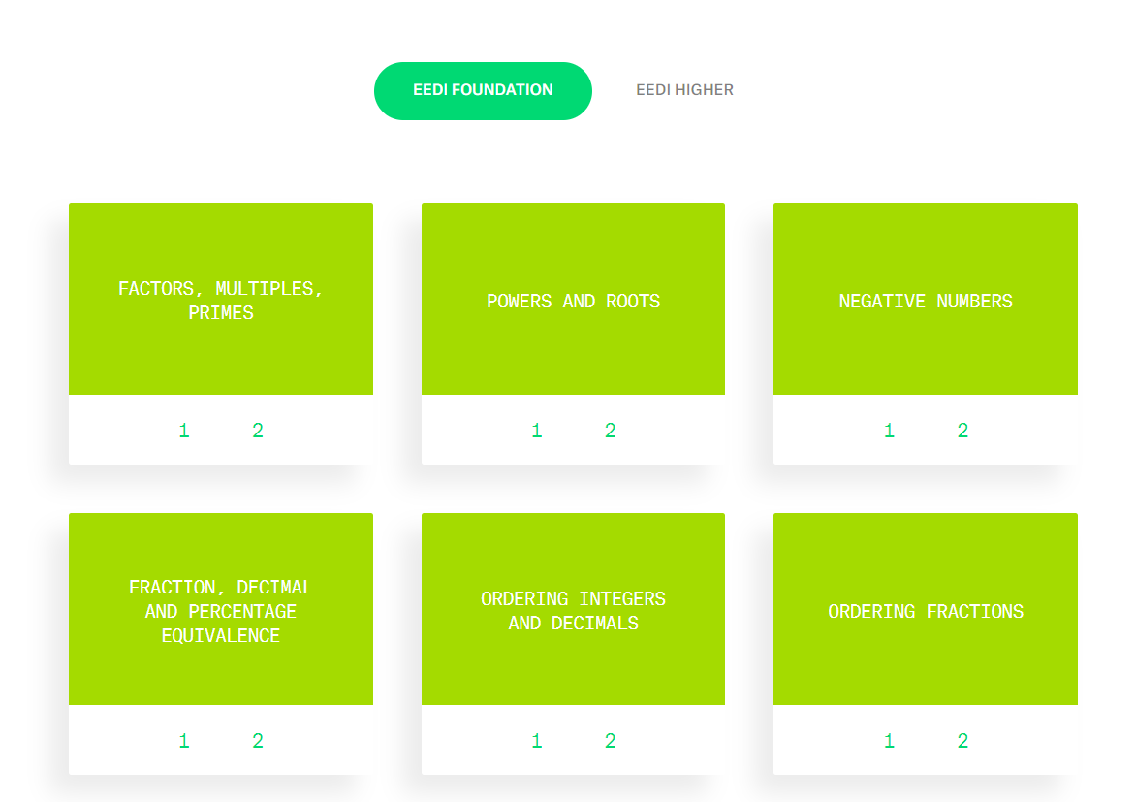
Find a topic you like

Slide 24
Always choose Quiz 1 from that topic (it has most data)

Slide 25
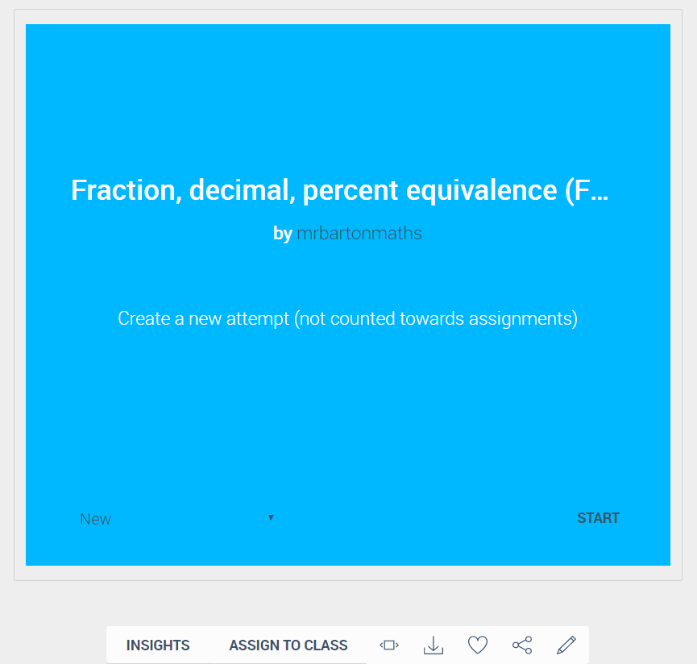
Click on Insights

Slide 26
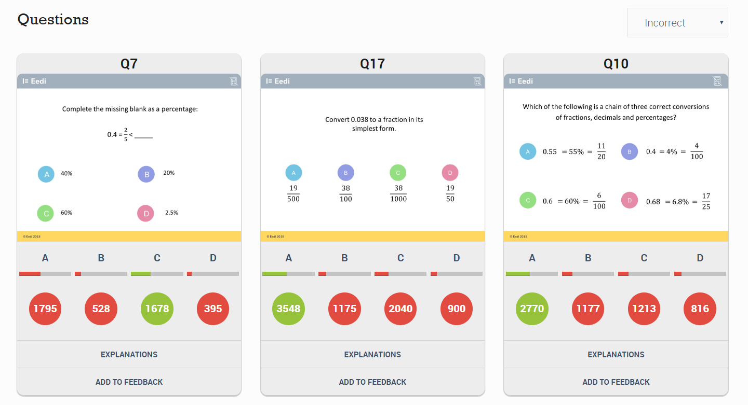
Scroll down the page to see the 3 worst answered questions

Slide 27
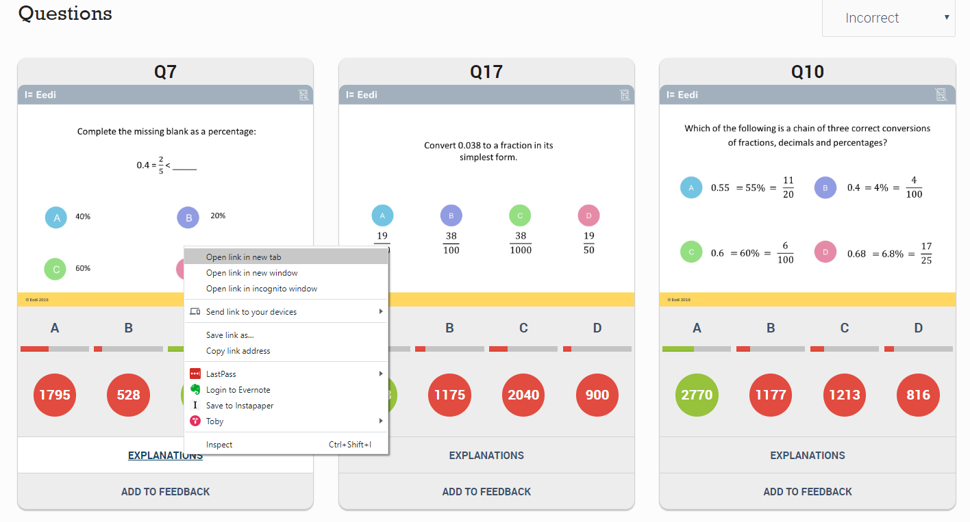
For each question, right-click on Explanations and choose
“Open link in a new tab”

Slide 28
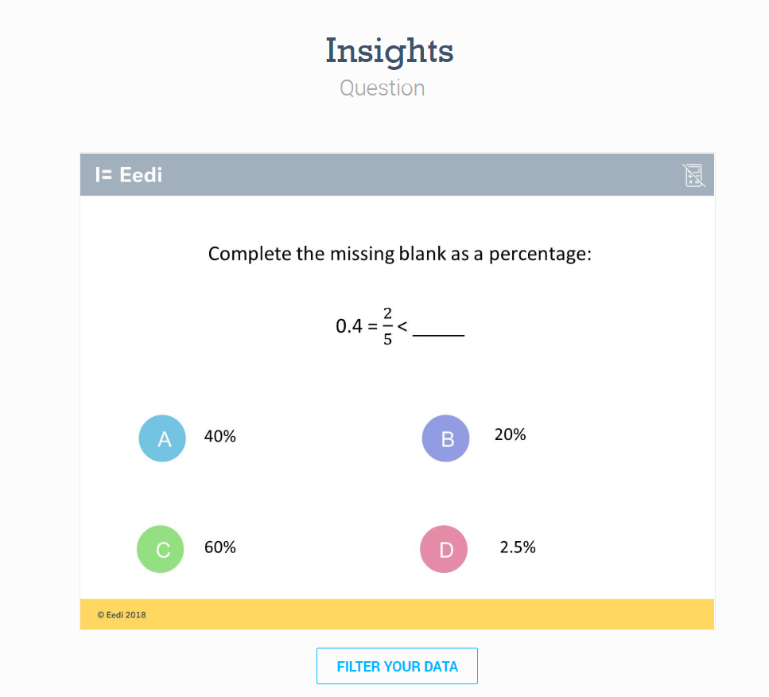
Now you are on a page where you can access more data and explanations for each question

Slide 29
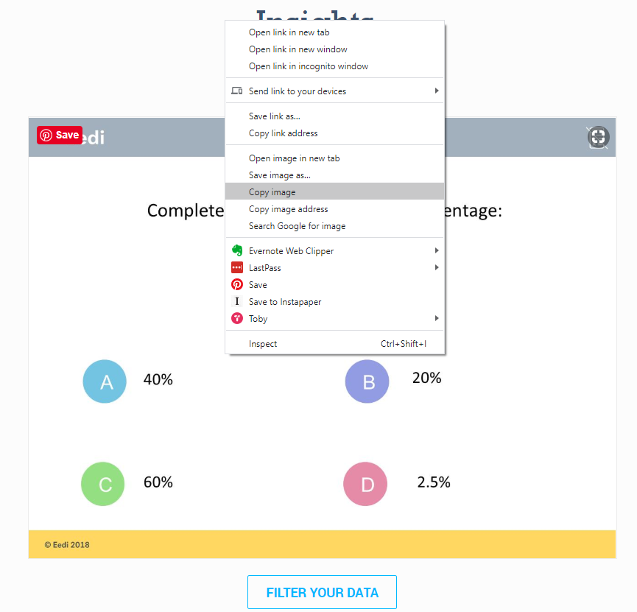
First, copy the image of the question (right-click: “copy image”) and paste it into a blank PowerPoint slide

Slide 30
Next click on Filter your data

Slide 31
Scroll down the page and change Cohorts to Percentage

Slide 32
You can then take a screen shot of this table so you have the relevant figures for each answer and paste them into your PowerPoint

Slide 33
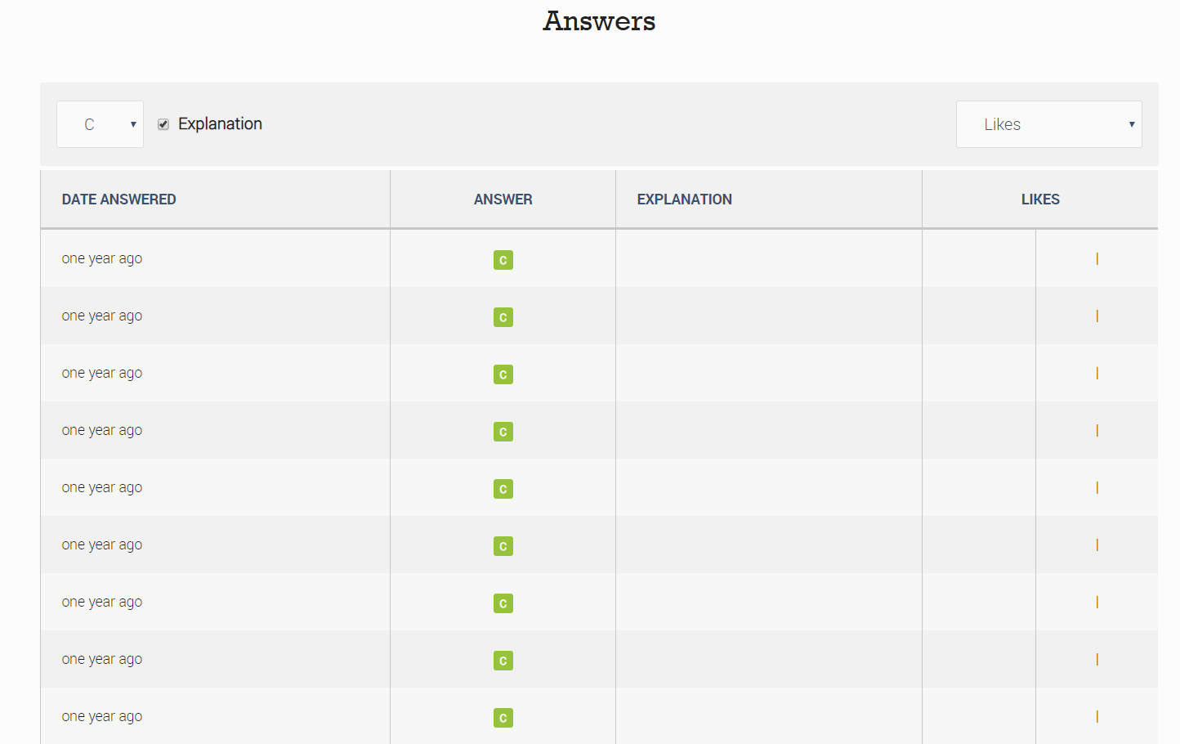
Scroll further down the page to get to the Answers

Slide 34
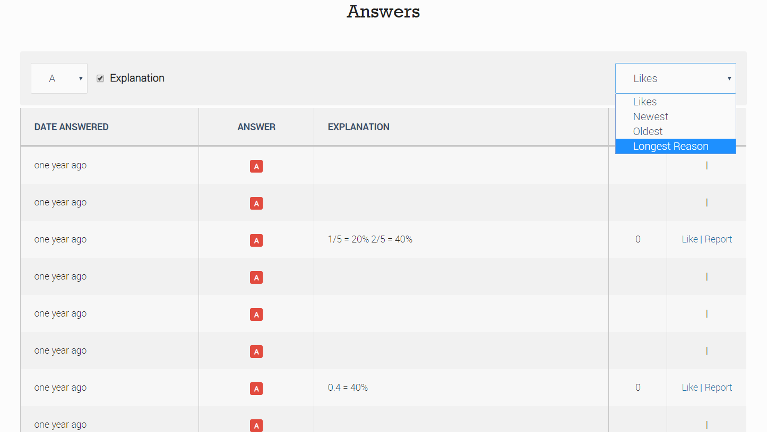
Choose the most popular wrong answer (in this case A), and change Likes to Longest reason (this tends to get better thought out answers)

Slide 35
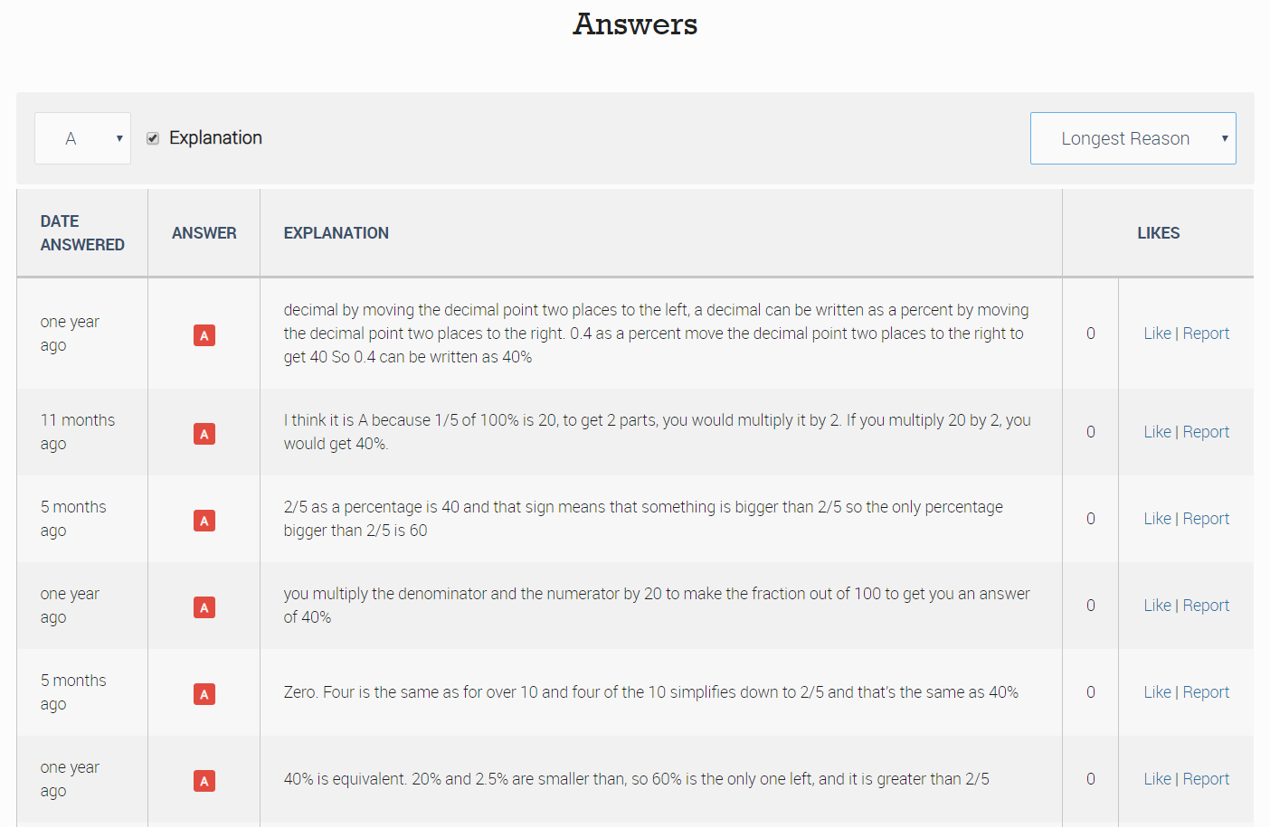
Read through the answers to find interesting ones

Slide 36
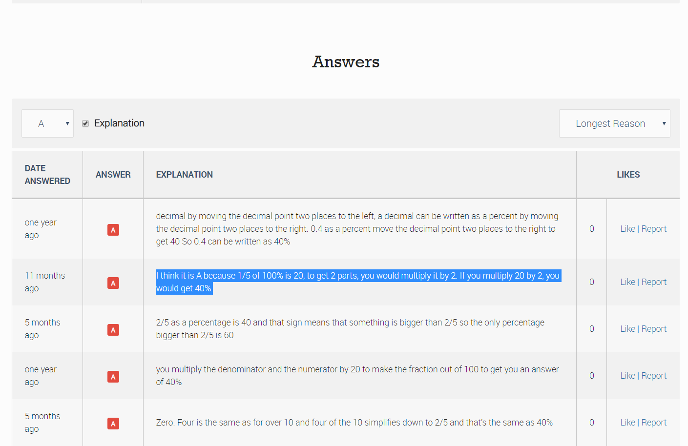
Copy and paste the text of the explanation and add it to your PowerPoint

Slide 37
Repeat this for the other two questions

Slide 38
And you are done!

Slide 39
The Revision Schemes of Work
You can access all the revision quizzes for SATs, GCSE Foundation and GCSE Higher here
You can also set these up as a free Revision Scheme of Work so your students receive a new quiz each week (or whatever frequency you choose), which is automatically marked for you
To get started on this, just visit Eedi
For help getting your students on the system, send an email to hello@eedi.co.uk attaching your students’ names and class-names in a spreadsheet

