Slide 1
Standards Unit S6:
Interpreting Frequency Graphs, Cumulative Frequency Graphs, Box & Whisker Plots
Suitable for students Level 8. Good quick revision for Level 9s?
About 20 mins?
Groups of 3 activity.
This activity is drasticaly reduced from the ‘poster’ making form of the lesson.
Graph data is deliberately a little ‘dirty’, unlike ‘perfect’ data in original materials.

Slide 2
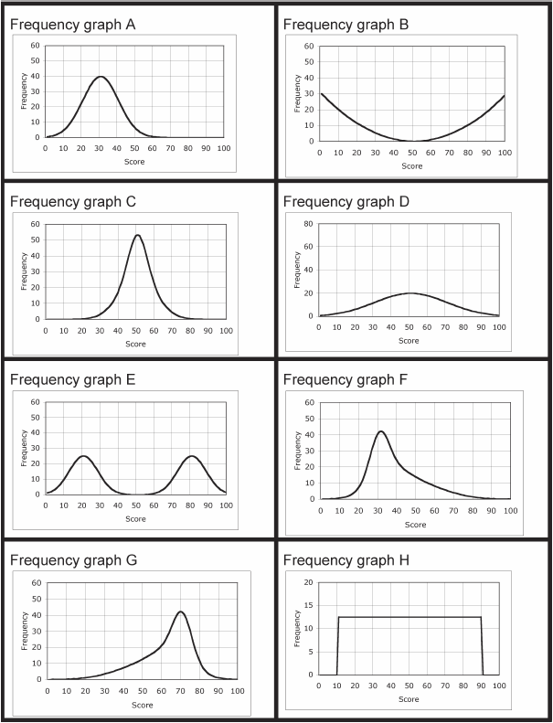
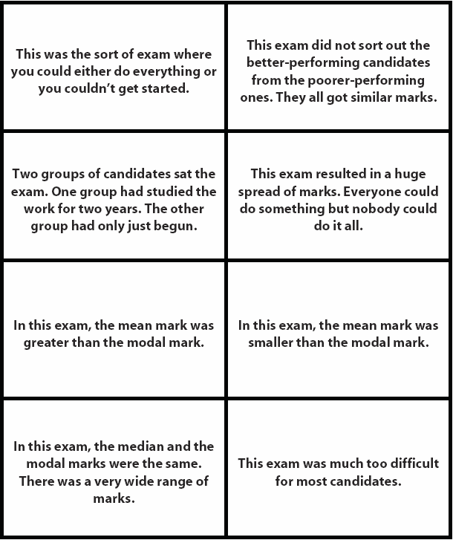

Slide 3
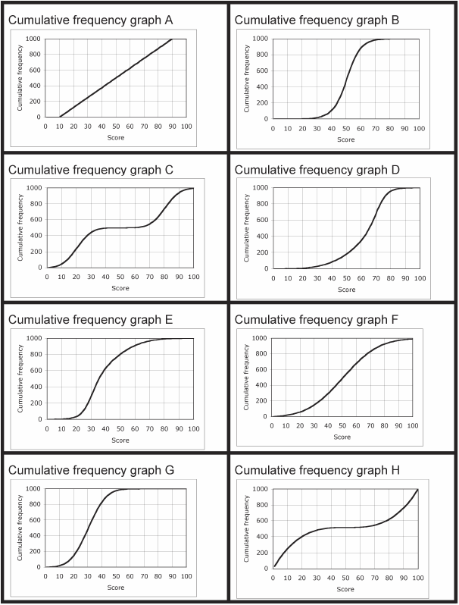
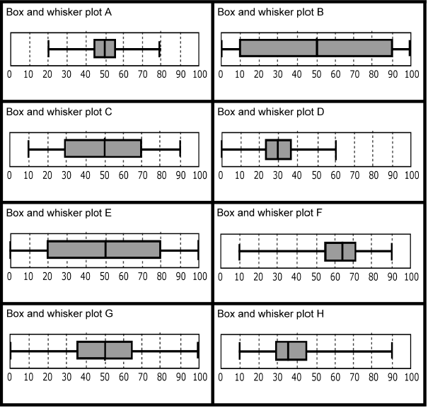

Slide 4
Lesson development abandoned.
Not enough good content here to bother.
Just do session as a very basic card match.
If possible, recommend actually using the official S.U. flipboard file, which allows manipulation of the cards on a smartboard. Then can partially build up completed pattern during mini-plenaries to help.

Slide 5
Card Match Solution
(to be checked)
Frequency Graph | Statement | Cumulative Freq Graph | Box &Whisker
F | This exam was much too difficult… | E | H
D | This exam resulted in a huge spread of marks… | F | G
C | This exam did not sort out the better-perf… | B | A
E | Two groups of candidates.. | C | E
B | This was the sort of exam… | H | B
G | In this exam, the mean mark was greater… | D | F
H | In this exam, the median and the modal marks.., | A | C
A | In this exam, the mean mark was smaller… | G | D

Slide 6
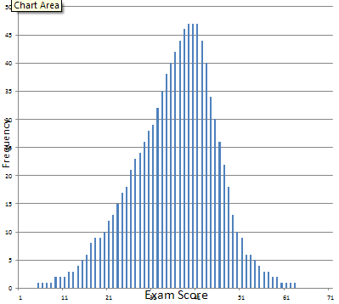
Frequency Graphs
A large number of students took an exam and their final scores are shown in the Frequency Bar Chart.
Frequency Bar Chart
Lesson development abandoned.
Not enough good content here to bother.
What can we easily deduce? (i.e. work out)

Slide 7
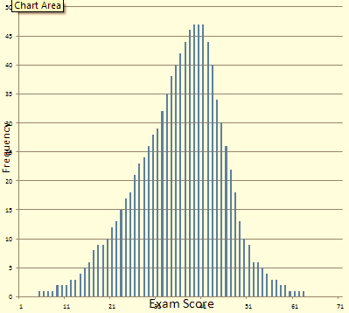
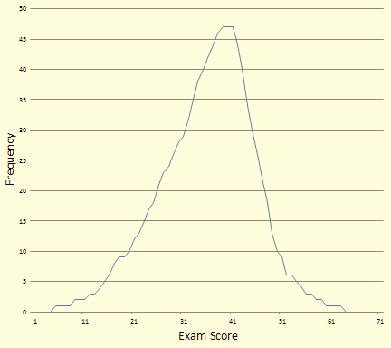
Frequency Graphs
A large number of students took an exam and their final scores out of 100 are shown in the Frequency Bar Chart.
Frequency Bar Chart
Frequency Line Graph
Lesson development abandoned.
Not enough good content here to bother.
When there are very many points on a bar graph like this, we usually represent the graph as a continuous line (even though the data itself is really discrete). It’s easier to use, and to create.

Slide 8
Student Exam Results
Frequency Line Graph
Lesson development abandoned.
Not enough good content here to bother.
Did the students find this exam easy, or hard? How can you tell?
What was the modal score?
Do you think the mean score was higher, or lower than the mode?
Roughly how many students sat the exam?
[quite hard to work out]

Slide 9
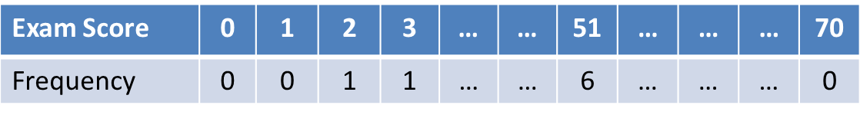
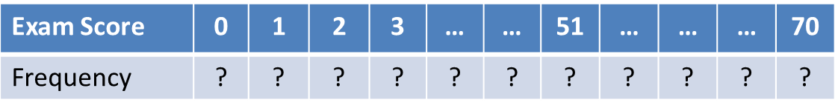
Frequency Tables to Frequency Graphs
Usually, we start off with a Frequency Table, and then plot the graph.
Frequency Line Graph
Lesson development abandoned.
Not enough good content here to bother.
But could we ‘go backwards’, and create the Table from the Graph?
Frequency Line Graph
Would it be easy and quick to do, or quite awkward?

Slide 10
Frequency Table
Exam Score | 0 | 1 | 2 | 3 | … | … | 51 | … | … | … | 70
Frequency | ? | ? | ? | ? | ? | ? | ? | ? | ? | ? | ?
Grouped Frequency Table
Lesson development abandoned.
Not enough good content here to bother.
Exam Score | 0 - 10 | 11-20 | 21-30 | 31-40 | 41-50 | 51-60 | 61-70
Frequency
Grouped Cumulative Frequency Table
Exam Score | 0 - 10 | 11-20 | 21-30 | 31-40 | 41-50 | 51-60 | 61-70
Frequency

