Slide 1
Standards Unit S4: Understanding Mean, Median, Mode and Range
Suitable for students at Level 5 or 6
1 – 2 hours.
Groups of ??? activity.
Camera to record card matches.
Beneficial if students have access to just a few laptops where they themselves can check their results, but not essential.

Slide 2
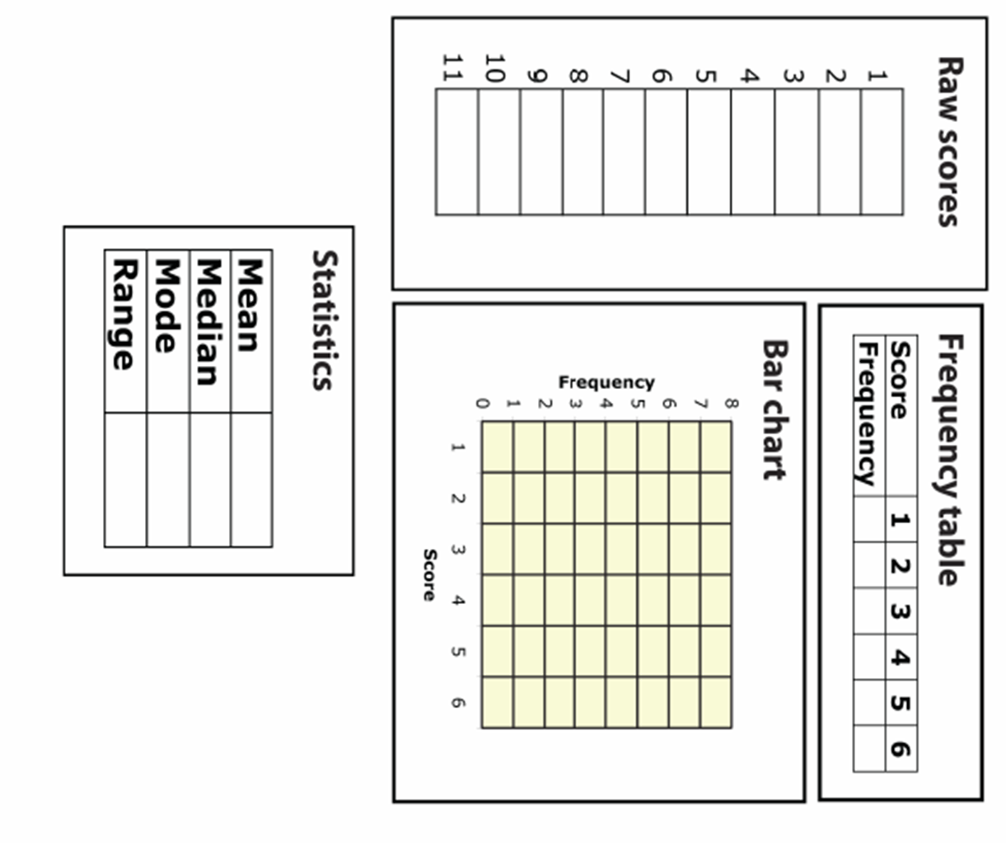
Name: . . . . . . . . . . . . . . . . . . . . . . . .
. . . . . . . . . . . . . . . . . . . . . . . .

Slide 3
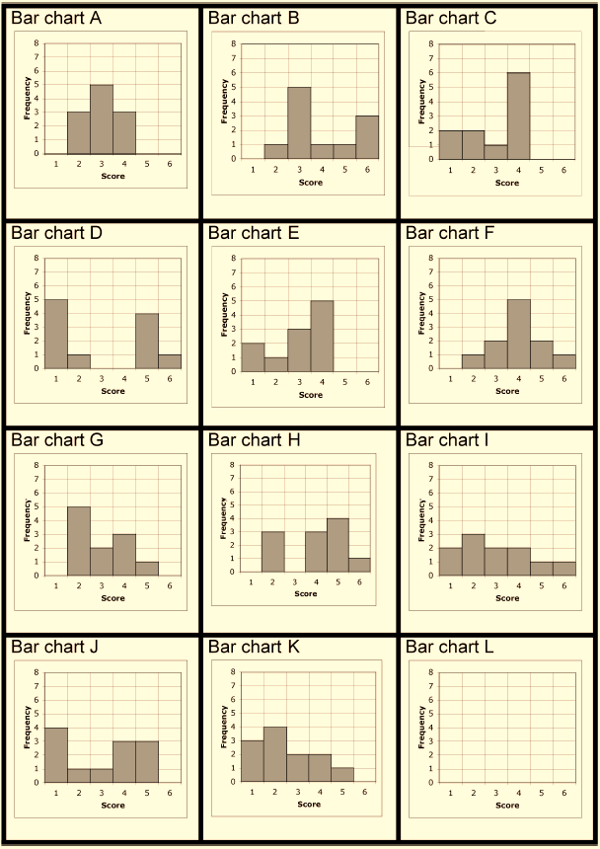
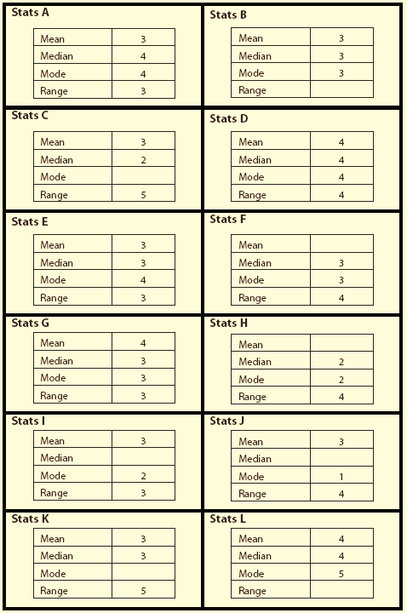

Slide 5
Consumable Resources Needed:
Each pair needs so spare slips of paper to record ‘missing data’ on some of the cards
Each pair preferably has a calculator
Re-usable Resources Needed:
Camera.
Mini-whiteboards needed from the start.
Students preferably have access to just a few laptops so that they can check their own results on program called ‘Statistics 1’.
Each pair needs Card Set A and B.

Slide 6
Notes to start.
Students must be pre-assigned into pairs and have a mini-whiteboard each from the start.
Cards can also be distributed from the start, but not opened.

Slide 7
Try to write the 6 numbers that would go in this table. Work with your partner if necessary.
Now sketch a bar graph like this, and plot the data from the table.
Averages
Who knows what ‘mode’ means? Go ahead and calculate it if you can.
Everyone else…
Who knows what ‘median’ means? Go ahead and calculate it if you can.
Everyone else…
Who knows what ‘mean’ means? Go ahead and calculate it if you can.
Everyone else…
Who knows what ‘range’ means? Go ahead and calculate it if you can.
Everyone else…
Could we calculate the averages just by looking at the Bar graph?
Without writing anything down, how can we calculate the median, mode and range from the Bar graph?
Secretly write your favourite integer between 1 and 6 on your whiteboard.
How can we calculate the mean?
Could we calculate these averages just by looking at the Frequency table?
Could we calculate the mean just by adding all the frequencies and dividing by 6?
How can we find the median from the table alone?

Slide 8
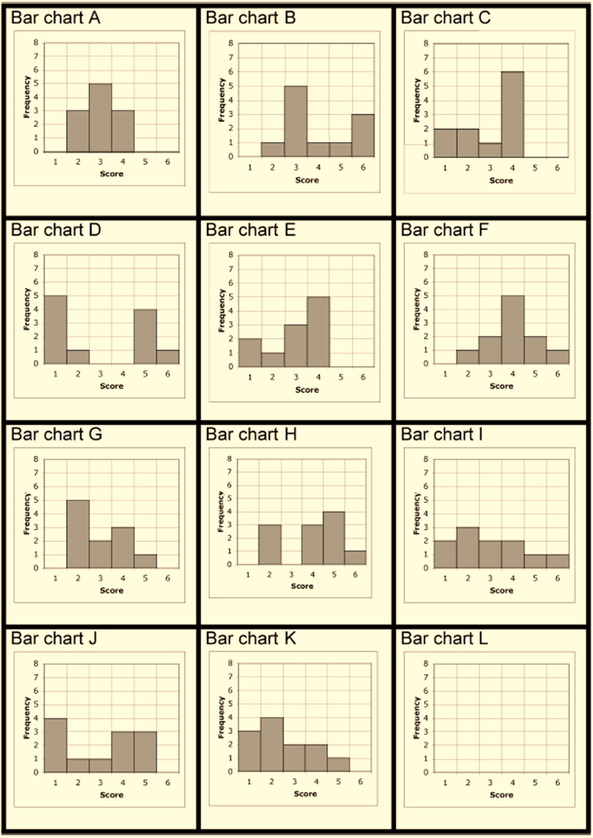
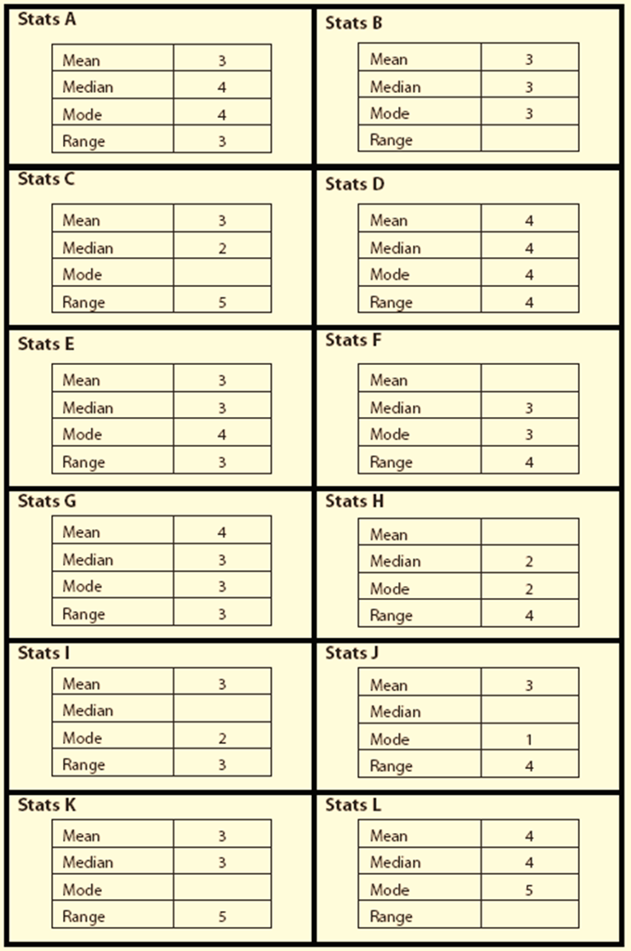
Card Matching Activity
Match the cards up. Some have information missing.
Write the missing information down on a slip of paper.

Slide 9
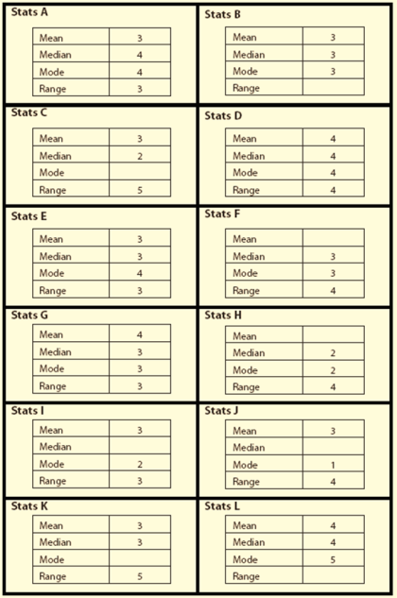
Need some hints?
Sort each of the sets into an order.
First in order of the size of the range.
Next try in order of modal value.
Then…
If you really struggle, write out the raw scores from the bar graph.

Slide 10
PAUSE
Which two Bar graph cards show a sample size of 12?
Can you tell how big the sample size is from the statistics data?
How do you calculate the median value if there is no middle value?
Which card has no exact middle value?
I will shortly record your card matches, and ask each of you for explanations as to why you’ve paired cards together
We will check solutions on a program.

Slide 11
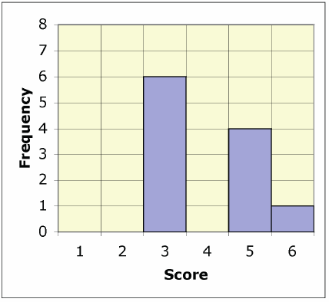
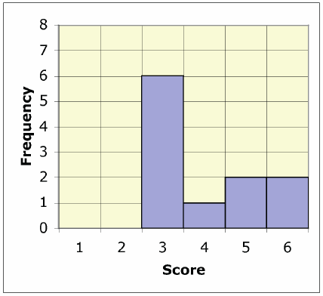
Checking of Results
How did you start to sort the cards?
Which was the easiest thing to do?
Correct card matches were:
Chart A | Chart B | Chart C | Chart D | Chart E | Chart F
Chart G | Chart H | Chart I | Chart J | Chart K | Chart L
The ‘missing bar graph’ (Bar Chart L).
Mean = 4 ; Median = 3 ; Mode = 3
Range = 3
What was it like?

