Slide 1
Standards Unit S3: Using Probability Computer Games
Suitable for students from high Level 4 to Level 7 (Level 7-8 challenge at very end)
~1 hour for each of the two games.
One game alone, both in consecutive lessons, or both over a period of time can be used. No background is required, but its helpful to use S2 Evaluating Probability statements before this activity. [Except, I would say, for weaker groups who’ll be better spending just more time on this]
Paired activity.
Laptops preferably, otherwise must be in ICT suite.
Camera?
Mini-whiteboards for analysis part & plenary

Slide 2
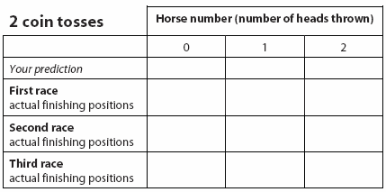
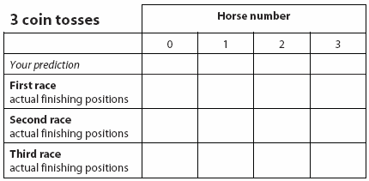
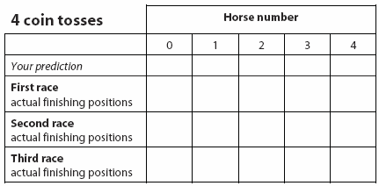
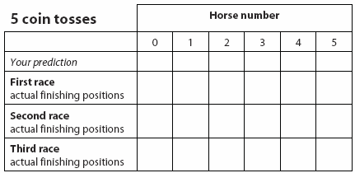
Names: . . . . . . . . . . . . . . . . . . . . . . . . . . . . .
. . . . . . . . . . . . . . . . . . . . . . . .

Slide 3
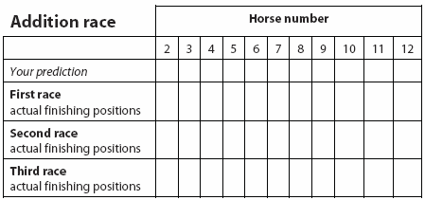
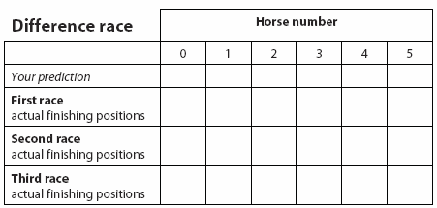
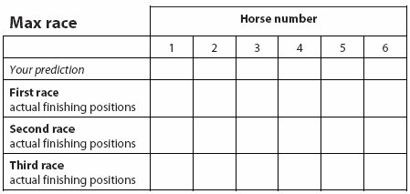
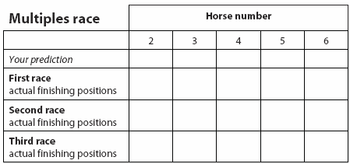
Names: . . . . . . . . . . . . . . . . . . . . . . . . . . . . .
. . . . . . . . . . . . . . . . . . . . . . . .

Slide 4
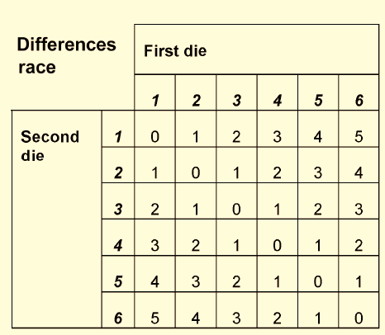
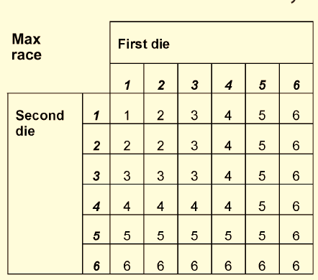
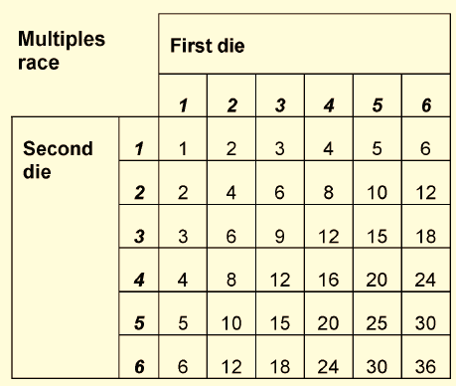

Slide 5
Consumable Resources Needed:
Each pair needs 1 A4 colour copy of recording Sheet 1 and/or Sheet 2
(depending upon which of coin / dice game(s) are being played
If playing the Dice games, each student needs a copy of the third worksheet (sample spaces).
Re-usable Resources Needed:
Mini-whiteboards needed for analysis and plenary
Laptop shared between pair of students.
Single Excel spreadsheet into which to collect all class results

Slide 6
Notes to start.
Students must be pre-assigned into pairs.
Appropriate worksheet(s) must be distributed from the start.
Students need mini-whitebaords
PCs must be loaded with games software.
My PC must be running my Excel analysis spreadsheet: S3_ProbabilityGames
Note: Spreadsheet supports aggregation of Race results from:
- all 4 of the COIN races
- only the last, ‘Multiples’, Dice race.
No particular reason, just that otherwise spend too much time inputting .data

Slide 7
Probability Races
Immediately demonstrate one of the races.
Actually get students to complete the ‘Prediction’ and ‘First race’ lines on their worksheet. No practice runs.
Notes: 1. Only one of the two games will be used in a single session.
2. Record 2nd & 3rd places etc. AT THE TIME THE FIRST HORSE CROSSES THE LINE
Coin Races
2 coins (3 horse race)
Start point is optional.
3 coins (4 horse race)
4 coins (5 horse race)
5 coins (6 horse race)
Dice Races
Add (6 horse race)
Difference (6 horse race)
Max (6 horse race)
Multiples (6 horse race)

Slide 8
Coin Race Slides

Slide 9
PAUSE
Make certain you are recording your predictions before starting the races.
Make certain you complete at least one of each type of race. Then go back and complete a second and third race, if there’s time.
Think about these questions…
Are the races fair?
Does the same horse keep winning?
“ “ “ “ “ losing?
Why?
Can you predict the winning distance?
Get ready to switch off computers
Possibly collect all class results into Excel at this point

Slide 10
Why do the same horses keep winning?

Slide 11
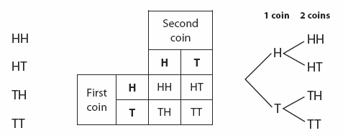
Coin Races
2 coin race
Outcome list
Sample Space
Probability Tree
Mini-whiteboards.
Working with your partner…
1. Write down the possible outcomes for the 3 coin race
2. Draw the sample space diagram for the 3 coin race
3. Draw the tree diagram for the 3 coin race

Slide 12
Coin Races
3 coin race

Slide 13
Coin Predictions
 |  | Number of ways of getting… |  |  |  |  |  | Number of different outcomes
 |  | 0 heads | 1 head | 2 heads | 3 heads | 4 heads | 5 heads
Number of Coins | 1 | 1 | 1 |  |  |  |  | 2
 | 2 | 1 | 2 | 1 |  |  |  | 4
 | 3 | 1 | 3 | 3 | 1 |  |  | 8
 | 4 | 1 | 4 | 6 | 4 | 1 |  | 16
 | 5 | 1 | 5 | 10 | 10 | 5 | 1 | 32
 | 6
In 3 coin race, p(‘Horse 2’) = $\frac{3}{8}$
Number of successful outcomes
Probability =
Total number of outcomes
In 5 coin race, p(‘Horse 4’) = $\frac{1}{32}$

Slide 14
 |  | Number of ways of getting… |  |  |  |  |  | Number of different outcomes
 |  | 0 heads | 1 head | 2 heads | 3 heads | 4 heads | 5 heads
Number of Coins | 1 | 1 | 1 |  |  |  |  | 2
 | 2 | 1 | 2 | 1 |  |  |  | 4
 | 3 | 1 | 3 | 3 | 1 |  |  | 8
 | 4 | 1 | 4 | 6 | 4 | 1 |  | 16
 | 5 | 1 | 5 | 10 | 10 | 5 | 1 | 32
 | 6
In 3 coin race, p(‘Horse 2’) = $\frac{3}{8}$
In 5 coin race, p(‘Horse 4’) = $\frac{1}{32}$
In 4 coin race, ‘Horse 3’ should, on average, be 6 times further down the course than ‘Horse 1’ or ‘Horse 5’
Are these predictions, and others, accurate?
Compare to your results, and compare to the aggregated results

Slide 15
Coin Race Slides

Slide 16
PAUSE
Make certain you are recording your predictions before starting the races.
Make certain you complete at least one of each type of race. Then go back and complete a second and third race, if there’s time.
Think about these questions…
Are the races fair?
Does the same horse keep winning?
“ “ “ “ “ losing?
Why?
Can you predict the winning distance?
Get ready to switch off computers
Possibly collect class results for the ‘Multiples’ race into my spreadsheet at this point.

Slide 17
Why do the same horses keep winning?

Slide 18
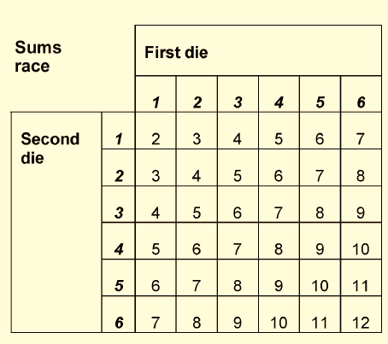
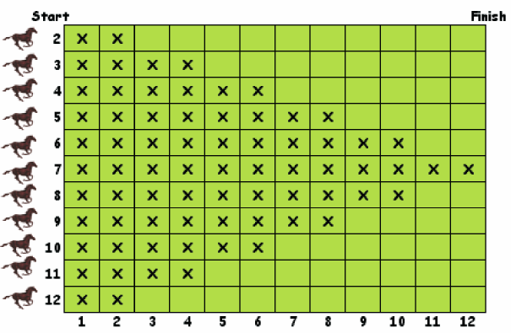
Sums Race
Why do the horses near the middle always win?
Sample Space
Expected Result
Horse 7 is six times more likely to move than Horse 2.

Slide 19
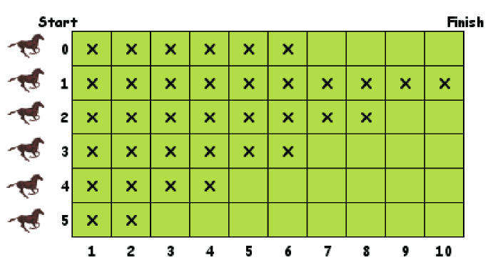
Difference Race
Complete the ‘Difference’ sample space on the worksheet
Sample Space
Expected Result
Horse 1 is 2½ times more likely to move than Horse 4.
Does this prediction agree with your results?

Slide 20
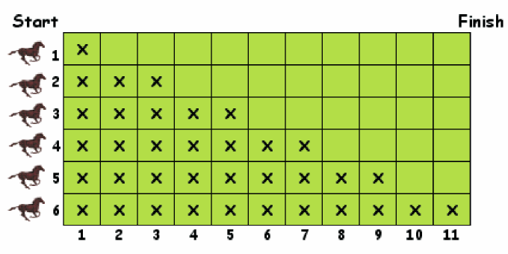
Max Race
Complete the ‘Max’ sample space on the worksheet
Sample Space
Expected Result
Horse 5 is three times more likely to move than Horse 2.
Does this prediction agree with your results?

Slide 21
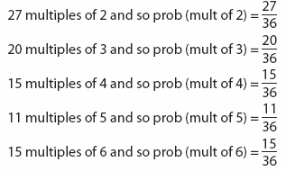
Multiples Race
Complete the ‘Multiples’ sample space on the worksheet
Sample Space
Expected Result
There are 27 multiples of 2, and 15 multiples of 4
Does this prediction agree with your results?
It only predicts what will happen on average.
Compare to aggregated results recorded in Excel spreadsheet

Slide 22
Sample Spaces
Sample Spaces are extremely helpful in making predictions.
Even totally random events can produce predictable outcomes.
The outcomes from the dice were totally random, but the winning horses were highly predictable.
This is crucial in Science and Nature.
Before science, people thought that anything clever had to have been deliberately made that way.
For example, birds fly together in a pattern – they must deliberately do this?
Fish swim together in shoals – they deliberately do this?
….
But we have shown that sometimes totally random events can create clear patterns.
Improve this slide

Slide 23
Analyse This
~Level 6?
Level 5-6 if sufficiently scaffolded, e.g. provide sample space diagram
Here’s a new game.
You have one coin and one die.
The rule of the game is that:
If coin lands ‘HEAD’, then you DOUBLE the dice score.
If coin lands ‘TAILS’, then you HALVE the dice score.
When you toss both the coin and die, what is the probability that you:
a) score 2 or more points
b) score between 1.6 and 6.5 points?

Slide 24
Sample Space for Game
How do you draw the sample space?
 |  | Dice Score
 |  | 1 | 2 | 3 | 4 | 5 | 6
Coin Result | H | 2 | 4 | 6 | 8 | 10 | 12
 | T | 0.5 | 1 | 1.5 | 2 | 2.5 | 3
When you toss both the coin and die, what is the probability that you:
a) score 2 or more points
b) score between 1.6 and 6.5 points?

