Slide 1
Standards Unit S2: Evaluating Probability Statements
Suitable for students at Levels 5 and 6
Do not be over-ambitious in resolving all issues in this single lesson
~50 mins.
Paired work.
This activity can expose lots of mis-conceptions but, to avoid boredom with the task, it is not necessary that everyone learns every lesson from it. Sufficient that each person corrects one mis-understanding, than everything. S3, prob games is a good follow-up and can help resolve these issues further
Also possible to repeat this activity, with different partners, at a later date (say 6 months or a year later)

Slide 2
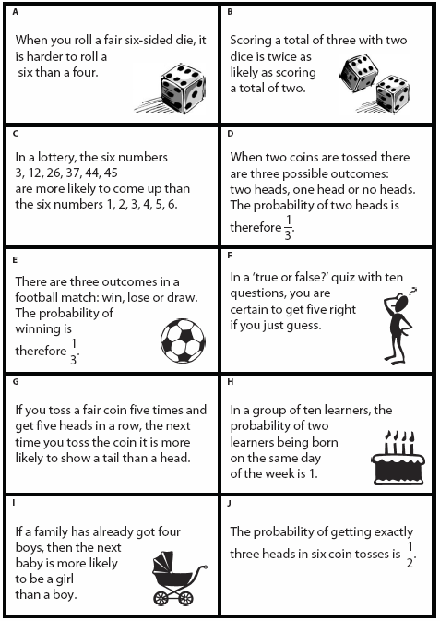

Slide 4
Consumable Resources Needed:
1 copy of ‘Statements’ sheet per student (to stick in books and refer to).
Re-usable Resources Needed:
1 card set per team of 2 or 3 students.
Mini-whiteboards

Slide 5
Notes to start.
Pre-assign students in teams of 3, or 2 students.
Suggested (ideal) structure is:
Deal the cards out between the two, or three people in each team. [3 or 5 cards each].
Taking it in turns, each student places their card into a ‘True’, ‘False’, ‘Unsure’ pile and justifies their reasons. Others challenge until they all agree. Then next Statement.
THEN give out uncut, worksheet of the same statements, just to stick into books and refer to.
Ask each student to write, in their books, an explanation for each card.
The manipulable cards are merely used to promote a discussion. Even if weaker students ignore the social protocols of taking in turns, and justifying, at least cards will promote some discussion.

Slide 6
Probability Statements
Estimate (as a decimal) the probability that…
- you will be hit by lightening this afternoon
- you will get a ‘4’ if you throw a die
- you will be off-school with an illness within the next year
Describe an event with a probability of…
- absolutely zero
- nearly one
- about 0.5
- about 0.2

Slide 7
True or False?
I will soon ask you to sort the cards into True or False.
Work like this:
- share the cards as fairly as possible.
- take it in turns putting down a card in a ‘True’, ‘False’ or ‘Unsure’ pile. Explain as clearly as you possibly can to your partners why you have placed it there. Then see if they agree.
- you move the card to another pile if you are convinced you’ve made a mistake.
True
False
Unsure
Distribute worksheets ready for use

Slide 8
True or False?
Stick the copy of cards into your book & make notes in your book about each Statement.
Explain the reason each Statement is True or False
If unsure about a card, what experiment could you do to find the answer?

Slide 9
PAUSE
Choose one card that you are certain is True.
How do you know it is True?

Slide 10
PAUSE
Choose one card that you are certain is False.
How do you know it is False?
Replace all cards neatly in wallets.
Spend a few more minutes correcting and finishing your reasoning

Slide 11
False
True
False
False
False
False
False
True
False
False
Assess how well do you currently understand probability?
6 correct = Bronze
7-8 correct = Silver
9 correct = Gold
10 correct = Gold+

Slide 12
Follow up in future with S3_Probability Games if need further help

