Slide 1
Standards Unit SS7: Transforming Shapes
Mini-whiteboards with GRIDS are essential for the final assessment activity
Suitable for students at Low level 5 to 6
1 hour.
Pair activity.
Camera needed to record work.

Slide 2
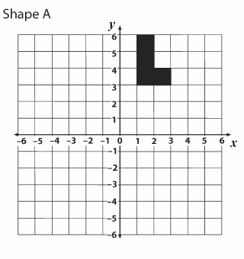
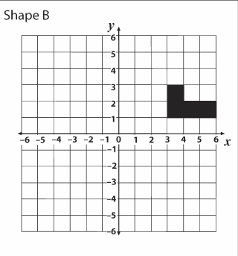
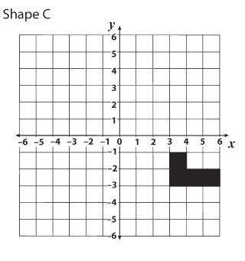
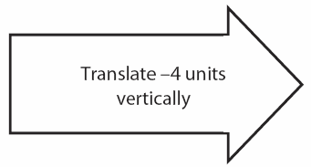
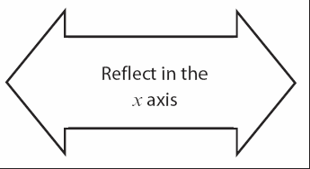
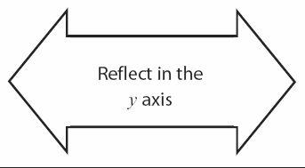

Slide 3
Consumable Resources Needed:
Re-usable Resources Needed:
Still camera.
Mini-whiteboards with GRIDS.
Each pair needs 1off set of Card Sets A, B and C (extension)
THIN mini-whiteboard-type pens to write on some cards.
Each pair might also need one of my 12 re-usable packs of acetates + yellow grid.

Slide 4
Notes to start.
Students must be pre-assigned with a partner. Pair work.
Card Set A and B distributed at start of lesson.
Mini-whitebaords will be needed by each student at the end of the lesson.

Slide 5
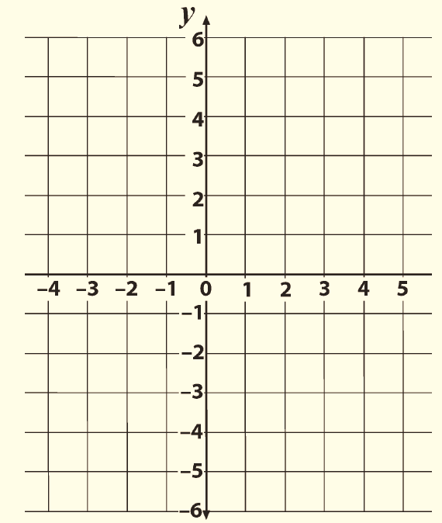
Transformations: Quick Review
Where would the image of this shape be if it were:
Q1. Translated by$\left(\begin{matrix}4 \\ 1\end{matrix}\right)$
Q2. Reflected in the line $x=2$
Q3. Rotated 90º clockwise about the point (1, 1)
Q4. Reflected in the line $y=−1$
Q5. Translated by $\left(\begin{matrix}−2 \\ 0\end{matrix}\right)$

Slide 6
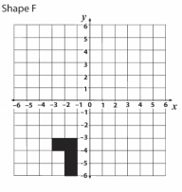
Your turn
You will need lots of clear space on your table.
Start by finding pairs of Shape cards linked by an Arrow card
Then start to turn it into a network of Shapes and Arrows

Slide 7
Some more details
There are some yellow grids and acetate versions of the shapes if they might help you work out the transformations.
There is also an extension set of Shapes and Arrows that can be added to your network of cards.
Some of these have missing information, which you must complete by writing on the cards with a mini whiteboard pen.

Slide 8
A quick pause…
Quickly pop to see another team’s network of cards. Can you see if they have made any errors?
Does there solution look like yours? Can they both be right?

Slide 9
Try to move on to Extension Cards
Let me record your work before you clear away.
Wipe clean any cards you have written on.
Neatly pack all cards way back into their wallet(s).
Everyone will then need a mini-whiteboard with grid

Slide 10
Assessment Activity
First, draw some axes and plot the point (1,4).
Now, show me the image of the point after it is:
Q1. reflected in the x-axis
Q2. reflected in the y-axis
Q3. rotated through 180º about (0,0)
Q4. reflected in the line $y=x$
Q5. reflected in the line $y=−x$
Q6. rotated 90º clockwise about (0,0)
Q7. rotated 90º anticlockwise about (0,0)

Slide 11
Assessment Activity: Challenge Q’s
What single transformation is equivalent to
Q1. reflection in x-axis, followed by reflection in y-axis?
Q2. rotation 90º clockwise about (0,0), followed by refection in y-axis?

