Slide 1
Standards Unit SS5: Evaluating Statements about Enlargements
This is really about Linear, Area and Volume Scale Factors. Suitable for students at Level 6.
Must have met circumference and area of circles, and preferably Pythagoras too. Suits high ability groups – quite a complex task.
At least 1 hour.
Groups of three activity.
Video camera needed to record work.
This activity has been slightly reduced from making a full, persistent poster, but temporary posters are still made. Try to record explanations on video for showing /discussion in next lesson.
Triangle card requires use of Pythagoras to convert between perimeter and area calculations.

Slide 2
Shape D
Shape A
Name: . . . . . . . . . . . . . . . . . . . . . . . .
Shape E
Shape B
Perimeter of shape A =
Area of shape F=
Perimeter of shape C=
Area of shape E=
Perimeter of shape B=
Area of shape D =
Shape F
Shape C
. . . . . . . . . . . . . . . . . . . . . . . .

Slide 3
Name: . . . . . . . . . . . . . . . . . . . . . . . .
. . . . . . . . . . . . . . . . . . . . . . . .

Slide 4
Consumable Resources Needed:
Blu-tac
Each pair needs A3 pastel-coloured paper for poster.
Each student needs 1off A5 copy of ‘Perimeter & Area’ worksheet , together with possible A4 extension worksheet
Re-usable Resources Needed:
Video camera.
Mini-whiteboards needed for rough work during card sort
Each group of 3 needs Card Set A and (if needed to help them) Card Set B.

Slide 5
Notes to start.
Students must be pre-assigned into teams of 3, though will begin work individually.
Card Set A.

Slide 6
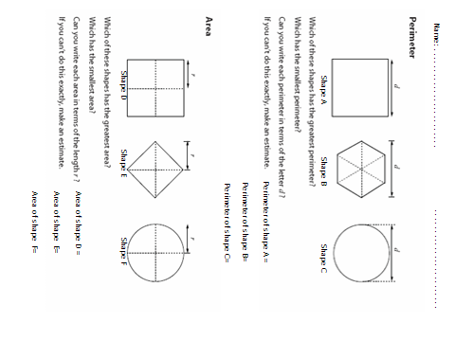
Enlargements of Perimeters, Areas and Volumes
On your own…
Explain how you would describe ‘perimeter’ and ‘area’ to an 8 year old child that had never heard of them. You can use a diagram too if you wish.
and then complete the worksheet as fully as you can

Slide 7
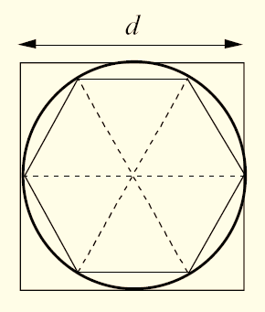
What have you found?
Perimeter Problems
What was the perimeter of the square?
“ “ “ hexagon?
The perimeter (circumference) of the circle must be somewhere in the middle of these two. Between 3d and 4d.
What is it?

Slide 8
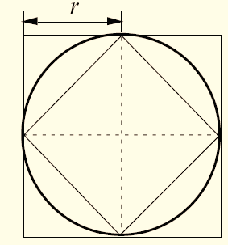
What have you found?
Area Problems
What is the area of the large square?
“ “ “ small square?
The area of the circle must be somewhere in the middle of these two. Between 2r² and 4r².
What is it?
Stick the worksheet in your book.

Slide 9
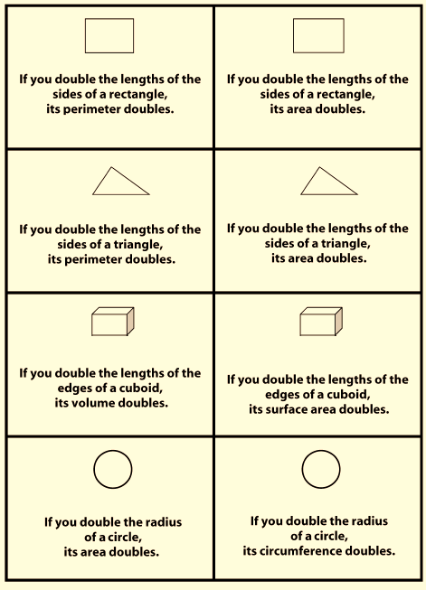
Card Sorting Activity
You will soon make a poster with a table like this and, after some calculations, place each of the cards into one of the 3 columns together with your detailed explanation. We’ll then record some video clips of the posters.
ALWAYS True
SOMETIMES True
NEVER True
Name 1; Name 2; Name 3
First, take it in turns selecting one of the four pairs of cards.
Rectangle pair
Triangle pair
Cuboid pair
Circle pair

Slide 10
Card Sorting Activity
Look at the pair of chosen cards.
Then draw the shape on a mini-whiteboard, and give it some measurements.
5
10
On another mini-whiteboard, draw the same shape but twice the size (double all the measurements).
10
20
Then calculate the perimeters and areas of your two shapes, and decide if the 2 statements on the cards appear to be true or false.

Slide 11
Card Sorting Activity
If you think the Statement is ALWAYS true, try to show why by using algebra. Let the lengths on the drawing be x and y, for example, and then calculate the other lengths using these.
Stick the card to your poster in the correct column, and write-up your explanation around it on your poster.
If you think the Statement is NEVER true, explain how to change the Statement so that it becomes true. Stick the card to your poster, and copy the explanation around it.
ALWAYS True
SOMETIMES True
NEVER True
r r rl;kwj;lwkj;wlk w wkelje;elel
Wkeljk qwlrkw;l wql;r qw;llelkrj w;lkrw;lk welwj;l qw w qw ;wkl lelkje rrlr rr r;l;wk;lq e w w r r r r rl;kwj;lwkj;wlk w wkelje;elel
Wkeljk qwlrkw;l wql;r qw;llelkrj w;lkrw;lk rl;kwj;lwkj;wlk w
Wkeljk qwlrkw;l r r rl;kwj;lwkj;wlk w wkelje;elel
w qw ;wkl lelkje rrlr w wkelje;elel
Wkeljk qwlrkw;l wql;r qw;llelkrj w r r r r rl;kwj;lwkj;wlk w wkelje;elel
Wkeljk qwlrkw;l wql;r qw;llelkrj w;lkrw;lk welwj;l qw w qw ;wkl lelkje rrlr rr r;l;wk;lq e w w r r r r rl;kwj;lwkj;wlk w wkelje;elel
w qw ;wkl lelkje rrlr rr r;l;wk;lq e w w r r r r rl;kwj;lwkj;wlk w wkelje;elel
Name 1; Name 2; Name 3

Slide 12
Pause to check…
ALWAYS True
SOMETIMES True
NEVER True
Draw the poster first…
Name 1; Name 2; Name 3
Choose a pair of cards
Explore what happens with specific values
5
10
10
20
Explore what happens with algebraic values
y
2y
x
2x
Place each card in correct column, together with detailed explanation

Slide 13
Are these ALWAYS, SOMETIMES or NEVER True?

