Slide 1
Standards Unit SS3: Dissecting a Square
If % conversions omitted
10* activity
Suitable for students at Levels 3, 4, 5, 6 or even 7?
Lots of additions / subtraction of simple (1/8, 1/16) etc. fractions
Primarily about fractions and percentages. Includes calculation of areas of rectangles, with extensions to triangles and even circle areas.
No cards in this activity.
Activity takes 1-2 hours.
Calculators needed to convert to %’s.
Must work in pairs.
Lower level learners just focus on rectangles, not triangles.

Slide 2
Consumable Resources Needed:
Each student needs 1off A5 copy of Sheet 1
There’s a slightly ‘easier version’ of this sheet if needed for some students (but no modelled answers yet produced for that sheet)
Each student needs 1off A4 copy of Sheet 2
Re-usable Resources Needed:

Slide 3
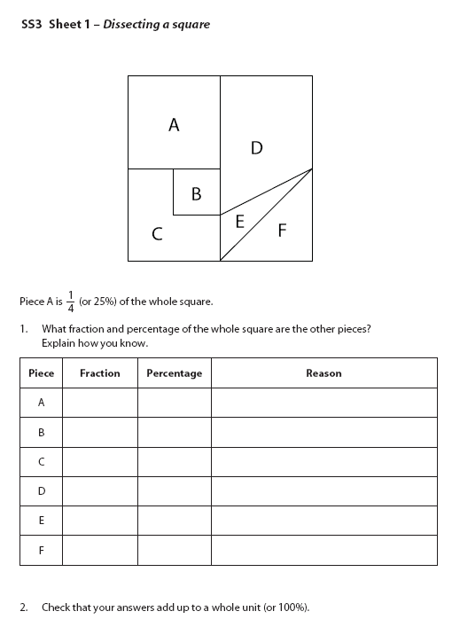
Your name: ……………………
Your name: ……………………
This just means cutting into pieces
This just means cutting into pieces

Slide 4
Your name: ……………………
Your name: ……………………
(Easier version)
(Easier version)
This just means cutting into pieces
This just means cutting into pieces
B
A
B
A
C
F
C
F
D
E
D
E

Slide 5
Dissector’s name: ………….……
Spare grid, for workings out
Solver’s name: ………….………..

Slide 6
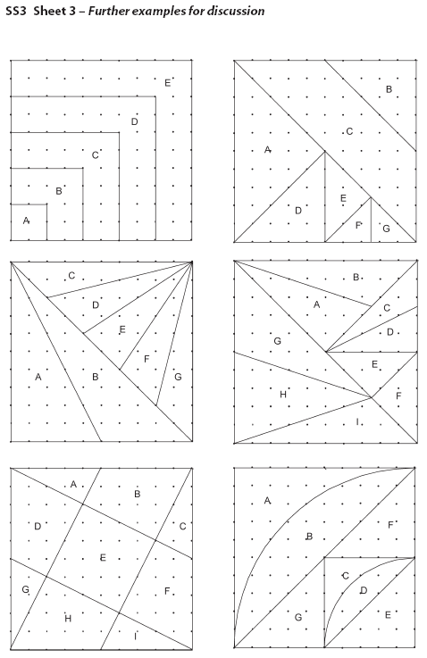

Slide 7
Notes to start.
Students must be pre-assigned with a partner. Pair work.
Best if handouts are pre-distributed too in plastic wallets. Worksheets taken out when needed.

Slide 8
A roadsign…
Is it pointing Left or Right?
North, South, East or West?
Estimate what fraction is coloured white.
Take your time to be more accurate.
How could we measure what fraction is white?

Slide 9
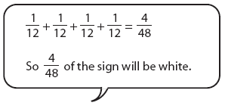
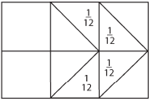
What fraction of the sign is white?
A year 6 student has tried to work it out, but made an error.
Discuss with your partner what mistake has been made

Slide 10
Lucky Shopping?
You decide to buy two pairs of trainers (they’re 15% off!) and go to the checkout.
The person at the checkout says:
‘15% off each item
That will be 30% off the total price’
Is that what you expected to pay?
Discuss it with your partner

Slide 11
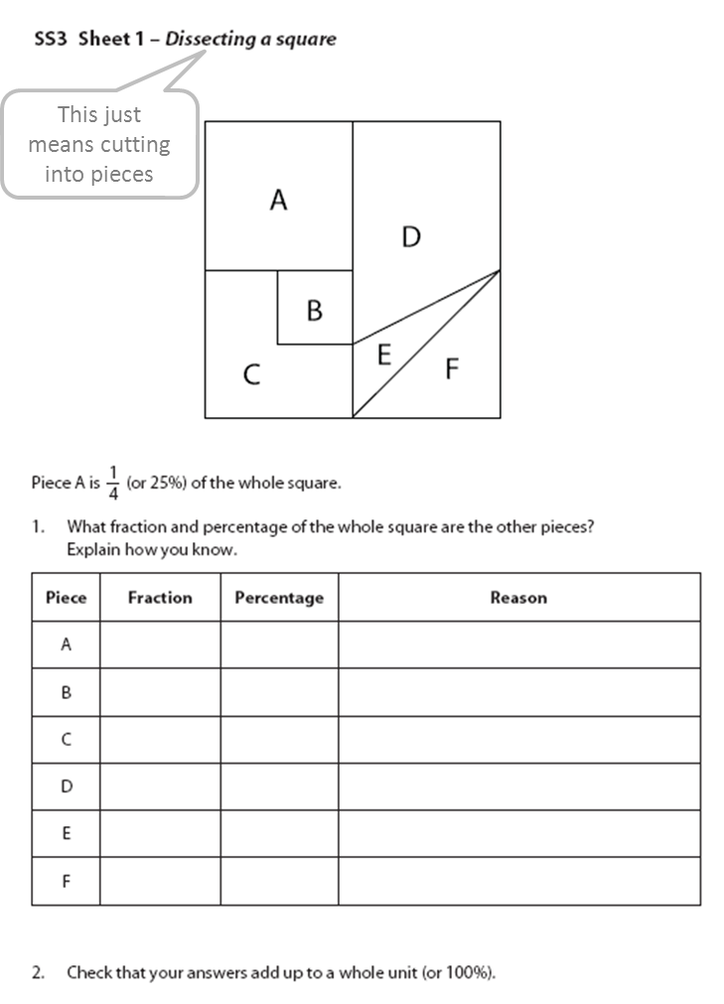
Work with your partner to complete your worksheet
Draw any lines, or workings out on here
Remember this question too!

Slide 12
Work with your partner to complete your worksheet

Slide 13
How have you calculated area C?
Is there only one way to do it?

Slide 14
How do you convert a fraction to a %?
Percentages: % = $\frac{1}{100}$ How many hundredths of the whole?
$$\frac{1}{8}=\frac{1}{8}×\frac{100}{100}$$
Example:
$$=\frac{1}{8}×\frac{100}{1}×\frac{1}{100}$$
$$=\frac{1}{8}×100$$
$$\%$$

Slide 15
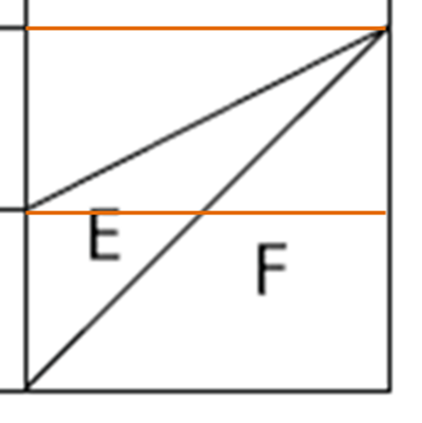
Label the points to make it easier to talk about things.
The square aceg is a ¼ of the full square remember.
a
g
b
f
c
e
d
Look at triangle ceg. Why is it half the area of the square?
That’s area F.

Slide 16
Now look at triangle bcg.
a
g
b
f
c
e
d
Triangle bcg is what is left of the square (aceg), after taking away two other triangles.
Triangle ceg (area F) we know is ½ of ¼ (1/8)
Triangle abg is just ¼ of the square (1/16).

Slide 17
Full Answers
$$\frac{1}{4}$$
25%
it said it on the sheet!
$$\frac{1}{16}$$
6.25%
a quarter of A
$$\frac{3}{16}$$
18.75%
three times B
$$\frac{5}{16}$$
31.25%
area B + area A
$$\frac{1}{16}$$
6.25%
from previous slide, $\frac{1}{4}$ $−$ $\frac{1}{8}−$ $\frac{1}{16}$
$$\frac{1}{8}$$
12.5%
half of area A
1
100%

Slide 18
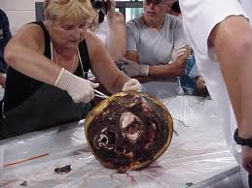
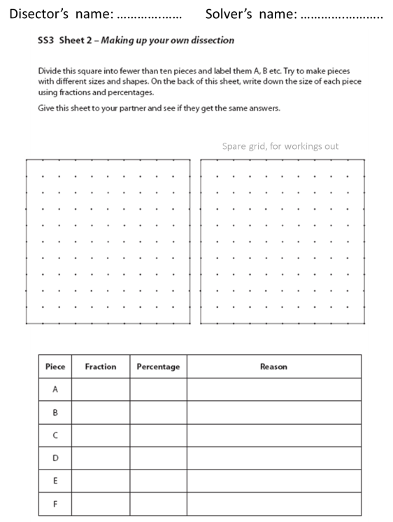
Your turn to dissect!
Squares don’t bleed or scream. ☺
Study the second worksheet…

Slide 19
Dissect the Square
D
Divide the square into 7 or 8 different shape pieces by joining points on the grid with straight lines.
B
A
C
F
Then label each area.
E
Complete the rest of the worksheet by working out the fractions and % shaded

Slide 20
Some harder dissections

Slide 21
Ensure your names are on your worksheets.

Slide 22
Could we calculate the fraction of these areas?

