Slide 1
Standards Unit SS1: Classifying Shapes
activity
Suitable for students at) etc. fractions
1-2 hours.
Note: Each pair of students is only expected to classify the shape according to ONE single grid. It is the group as a whole that uses the five different grids.
Student exercise books needed.

Slide 2
Consumable Resources Needed:
Each pair needs 4 consumable ‘Our Group 1 was’ definition cards and 4 consumable ‘Group 1’s new shape’ cards. Eight blank cards in total for each pair placed in a separate wallet..
Re-usable Resources Needed:
Still camera needed from start.
Each pair needs glue stick.
Each pair needs 1off set of Card Set A
Each pair needs just ONE of the re-usable ‘shape classification tables’.

Slide 3
Print onto thin pale-coloured card
Our Group 1 was:
Our Group 1 was:
Our Group 1 was:
Our Group 2 was:
Our Group 2 was:
Our Group 2 was:
Our Group 3 was:
Our Group 3 was:
Our Group 3 was:
Our Group 4 was:
Our Group 4 was:
Our Group 4 was:

Slide 4
Print onto thin pale-coloured card (needs sticking in books)
Group 1’s new shape
Group 2’s new shape
Group 3’s new shape
Group 4’s new shape
Group 1’s new shape
Group 2’s new shape
Group 3’s new shape
Group 4’s new shape
Group 1’s new shape
Group 2’s new shape
Group 3’s new shape
Group 4’s new shape

Slide 5
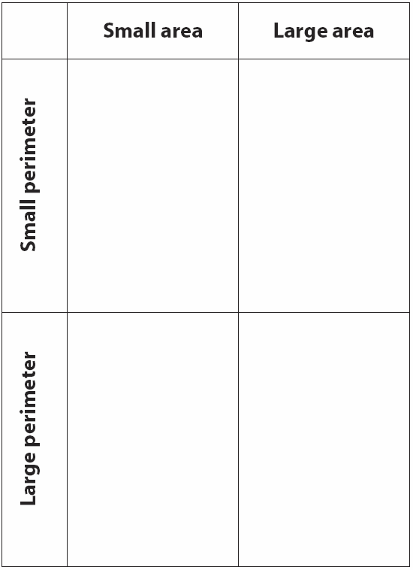
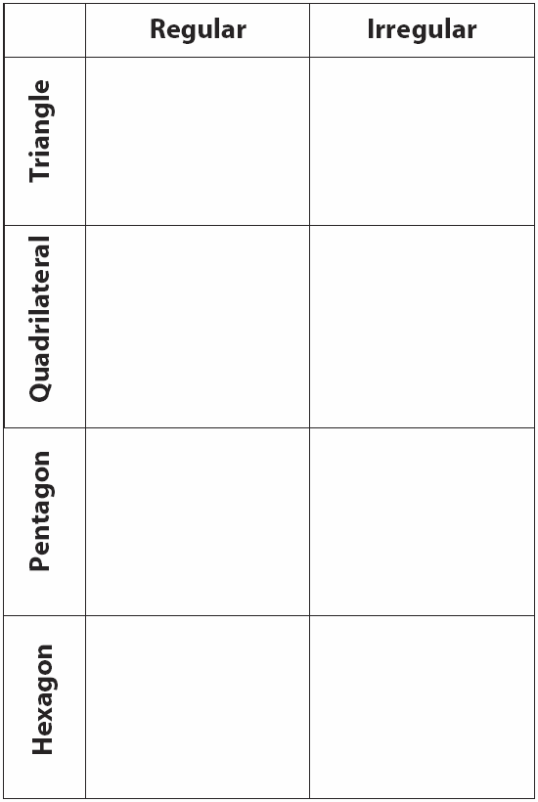
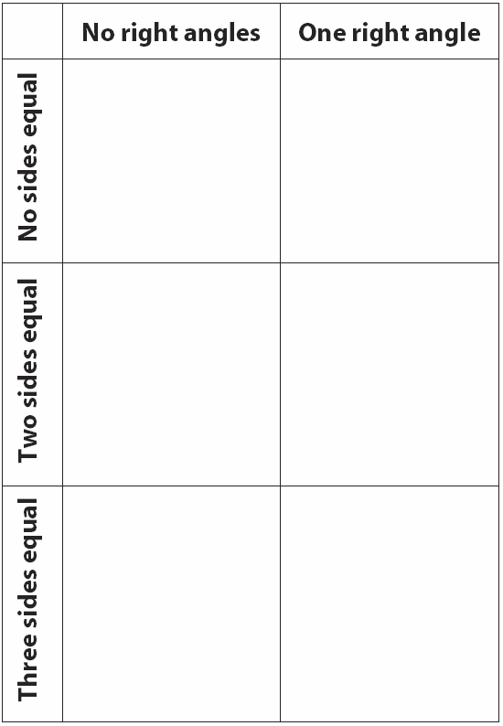
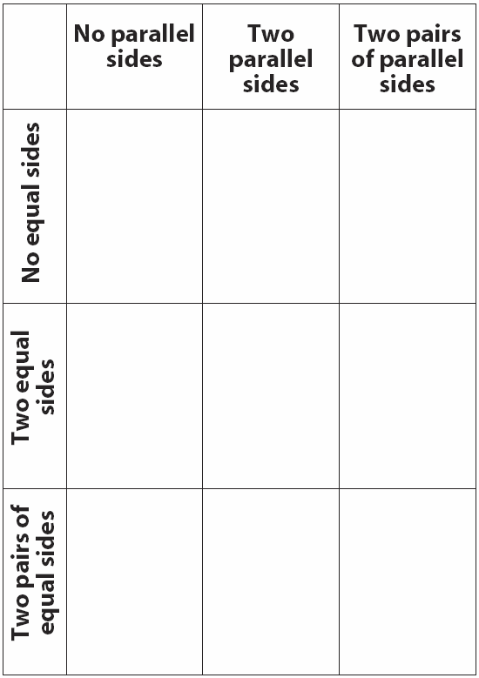
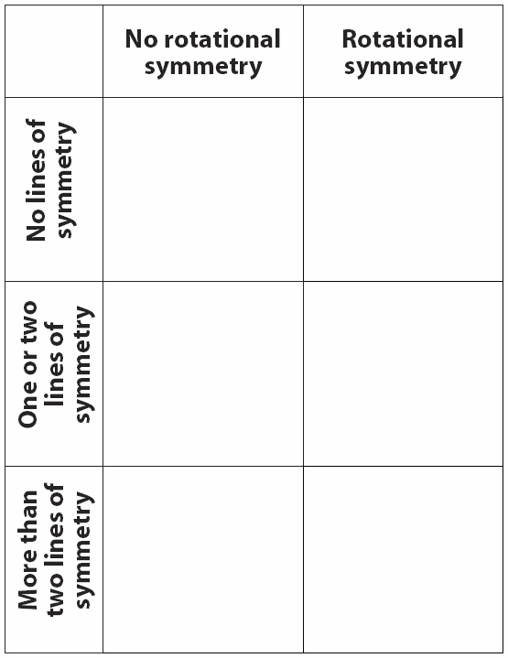
Easier classifications
Harder classifications

Slide 6
Notes to start.
Students must be pre-assigned with a partner. Pair work.
Card Set A distributed immediately, along with 8 extra (blank) cards that they will stick in their books and glue.
Mini-whitebaords will be needed by each student at the end of the lesson.

Slide 7
Sorting Shapes
Write this title at the top of a new page in your books.

Slide 8
Sorting Shapes
In the FRONT of your books, copy the title and then write down all you can about these 3 shapes?
Irregular Quadrilateral
Two opposite sides the same length
2 acute; 2 obtuse
A
B
Irregular heptagon
Two parallel sides
1 acute; 5 obtuse; 1 reflex
Appears to be a REGULAR octagon.
These have:
All sides the same length
All angles the same size
4 lines of reflective symmetry
Order 8 rotational symmetry
C

Slide 9
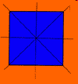
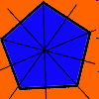
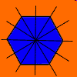
Two Types of Symmetry
An object has Rotational Symmetry if there is a center point around which the object is turned a certain number of degrees and the object still looks the same.
an equilateral triangle has 3 internal angles,3 lines of symmetry & a rotational symmetry at order 3.
a square has 4 internal angles, 4 lines of symmetry & a rotational symmetry at order 4.
a regular pentagon has 5 internal angles,5 lines of symmetry & a rotational symmetry at order 5.
a regular hexagon has 6 internal angles,6 lines of symmetry & a rotational symmetry at order 6.
a regular octagon has 8 internal angles,8 lines of symmetry & a rotational symmetry at order 8.

Slide 10
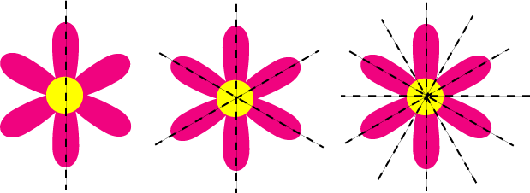
A shape has reflective (or line) symmetry when one half of it is the mirror image of the other half.

Slide 11
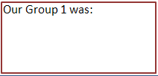
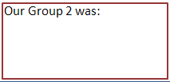
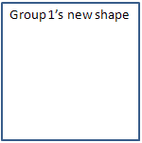
Sorting Shapes Activity
Record images of sorted groups
Step 1.
Quickly sort the card shapes into two groups.
You decide on the groups.
Step 2.
Then sort each group into another two groups.
So you’ll have 4 groups altogether.
Step 3.
Write a description of each of your 4 groups on the 4 blank rectangular cards.
Each do two cards. Describe the groups very accurately.
Step 4.
Draw another new shape to add to each of the 4 groups on the 4 other blank cards.
Each do two cards and draw them accurately.

Slide 12
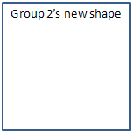
Sorting Shapes Activity
Step 5.
Collect up the re-usable cards into neat pile and just place on top of plastic wallet
Then glue your two ‘description’ cards, and your two ‘shape’ cards into your exercise book.
Sorting Shapes

Slide 13
Sorting Shapes: Review
Develop formal language & notations
What classifications have you used?

Slide 14
Adding Detailed Notes
Sorting Shapes
Now add some extra notes to your work to describe it as accurately as possible.
Do you have other good ideas for how you would have liked to have sorted your cards?

Slide 15
Another Sort
Record images of sorted groups
Now re-sort the cards according to the table I give you.
You will be sorting your cards onto one of these grids.
If you cannot find any shapes to fill a cell, it is very important that you write some detailed notes in your book describing that cells definition, and explaining why no shapes can fit that category.

Slide 16
Adding Detailed Notes
Write down any further notes on things you have learnt whilst sorting these cards.
After I have recorded an image of your completed work, neatly replace the cards in the plastic wallet.

Slide 17
Assessment Activity
Using your mini-whiteboards, show me:…
Q1. a quadrilateral with two lines of symmetry
Q2. a triangle with three lines of symmetry
Q3. a right-angled isosceles triangle
Q4. a triangle with one obtuse angle
Q5. a triangle with two obtuse angles
Q6. a shape whose interior angles add up to 360º
Q7. a shape whose interior angles add up to 360º
Q8. a trapezium with only one right angle
Q9. a quadrilateral with one reflex angle
Q10. make up your own question for the class to answer.

