Slide 1
Standards Unit N9: Evaluating Directed Number Statements
Suitable for students from high Level 4 to high 6 or even 7
[Simpler version excludes multiplication and divide cards, which are separate].
Best if students have recently covered this topic, because it starts off quite hard.
~1 hour.
Pairedactivity.
Camera
This is an ALWAYS, SOMETIMES, NEVER card sort activity in which students create posters

Slide 2
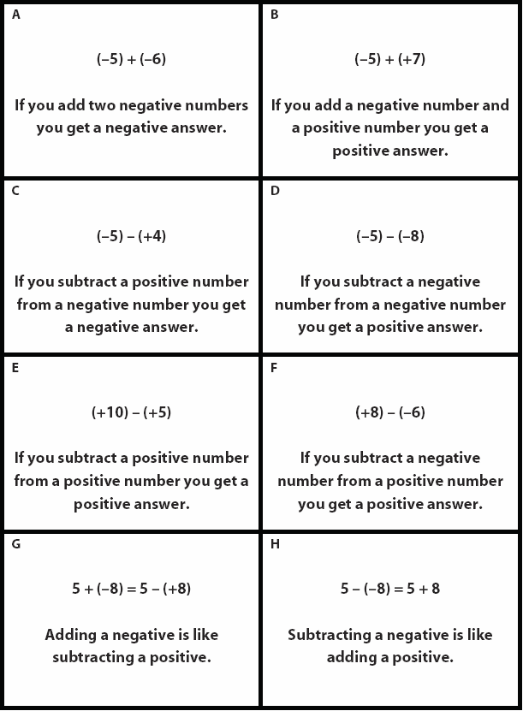
Easier
Harder

Slide 3
Addition & Subtraction Cards
Addition & Subtraction Cards

Slide 4
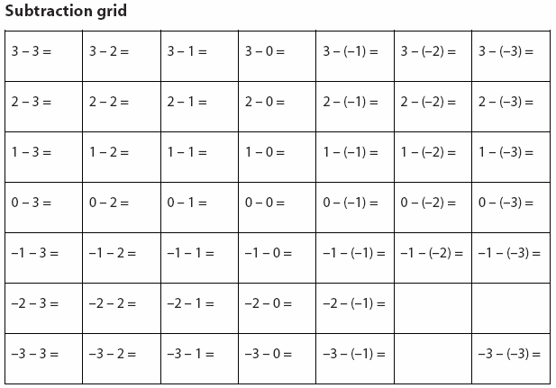
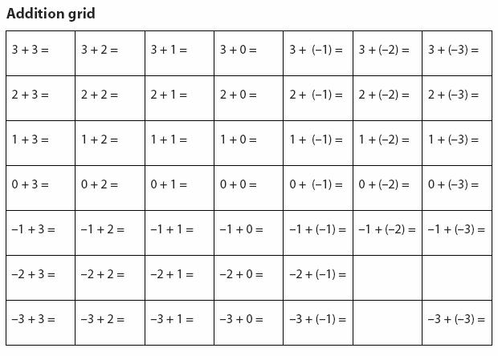

Slide 5
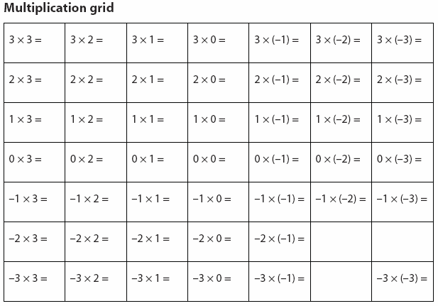

Slide 6
Consumable Resources Needed:
Each pair needs 1 A4 copy of Statements (on single pale-coloured paper)
Depending upon class, choose either ‘full’ set of cards (including multiplication & division), or just restrict to addition & subtraction. Two versions of Statements worksheet available for this purpose.
1 A4 copy of Addition/Subtraction grid, and/or Multiplication/Division grids to help support students when they struggle.
1 A3 or larger poster sheets
Re-usable Resources Needed:
Coloured marker pens to write posters.
Camera
Mini-whiteboards needed from start as a warm-up.
Calculators

Slide 7
Notes to start.
Students must be pre-assigned into pairs, though will begin work individually.
Mini-whitebaords distributed from the beginning.
Do not give out ‘grid’ worksheets until / unless needed.
DO not give out or mention calculators until near end. Better for checking/challenging/extending than initial thinking.

Slide 8
Number Calculations
On mini-whiteboards…
Show me:
a simple multiplication question that gives the answer 12
a simple division question that gives the answer 12
a simple addition question that gives the answer 0
a simple subtraction question that gives the answer -3
can you show me a harder example?
a simple addition question that gives the answer -12
can you show me a harder example?
a simple multiplication question that gives the answer -4
can you show me a harder example?
a simple subtraction question that gives the answer -4
can you show me a harder example?
a simple division question that gives the answer -6
can you show me a harder example?

Slide 9
Negative Number Calculations
(+5) + (-4) =
Don’t work it out yet. What does this actually say?
Why are there brackets?
Do we need them?
Is it any different to
+5 + -4 =
Why are there some big spaces?
Is that any different to
+5+-4 =
Why is there a ‘+’ at the beginning?
Is that any different to
5+-4 =
Why is there a ‘+’ and ‘-’ together in the middle?
Is that any different to
5 - 4 =
Important: 5 + -4 has the same answer to 5 – 4, but a different meaning.
Just like 10 – 5 has the same answer to 7 – 2, but has a different meaning.

Slide 10
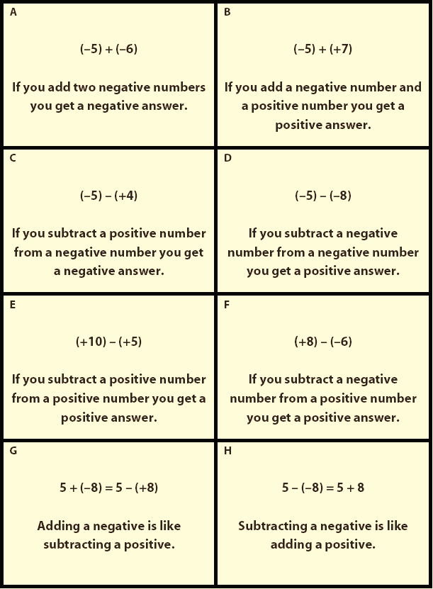
Card Sorting Task
In pairs, you will soon:
Cut and sort the Statements into 3 piles.
Always true
Sometimes true
Never true
Make a poster with the cards, explaining in detail why each card is Always, Sometimes or Never true.

Slide 11
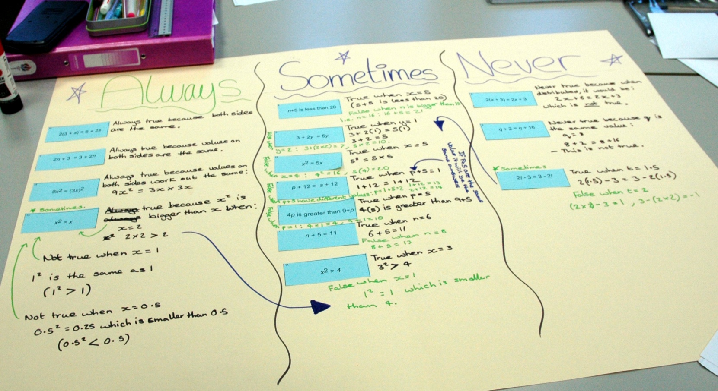
Posters will look like this…

Slide 12
Important…
Each card contains an example calculation.
But you need to decide if the Statement is:
ALWAYS true SOMETIMES true NEVER true
Think of examples with large and small numbers.
Try to think of examples with decimals or fractions too.

Slide 13
Important…
Each card contains an example calculation.
What I want to see on your posters is…
If it’s ALWAYS true:
Give a variety of examples showing it’s true
If it’s SOMETIMES true:
Give some examples showing when it’s true, and some when it’s not.
If it’s NEVER true:
Explain why you are sure it CANNOT be true.

Slide 14
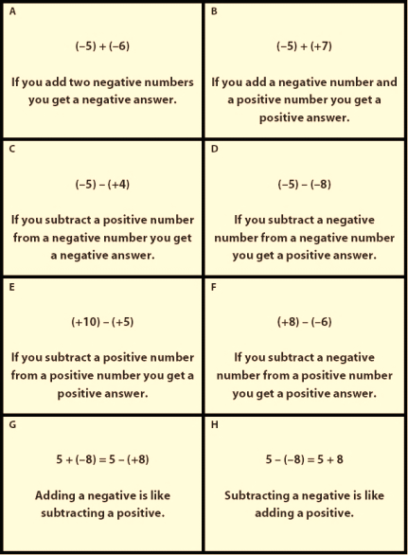
Let’s check…
What are you going to do?
Step 1. Cut and sort Statements into:
Always, Sometimes, Never true
Step 2. Create poster explaining why.
If it’s ALWAYS true:
Give a variety of examples showing it’s true
If it’s SOMETIMES true:
Give examples of true and false.
If it’s NEVER true:
Explain why it CANNOT be true.

Slide 15
PAUSE…
Progress check.
Further tips to help you:
Tip #1: Complete these simple worksheets
Cut and stick these worksheets onto your poster too.

Slide 16
Continue…
Step 2. Create poster explaining why.
If it’s ALWAYS true:
Give a variety of examples showing it’s true
If it’s SOMETIMES true:
Give examples of true and false.
If it’s NEVER true:
Explain why it CANNOT be true.

Slide 17
PAUSE…
Progress check.
Further tip:
Tip #2: If you’ve time, use a calculator to help check your answers.
Subtraction button.
(-5) + (+7) =
Positive/Negative button.
-5 + +7 =
Type in calculator as:

Slide 18
Check that you have…
Written your names on your poster
Step 2. Created poster explaining why.
If it’s ALWAYS true:
Give a variety of examples showing it’s true
If it’s SOMETIMES true:
Give examples of true and false.
If it’s NEVER true:
Explain why it CANNOT be true.
Given examples of large numbers?
Done this?
Given examples of very small numbers? (decimals, fractions, or even zero)

Slide 19
Quickly & neatly clear up all equipment

Slide 20
So, which Statements are ALWAYS true?
Addition & Subtraction Cards

Slide 21
So, which Statements are ALWAYS true?
Multiplication & Division Cards

