Slide 1
Standards Unit N8: Using Directed Numbers in Context
Suitable for students at Levels 4 to low 5.
A ‘light’ introduction. Insufficiently demanding for ‘top’ sets.
No specific background knowledge required.
Do not use proper version of card – since many are written on, and there are not too many, better to have students cut paper ‘cards’ themselves, write on, and discard.
Capture student patterns and work by taking photos of their arrangements.

Slide 2
Students will work in PAIRS.
4 re-usable, A4 ‘City temperature cards’ (for whole class activity)
Single consumable A4 worksheet per group (pair). Contains both card types.
Use camera to take photos of card arrangements. This will also motivate students to arrange them methodically, rather than discard once missing numbers calculated once,

Slide 3
London
13ºC

Slide 4
Moscow
-8ºC

Slide 5
Montreal
-11ºC

Slide 6
Madrid
20ºC

Slide 7
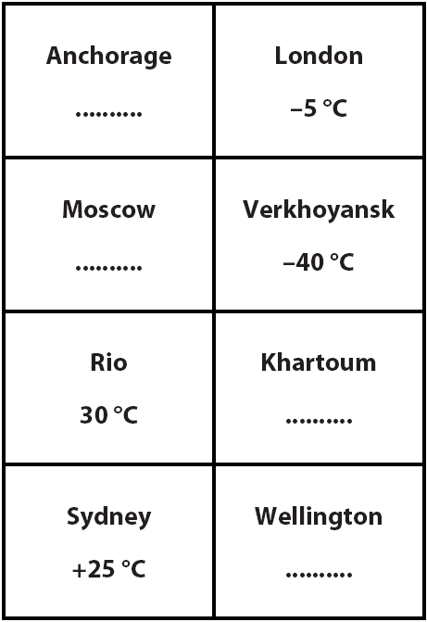
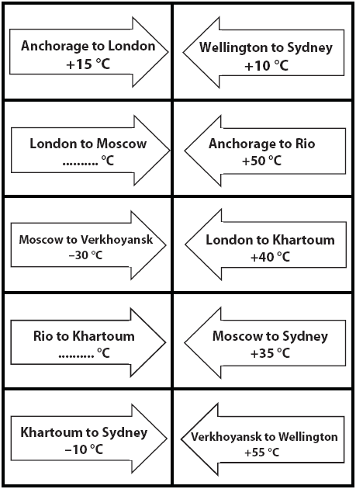

Slide 8
Notes to start.
4 students given the A4 ‘City temperature’ cards, and invited to stand at front.
Pairs of students pre-arranged.
Probably better if more-able students work with less-able.

Slide 9
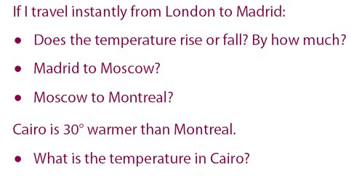
City Line Up in Order of Temperature
Coldest to Hottest

Slide 10
In Pairs
First, quickly cut out the cards from the worksheet.
Can you guess what I will be asking you to do?

Slide 11
In Pairs
Arrange the City cards beside the Temperature Change cards.
‘City’ cards
‘Temperature Change’ cards
You can then write in the correct temperature at Anchorage
Work out all the missing temperatures in this way.

Slide 12
Final Temperature Missing
This shows how to ADD a positive number to a negative number
What do you think is the answer to -5 + (+7) ?

Slide 13
Starting Temperature Missing
This shows how to SUBTRACT a negative number from a positive number
What do you think is the answer to +3 - (-7) ?

Slide 14
Change in Temperature Missing
This shows how to SUBTRACT a positive number from a negative number
What do you think is the answer to -8 - (+3) ?

Slide 15
Combining Temperature Changes
This shows how to ADD a negative number to another negative number
What do you think is the answer to -2 + (-12) ?

Slide 17
Where else are negative numbers used?
Bank accounts
£400
Pay in £150.
Pay in another £100.
£200
Spend £200.
Spend another £200.
£0
How much money do you have in your bank account now?
-£200
What does this actually mean?
-£400
So why don’t you hear people say they have negative £150?
With money, we say ‘overdrawn’ rather than ‘negative’, but it means the same thing!

Slide 18
Where else are negative numbers used?
What could this actually mean?...

Slide 19
Why do Negative numbers sometimes seem difficult?
Unfortunately, we use the ‘minus’ sign to mean two different things:
subtraction e.g. 6 – 3
negative e.g. -7
It will help you a great deal if you never say ‘minus’.
Say either ‘subtract’, or ‘negative’, and you will get more answers right.
Try reading these out loud, but do not say ‘minus’. ☺
-7 + 5
3 + -4
-8 - 5
-10 + 2
-1 - 5
-4 - -5

