Slide 1
Standards Unit N7: Using Percentages to Increase Quantities
Suitable for students around Level 5 and 6
Excellent, challenging task. A discovery aspect too.
I would say best a week or three after percentage multipliers have been mentioned? Or at least, after some work on calculating % changes from a spider diagram. Otherwise possibly ‘too much’ learning in one activity??
1 -2 hours depending upon exactly which sets of cards are used.
Groups of 3 activity. Important here to have mixed ability teams, because do not want to differentiate task if at all possible.
Camera.
Intended to expose mis-conceptions, and thus develop improved intuitions rather than merely methodically following a process.
This activity can, with good effect, be repeated a short while later by getting all students to use the ‘Harder’ set of Money cards.

Slide 3
£38
£45.60
£38
£45.60
£76
£57
£76
£57

Slide 4
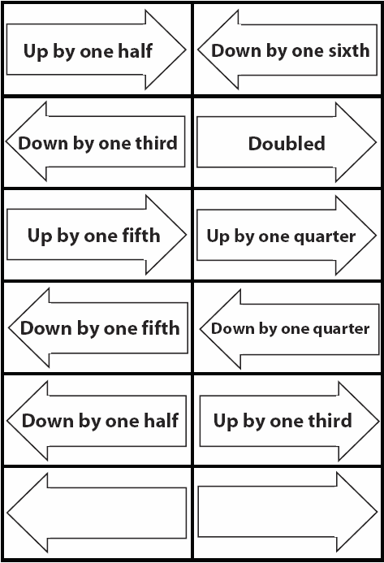
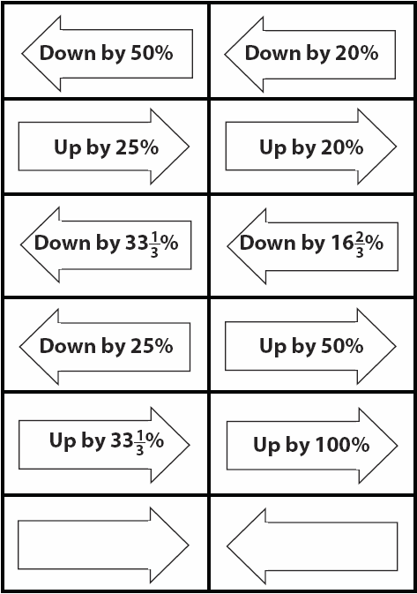

Slide 6
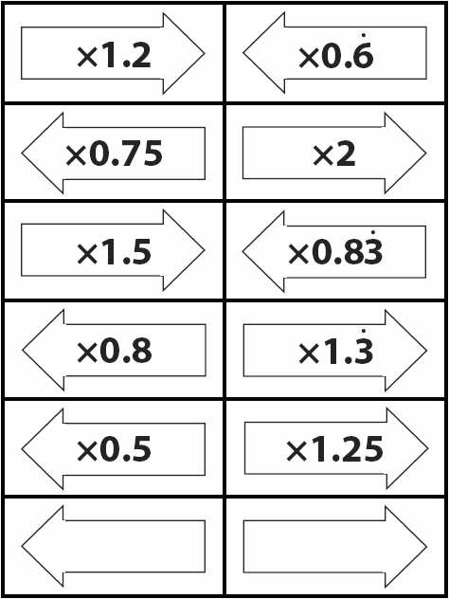
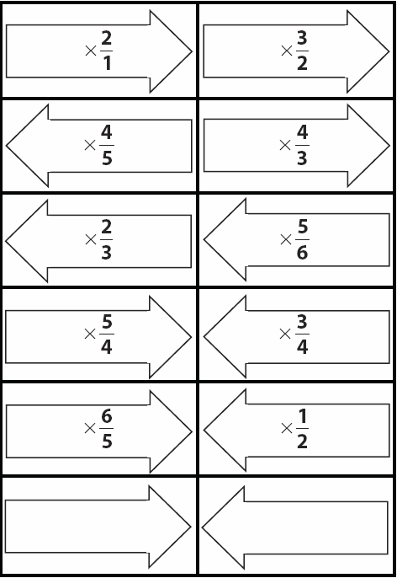

Slide 8
Consumable Resources Needed:
Blu-tac to hold down cards and stop them falling about
Little ‘name’ cards to put beside the sorted cards to that their ‘owners’ can be recorded in the photos – so that photos can be easily returned to the correct students.
Re-usable Resources Needed:
Card sorting sets
Camera, to record card –sort arrangements
Mini-whiteboards
Ideally, smaller marker pens to write on the ‘blank’ cards
CALCULATORS
Extension ‘Money’ cards can be used from the OUTSET for the most able students.

Slide 9
Notes to start.
Students must be pre-assigned into MIXED ABILITY teams of 3. (i.e. all teams equal, so little need to differentiate – which is problematic on this activity).
Be very careful not to correct students too early. It is *much* better that that discover errors for themselves, by continuing to add more cards and finding that they do not fit.
If they struggle greatly, allow some of them to discuss with other students that have understood things.
The intention IS that all cards end up being placed between the ‘Money’ cards simultaneously, but that mini-plenaries are taken after each new card set is added (in order to emphasise the patterns).
The ‘best’ order to do it is by starting with the Percentage changes (hardest), and then adding the easier ones.
But, as indicated in the slides, it is ‘easier’ to start with the others and build towards the Percentage cards. The slides probably imply too much freedom of choice. Keep students together on same card set if at all possible (see below).
Key teacher input is in trying to elicit the patterns from the students (reviewed on a later slide) during the card sorting itself. Must listen in very carefully, and prompt carefully. Again, it is much, much better if students can discover these during card sorting, than simply being told of the patterns.
The most able students should be given the ‘Extension Money’ cards from the outset.
However, for effective mid-session plenaries it’s far better if all students have been working on exactly the same card set. (albeit with different ‘Money’ cards).

Slide 10
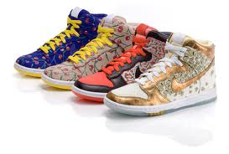
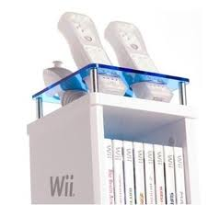
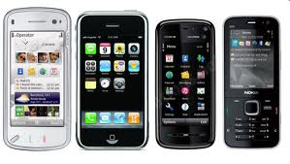
Sale On!
On your own, in your books, answer this…

Slide 11
We’ll return to your book work later, but now…
Card Sorting Activity: Groups of 3
You will need lots of clear space on a table
You all need to be round the same side of the table to see the cards properly

Slide 12
We’ll return to your book work later, but now…
Card Sorting Activity: Groups of 3
Step 1:
Put the ‘money’ cards in increasing order, in a clockwise direction
Step 2:
Place the other cards in the correct positions in between
Step 3:
Use a calculator to check that each card is correctly placed

Slide 13
Before you start…
There are 5 slightly different types of card.
Word Cards
Decimal Cards
Fraction Cards
% Cards
Blank Cards
Sort the different sets of card out, and choose which set you wish to place between the Money cards

Slide 14
Before you start…
These sets are easier
These sets are harder
Word Cards
Decimal Cards
Fraction Cards
% Cards
Blank Cards
These blank cards are for you to write the % changes on yourself

Slide 15
Be certain of what you are doing…
Step 1A:
Put the ‘money’ cards in increasing order, in a clockwise direction
Step 1B:
Choose which of the five sets of cards you wish to place down first.
Word Cards
Decimal Cards
Fraction Cards
% Cards
Blank Cards

Slide 16
Be certain of what you are doing…
Step 2:
Then place your ‘arrow’cards in their correct positions.
Step 3:
Finally, use a calculator to check everything is perfect!

Slide 17
Starting off…
Step 1A:
Put the ‘money’ cards in increasing order, in a clockwise direction
Step 1B:
Choose which of the five sets of cards you wish to place down first.
Easier
Harder
Word Cards
Decimal Cards
Fraction Cards
% Cards
Blank Cards

Slide 18
Placing cards and checking that they are correct
Step 2:
Place your ‘arrow’cards in their correct positions.
Team:
Jess,
Hayden,
Becky
Ensure I record your work before replacing or removing any of the cards
Step 3:
Finally, use a calculator to check.

Slide 19
PAUSE: The Percentage Cards
Mini-plenary on Percentage Cards
What have you found about the % increases and deceases?
?
?
?

Slide 20
PAUSE: The Percentage Cards
Have you spotted any easy ways to calculate the changes?
‘Up by 20%’
can be easily calculated by…
x 1.2
‘Up by 33%’
can be easily calculated by…
x 1.33
‘Up by 100%’
can be easily calculated by…
x 2
How could you calculate these…
‘Up by 75%’
could be easily calculated by…
x 1.75
‘Up by 3%’
could be easily calculated by…
x 1.03
All these numbers are called multipliers

Slide 21
PAUSE: The Percentage Cards
What about percentage decreases?
x (1 – 0.25)
‘Down by 25%’
can be easily calculated by…
x 0.75
‘Down by 33%’
can be easily calculated by…
x (1 – 0.33)
x 0.67
x (1 – 0.167)
‘Down by 16.7%’
can be easily calculated by…
x 0.833
How could you calculate these…
‘Down by 95%’
can be easily calculated by…
x 0.05
‘Down by 2%’
can be easily calculated by…
x 0.98

Slide 22
PAUSE: The ‘Word’ Cards
Mini-plenary on Word Cards
What is the ‘opposite’ (inverse) of…
‘Doubling’
‘Down by one half’
‘Up by one half’
‘Down by one third’
‘Up by one third’
‘Down by one quarter’
What do you think are the inverse operations of…
‘Up by one sixth’
‘Down by one seventh’
‘Up by one tenth’
‘Down by one eleventh’

Slide 23
PAUSE : The Decimal Cards
Mini-plenary on Decimal Cards
The pattern between pairs of decimal multipliers is quite hard to see. Use a calculator to multiply the pairs of decimals. Can you find the pattern?
x 2
x 0.5
2 x 0.5 = 1
x 1.5
x 0.$\dot{6}$
1.5 x 0.$\dot{6}$ = 1
x 1. $\dot{3}$
x 0.75
1. $\dot{3}$ x 0.75 = 1
x 1.25
x 0.8
1.25 x 0.8 = 1
Can you calculate the inverse decimal multipliers of…
x 1.05
x 0.952 (to 3 s.f.)
x 0.43
x 2.33 (to 3 s.f.)

Slide 24
PAUSE : The Fraction Cards
Mini-plenary on Fraction Cards
The pattern between inverse pairs of fractional multipliers is very simple.
x $\frac{2}{1}$
x $\frac{1}{2}$
$\frac{2}{1}$x $\frac{1}{2}$ = 1
x $\frac{3}{2}$
x $\frac{2}{3}$
$\frac{3}{2}$x $\frac{2}{3}$ = 1
x $\frac{4}{3}$
x $\frac{3}{4}$
$\frac{4}{3}$x $\frac{3}{4}$ = 1
What is the inverse of…
( x $\frac{1}{2.5}$ ) x $\frac{2}{5}$
x 2.5

Slide 25
Assess what we have learnt…
Mini-whiteboards
If a price increases by 10%...
How can you write that as a decimal multiplier?
How can you write it as a fractional multiplier?
What percentage will it then need to go down to get back to the original price?
How can you write that as a decimal multiplier?
And how is it written as a fractional multiplier?

Slide 26
Assess what we have learnt…
Now consider a price decreases of 30%...
How can you write that as a decimal multiplier?
And as a fractional multiplier?
What percentage will it then need to go up to get back to the original price?
How can you write that as a decimal multiplier?
And again, as a fractional multiplier?

Slide 27
Remember this?
Now make any corrections you want to your original answer, and give the clearest explanation you can.
Discuss percentage, decimal and fractional mutlipliers

