Slide 1
Standards Unit N6: Developing Proportional Reasoning
Calculators (at least 1 between 2).
60-90 mins.
There is no card sorting involved in this lesson. The ‘cards’ are merely templated problems, and are not sorted or positioned in any way. I may have had such cards created, but they are useless. Discard if found.

Slide 2
Consumable Resources Needed:
Each student needs 1 A4 copy of Sheet 2, Sample work to write on and ‘mark’.
Each student needs 1 A4 copy of Sheet 3, Making up Your own Questions.
Photocopy a double-sided sheet containing both (1 is already created, and held with other resource sheets
Re-usable Resources Needed:
I have 13 copies of the Questions – enough to share between 2 or 3 students.

Slide 3
Solve these problems

Slide 4
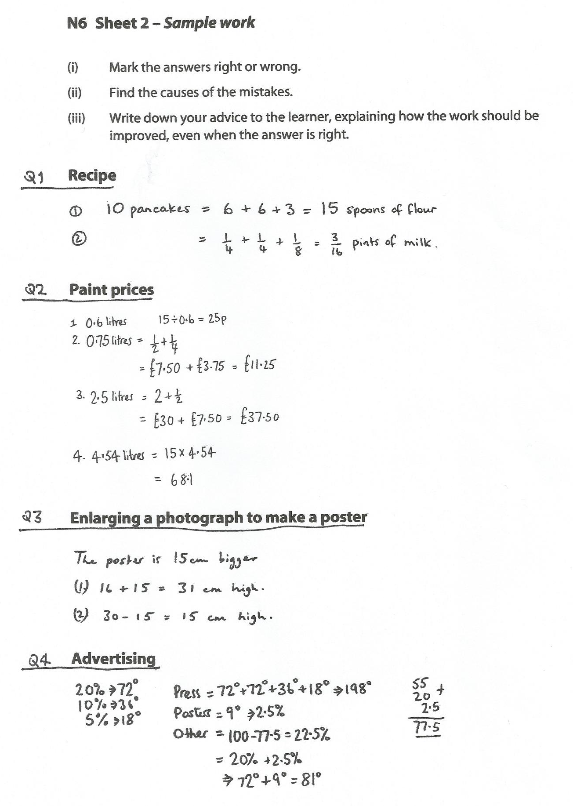

Slide 5
All these problems involved two quantities
Q1 No. of pancakes & Amount of ingredients
Q2 Quantity of paint & Cost of paint
Q3 Height of poster & Width of poster
Q4 % of money spent & Angle in the Pie chart
They are all proportional because if we multiply the first quantity by something (say x3), we must multiple the second quantity by the same amount

Slide 6
What other pairs of things are proportional?
Faster you go, further you travel.
Circumference of a circle, and its radius
The nights you stay in a hotel, and the total cost
The amount of savings you have in a bank, and the interest you get.
The amount you spend in a supermarket, and the number of school vouchers you get.
Some things that are NOT proportional?
The faster you go, the LESS time it takes to get there.
The amount you eat, and how full you feel.
How much you talk, and how much you listen
How much exercise you do, and how much you sleep.
How old you are, and your pocket money
Your age and your height

Slide 7
Solving Proportion Problems in 1 Step
litres
£
Proportion problems are really just multiplication problems!
You usually just have to find the multipliers.

Slide 8
Solving Proportion Problems in 1 Step
What do you think this diagram means?
litres
£
4
10
7
?
What are the multipliers now?

Slide 9
Solving Proportion Problems in 1 Step
Another example. What does this mean?
litres
£
7
18
2.5
?
What are the multipliers now?

Slide 10
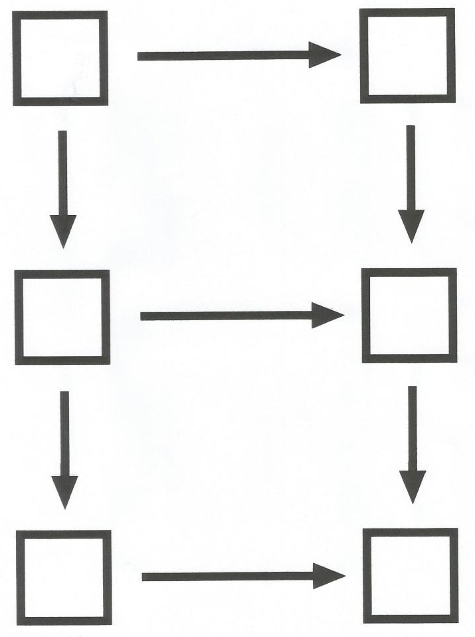
Solving Proportion Problems in 2 Steps
Or you might find this 2-step method easier
4
10
1
?
7
?

Slide 11
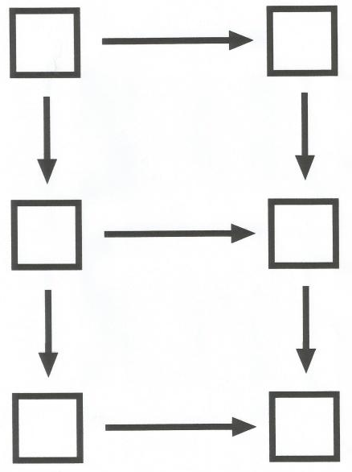
Your Turn
Solve any problems you couldn’t do using the new diagram method.
(or use it instead of the method you used previously)
1

Slide 12
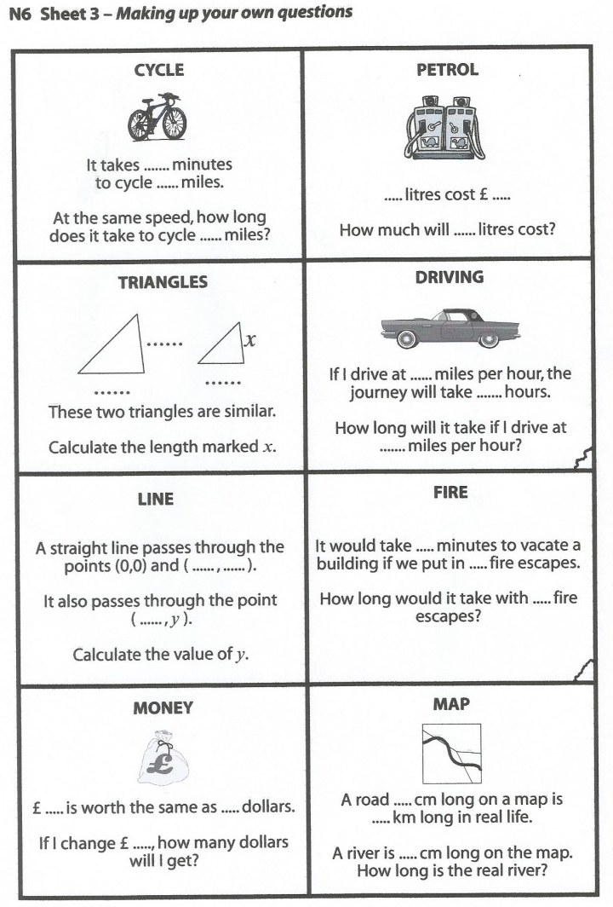
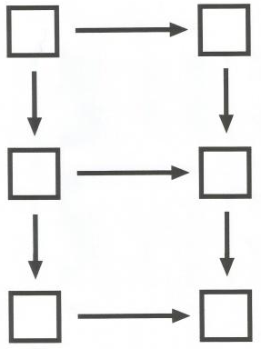
Now…
Some of these cards describe Proportional problems, and some don’t.
1. Decide if each is a proportional problem. If it isn’t, draw a line through it!
2. For all remaining problems, create your own (quite difficult) problems.
3. In your exercise books, use one of the diagram methods, or your own method, to solve all your own problems.
1

Slide 13
Review
How do you know if a situation is proportional or not?
Are each of these statements True or False?
If one value doubles, the other doubles.
If one value is zero, the other is zero too.
If one value is one, the other is one too.
If you add one to one value, you must add one to the other too.
If you were to plot a graph of one value against the other, it would be a straight line through the origin.
If you were to plot a graph of one value against the other, it would be a straight horizontal line.

