Slide 1
Standards Unit N3: Rounding Numbers
Suitable for students at Level 3 or 4?
Need ~ 15 very long, consumable strips of paper / card. About 5cm or 10cm wide, but 1 or 2m long.
Rounding whole numbers to nearest 10, 100, 1000.
Activity takes around 45+ minutes. Each student needs mini-whiteboard.

Slide 2
Consumable Resources Needed:
Each team needs 4 off 1-2m long strips of paper or card
Pens + blu-tac to temporarily stick things down on desks
~1000 blank cards approximately 2cm square.
Re-usable Resources Needed:
CAMARA to take photos to stick in books and/or display.
Each student needs mini-whiteboard

Slide 3
Notes to start.
Students give initial answers individually on mini-whiteboards.
If they struggle, explain you will return to it later in session.

Slide 4
Think about these questions…
How far away is Ipswich town centre?
How long would it take you to cycle to school?
How many people are at this school?
How long is a pencil?
Do we always need to give accurate answers?
Are very accurate answers sometimes STUPID?

Slide 5
Rounding
Quite often, we need to round answers to the nearest 10 or 100.
e.g. How many people are in school today?
Would it be best giving an exact answer, or round it to the nearest 10, or the nearest 100?

Slide 6
Pairs Work: Your will…
Step 1. Create a number line from 0 to 200, marked every ‘5’ units.
0
5
10
15
20
25
30
35
40
45
50
190
200
Stick it down so that it doesn’t move
Step 2. Create 20 ‘number cards’. Any numbers between 0 and 200, but make some awkward like 57, 139, or even 67½!
Step 3. Place each card near where it should be on the number line.
Step 4. Most important!
Adjust the position of each card so that it is beside its nearest ‘10’.
Now stick the cards down so they don’t move.

Slide 7
It will look something like this…
22
16 ½
7
23
54
191
199
3
11
17
33
47
188.7
194
0
5
10
15
20
25
30
35
40
45
50
190
200
except that two of these are wrong.
Can you see which are wrong?

Slide 8
It will look something like this…
22
16 ½
7
23
54
191
199
3
11
17
33
47
188.7
194
0
5
10
15
20
25
30
35
40
45
50
190
200
except that two of these are wrong.
Can you see which are wrong?

Slide 9
It will look something like this…
22
16 ½
7
23
54
191
199
3
11
17
33
47
188.7
194
0
5
10
15
20
25
30
35
40
45
50
190
200
Where would this card go?
115
110
120

Slide 10
Check: What will you do?
Step 1. Create a number line from 0 to 200, marked every ‘5’ units.
0
5
10
15
20
25
30
35
40
45
50
190
200
Stick it down so that it doesn’t move
Step 2. Create 20 ‘number cards’. Any numbers between 0 and 200, but make some awkward like 57, 139, or even 67½!
Step 3. Place each card near where it should be on the number line.
Step 4. Most important!
Adjust the position of each card so that it is beside its nearest ‘10’.
Now stick the cards down so they don’t move.

Slide 11
Stop and Assess…
I soon want you to go and check others work.
22
16 ½
x
15
23
191
199
x
x
x
3
11
17
33
47
52
✓
188.7
194
0
5
10
15
20
25
30
35
40
45
50
190
200
If you think they have put a card in the wrong place on their number line, write one small ‘x’ on the card.
If someone else has already marked it with a cross, and you agree it is wrong, add another small cross. But if you think it’s correct, put a little tick.
How many errors can you spot in other student’s work?

Slide 12
Check: What will you do?
I soon want you to go and check others work.
22
16 ½
x
15
23
191
199
x
x
x
3
11
17
33
47
52
✓
188.7
194
0
5
10
15
20
25
30
35
40
45
50
190
200
If you think they have put a card in the wrong place on their number line, write one small ‘x’ on the card.
If someone else has already marked it with a cross, and you agree it is wrong, add another small cross. But if you think it’s correct, put a little tick.
How many errors can you spot in other student’s work?

Slide 13
Return to your own table…
Who spotted the most mistakes?
Look to see if others have added any marks to your cards.
Did anyone do perfect work?
Have they made a mistake, or you?
Make any corrections, so that everything is perfect.
I will come and take a photo to record your work.

Slide 14
What have we learnt so far?

Slide 15
A second number line 0 to 2000 marked in ‘50’s
Step 1. Create a number line from 0 to 2000, marked every ‘50’ units.
Step 2. Create 20 ‘number cards’. Any numbers between 0 and 2000. Make some awkward!
Step 3. Place each card near where it should be on the number line.
Step 4. Most important!
Adjust the position of each card so that it is beside its nearest ‘100’.

Slide 16
What have we learnt anything new?
Have you got quicker adjusting the cards?

Slide 17
A 3rd number line 0 to 20,000 marked in ‘500’s
Step 1. Create a number line from 0 to 20, 000, marked every ‘500’ units.
Step 2. Create 20 ‘number cards’. Any numbers between 0 and 20,000. Make some awkward!
Step 3. Place each card near where it should be on the number line.
Step 4. Most important!
Adjust the position of each card so that it is beside its nearest ‘1000’.

Slide 18
Start to clear up…
Photo’s of final number line

Slide 19
Have we learnt anything else?
Have you got even quicker adjusting the cards?
Which do you find easiest:
rounding to nearest 10, 100 or 1000?

Slide 20
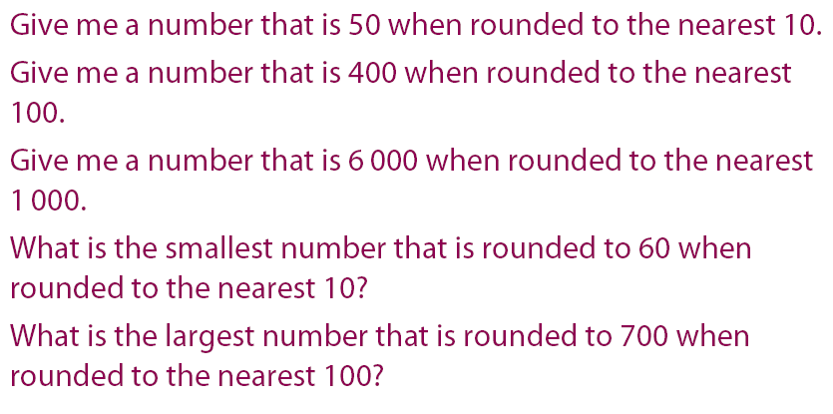
Final Assessment
Mini-whiteboards

