Slide 1
Standards Unit N2: Evaluating Statements about Number Operations
Suitable for students at Levels 5 to weak 7.
Good if negative numbers have been worked on quite recently (~2-6 weeks beforehand)
Calculators useful for checking answers. Scissors, Glue, Pale Red and Green A4 paper and two sheets of A3 Amber and A4 Plastic Wallets needed. A3 Plastic wallets too to hold all final posters, especially if needing to be carried over to next lesson for marking /evaluation.
60-90 mins. Teams of 3 virtually essential.
Cards themselves are NOT re-usable (‘my’ cards are pointless)
Learners need to be aware of squaring and square roots, and possibly inequality representations on a number line.
Addresses many mis-conceptions with negative numbers and fractional multiplication/division etc.

Slide 2
Consumable Resources Needed:
Each student needs 1 double-sided ‘calculation’ sheet (my design, attached)
Each student needs 1 A3 coloured sheet (pale red, amber or green) for their poster
I need a few copies of ‘inequalities on number line’ sheets as an extension for any teams that finish. They can cut and stick these to their ‘SOMETIMES’ poster too.
Re-usable Resources Needed:
Plastic A4 wallets to hold a group of student’s initial worksheets.
Plastic A3 wallets to hold final posters, especially if carry over to next lesson.

Slide 3
Working by yourself, and without a calculator, fill in the missing numbers below.
Name: ……………………..

Slide 4
In the space below, write down what you have learnt from doing this. If you still find something difficult, say what they are too.
Now have another go at filling in the missing numbers.

Slide 7
Complete the first side of the worksheet
Working by yourself, and without a calculator, fill in the missing numbers below.
Name: ……………………..
When completed, just place it into one of the plastic wallets and leave to one side.

Slide 8
Consider the statement…
$$x^{2}≥x$$
What does it mean in words?
Is it TRUE?
So is it ALWAYS, SOMETIMES or NEVER True?
Sometimes true
Can we say PRECISELY when it is True?
Perhaps use this?

Slide 9
Your Task
I’ll give each team 14 similar statements to solve.
In your group:
i) work out precisely whether each statement is:
Always, Sometimes, or Never true
ii) you will each produce an A3 poster of results.
iii) each team’s posters will be assessed, and the best displayed.
You can use a calculator if you want.
Listen to these detailed instructions very carefully…

Slide 10
You will begin your posters exactly like this…
Student 1’s Name: Partners names
Student 2’s Name: Partners names
Student 3’s Name: Partners names
ALWAYS True
SOMETIME True
NEVER True
Student #1 will write the ALWAYS True Poster
Student #2 will write the SOMETIMES True Poster
Student #3 will write the NEVER True Poster
Decide NOW who will be Student #1, #2 and #3

Slide 11
1. Quickly cut the Statements out from the sheet. Share the cards out as fairly as possible.
2. Together, very carefully sort them into 4 piles:
ALWAYS true
SOMETIMES true
NEVER true
NOT SURE
Think about positive numbers, negative numbers, fractions, large numbers and ZERO!
3. Finally, each take your own set of cards (‘Always’, ‘Sometimes’ or ‘Never’) and produce your own poster giving precise reasons.

Slide 12
Your team’s final work will look like this…
Student 1’s Name: Partners names
Student 2’s Name: Partners names
Student 3’s Name: Partners names
ALWAYS True
SOMETIMES True
NEVER True

Slide 13
Your team’s final work will look like this…
Student 1’s Name: Partners names
Student 2’s Name: Partners names
Student 3’s Name: Partners names
ALWAYS True
SOMETIMES True
NEVER True
For each ‘ALWAYS True’ Statement give:
Examples of small, large, positive and negative numbers showing why you think it is true.

Slide 14
Your team’s final work will look like this…
Student 1’s Name: Partners names
Student 2’s Name: Partners names
Student 3’s Name: Partners names
ALWAYS True
SOMETIMES True
NEVER True
For each ‘SOMETIMES True’ Statement give:
Examples of when the Statement IS True.
Examples of when the Statement is FALSE.

Slide 15
Your team’s final work will look like this…
Student 1’s Name: Partners names
Student 2’s Name: Partners names
Student 3’s Name: Partners names
ALWAYS True
SOMETIMES True
NEVER True
For each ‘NEVER True’ Statement:
Write an explanation of why you are sure it’s never true.

Slide 16
1. Cut out Statements from sheet.
3 minutes
2. Together, carefully sort into 4 piles:
ALWAYS true
SOMETIMES true
NEVER true
NOT SURE
20-30 minutes
Think about positive numbers, negative numbers, fractions, large numbers and ZERO!
3. Each produce your own poster giving precise reasons.
15 minutes

Slide 17
Mini Plenary
Any cards in your ‘NOT SURE’ pile?
What does this statement actually mean?
Try the simplest no. first.
Try another simple number.
Try a large, but simple number?
Try a small number?
Try a negative number?
Try a small negative number?
Try ZERO!

Slide 18
1. Cut out Statements from sheet.
2. Together, carefully now sort into 3 piles:
ALWAYS true
SOMETIMES true
NEVER true
NOT SURE
Think about positive numbers, negative numbers, fractions, large numbers and ZERO!
3. Each produce your own poster giving precise reasons.

Slide 19
Helpful Hint?
ALWAYS true
SOMETIMES true
NEVER true
10 of the Statements are ‘SOMETIMES True’
Which means that Student #2 has too much work to do.
So to make work on the Posters fairer…

Slide 20
A slight change to who does which Poster…
Student #1
Student #2
Student #3
Now has a second ‘SOMETIMES’ Poster to complete, with 5 cards.
Now does these 2 posters.
But only has 4 cards.
Has 5 cards to describe.
Student 1’s Name: Partners names
Student 1’s Name: Partners names
Student 2 or 3’s Name: Other names
Student 2 or 3’s Name: Other names
ALWAYS True
NEVER True
SOMETIMES True
SOMETIMES True

Slide 21
1. Finish sorting into 3 piles:
ALWAYS true
SOMETIMES true
NEVER true
0, 1, 2, 3 or 4
cards
10 cards
0, 1, 2, 3 or 4
cards
Think about +, -, 1, ½ and 0.
2. You can begin to produce your Posters.
Student 1’s Name: Partners names
Student 1’s Name: Partners names
Student 2 or 3’s Name: Other names
Student 2 or 3’s Name: Other names
ALWAYS True
NEVER True
SOMETIMES True
SOMETIMES True

Slide 22
You should be producing your posters…
Give varied examples showing why you think each Statement is ALWAYS true
Student 1’s Name: Partners names
Student 1’s Name: Partners names
Student 2 or 3’s Name: Other names
Student 2 or 3’s Name: Other names
ALWAYS True
NEVER True
SOMETIMES True
SOMETIMES True
Give reasons why you think each Statement is NEVER true.
Give examples of when each Statement is True, and Untrue (false)

Slide 23
STOP: Check that your other team-mates are doing their Posters correctly! You are a team!
Give varied examples showing why you think each Statement is ALWAYS true
Student 1’s Name: Partners names
Student 1’s Name: Partners names
Student 2 or 3’s Name: Other names
Student 2 or 3’s Name: Other names
ALWAYS True
NEVER True
SOMETIMES True
SOMETIMES True
Give reasons why you think each Statement is NEVER true.
Give examples of when each Statement is True, and Untrue (false)

Slide 24
Clearing Up
Replace all equipment, and clear any scraps into bin.

Slide 25
Assessment Phase
Swap your one (or two) Posters with someone from another team.

Slide 26
The ‘ALWAYS True’ Poster…
Student 1’s Name: Partners names
ALWAYS True
If you have someone’s ‘ALWAYS True’ Poster,
Mark and comment on it.
GRADES:
Poor teamwork?
Bronze
Silver
GOLD

Slide 27
The ‘Never True’ Poster…
Student 1’s Name: Partners names
NEVER True
If you have someone’s ‘Never True’ Poster,
Mark and comment on it.
GRADES:
Poor teamwork?
Bronze
Silver
GOLD

Slide 28
The ‘SOMETIMES True’ Posters…
Student 2 or 3’s Name: Other names
SOMETIMES True
If you have someone’s ‘SOMETIMES True’ Poster,
Mark and comment on it.
GRADES:
Poor teamwork?
Bronze
Silver
GOLD

Slide 29
Return the Poster(s) you are holding to the other person.
Then check through you own posters, and your team’s other posters to see how well you’ve done.

Slide 30
1. Neatly file Posters away.
2. Collect your original A4 worksheet and have another go at filling in the missing numbers.
3. Look back at your first attempt, and see if you have improved. In the box on side 2, comment on what you have learnt, or what is still confusing you.
In the space below, write down what you have learnt from doing this. If you still find something difficult, say what they are too.
Now have another go at filling in the missing numbers.

Slide 31
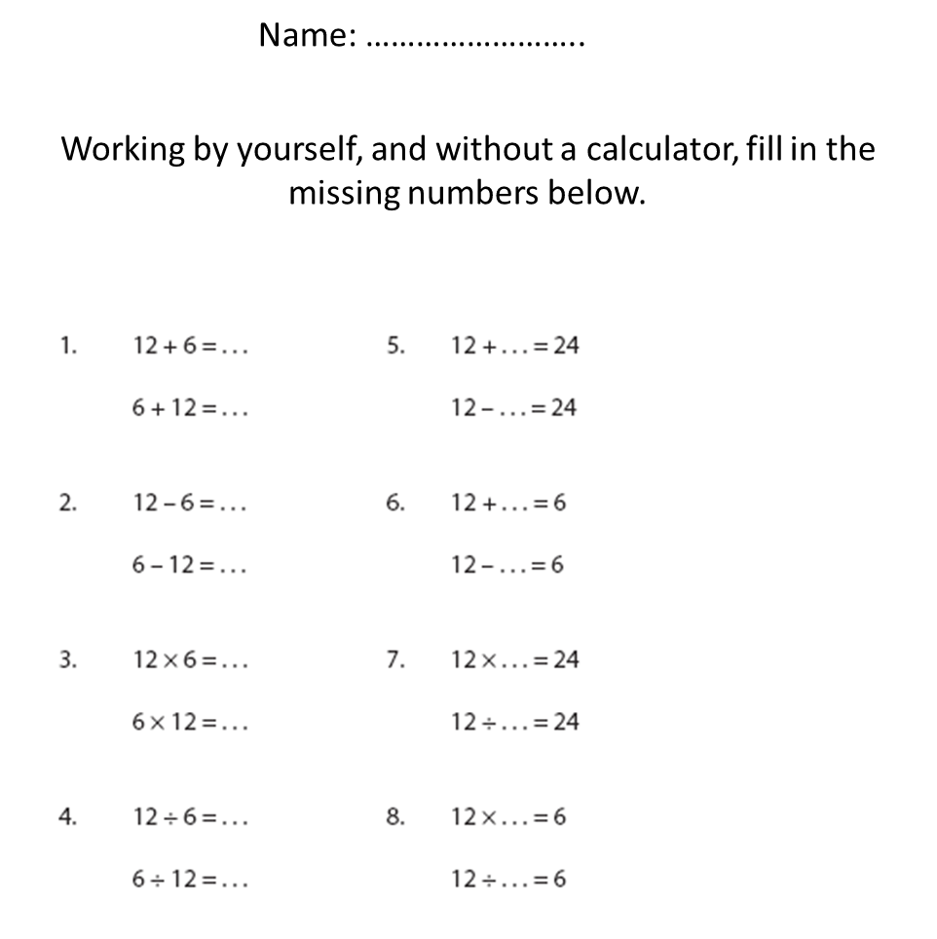
Assess Your Own Work…
12
18
18
-12
Score yourself:
10-12 earns BRONZE
13-14 earns SILVER
15 earns GOLD
16 earns GOLD+
6
-6
-6
6
72
2
72
½
2
½
½
2

