Slide 1
Standards Unit N1: Ordering FDPs
Suitable for students at strong 4’s and 5.
Need to check that the cards are properly available and correctly sorted
Reviewing, identifying and correcting misconceptions in FDP.
30-60 mins.
Different card sets allow differentiation.
Groups of 3 preferable, but pairs okay?

Slide 2
Consumable Resources Needed:
Each student needs 1 double-sided ‘
Each student needs 1
I need
Card set BB is my own set of % cards – deliberately created to add to the mix
Re-usable Resources Needed:
Blu-tac to stick cards onto desk and stop them moving around.
VIDEO CAMERA to take photos of team’s sorted cards. Stick in books and/or display.
Each student needs mini-whiteboard
High ability groups need card sets:
Normal ability groups need card sets: A, B, C, D – and then add BB
Low ability groups need card sets: A, B, E, F – and then add BB
Try to avoid using these. Managerially too hard. Instead, do more prior work on fractions represented on number lines, and areas beforehand .

Slide 3
Notes to start.
Students work initially in their books, with title and answering first questions alone.
If they struggle, explain you will return to it later in session.
Pre-organise your teams of 3 (maybe one or two groups of 2 too).
Pre-distribute the packs of cards and blu-tac.
When students are sorting the cards, go round with the video camera and listen-in to students explaining why pairs of cards match.
A successful video can then be used to model such good groupwork to other classes later.

Slide 4
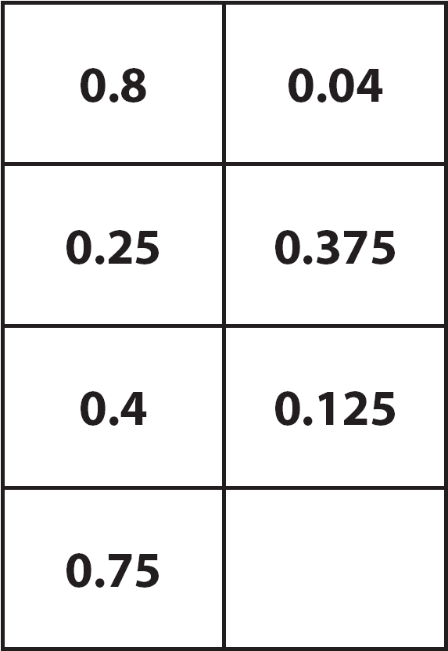
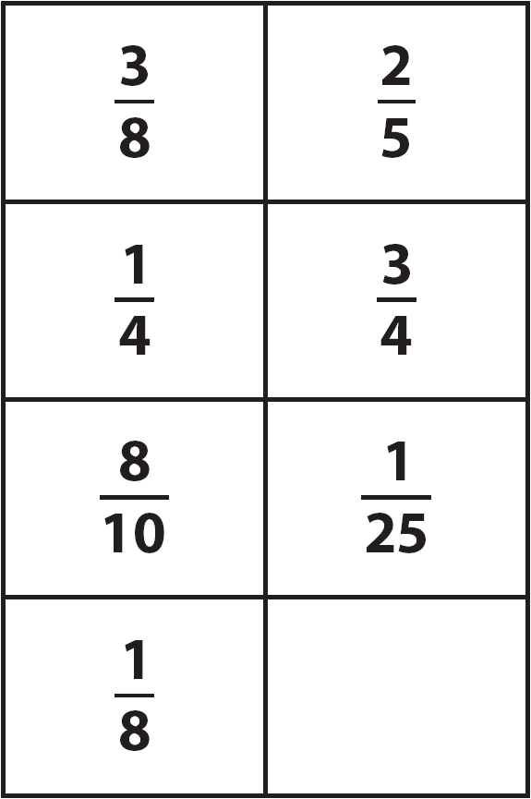

Slide 5
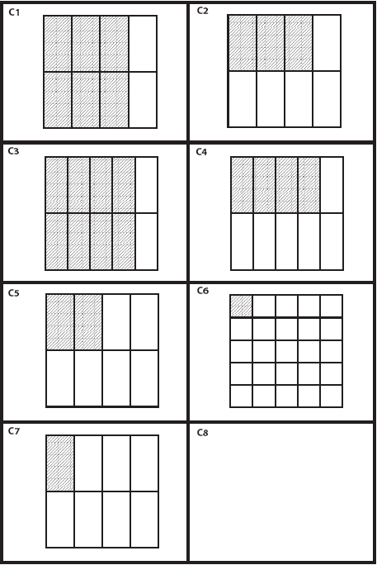
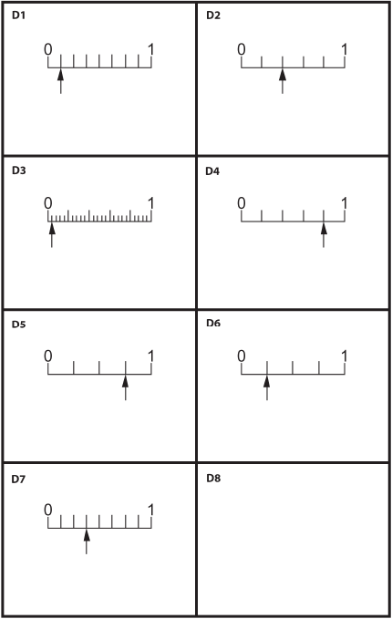

Slide 6
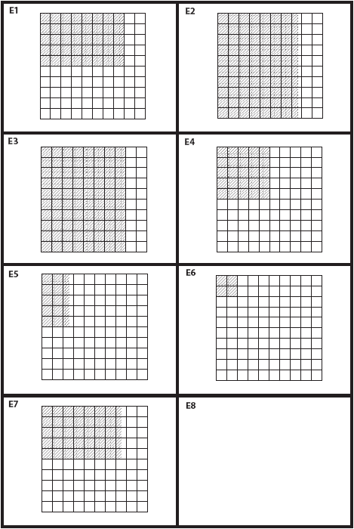
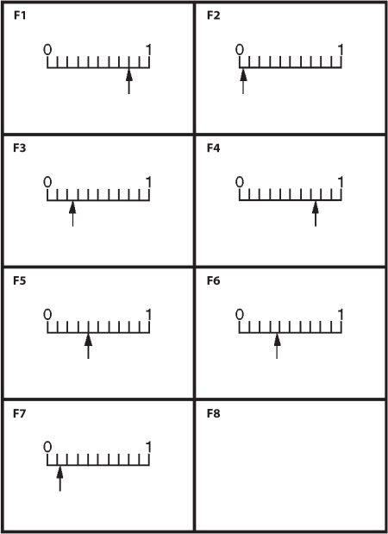

Slide 7
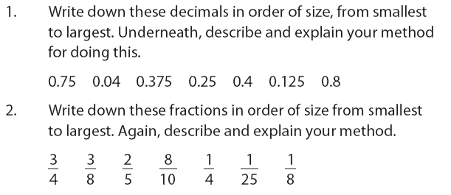
Fractions, Decimals and Percentages
Working alone, do your best to…

Slide 8
Group Task
Each group will be given 28 cards to match up.
There are 4 different types of cards.
Fraction cards
Decimal cards
Area cards
Scale cards
+ 5 more
+ 5 more
+ 5 more
+ 5 more

Slide 9
Step 1: Lay out all the cards like this.
+ 5 more
+ 5 more
+ 5 more
+ 5 more

Slide 10
Step 2: Take it in turns matching up a PAIR of cards.
Explain, in detail, WHY you think they match.
Your partners then decide if they agree with you or not.
If okay, stick down with blu-tac - then next partner matches up a pair.
Row of 4 is now complete
+ 5 more
+ 5 more
+ 5 more
+ 5 more

Slide 11
Step 2: Take it in turns matching up a PAIR of cards.
When complete, your 28 cards will now be in table with 4 columns and 7 rows.
Fractions
Decimals
Areas
Scales
Row 1
Row 2
Row 3
Row 4
Row 5
Row 6
Row 7

Slide 12
Extension 0: Re-order the rows so that they increase in size.
Fractions
Decimals
Areas
Scales
Row 1
S m a l l e s t v a l u e
Row 2
Row 3
Row 4
Row 5
Row 6
Row 7
L a r g e s t v a l u e

Slide 13
Extension 1: Match the fifth set of ‘Percentage’ cards.
When complete, your 35 cards will now be in table with 5 columns and 7 rows.
Fractions
Decimals
Areas
Scales
Percentages
Row 1
25%
Row 2
Row 3
Row 4
Row 5
Row 6
Row 7

Slide 14
Extension 2: Make up sets of cards for 3 new rows.
Each student chooses a fractional value that is made into 4 new cards by another team member.
Fractions
Decimals
Areas
Scales
Row 1
Row 2
Row 3
Row 4
Row 5
Row 6
Row 7
Row 8
Row 9
Row 10

Slide 15
Assessment
Fractions
Decimals
Areas
Scales
Row 1
Row 2
Row 3
Soon, two of you will go to assess other team’s work, while one of you stays to explain your choices to other visitors.
Make sure you explain any of the extensions your team did.
I will also take photos of your results to analyse later.
Row 4
Row 5
Row 6
Row 7

Slide 16
Getting Ready for next Phase
Soon:
1. Remove ALL the blu-tac off the cards
2. Return all cards neatly into the correct plastic wallets.
3. Collect a mini-whiteboard & pen
(needed for next piece of work)
4. Go to check you exercise book work that ordered decimals and fractions. Do you want to change anything now? Explain any initial errors you made, and what you have remembered or learnt from today’s work.

Slide 17
Did we learn anything from the card matching activity?
Collect answers to these questions on mini-whiteboards
Which pairs of cards were hardest to match?
Fractions and Decimals?
Fractions and Areas?
Fractions and Scales?
Decimals and Areas?
….
Would you be able to match similar cards quicker next time?
Which Year groups would be most suited to this activity?

Slide 18
FDP Quiz Q1 & 2
You can quickly discuss these questions with your partner if you need to, but you must all show me answers.
What number would come next in this sequence:
0.4 0.7 1.0 ?
What number would come next in this sequence:
$\frac{3}{4}$ $\frac{5}{8}$ $\frac{1}{2}$ ?

Slide 19
Q3 & Q4
Write any decimal number that is between:
0.5 0.6
Write the fraction that is midway between:
$\frac{2}{3}$ $\frac{8}{9}$

Slide 20
Q5 & Q6
Write the decimal number equivalent to:
$\frac{3}{5}$
Write the fraction that is equivalent to:
0.3

Slide 21
Q7 & Q8
Draw a number line from 0 to 1 marked in $\frac{1}{8}$ ‘s
Mark approximately where $\frac{2}{3}$ is on the number line.
Mark approximately where $\frac{2}{3}$ is on the number line.

Slide 22
Q9 & Q10
What fraction of this diagram is shaded?
Expressed as a decimal, what fraction of this diagram is shaded?

Slide 23
Q11 & Q12
Write the decimal number that is midway between:
0.5 0.51
Write 32% as a fraction (do not cancel it down).

Slide 24
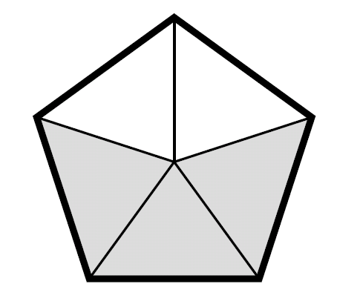
Q13 & Q14
What is the RATIO of the shaded to unshaded regions in this pentagon?
Write the fraction that is midway between:
$\frac{2}{5}$ $\frac{3}{5}$

