Slide 1
Standards Unit N10: Developing an Exam Question: Number
Suitable for GCSE Revision.
Exemplifies a particular revision technique?
Okay to add some variety to GCSE-style revision sessions
60 mins. Teams of 2.
Cards themselves are NOT re-usable (‘my’ cards are pointless)

Slide 2
Consumable Resources Needed:
Each team needs 2 or 3 off A3 poster paper to answer questions [and display for others to see]
Blu-tac to stick posters up
Each team needs 1 A4 colour question template sheet (they can choose whether to use left side, or right side, or to pose 2 entirely different questions).
Re-usable Resources Needed:
Each team needs 1 A5 initial question sheet (though displayed in slideware too).
Camera to record some work, esp. for display purposes..
Plastic A4 wallet to hold worksheets over to next lesson if necessary.

Slide 3
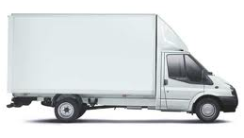

Slide 4
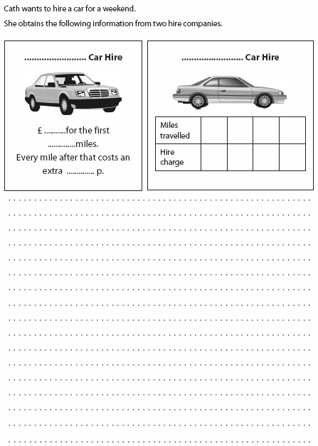
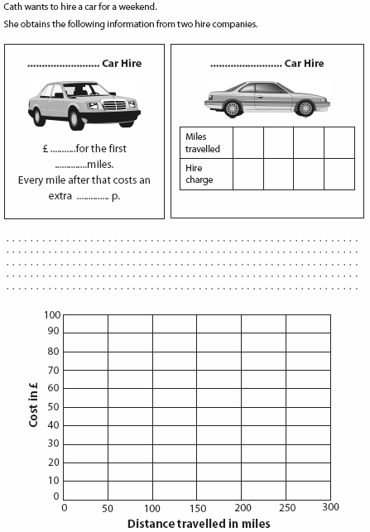
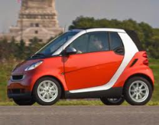
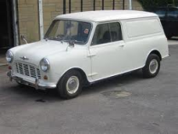
Question designed by: ………………………..
Question designed by: ………………………..

Slide 5
Student’s initially work in their normal exercise books
Better method, with smaller class and more willing students would be fore them to work together on A3 ‘poster’ paper (in rough, not neat) and bring that up to front to explain their method.
Or I could just summarise their method to everyone else.

Slide 6
Work with a partner to solve this…

Slide 7
What are the different ways to solve Q1?

Slide 8
What are some different ways to solve Q2?
Bujit’s Van Hire

Slide 9
Other questions that could have been asked…
Q1
Q2
Q3
Q4
Q5

Slide 10
Choose ONE of these questions to answer
Q1
Q2
Q3
Q4
Q5

Slide 11
Record your answers here
Questions | 1 | 2 | 3 | 4
Q1
Cheapest company?
Saving?
B’s more expensive over?
Q2
H’s more expensive over?
Cross-over point is:
Q3
Table is:
Q4
Graph is:
Q5
Formula for B is:
Formula for H is:

Slide 12
Q2 One solution method

Slide 13
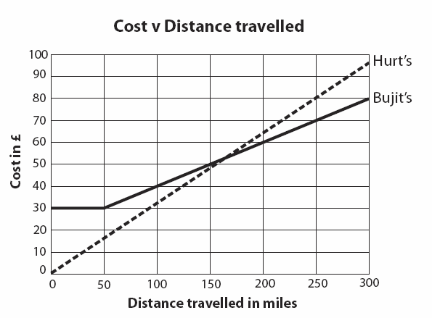
Q4 Solution
Cross-over point is at around 165 miles

Slide 14
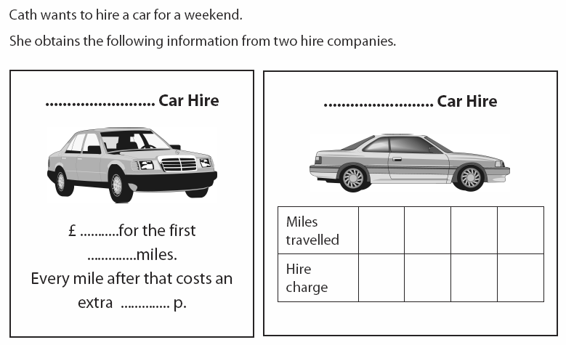
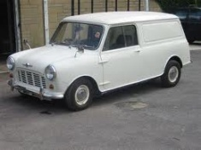
Designing your own exam question
1. Create your own ways, or prices of charging
You can create more interesting questions if there’s a cross-over point
You can write different policies entirely (e.g. based upon time out, or day of week?)
2. Create two or three questions, from ‘easy’ to ‘harder’

Slide 15
Carefully answer your own exam question
Try to produce a ‘model answer’ on another sheet of paper.
We will then pass your question on for others to attempt, and you will mark their work later.

Slide 16
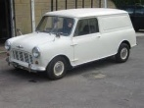
Plenary
Which teams asked good questions?
Which teams were able to correctly answer questions posed by another team?
Is it easy to write such exam questions?
How easy is it to fairly mark others’ work?

