Slide 1
Standards Unit C5: Stationary Points of Cubics
Core 1 or 2 Suitable for quite early stage LEARNING of finding Stationary Points.
Do this BEFORE students do independent work to calculate Stationary Points.
?
1 to 2 hours. Teams of 2.

Slide 2
Print sheet 1 on place coloured PAPER 25 sheets to start with.
Print card Set A on Yellow Card. 10 sets?
Print card Set B on White Card (consumable). 9 sheets to start with.
Print card Set C on white PAPER. 20 sheets to start with.
Consumable Resources Needed:
Sheet 1 for each student.
Each pair needs just 6 of the consumable card from Card Set B.
Re-usable Resources Needed:
Card Set A
Camera. Definitely.
….

Slide 3
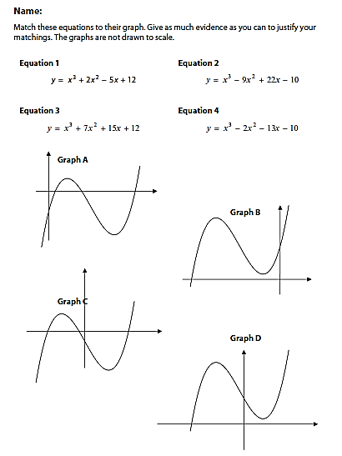

Slide 4
Card Set A

Slide 5
Card Set B

Slide 6
Card Set C

Slide 7
Students start with

Slide 8
Calculus: Reviewing Stationary Points
Work individually on a mini-whiteboard
Verbal Q.
Who can describe the general process of determining Stationary Points?
Q1
Q2
Q3
Q4

Slide 9
Q5
What can you say about the shape of a quadratic graph?
Sketch some different quadratic graphs.
How many maxima or minima does a quadratic have?
Q6
What can you say about the shape of a CUBIC graph?
Sketch some different cubic graphs.
How many maxima and minima does a cubic usually have?

Slide 10
Card Sorting Activity – in Pairs
The cards describe 3 different cubic functions and the steps to find their Stationary Points.
Your task is to sort the cards into an order that gives the solutions.
Minima is ………….
Maxima is ………….
Cubic function
Differentiate
Turning Point Coords
Second Differential
3 Functions. 8 steps to each solution + ‘answer’ cards
Extension: Find examples of cubics with only one or zero S.P.’s

Slide 11
Card Sorting Activity – in Pairs
The cards describe 3 different cubic functions and the steps to find their Stationary Points.
PAUSE
Your task is to sort the cards into an order that gives the solutions.
Next steps:
1.Compare your work with other teams’ work. Check the orders are correct.
2. Then, using larger paper ‘cards’, add 7 short descriptions below each card explaining the purpose of the step.
3. Draw a sketch of the graph of each cubic on the 8th paper card, and add it to the end of each row. Mark the S.P.s
Minima is ………….
Maxima is ………….
Cubic function
Differentiate
Turning Point Coords
Second Differential
3 Functions. 8 steps to each solution + ‘answer’ cards

Slide 12
Card Sorting Activity - Assessment
Geogebra
Make some quick notes on any important points you’ve learnt, or things that have tripped you up.
Working individually…
Now complete Worksheet A.

Slide 13
Worksheet A : Answers
Note: These are not good sketch graphs. Why not?
[The full detail was been left off in order to make matching them harder for you].

