Slide 1
Standards Unit C4: Differentiating & Integrating Fractional and Negative Powers
Suitable for Core 2 review.
?
1 to 2 hours. Teams of 2.

Slide 2
Print each of the following 6 card sets onto different coloured paper.
There are 2 sets on each A4 sheet.
Consumable Resources Needed:
lkhlkjhlkj
Re-usable Resources Needed:
Camera. Definitely.
….

Slide 3
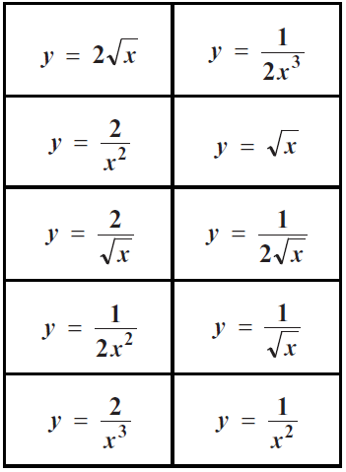
Card Set A
Card Set A

Slide 4
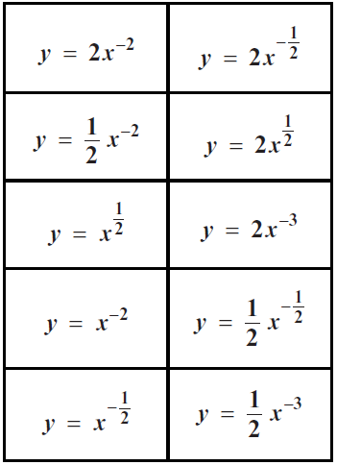
Card Set B
Card Set B

Slide 5
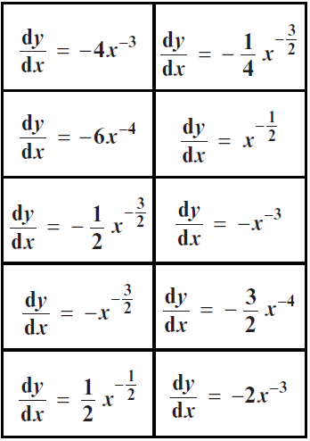
Card Set C
Card Set C

Slide 6
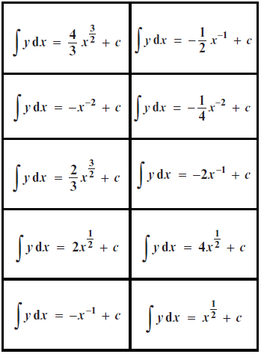
Card Set D
Card Set D

Slide 7
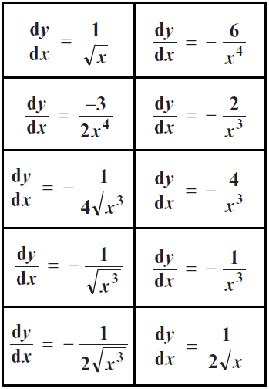
Card Set E
Card Set E

Slide 8
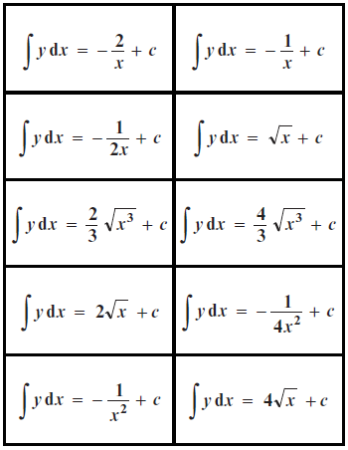
Card Set F
Card Set F

Slide 9
Students start with

Slide 11
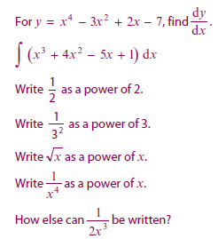
Calculus: Fractional and Negative Indices Quiz
Work with a partner on a mini-whiteboard
Q1
Q2
Q3
Q4
Q5
Q6
Q7

Slide 12
Card Sorting Exercise
Working with a different partner…
You are aiming to match the 4 different types of card and create a table
Function
(expressed in its standard form)
Function
(expressed in index form)
Differential
Integral
Card Set A
Card Set B
Card Set C
Card Set D
Stage 1: Just use card sets A and B. Match the functions.
Stage 2: Then add set C cards. Finally set D.
Stage 3: Ask for extension cards.

Slide 13
 | Function | Function (in index form) | Differentiated Function | Integrated Function
1
2
3
4
5
6
7
8
9
10

Slide 14
Extension
Now extend your table by adding two extra columns for each function
Function
(expressed in its standard form)
Function
(expressed in index form)
Differential
Differential
(expressed in its standard form)
Integral
Integral
(expressed in its standard form)
Card Set A
Card Set B
Card Set C
Card Set E
Card Set D
Card Set F

Slide 15
Mini-whiteboard Questions
Work with a partner on a mini-whiteboard
Can you generalise your findings in order to find:
Q1.
Q2.
Q3.
Q4.

