Slide 1
Standards Unit C3: Matching Functions and Derivatives
Suitable for review of Core 1 unit on Differentiation.
(most complex differentiation is quadratic – but can extend to cubics)
?
…...
30-60 mins . Teams of 2.

Slide 2
Consumable Resources Needed:
Extension card set.
Re-usable Resources Needed:
Mini-whiteboards.
Basic card set.
Camera. To quickly record student’s arrangements of cards

Slide 3
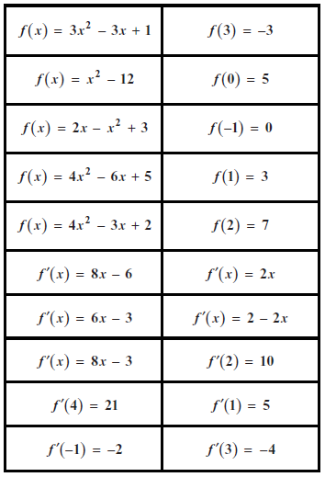
Basic card set (re-usable)

Slide 4
Extension set of cards (consumable)
$$f′\left(x\right)=$$
$$f′\left(x\right)=$$
$$f′\left(x\right)=$$
$$f′\left(x\right)=$$
$$f′\left(x\right)=$$
$$f′\left(4\right)=$$
$$f′\left(4\right)=$$
$$f′\left(4\right)=$$
$$f′\left(4\right)=$$
$$f′\left(4\right)=$$
$$f\left(−5\right)=$$
$$f\left(−5\right)=$$
$$f\left(−5\right)=$$
$$f\left(−5\right)=$$
$$f\left(−5\right)=$$

Slide 6
All students complete initial, basic card matching exercise.
They then attempt the extension card matching/creation activity to varying degree of depth.
Slide 9 (going through the answers) is to be completed by asking pairs of students for their answers, a justification, and handwriting answers in box on whiteboard. ALSO ask students about the shape of the associated graph – they will have made notes on their whiteboards (I can draw/discuss the graphs on a separate whiteboard).

Slide 7
Matching Functions and their Derivatives
You will have 20 cards of 4 different types to arrange
 | Functions | Evaluated function | Derivative | Evaluated derivative
1
2
3
4
5
When finished, create your own additional cards

Slide 8
Matching Functions and their Derivatives
PAUSE
We will check answers in a minute.
But first, write some notes on whiteboards about the graph of each of the functions.
 | Functions | Evaluated function | Derivative | Evaluated derivative
1
2
3
4
5

Slide 9
 | Functions | Evaluated function | Derivative | Evaluated derivative
1
2
3
4
5

Slide 10
Mini-whiteboard Quiz
Swap partners from the last activity

Slide 11
$$f\left(x\right)=3x^{2}−2x−1$$
Q1. Write down the values of:
f(0)
f(3)
f(-1)

Slide 12
$$f\left(x\right)=3x^{2}−2x−1$$
Q2. Work out the values of:
f’(0)
f’(3)
f’(-1)

Slide 13
Q3. Show me a function where f(2) =1
What is the simplest function you can make where f(2) = 1 ?
What is the most complex function you can make where f(2) = 1 ?

Slide 14
Q4. Can you show me a function f(x) where:
$$f^{′}(x)=5x^{2}+1$$
Is there only one correct answer to this question, or can you find lots of correct answers?
N.B. This may be a challenging question – integration may not have yet been taught.

Slide 15
Q5. Sketch a graph of a function where:
$$f\left(0\right)=10$$
On the same axes, sketch several other such functions.

Slide 16
Q6. Sketch a graph of a function where:
$$f′\left(0\right)=0$$
On the same axes, sketch several other such functions.

Slide 17
Q7. Explain, in words, what each of these mean.
$$f\left(−2\right)$$
$$f′\left(−2\right)$$

Slide 18
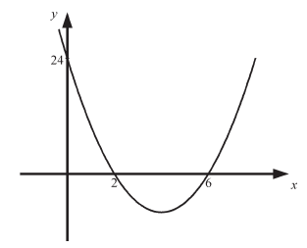
Q8. Say as much as you can about f(x) and f’(x) at various points on this graph

