Slide 1
Standards Unit C1: Linking the properties and forms of Quadratic functions
Suitable for Core 1 .
?
1-2 hours. Teams of 2.

Slide 2
Card printing instructions.
Page 1 cards print on pale cream CARD
Page 2 cards print on pale cream PAPER
Page 3 cards print on pale green CARD
Page 4 cards print on pale green CARD
Page 5 cards print on pale BLUE PAPER [Extension – blank cards]
Students choose to use either cream CARDS (in pack), or can collect pale cream ‘blank’ PAPER cards (harder)
Consumable Resources Needed:
Re-usable Resources Needed:
Mini-whiteboards
Card sets
Camera. Definitely.
Laptop(s) with Geogebra

Slide 3
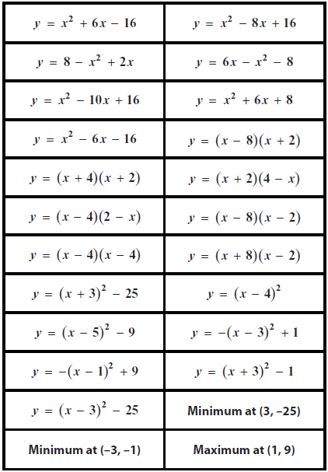
Card Set A

Slide 4
$$y=(x+a)(x+b)$$
$$y=(x+a)(x+b)$$
$$y=a{(x+b)}^{2}+c$$
$$y=(x+a)(x+b)$$
$$y=ax^{2}+bx+c$$
$$y=a{(x+b)}^{2}+c$$
$$y=a{(x+b)}^{2}+c$$
$$y=ax^{2}+bx+c$$
$$y=ax^{2}+bx+c$$
$$y=a{(x+b)}^{2}+c$$
$$y=ax^{2}+bx+c$$
$$y=(x+a)(x+b)$$
$$y=(x+a)(x+b)$$
$$y=(x+a)(x+b)$$
$$y=ax^{2}+bx+c$$
$$y=a{(x+b)}^{2}+c$$
$$y=(x+a)(x+b)$$
$$y=a{(x+b)}^{2}+c$$
$$y=ax^{2}+bx+c$$
$$y=a{(x+b)}^{2}+c$$
$$y=ax^{2}+bx+c$$
Card Set A

Slide 5
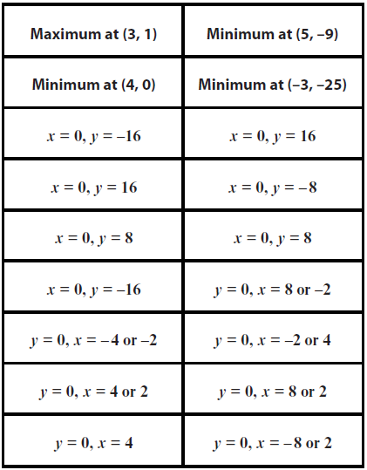
Card Set A

Slide 6
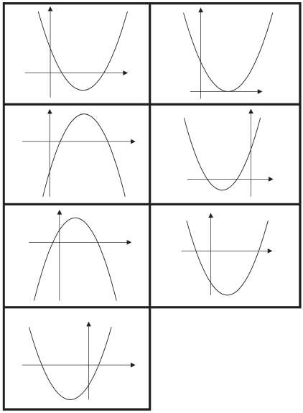
Card Set B

Slide 7
Card Set A

Slide 8
Slides 1 and 2 are meant to provide a very quick overview / orientation – not to ‘teach’ the material.
The card sorting is intended to make students struggle and identify patterns and mis-conceptions. Expect a wide variation in their degree of success.

Slide 9
Quadratic Functions Review
Mini-whiteboards
Discuss in pairs, but each make your own notes
What is a quadratic function?
Write down everything you know about quadratics.
What are their different forms?
What techniques can you use to solve them?
What do their graphs look like?
What are ‘roots’ of a quadratic?
How do you find the intercepts with axes?

Slide 10
Quadratic Functions
Polynomials
Linear Quadratics Cubics Quartics
GCSE
A-Level
Quadratic expressions
Quadratic equations
Quadratic functions
Standard form
$$y=ax^{2}+bx+c$$
Quadratic formula
Disguised forms
Factor form
$$y=(x+a)(x+b)$$
Gives roots
Vertex form
$$y=a{(x+b)}^{2}+c$$
Gives vertex
All quadratics produce parabolic curves.
$$a>0$$
$$a<0$$

Slide 11
Quadratic Functions – Card Sorting Activity
Work in pairs: Person A and Person B.
Sort the 49 cards into a table.
Concentrate on completing one ROW at a time. Show workings on whiteboard.
When starting a row, try to pick a different type of ‘start card’ each time
 | Standard form | Factor form | Vertex form | Vertex | x intercept | y intercept | Graph
1
2
3
4
5
6
7
$$y=2x^{2}−3x+4$$
If you are confident you can do this, make it harder for yourself by IGNORING the cream coloured cards in your pack and INSTEAD WRITING ON the paper, replacement versions
$$y=(x+5)(x−3)$$
$$y=2{(x−1)}^{2}+3$$
Minimum at (2, -3)
x = 0, y=4
y = 0, x=-5 or -3

Slide 12
Quadratic Functions – Card Sorting Activity
Work in pairs: Person A and Person B.
Sort the 49 cards into a table.
PAUSE
 | Standard form | Factor form | Vertex form | Vertex | x intercept | y intercept | Graph
1
2
3
4
5
6
7
Let’s check one row
Let’s check each team’s work so far.
Person A’s stay with your cards and explain to visitors.
Person’s B go to visit another team.
Check their work. Give hints only.

Slide 13
Quadratic Functions – Card Sorting Activity
Extension Work
Make up your own sets of additional cards (Blue paper blanks)
Include some where the coefficient a≠1 or -1
Work in pairs: Person A and Person B.
Sort the 49 cards into a table.
 | Standard form | Factor form | Vertex form | Vertex | x intercept | y intercept | Graph
1
2
3
4
5
6
7
PAUSE
Assessment
Person B’s now stay with your work.
Person A’s to visit and check others work.
Also use Geogebra.

Slide 14
Quadratic Functions – Card Sorting Activity
PAUSE
Work in pairs: Person A and Person B.
Sort the 49 cards into a table.
 | Standard form | Factor form | Vertex form | Vertex | x intercept | y intercept | Graph
1
2
3
4
5
6
7
Any questions?
What did you find easy?
What was difficult?
Make any notes you want to.
Then clear up.

Slide 15
Mini-whiteboard Quiz
Try Q’s yourself first. Then share with your partner.
Q1.

Slide 16
Mini-whiteboard Quiz
Q2.

Slide 17
Mini-whiteboard Quiz
Q3.

Slide 18
Mini-whiteboard Quiz
Q4.

Slide 19
Mini-whiteboard Quiz
Q5.

Slide 20
Mini-whiteboard Quiz
Q6.

Slide 21
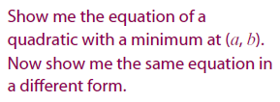
Mini-whiteboard Quiz
Q7.
Or, HARDER

Slide 22
Mini-whiteboard Quiz
Q8.
Or, HARDER

Slide 23
Looking ahead to Core 2
Polynomials
Linear Quadratics Cubics Quartics
Today’s techniques
Will often use Calculus to study these functions
Can you guess what a turning point is?
Which of these graphs have turning points?
How many turning points does each graph have?

