Slide 1
Standards Unit A5: Interpreting Distance-Time graphs with a Computer
Suitable for students Level 4 to 6
No previous background of Distance-Time graphs necessary. Helpful though if speed understood, and mabe distance = speed / time
1 hour.
Each pair of students preferably needs access to a laptop running the program. In a less exploratory manner, I could demo all scenarios, and students merely view. Far less rich or involving experience though.
Camera needed to record work?

Slide 2
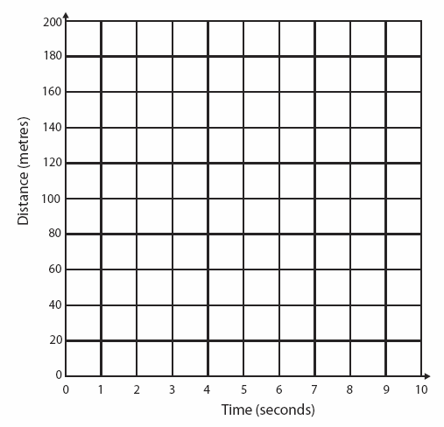
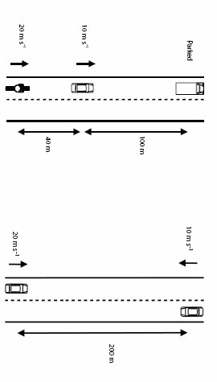
Situation 1
The picture shows an aerial view of cars on a road.
If the vehicles continue to travel at steady speeds, what will happen in the next few seconds? Write your answer in words, and try to show what happens on the graph.
Name: . . . . . . . . . . . . . . . . . . . . . . . .
Traffic Situations
Situation 2
How many seconds will it be before these two cars meet?
Where will the be along the road at this time?
Explain how you know this, and try to use the graph.
. . . . . . . . . . . . . . . . . . . . . . . .

Slide 3
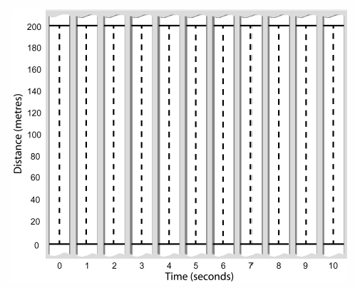
Name: . . . . . . . . . . . . . . . . . . . . . . . .
Photographs and Graph
Situation example:. . . . . . . . . . . . . . .

Slide 4
Practice Photo Sheet
Practice Distance-Time Graph Sheet
Example number: . . . . .
Example number: . . . . .
Example number: . . . . .
Example number: . . . . .

Slide 5
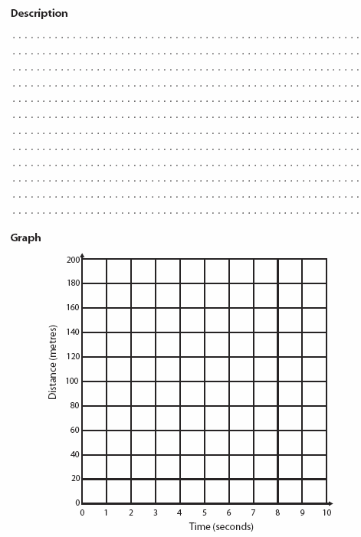
Name: . . . . . . . . . . . . . . . . . . . . . . . .
Inventing new situations
. . . . . . . . . . . . . . . . . . . . . . . .

Slide 6
Scenario Re-creation
Scenario Re-creation
Name: . . . . . . . . . . . . . . . . . . . . . . . .
Name: . . . . . . . . . . . . . . . . . . . . . . . .
Scenario author:. . . . . . . . . . . . . . . . . . . :
Scenario author:. . . . . . . . . . . . . . . . . . . :

Slide 7
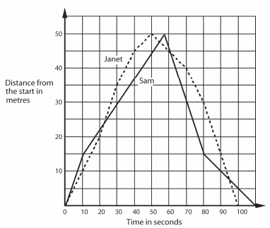
Name: . . . . . . . . . . . . . . . . . . . . . . . .
Name: . . . . . . . . . . . . . . . . . . . . . . . .
Accurately describing a Swimming Race
Accurately describing a Swimming Race
An exam question asked a student to describe exactly what happened in the swimming race shown in the graph.
An exam question asked a student to describe exactly what happened in the swimming race shown in the graph.
The student answered:
The student answered:
Check the student’s answer and see how many mistakes they have made. Write out the corrections below.
Check the student’s answer and see how many mistakes they have made. Write out the corrections below.
Now try to write your own accurate commentary on the reverse .
Now try to write your own accurate commentary on the reverse .

Slide 8
Consumable Resources Needed:
Worksheet 1 1 per student
2 2 per student (but make double-sided)
3 2 “ “ “ “
4 1 “ “
5 ½ “ “
6 ½ “ “
Re-usable Resources Needed:
Laptop and access to program – one between two.

Slide 9
Notes to start.
Students must be pre-assigned into pairs, with worksheets and spares in plastic wallets ready to use from outset.

Slide 10
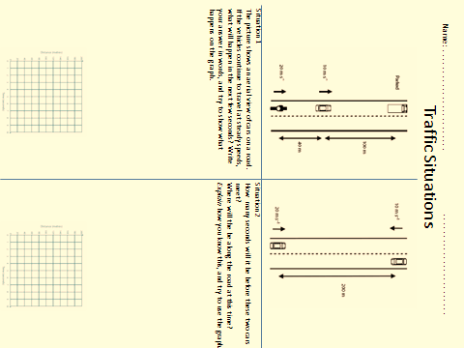
3-5 mins only
Speeding Cars
We will see exactly what happens in a computer simulation next.
Work with your partner to complete the worksheet as best you can.

Slide 11
Traffic program
The options Photos, Markers and Graphs provide increasingly formal representations. Although they can all be selected simultaneously, only the ‘lowest’ form will be displayed
Situation 1 is ‘Velocity 7’
Show ‘Road’ only initially.
Explain the aerial view of the road.
Ask several students to red out their predictions from prior worksheet
Then show animation.
Repeat animation, this time with ‘Photo’ option ticked. Play, but pause after a few seconds. Ask students to predict the following few frames on ‘Practice worksheet’.
Press play to check predictions.
Ask how you can tell from the photos that a vehicle is stationary. How do you know it is going fast?
What would sequence of photos look like is we took more photos per second?
Explain sequence of photos is a bit like distance-time graph, but:
i) without axes
ii) mark as a point, not a picture
iii)continous, like a movie, rather than discrete photos
Then show with just the ‘Markers’ option selected.
Finally show with just the ‘Graph’ option selected.
How can you see the overtaking on the graph?

Slide 12
Traffic program
Situation 2 is ‘Velocity 5’
Repeat similar to before, but try to get students to predict using Practice distance- time graphs rather than Practice Photos. Revert to Practice Photos if they struggle.

Slide 13
Paired Work
Pairs of students to explore and predict the graphs for the different scenarios.
Alternatively, I just display selected scenarios.
In all cases:
select a scenario
view it just with ‘Road’ option selected.
discuss verbally what’s happening.
Draw, on Practice sheets (Photos or Graphs) what is happening.
Replay scenario with appropriate options selected, in order to check results.
Velocity 1
Velocity 2
Velocity 3
Velocity 4
Velocity 5
Velocity 6
Velocity 7
Velocity 8
Velocity 9 Do not study this one initially
Velocity 10 Do not study this one initially
When confident, each accurately complete a ‘Photographs and Graphs’ sheet to show me your best work for Velocity 9 and Velocity 10 scenarios.

Slide 14
Finish with laptops.

Slide 15
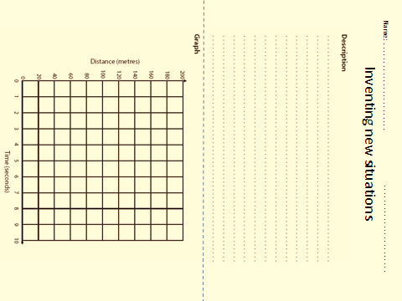
Create a New Scenario
Now use this worksheet to write your own traffic scenario. Include either 2 or 3 vehicles, and describe their precise speeds, and when they start and stop.
Complete the graph of your scenario too.
Try a second one too if you’ve time.
Fold your scenario in half (hiding the graph) and swap your scenarios with those from another pair.
Now, using their description, try to accurately re-create their graph on this worksheet.

Slide 16
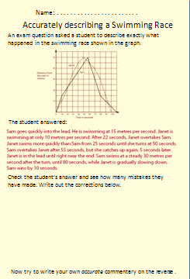
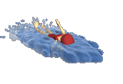
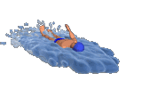
The Swimming Race
First look at the scales on the graph.
What can we immediately see from the graph?
Who wins the race?
Who wins the race?
Why does the graph have a point at the top?
How many lengths do they swim?
Is it a 25m length pool, or a 50m pool?

