Slide 1
Standards Unit A4: Evaluating Algebraic Expressions
though don’t need this terminology
Level 6-7?
Distinguishes between equations, inequations and identities
An ALWAYS, SOMETIMES, NEVER activity.
‘Cards’ are classified, and a poster made – but it’s a ‘working document’ and will not be neat! Photos are a much better way to capture display material from the session.
Students work in threes or pairs.
1 hour.

Slide 2
Consumable Resources Needed:
Each pair needs just 1 A4 copy of the ‘Cards’. Be useful to print it on light blue card, to make them easier to handle and (later) stick on poster
A3 pastel coloured Poster paper.
Re-usable Resources Needed:
Camera.
Mini-whiteboards for plenary assessment.

Slide 3
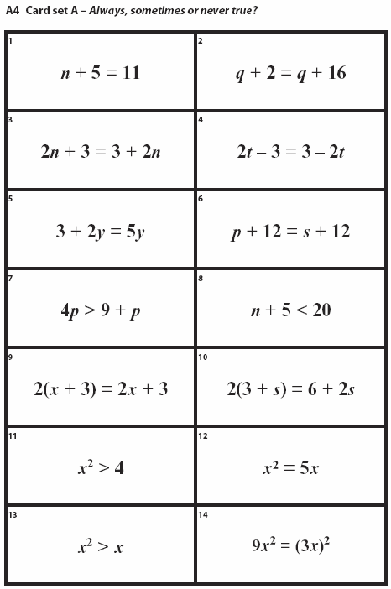

Slide 6
Pre-assign groups.
If all members can be trusted to participate, best to work as group of 3.
But pairing may be required for free-riders.
Expect students to ‘jump in’ and quickly and incorrectly stick down some of their cards. Challenge them. Allow them to correct work with arrows etc. Messy is good – evidence of learning!
Do not attempt to explain solutions until the final plenary. Just challenge them with…’but what about’. A key teaching objective is for students to learn how they really need to think hard in order to get them right.
Giving them answers too quickly will not achieve this goal.
Also, go through the answers very quickly, even if students still don’t understand everything. Too long spent on it otherwise.
Bigger learning lesson is that must use fractions, negatives and zero more.

Slide 7
Understanding Algebra Even Better
$$x+y=xy$$
Is this statement TRUE or not?
Are there some values of x and y that prove it is not always true?
Examples?
Are there any values of x and y that make the statement true?
Examples?
Note: x and y do not have to be different values. They represent the numbers of different things, say apples and oranges, perhaps.
There might be the same number of apples, as oranges. Or they might be different.
The statement above is SOMETIMES true.

Slide 8
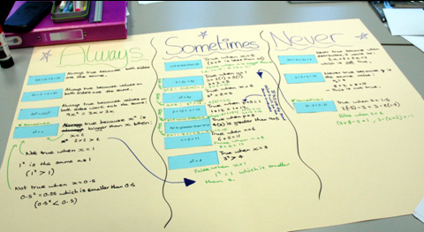
Your Task
I will give you a set of cards (you will need to cut them out).
I want you to produce a Poster which shows whether each statement is ALWAYS, SOMETIMES or NEVER true.
Your poster must give your reasons, and detailed examples that help prove you are right.

Slide 9
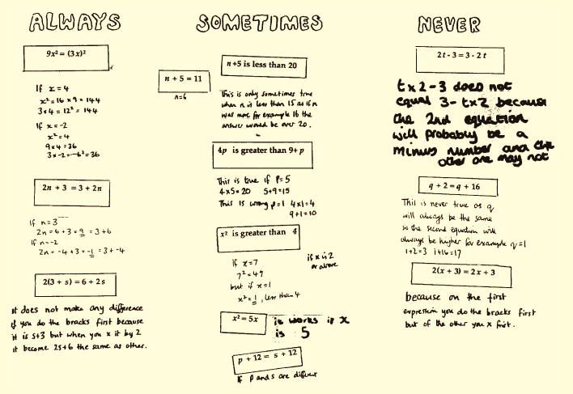
Suggestions
1. Write the three categories on your poster.
2 . Only stick your cards down when you’ve discussed it carefully!
3. As well as trying ‘easy’ values like 2, 3, 5 etc, try fractions, negative numbers, zero, and one.

Slide 10
Answers…
S
N
A

Slide 11
Answers…
S
S
S

Slide 12
Answers…
S
S
N

Slide 13
Answers…
A
S
S

Slide 14
Answers…
S
A

Slide 15
Ask students to justify their answers
Assessment Quiz
Decide whether the following Statements are:
Always true (A)
Sometimes true (S)
Never true(N)
$$x+2=3$$
$$n+12=n+30$$
$$x+6=y+6$$
$$x+y+z=y+z+x$$
$$3n>n+3$$
$$x^{2}>2x$$

