Slide 1
Standards Unit A1: Interpreting Algebraic Expressions
Suitable for Level 5? (ideally, just before single bracket expansions)
Must be competent with areas of compound rectangles, and algebraic expression including division.
This unit develops the ideas presented in N5, in their pure number context.
?
Do not use my cards. There’s a great deal of benefit in just using paper ‘cards’, because there’s a lot of writing to be done on them. Students should cut them out, and stick them on poster-size paper as originally intended. This also ‘fixes’ their answers and ensures no-one ‘misses out’ anything.
1 to 2 hours. Teams of 2 or 3 are okay.

Slide 2
Consumable Resources Needed:
Each pair needs a copy of each A5 card sheets (PRINT EACH A4 worksheet on different coloured paper).
Each pair one large A3 –sized white sheet for poster.
Blu-tac, Glue, scissors, pens.
Each student needs to have a copy of the ‘Perpendicular Bisector’ template. This
Re-usable Resources Needed:
Camera. Definitely.
Plastic A5 wallets containing the 4 (different coloured) card sheets use during session
Little plastic wallets to temporarily hold groups of cards mid-way through session.

Slide 3
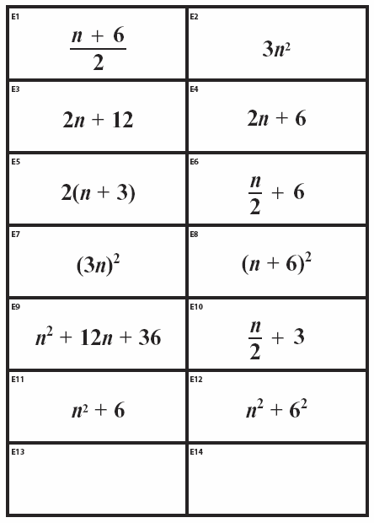

Slide 4
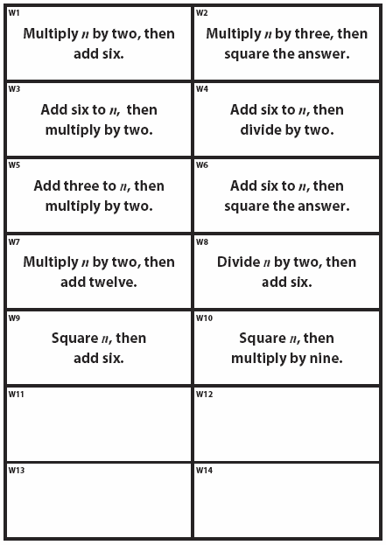

Slide 5
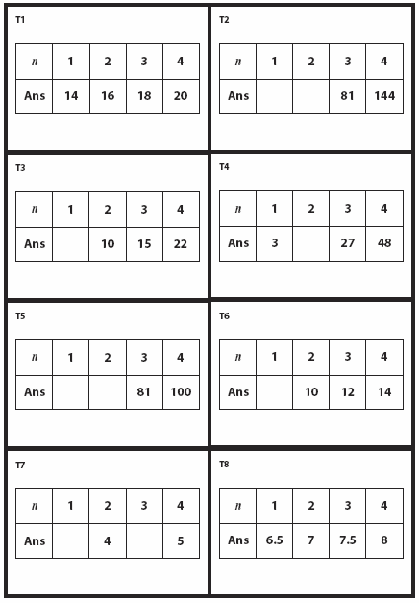

Slide 6
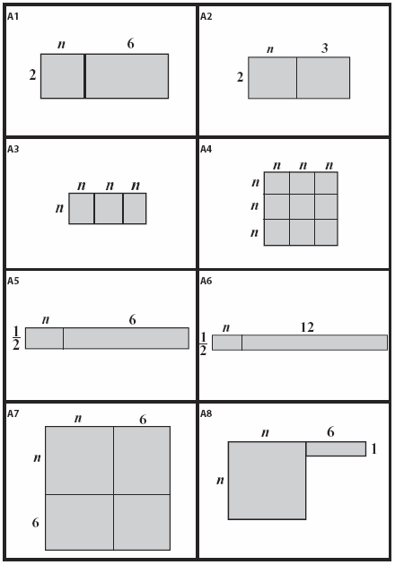

Slide 7
Students start with mini-whiteboard activity to remind them of … etc.
They can work together if they get stuck on a question.
My ‘starter’ slides are too long. This is covering stuff that the students themsevles are meant to be discovering / embedding in the first activity!!
Pre-assign partners too.
NOTE: Some of the expressions are equivalent. There are fewer ‘Table’ cards as well (for good reason). Let the students discover all this, and wok out why. Do not explain too early.

Slide 8
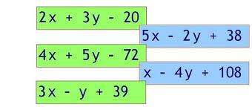
Algebraic Expressions
Write down three different algebraic expressions
A very simple one.
A medium one.
A hard one!

Slide 9
Show me an algebraic expression that means:
Multiply n by three, and then add four

Slide 10
Show me an algebraic expression that means:
Add four to n, then multiply your answer by 3

Slide 11
Show me an algebraic expression that means:
Add two to n, then divide your answer by 4

Slide 12
Show me an algebraic expression that means:
Multiply n by n, and then multiply your answer by 4

Slide 13
Show me an algebraic expression that means:
Multiply x by 6, and then square your answer
Hint?
It is not 6x²

Slide 14
Take turns reading these expressions out loud to your partner:
3p + 2q - 7
4x²+5
(n + 2)²
n + 2²

Slide 15
In Pairs, cut out and match-up these two sets of cards
Note: some cards do not have a match – you will need to write cards to make a match for them

Slide 16
Now match up these Tables with the pairs too.
Write all the missing values in the ToV’s

Slide 17
What are you finding?
There’s fewer Tables. Some Tables match more than one pair. Do not explain why yet, even if students guess etc.
Encourage students to group together any expressions they think are equivalent
I will take photo’s of the matching achieved so far, and written completion of the blank cards and Tables.
After I’ve done that, leave Card Set A in place, but take up Card sets B and C (remove blu-tac, and carefully place all these cards in plastic wallet for later use).

Slide 18
Match these new cards to Card Set A
Quickly stick all these paired cards onto A3 to make Poster.
Write notes explaining why they match.
Can stick your previous cards (in wallets) on too if you wish or (better, create your own ToV with more interesting numbers)

Slide 19
A bit like this, but with notes around the side explaining why they match

Slide 20
Extension work
How could we represent expressions containing subtractions?
Draw diagrams to show:
$2\left(x−3\right)$
$\left(x+3)(x−3\right)$
$x^{2}−9$
${(x−3)}^{2}$
$x^{2}−6x+9$

Slide 21
Poster Reviews
What have you learnt?
Mini-whiteboard quiz next…

Slide 22
Q1 & Q2
Draw me an area representing: $3(x+4)$
Now write an equivalent expression that gives the same area.

Slide 23
Q3 & Q4
Draw me an area that shows: ${(4y)}^{2}$
Now write an equivalent expression that gives the same area.

Slide 24
Q5 & Q6
Draw me an area representing: ${(z+5)}^{2}$
Then write a different expression that gives the same area.

Slide 25
Q7 & Q8
Draw me an area representing: $\frac{w+6}{2}$
Then write a different expression that gives the same area.

Slide 26
Q9
Discovered anything?
What do you still find hard?

Slide 27
Q???
Take turns trying to read these expressions to your partner:
(x + y²)²
(2x + 5y²)² – 6y
Challenge! 4(3x - 9y²)² – 6y²

