Slide 1
Standards Unit A10:
Connecting Perpendicular Lines
Suitable for very high ability students at Level 6, good Level 7 or Level 8 students?
It’s the card matching that’s challenging.
Super lesson!
.
Students need to work in PAIRS.
90++ mins. Teams of.
My cards are almost pointless – not many of them and too much hassle collecting etc. Paper versions fine
Learners need etc.

Slide 2
Consumable Resources Needed:
Each pair needs sheets of grid paper with pre-drawn axes.
Each pair needs 1 A5 copy of the ‘cards’. They needn’t be cut out at all – they are just a list of equations. In fact, best left uncut so they can be written on (standard form of equation).
Each pair needs a ‘Properties’ worksheet onto which the pairs of (line) equations are written, or stuck, or placed.
Each student needs to have a copy of the ‘Perpendicular Bisector’ template. This
i.e. 3 A4 sheets, and one A5 sheet per pair of students
+ pre-drawn graph paper sheets
+ mini-whiteboard
Re-usable Resources Needed:
Camera to record group-work.
Extremely useful to have Geogebra on standby to illustrate anything causing difficulty

Slide 3
Names: . . . . . . . . . . . . . . . . . . . . . . . . .
Assessment comments

Slide 4
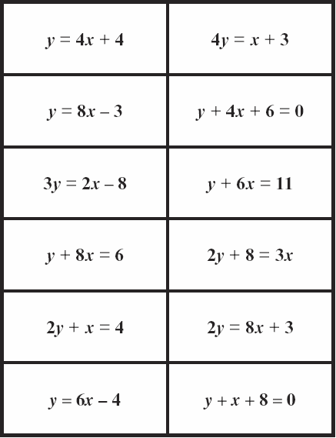
List of Straight Line Equations
List of Straight Line Equations

Slide 5
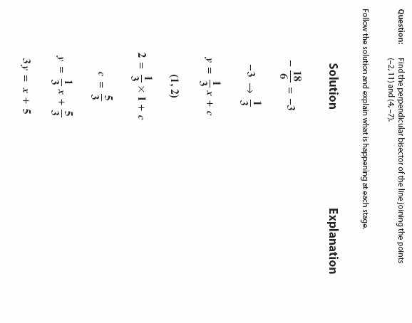
Name: . . . . . . . . . . . . . . . . . . .
Assessment:

Slide 6










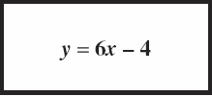

Do not print this sheet.
Useful only because it contains ‘exploded’ versions of equations, though no real use for this found

Slide 7
Students start with mini-whiteboard activity to remind them of gradients etc.
They can work together if they get stuck on a question.
Pre-assign partners too.
Pre-distribute grid paper too. Ensure students have rulers and pencils.

Slide 8
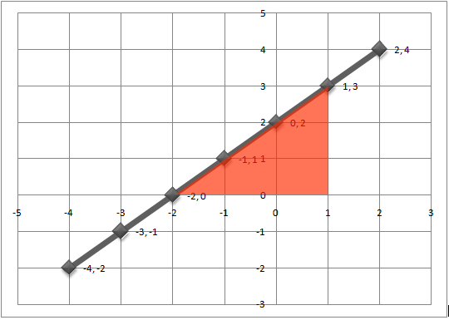
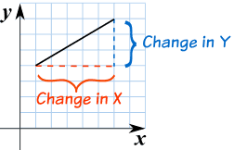
What is the slope of this line?
Hint:

Slide 9
What is the mathematical name for slope?
(begins with a ‘G’)
What is the letter that represents the gradient of the line in the equation y = mx + c ?

Slide 10
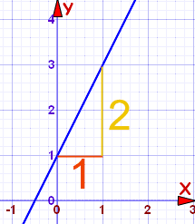
What is the gradient of this line?

Slide 11
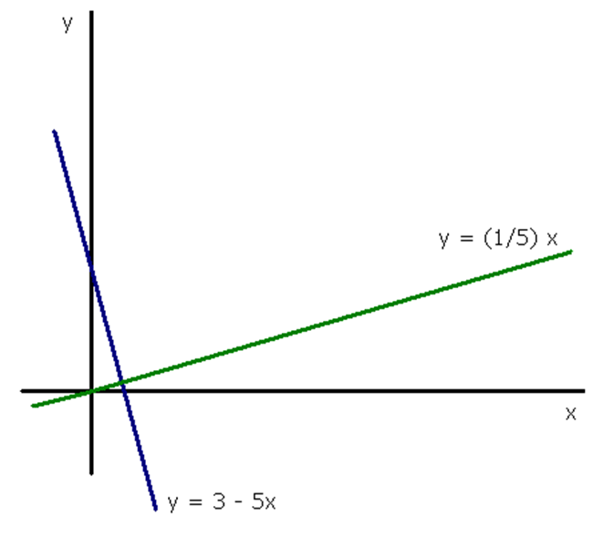
The blue and green lines are said to be….?

Slide 12
Which of these lines has a gradient of approximately 4?
B
A
D
C

Slide 13

ESTIMATE the gradient of this slope

Slide 14
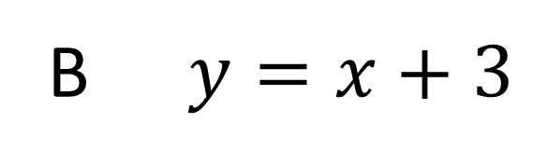
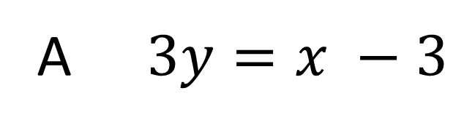
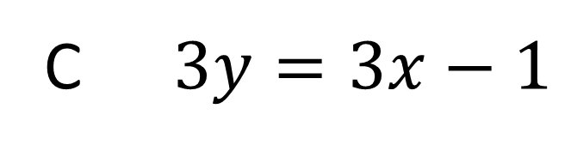
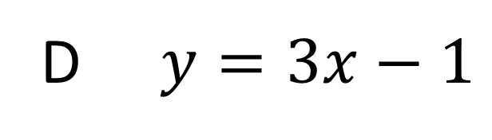
Which of these straight lines has a gradient of 3?
A $3y=x −3$
B $y=x+3$
C $3y=3x−1$
D $y=3x−1$

Slide 15
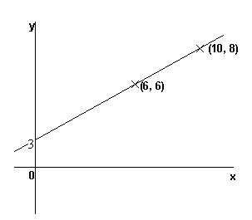
What is the slope of this line?

Slide 16

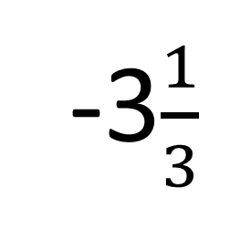
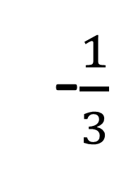
Estimate the gradient of this line.
-3$\frac{1}{3}$
$$\frac{1}{3}$$
-$\frac{1}{3}$
3

Slide 17
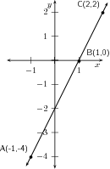
What is the slope of this line?

Slide 18
Which of these straight lines has a gradient of 3?
A $3y=x −3$
B $y=x+3$
C $3y=3x−1$
D $y=3x−1$

Slide 19
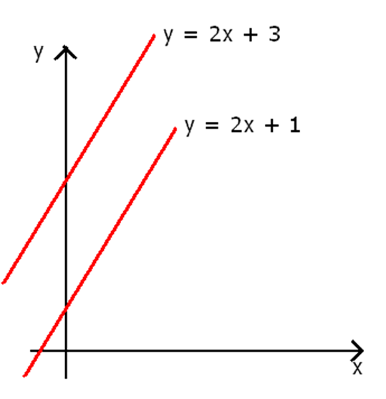
The two red lines are said to be….?

Slide 20
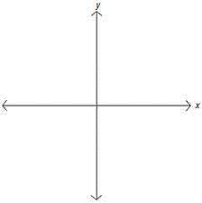
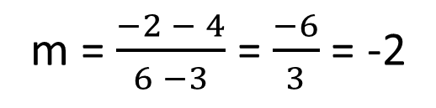
What is the slope (gradient) of the line between Points A and B?
A is at ( 6, -2)
B is at ( 3, 4)
m = $\frac{−2 − 4}{6 −3}$ = $\frac{−6}{3}$ = -2

Slide 21
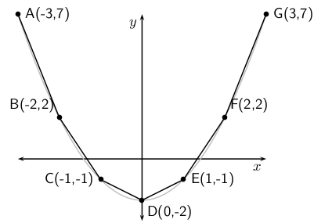
What is the slope of this curve between Points F and G?

Slide 22

Copy these axes and draw a line whose gradient $≈$ -2

Slide 23
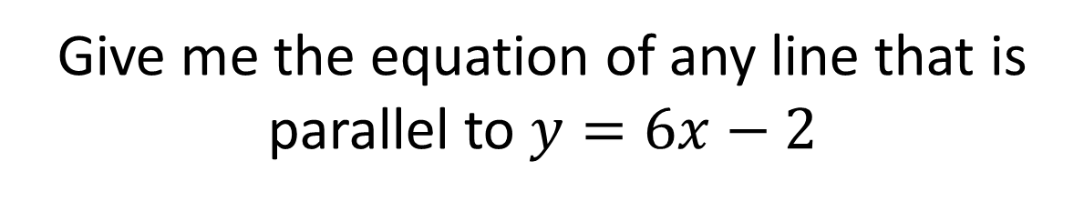
Show me the equation of any line whose gradient is -0.6
Give me the equation of any line that is parallel to $y=6x−2$
Show me the equation of a line that has a gradient of -5 and intercepts the y-axis at -5.

Slide 24
Students will now need grid paper.

Slide 25
Gradients of Perpendicular Lines
Working with your partner…
1. Accurately draw a line of gradient 2.
2. Accurately draw a line perpendicular to this.
3. Measure the gradient of the perpendicular line.
4. Copy this table.
 | First line | Perpendicular line
1 | 2 | ?
2
3
…
…
5. Draw other pairs of perpendicular lines are record their gradients in the table. Can you see a pattern?

Slide 26
What have you found?
 | First line | Perpendicular line
1 | 2
2
3
4
5
6
7
…
So, the gradients of perpendicular lines . . . . . . . . . . . . . . . . . .

Slide 27
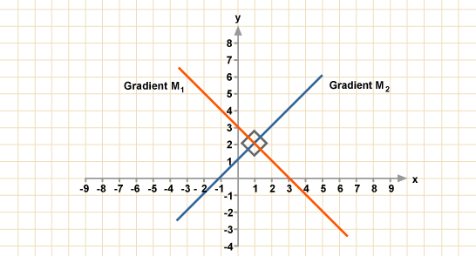
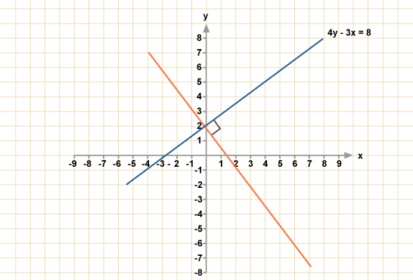
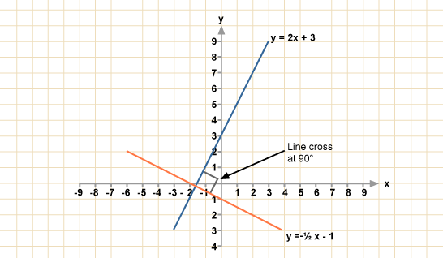
m₁ x m₂ = -1

Slide 28
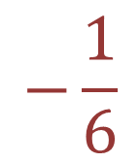

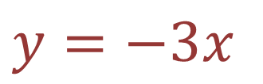
Practice Questions
If a line has a gradient of 6, a line perpendicular to it will have a gradient of…?
$$−\frac{1}{6}$$
Give an example of a line perpendicular to:
$y=\frac{1}{3}x−2$
$y=−3x$

Slide 29
Challenge Task: Match Lines to Properties
?
Match two equations to each of the cells in the worksheet.
When finished, try to find what the two final equations have in common and then complete this sentence

Slide 30
How have you started?
Any good ideas?
Convert all the straight line equations into their Standard form
y = mx + c
What should be done next?

Slide 31
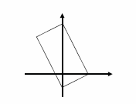
Extension Task for Early Finishers
Find 4 possible equations to make this shape

Slide 33
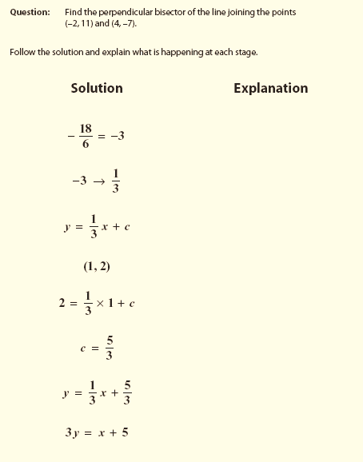
Exam-style Question Template
What does the question mean?
How might we expect to do it?

Slide 34
Assessment

