Slide 1
Core 4
Revision Past Paper Questions
(Edexcel)
Go back to home screen to select a topic
Go back to topic screen to select a question
Go to the mark scheme for that question
Go back to the question from the mark scheme
Or see more solutions
Or go back to first solutions
Next

Slide 2
Notes on operating this resource
When creating this, I used and to quickly navigate between slides directly before or after the slide in question.
As some mark schemes give additional notes, you can continue to see answers by clicking but you will not return to the original question with one click of .
To view the original question again, continue to click which should take you back.
Next

Slide 3
Notes on C4
There is an expectation that you can answer questions using knowledge of C1 and C2 – do not forget these parts
Partial fractions and the trapezium rule appear on most, but not on every paper, so do not panic if you have not used them at any stage in your exam
The most marks which are available for any topic are for integration (sometimes over a third!)
There are 8 Questions in each Paper on average
Next

Slide 4
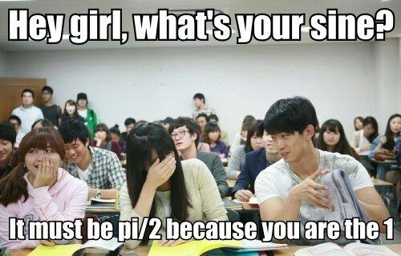
Home
Binomial Expansion
Differentiation
Integration
Parametric Equations
Vectors
Partial Fractions
Cheat sheet example

Slide 5
Differentiation
Jan 2006 (i)
Jan 2008 (i)
Jan 2010 (i)
Jan 2012 (i)
June 2014 (ii)
Jan 2006 (ii)
Jan 2008 (ii)
Jan 2010 (ii)
Jan 2012 (ii)
June 2014 (iii)
June 2006 (i)
June 2008 (i)
June 2010 (i)
June 2012 (i)
June 2006 (ii)
June 2008 (ii)
June 2010 (ii)
June 2012 (ii)
June 2006 (iii)
Jan 2009 (i)
June 2010 (iii)
June 2012 (iii)
Jan 2007 (i)
Jan 2009 (ii)
Jan 2011
Jan 2013
Jan 2007 (ii)
Jan 2009 (iii)
June 2011 (i)
June 2013 (i)
Jan 2007 (iii)
June 2009 (i)
June 2011 (ii)
June 2013 (ii)
June 2007
June 2009 (ii)
June 2011 (iii)
June 2014 (i)

Slide 6
Jan 2006

Slide 7
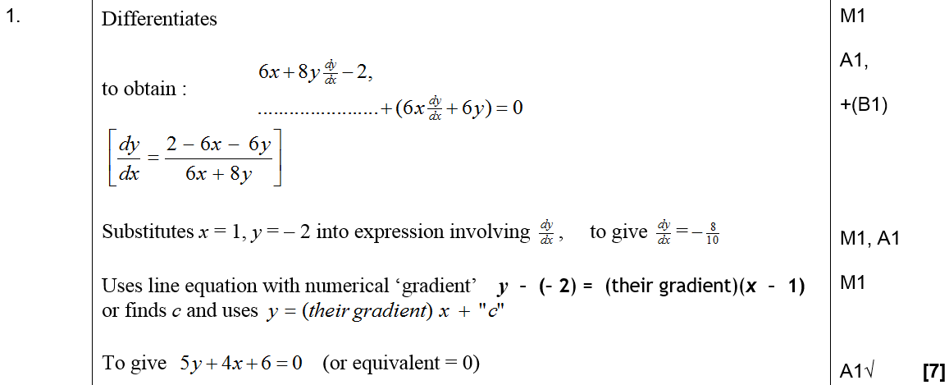
Jan 2006
A

Slide 8
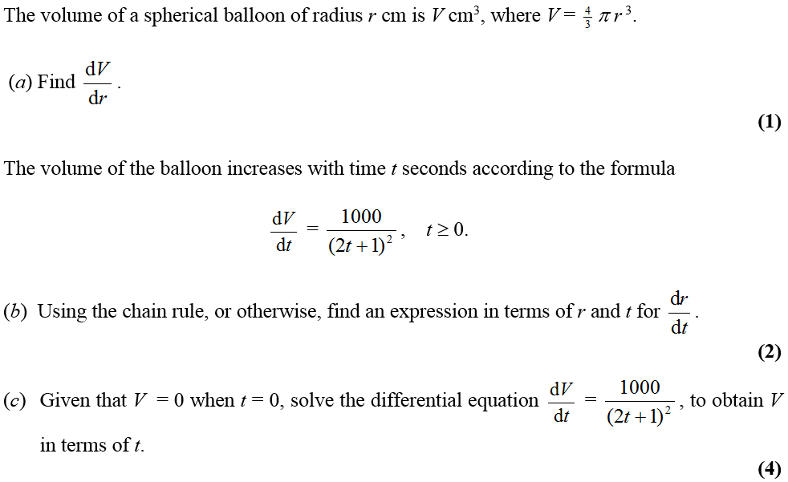
Jan 2006

Slide 9
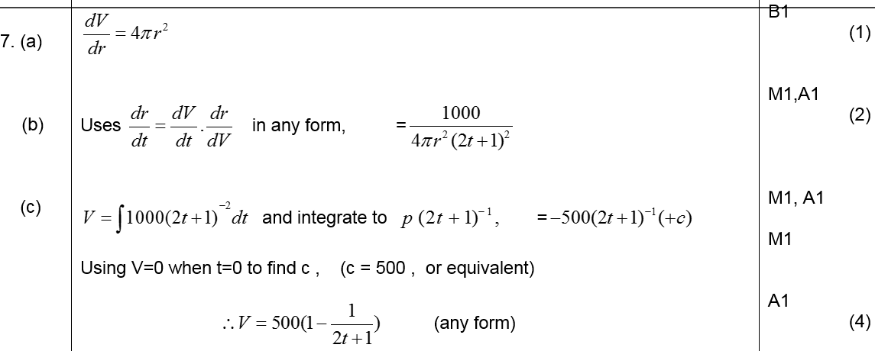
Jan 2006
A
B
C
D (i)
D (ii)

Slide 10
June 2006

Slide 11
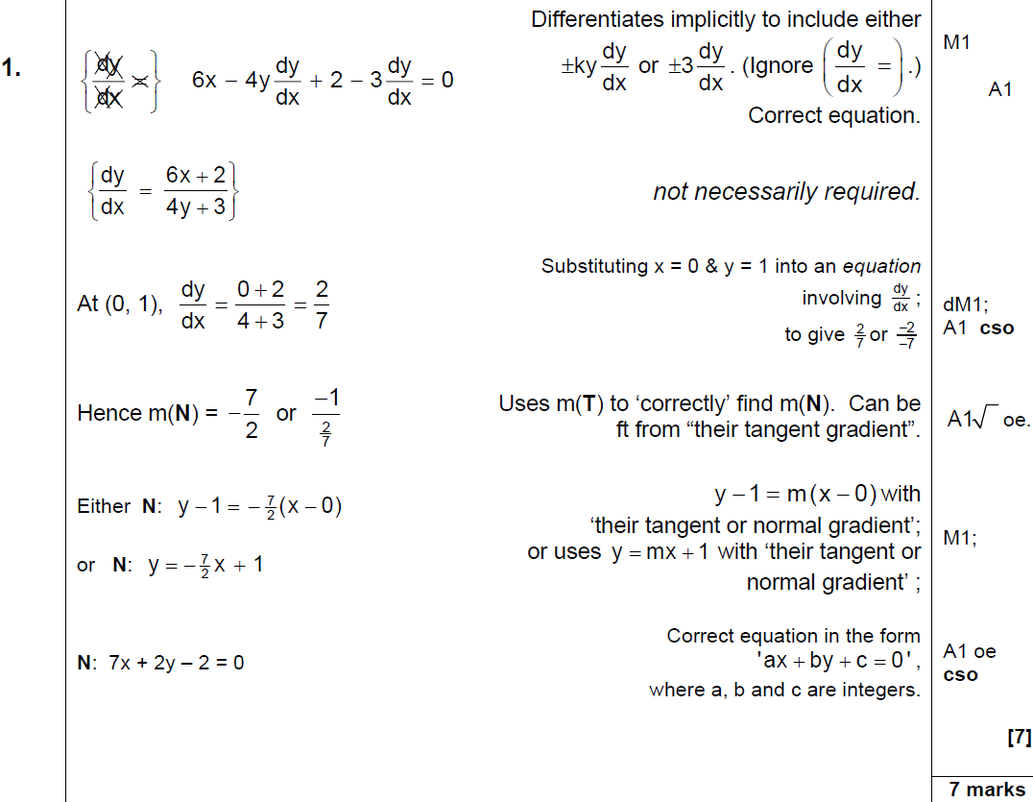
June 2006
A

Slide 12
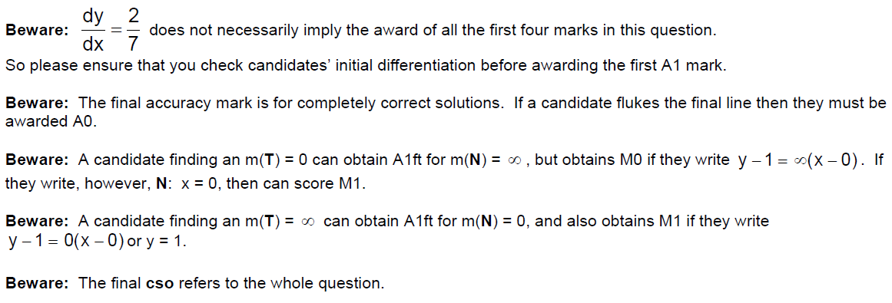
June 2006
Things to look out for

Slide 13
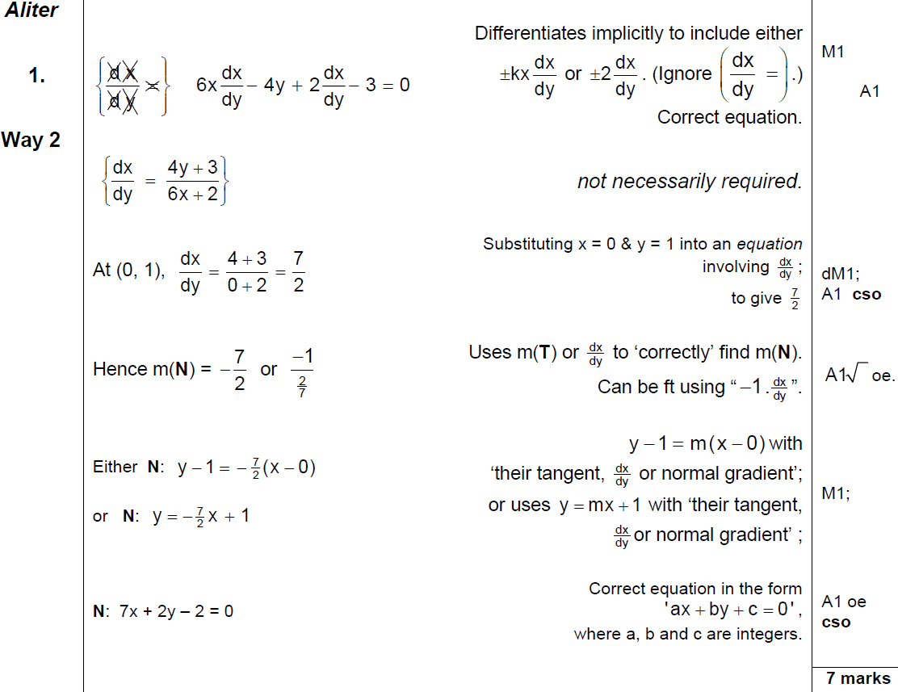
June 2006
Alternative Method 1

Slide 14
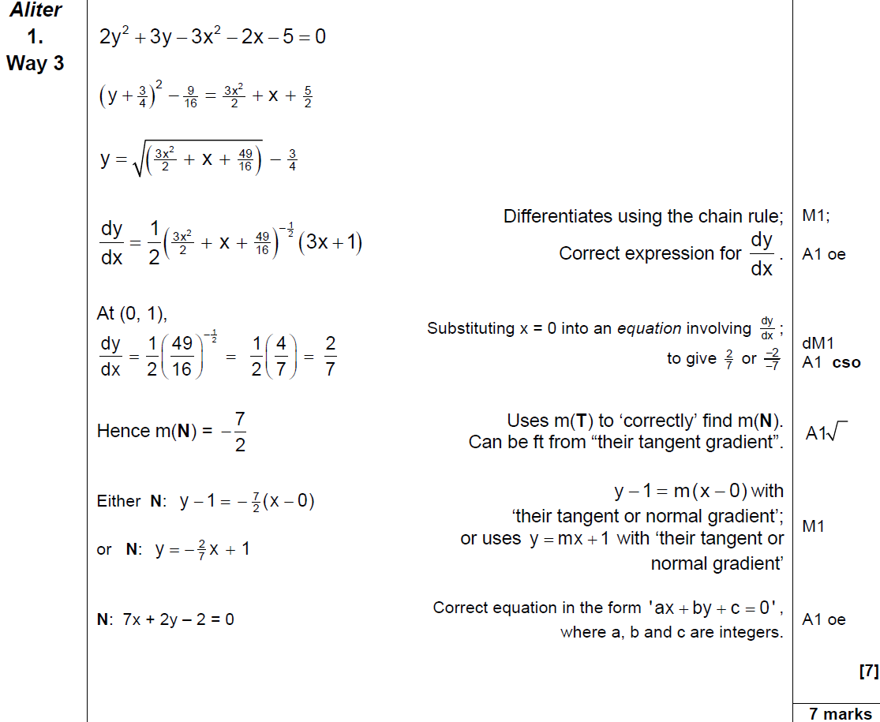
Alternative Method 2
June 2006

Slide 15
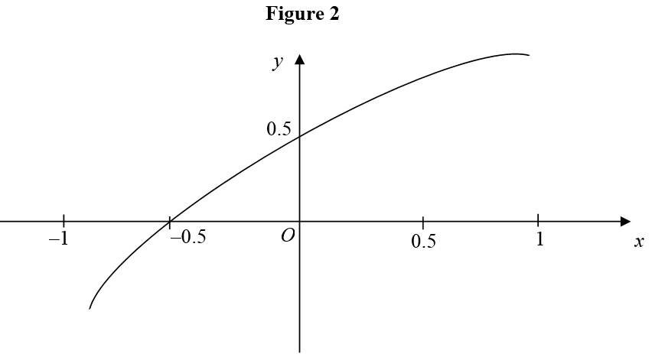
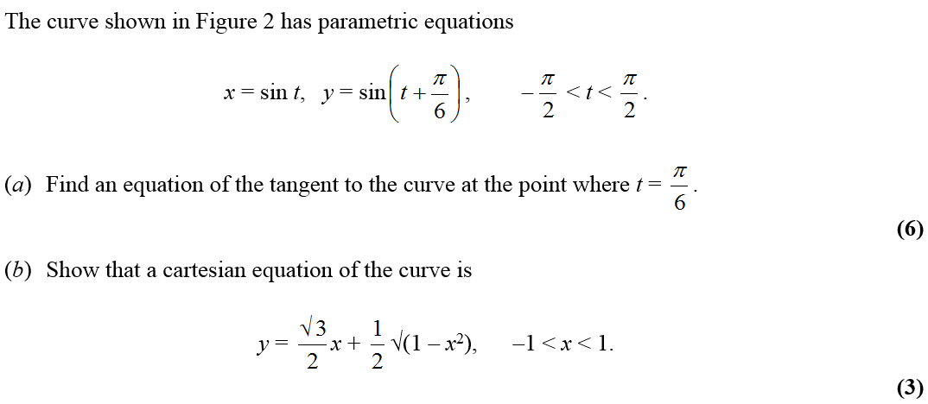
June 2006

Slide 16
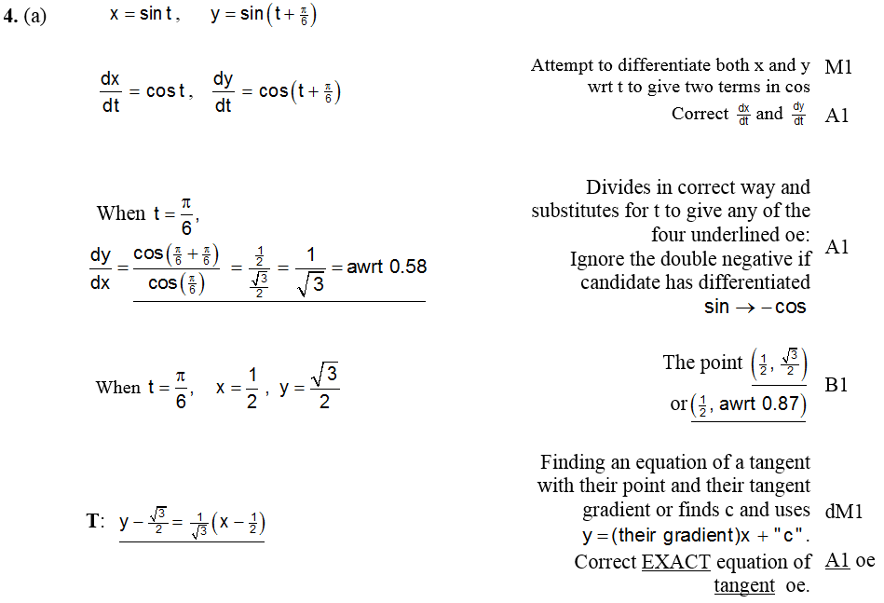
June 2006
A

Slide 17
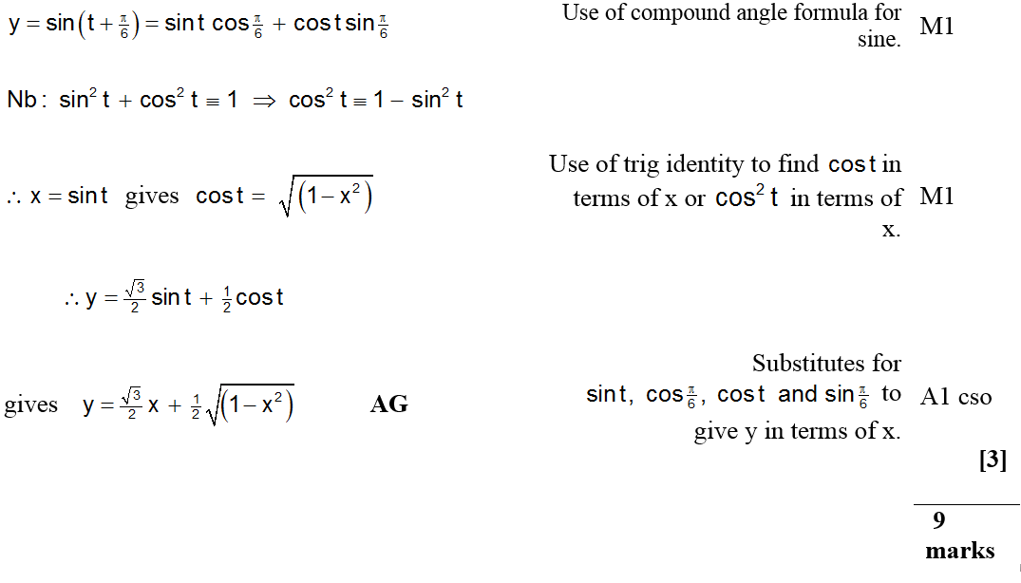
June 2006
B

Slide 18
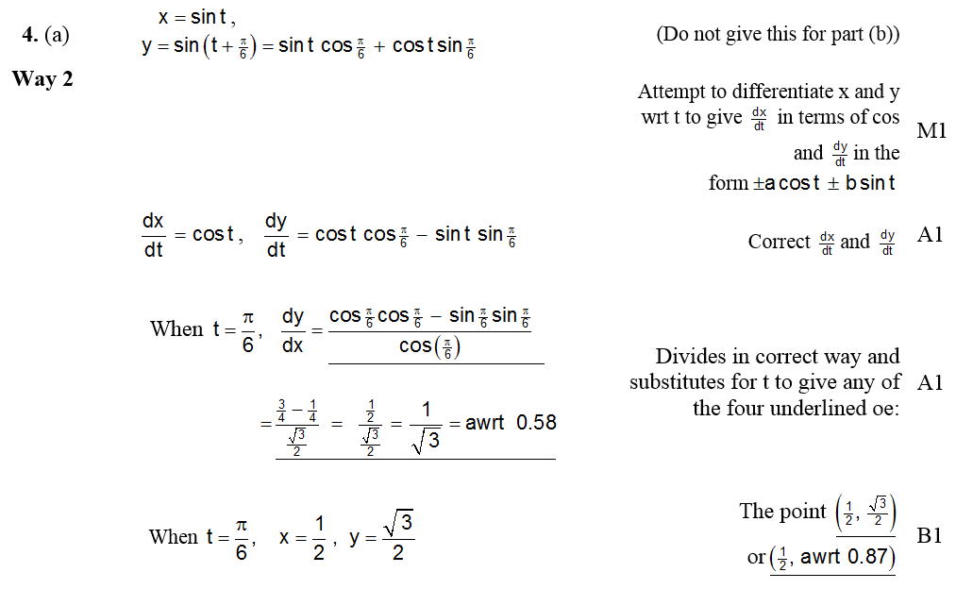
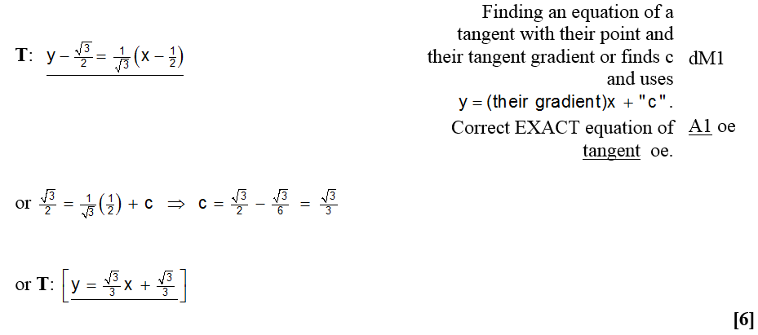
June 2006
A Alternative (i)

Slide 19
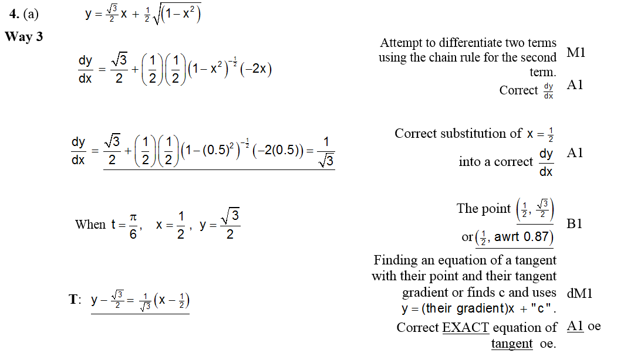
June 2006
Alternative A (ii)

Slide 20
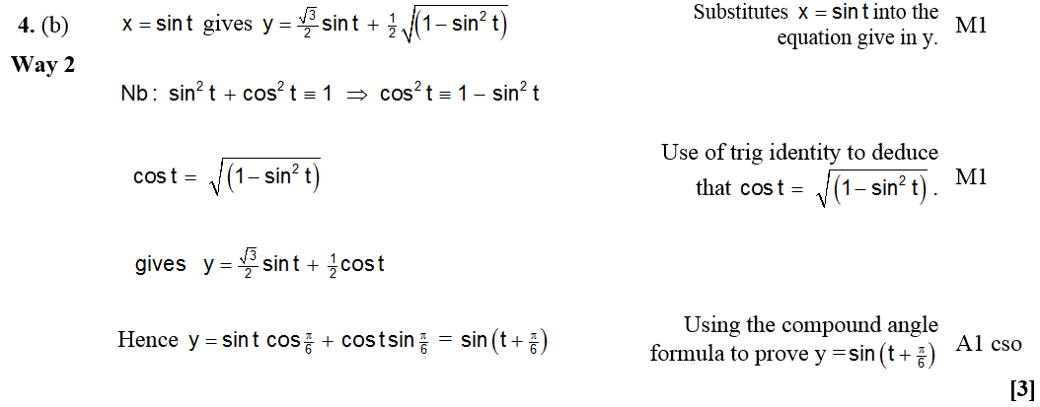
June 2006
Alternative B

Slide 21
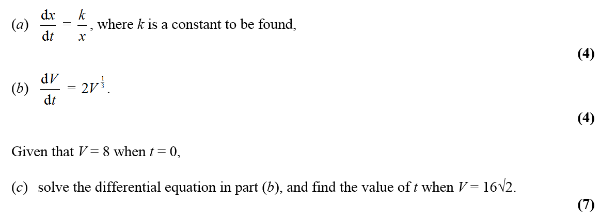
June 2006

Slide 22
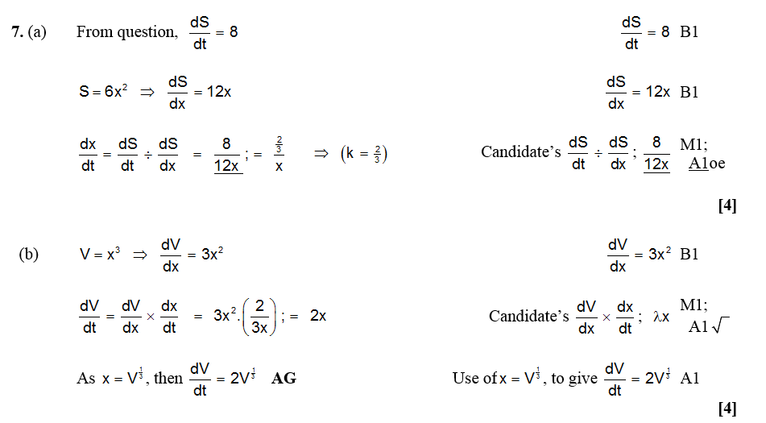
June 2006
A
B (i)

Slide 23
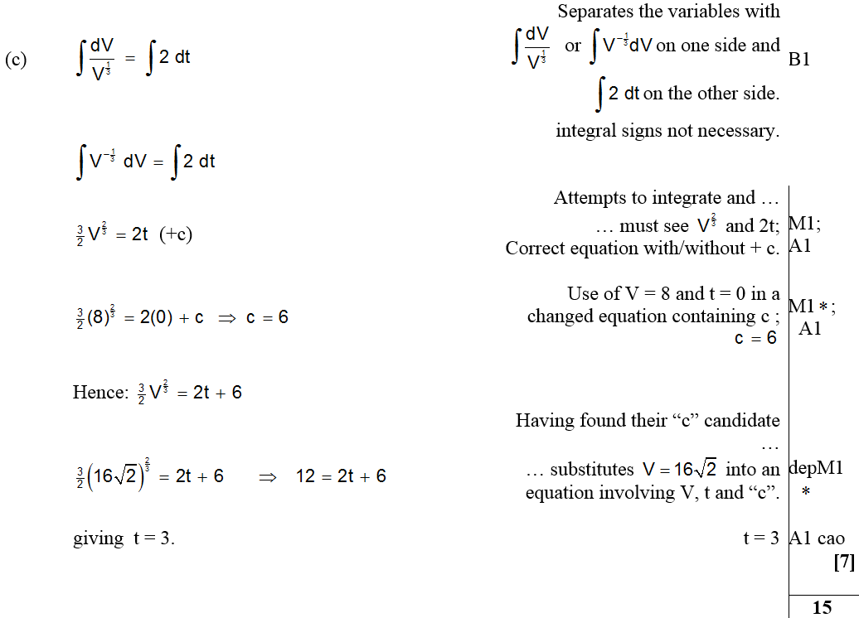
June 2006
C

Slide 24
June 2006
B Alternative (i)
B Alternative (ii)

Slide 25
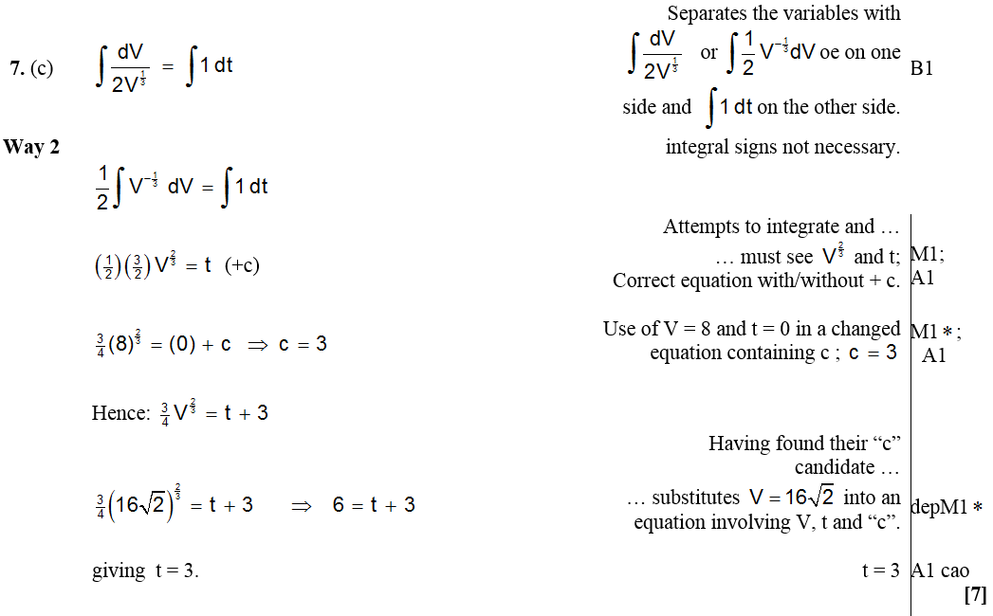
June 2006
C Alternative (i)

Slide 26
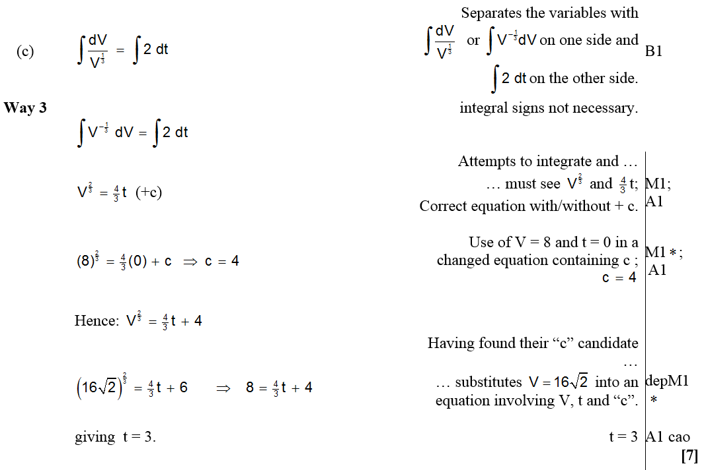
June 2006
C Alternative (ii)

Slide 27
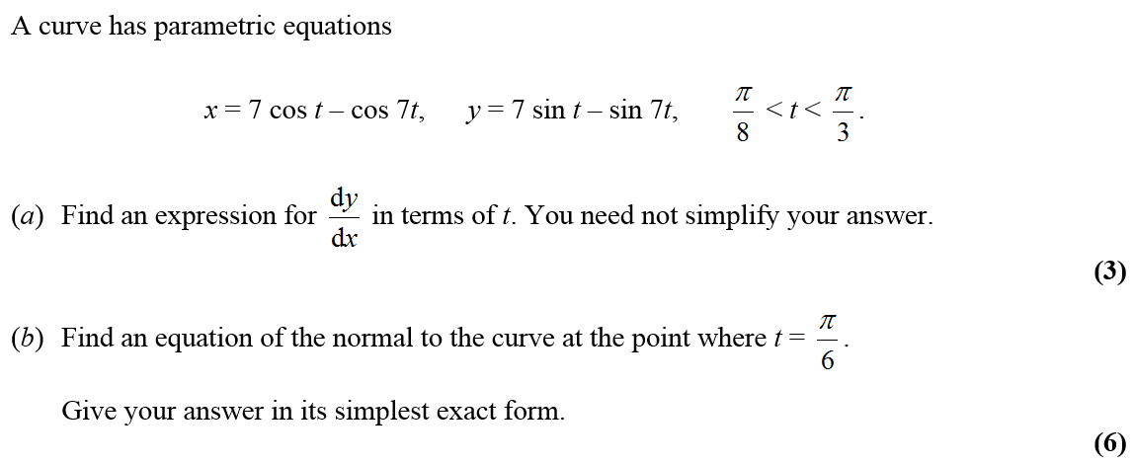
Jan 2007

Slide 28
Jan 2007
A
Alternative A

Slide 29
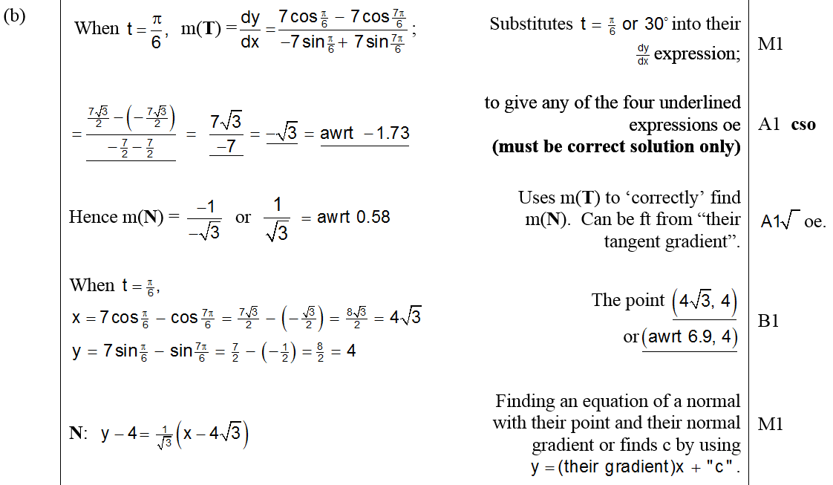
Jan 2007
B

Slide 30
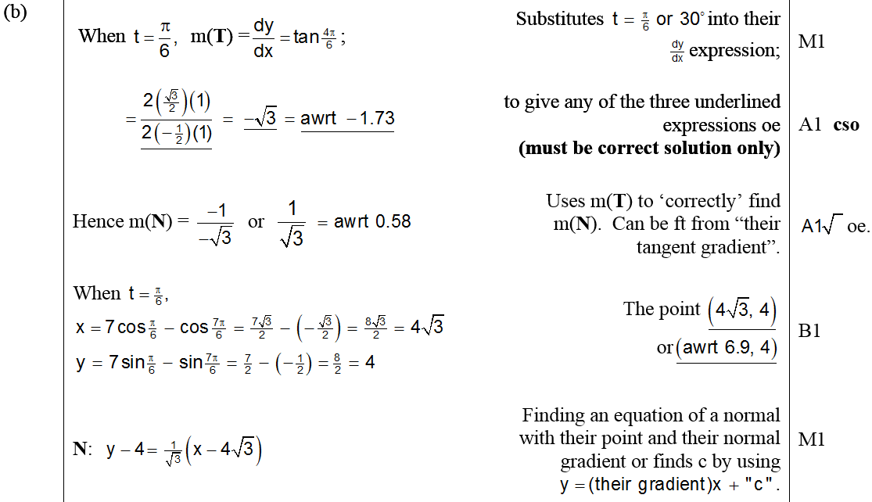
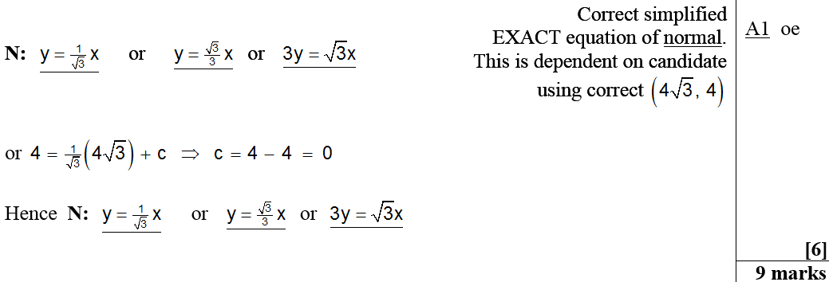
Jan 2007
Alternative B

Slide 31
Jan 2007
Beware

Slide 32
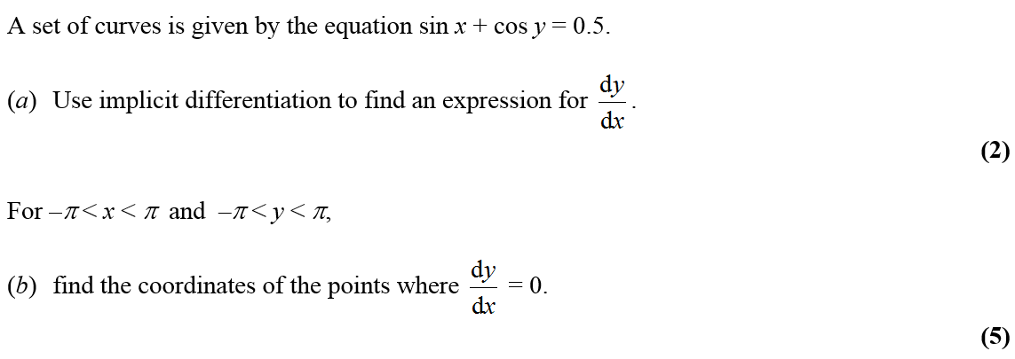
Jan 2007

Slide 33
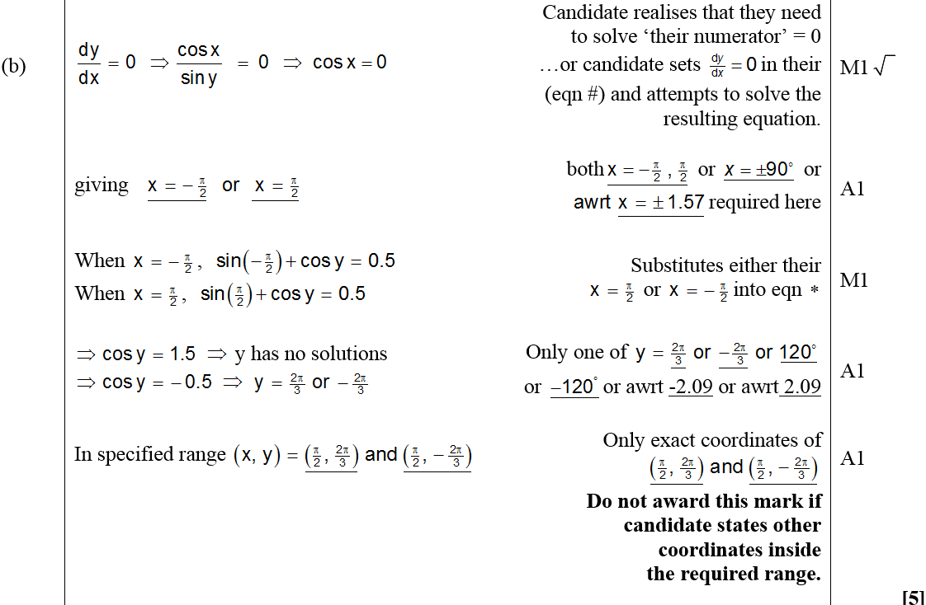
Jan 2007
A
B

Slide 34
Jan 2007

Slide 35
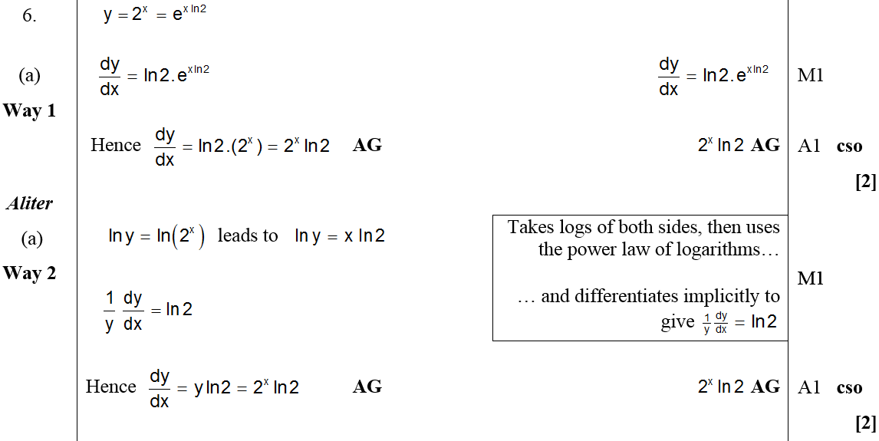
Jan 2007
A
Alternative A

Slide 36
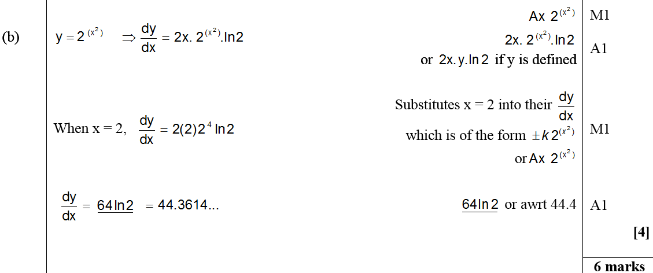
Jan 2007
B

Slide 37
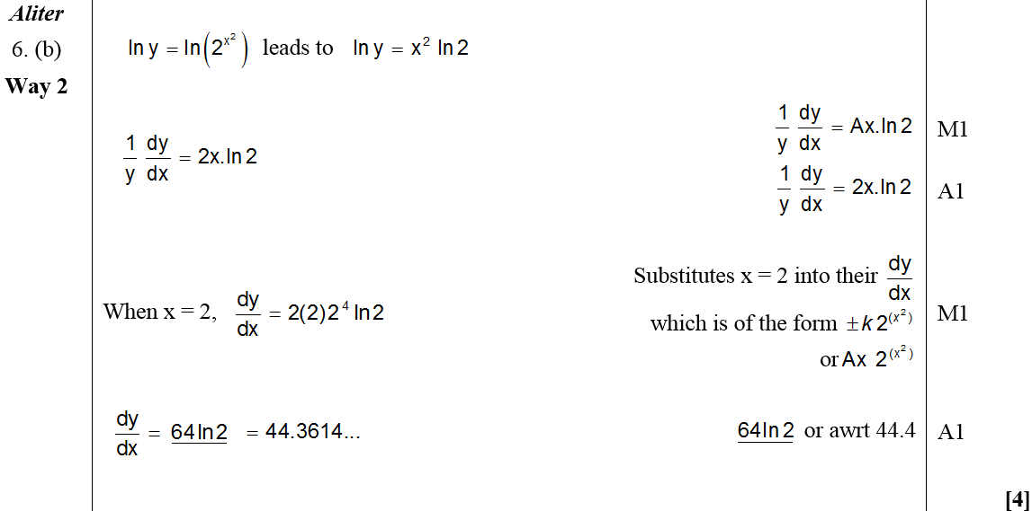
Jan 2007
Alternative B

Slide 38
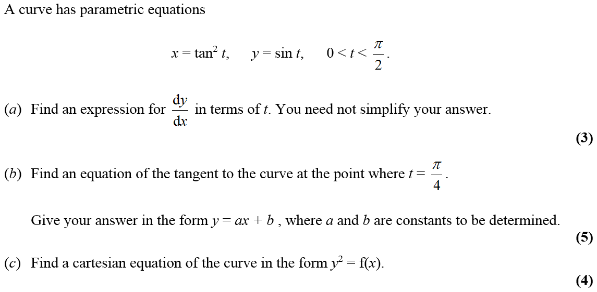
June 2007

Slide 39
June 2007
A

Slide 40
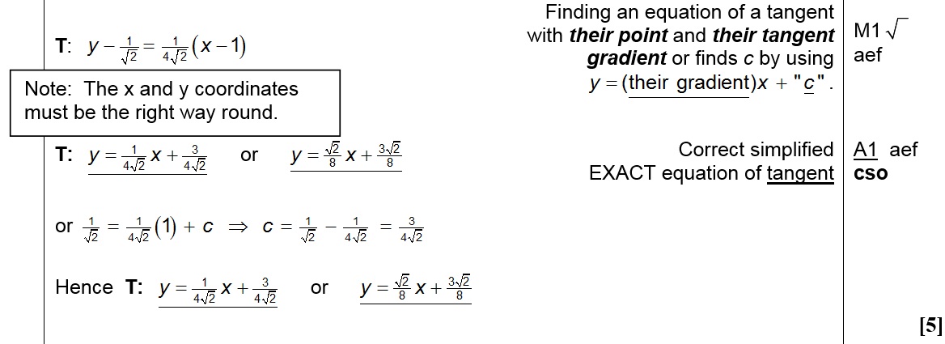
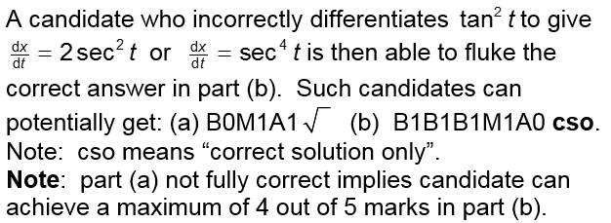
June 2007
B

Slide 41
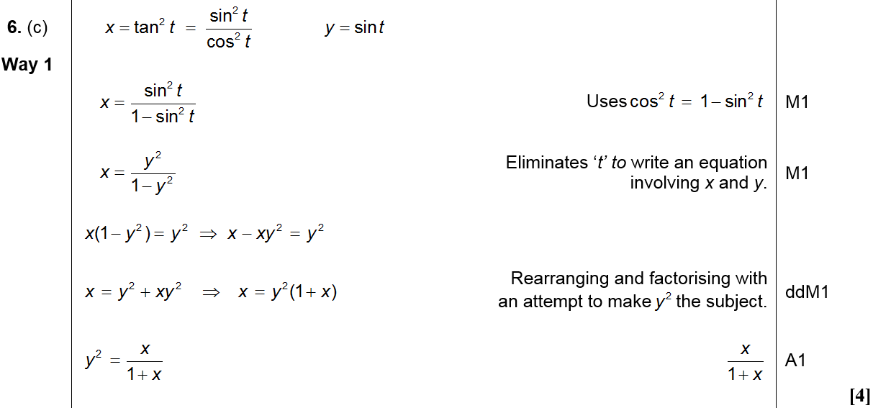
June 2007
C (Method 1)

Slide 42
June 2007
C (Method 2)

Slide 43
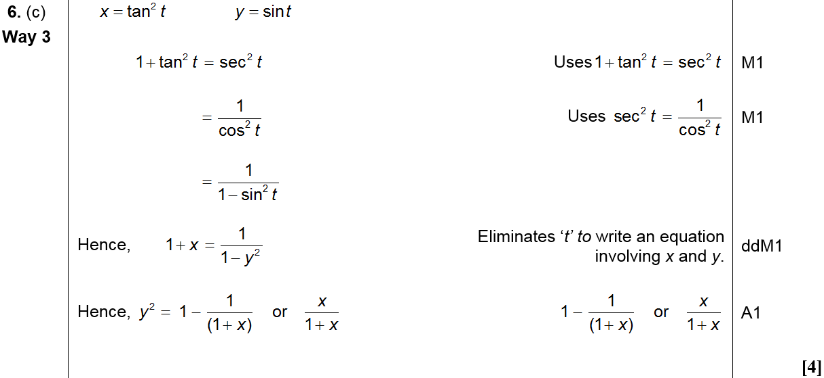
June 2007
C (Method 3)

Slide 44
June 2007
C (Method 4)

Slide 45
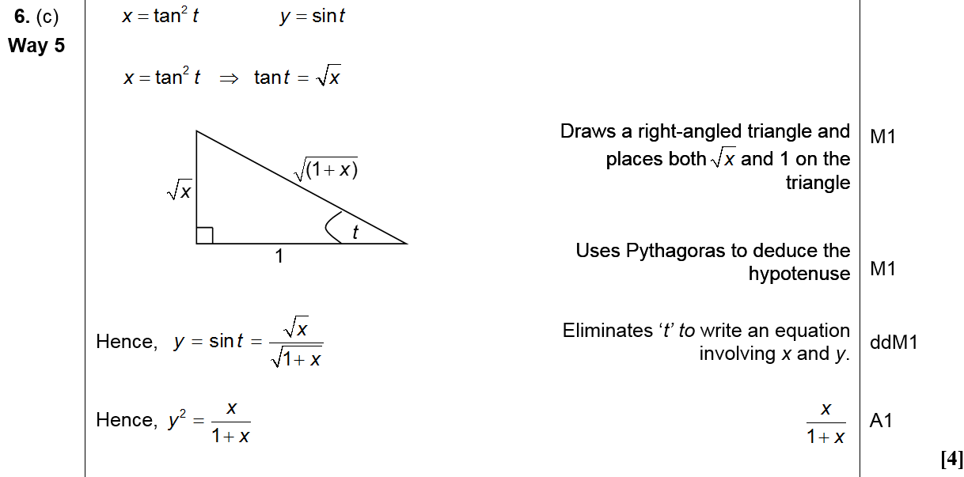
June 2007
C (Method 5)

Slide 46
Jan 2008

Slide 47
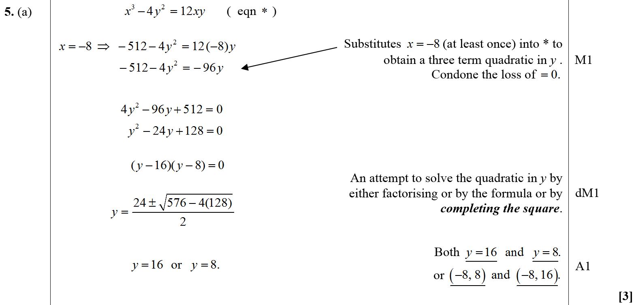
Jan 2008
A

Slide 48
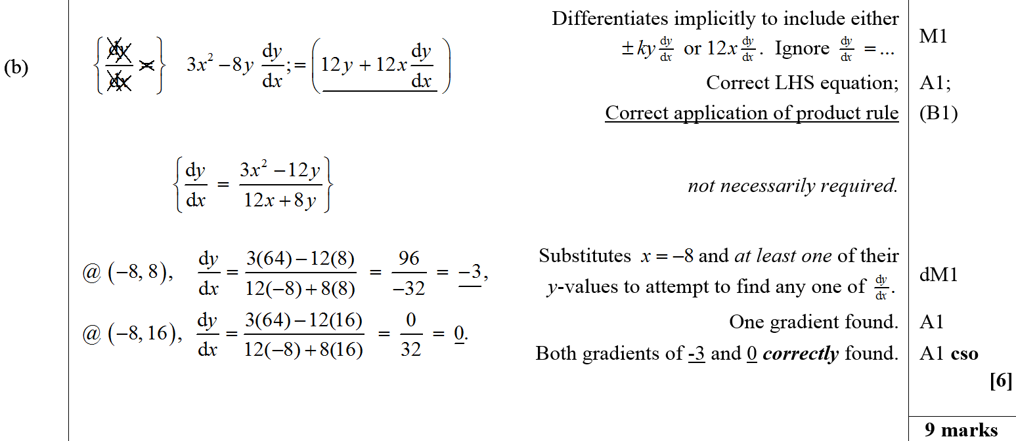
Jan 2008
B

Slide 49
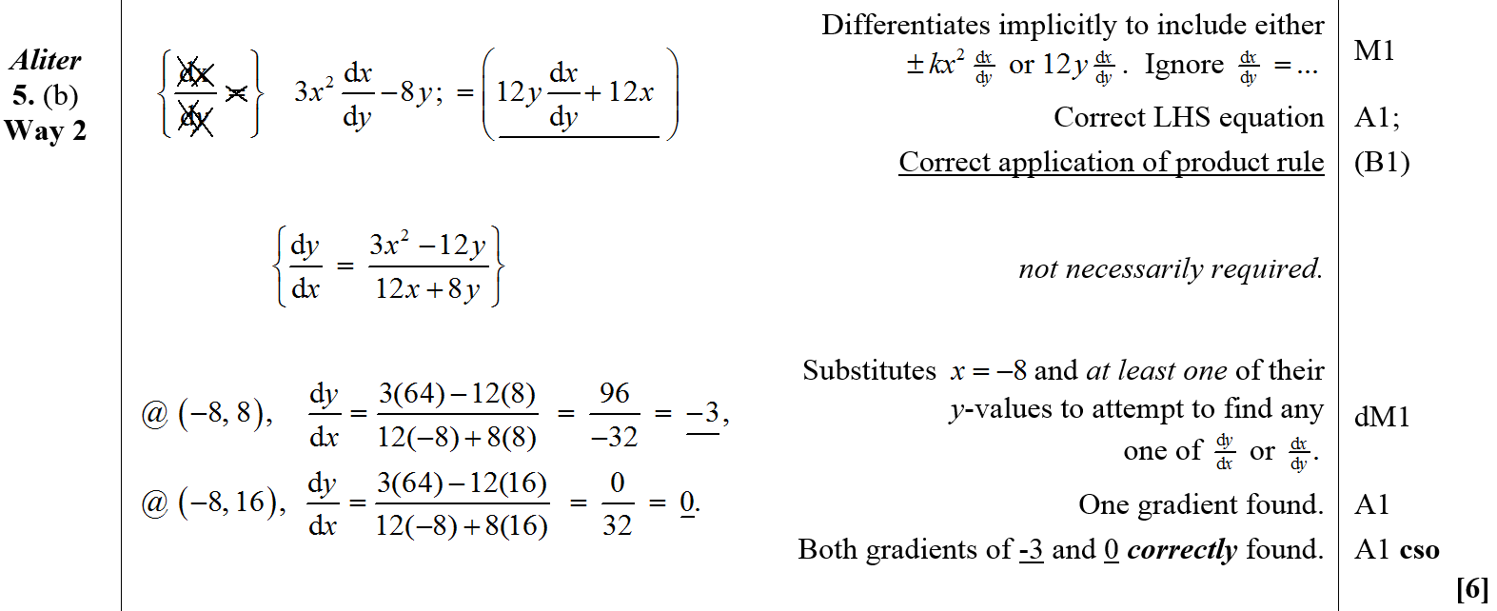
Jan 2008
B Alternative (i)

Slide 50
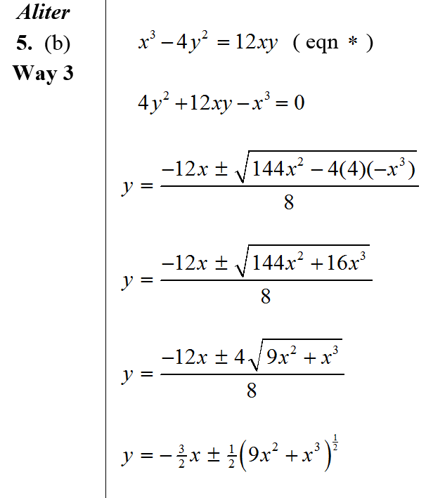
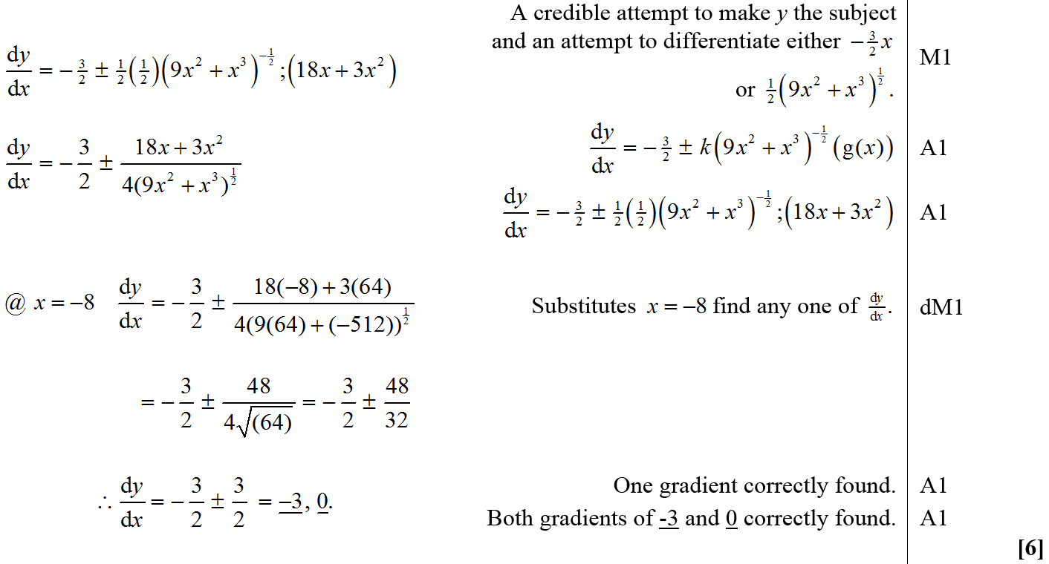
Jan 2008
B Alternative (ii)

Slide 51
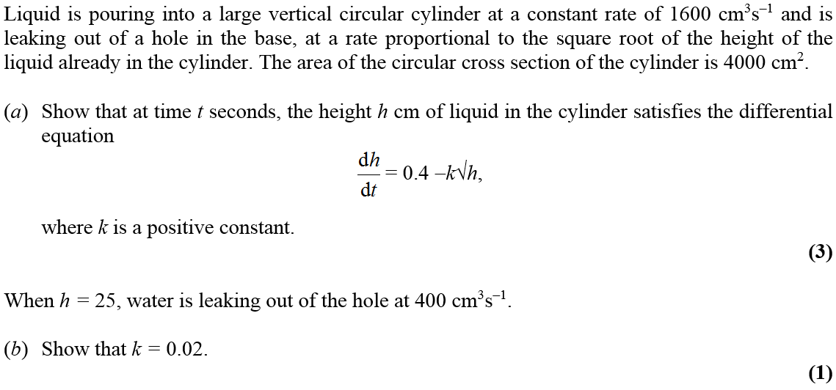
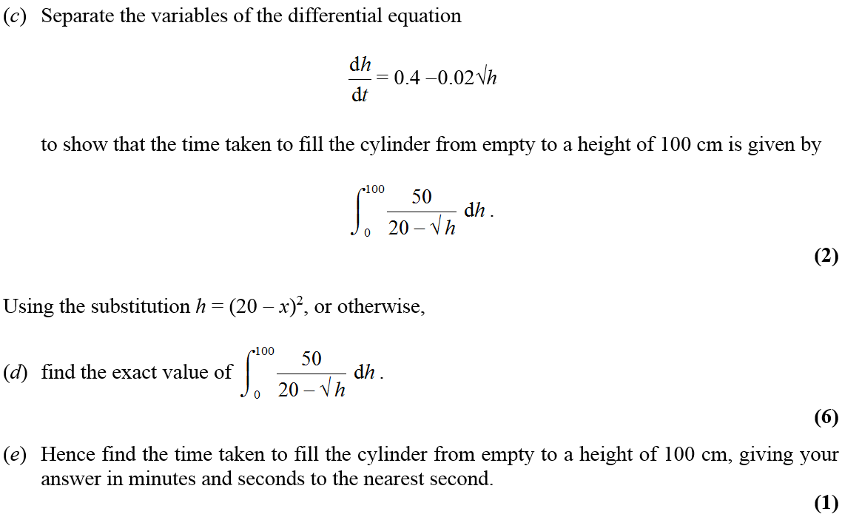
Jan 2008

Slide 52
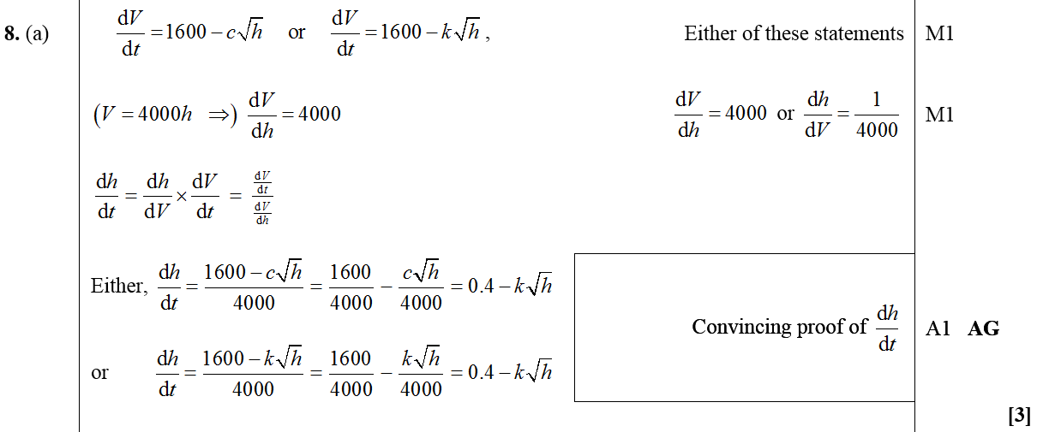
Jan 2008
A

Slide 53
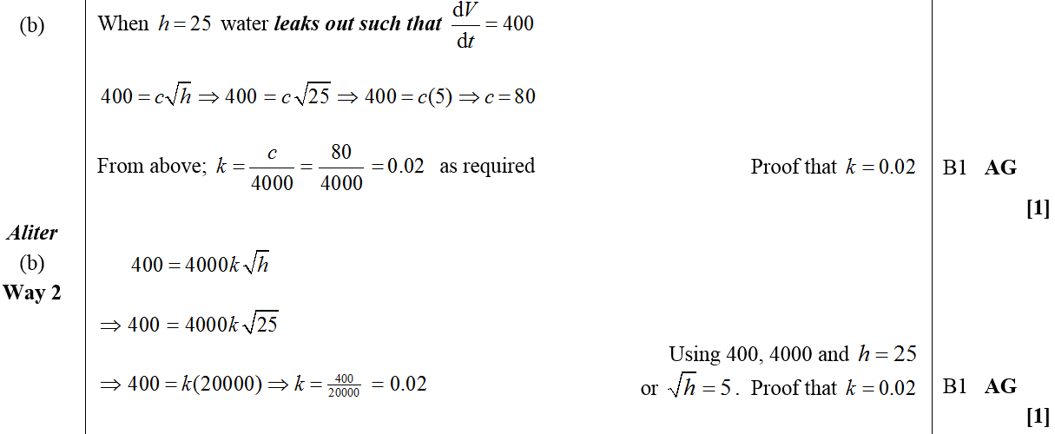
Jan 2008
B
Alternative B

Slide 54
Jan 2008
C

Slide 55
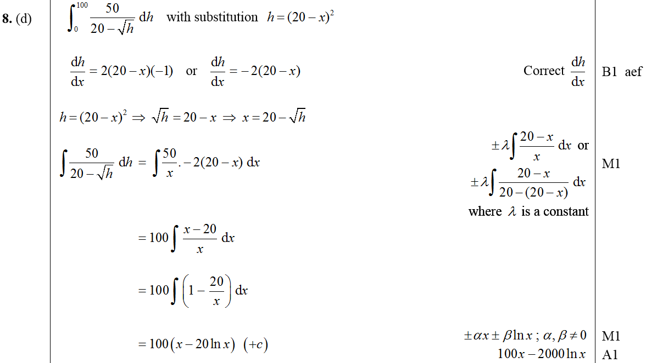
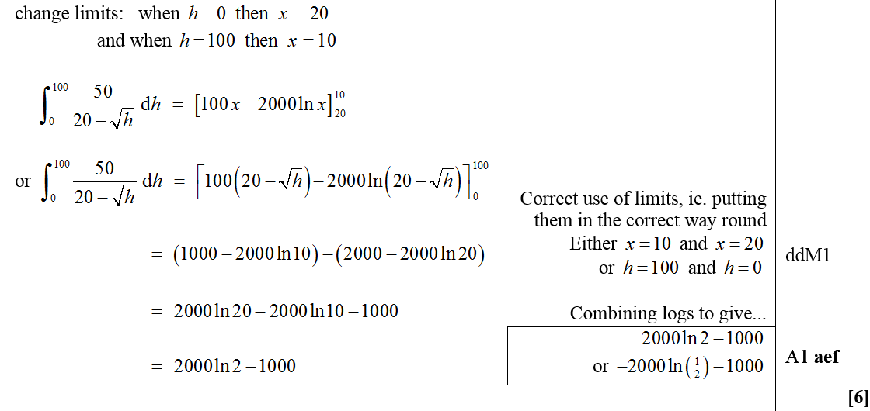
Jan 2008
D

Slide 56
Jan 2008
E

Slide 57
June 2008

Slide 58
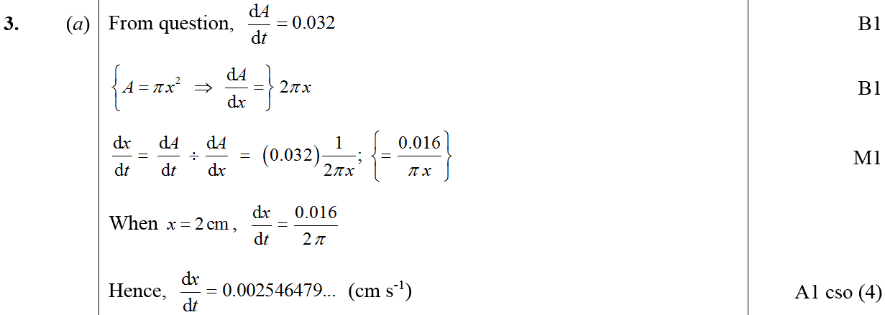
June 2008
A
B

Slide 59
June 2008

Slide 60
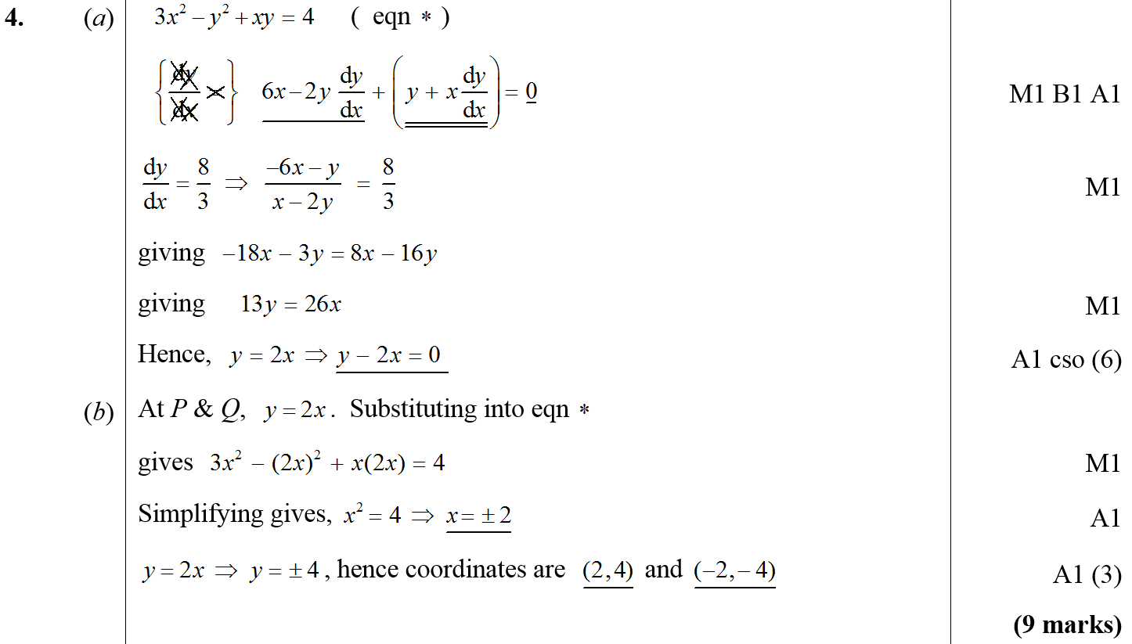
June 2008
A
B

Slide 61
Jan 2009

Slide 62
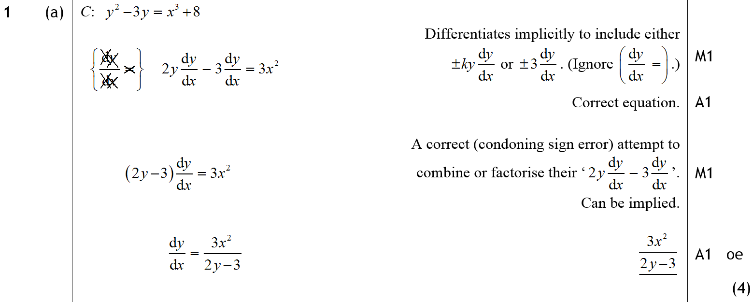
Jan 2009
A (i)

Slide 63
Jan 2009
B

Slide 64
Jan 2009

Slide 65
A
Jan 2009
B

Slide 66
Jan 2009

Slide 67
Jan 2009
A
B

Slide 68
Jan 2009
C

Slide 69
June 2009

Slide 70
June 2009
A
B

Slide 71
June 2009

Slide 72
June 2009
A
B
C

Slide 73
Jan 2010

Slide 74
Jan 2010
A
B
C

Slide 75
Jan 2010

Slide 76
Jan 2010
A

Slide 77
June 2010

Slide 78
June 2010
A

Slide 79
June 2010

Slide 80
June 2010
A
B

Slide 81
June 2010

Slide 82
June 2010
A
B

Slide 83
Jan 2011

Slide 84
Jan 2011
A

Slide 85
June 2011

Slide 86
June 2011
A
B

Slide 87
June 2011

Slide 88
June 2011
A

Slide 89
June 2011

Slide 90
June 2011
A
B

Slide 91
June 2011
C

Slide 92
Jan 2012

Slide 93
Jan 2012
A
B

Slide 94
Jan 2012
A Notes

Slide 95
Jan 2012
B Notes

Slide 96
Jan 2012
Alternative A

Slide 97
Jan 2012

Slide 98
Jan 2012
A
B

Slide 99
Jan 2012
A Notes
Alternative differentiation for A

Slide 100
Jan 2012
B Notes

Slide 101
Jan 2012
Alternative B

Slide 102
June 2012

Slide 103
June 2012
A
B
C

Slide 104
June 2012

Slide 105
June 2012
A

Slide 106
June 2012
B

Slide 107
June 2012

Slide 108
June 2012
A

Slide 109
June 2012
B
C

Slide 110
Jan 2013

Slide 111
Jan 2013
A
B
C

Slide 112
Jan 2013
D

Slide 113
June 2013

Slide 114
June 2013
A

Slide 115
June 2013
B
C

Slide 116
June 2013

Slide 117
June 2013
A
B

Slide 118
June 2014

Slide 119
June 2014
A
B

Slide 120
June 2014

Slide 121
June 2014
A

Slide 122
June 2014

Slide 123
June 2014
A

Slide 124
June 2014
B

Slide 125
Jan 2006 (i) T
Jan 2007 (iii) T
Integration
Jan 2012 (ii)
Jan 2013 (v)
Jan 2006 (ii)
June 2007 (i)
Jan 2008 (v)
June 2009 (iii)
June 2010 (iv)
Jan 2012 (iii) T
June 2013 (i)
Jan 2006 (iii)
June 2007 (ii)
June 2008 (i) T
June 2009 (iv)
Jan 2011 (i)
Jan 2012 (iv)
June 2013 (ii) T
Jan 2006 (iv)
June 2007 (iii)
June 2008 (ii)
Jan 2010 (i) T
Jan 2011 (ii)
June 2012 (i)
June 2013 (iii)
Jan 2006 (v)
June 2007 (iv) T
June 2008 (iii)
Jan 2010 (ii)
Jan 2011 (iii)
June 2012 (ii)
June 2013 (iv)
June 2006 (i)
June 2007 (v)
June 2008 (iv)
Jan 2010 (iii)
Jan 2011 (iv) T
June 2012 (iii) T
June 2014 (i) T
June 2006 (ii) T
Jan 2008 (i) T
Jan 2009 (i)
Jan 2010 (iv)
June 2011 (i) T
Jan 2013 (i)
June 2014 (ii)
June 2006 (iii)
Jan 2008 (ii)
Jan 2009 (ii)
June 2010 (i) T
June 2011 (ii)
Jan 2013 (ii) T
June 2014 (iii)
Jan 2007 (i)
Jan 2008 (iii)
June 2009 (i) T
June 2010 (ii)
June 2011 (iii)
Jan 2013 (iii)
Jan 2007 (ii)
Jan 2008 (iv)
June 2009 (ii)
June 2010 (iii)
Jan 2012 (i)
Jan 2013 (iv)

Slide 126
Jan 2006

Slide 127
Jan 2006
A

Slide 128
Jan 2006

Slide 129
Jan 2006
A

Slide 130
Jan 2006

Slide 131
Jan 2006
A

Slide 132
Jan 2006

Slide 133
Jan 2006
A
B
C
D (i)
D (ii)

Slide 134
Jan 2006

Slide 135
Jan 2006
A
Apologies, could not find designation of marks, but hope this still helps!
B
C

Slide 136
June 2006

Slide 137
June 2006
A

Slide 138
June 2006
B

Slide 139
June 2006

Slide 140
June 2006
A
B

Slide 141
June 2006
A
B

Slide 142
June 2006
C
D

Slide 143
June 2006
Alternative D (i)

Slide 144
June 2006
Alternative D (i)

Slide 145
June 2006
Alternative D (i)

Slide 146
June 2006
Alternative D (ii)

Slide 147
June 2006
Alternative D (iii)

Slide 148
June 2006

Slide 149
June 2006
A
B

Slide 150
June 2006
C

Slide 151
June 2006
Alternative B (i)
Alternative B (ii)

Slide 152
June 2006
Alternative C (i)

Slide 153
June 2006
Alternative C (ii)

Slide 154
Jan 2007

Slide 155
Jan 2007
A

Slide 156
Jan 2007
B

Slide 157
Jan 2007
Alternative A

Slide 158
Jan 2007

Slide 159
Jan 2007
A
B

Slide 160
Jan 2007
C

Slide 161
Jan 2007
Alternative B & C (i)

Slide 162
Jan 2007
Alternative B (ii)
Alternative C (ii)

Slide 163
Jan 2007

Slide 164
Jan 2007
A
B

Slide 165
Jan 2007
C

Slide 166
Jan 2007
D

Slide 167
June 2007

Slide 168
June 2007
A

Slide 169
June 2007

Slide 170
June 2007
A

Slide 171
June 2007
B
B notes

Slide 172
June 2007
Alternative B (i)

Slide 173
June 2007
Alternative B (ii)

Slide 174
June 2007

Slide 175
June 2007
A
Note

Slide 176
June 2007
Alternative A
Note

Slide 177
B
June 2007

Slide 178
June 2007

Slide 179
June 2007
A
B (Method 1)
A Notes

Slide 180
June 2007
B (Method 2)
B Notes

Slide 181
June 2007
C

Slide 182
June 2007

Slide 183
June 2007
A

Slide 184
June 2007
Alternative A (i)

Slide 185
June 2007
Alternative A (ii)

Slide 186
June 2007
B

Slide 187
June 2007
C

Slide 188
June 2007
Alternative C

Slide 189
June 2007
C

Slide 190
June 2007
D

Slide 191
Jan 2008

Slide 192
Jan 2008
A
B

Slide 193
Jan 2008
Alternative B
Note

Slide 194
Jan 2008

Slide 195
Jan 2008
A

Slide 196
Jan 2008
Alternative A

Slide 197
Jan 2008

Slide 198
Jan 2008
i

Slide 199
ii
Jan 2008

Slide 200
Jan 2008
i Alternative 1

Slide 201
Jan 2008
i Alternative 2

Slide 202
Jan 2008
Alternative ii

Slide 203
Jan 2008

Slide 204
Jan 2008
A

Slide 205
Jan 2008
B

Slide 206
Jan 2008
C
Alternative C (i)

Slide 207
Jan 2008
Alternative C (ii)
Alternative C (iii)

Slide 208
Jan 2008
D

Slide 209
Jan 2008

Slide 210
Jan 2008
A

Slide 211
Jan 2008
B
Alternative B

Slide 212
Jan 2008
C

Slide 213
Jan 2008
D

Slide 214
Jan 2008
E

Slide 215
June 2008

Slide 216
June 2008
A
B

Slide 217
June 2008

Slide 218
June 2008
A
B

Slide 219
June 2008

Slide 220
June 2008
A

Slide 221
June 2008
B

Slide 222
June 2008

Slide 223
June 2008
A
B

Slide 224
June 2008
C
D

Slide 225
Jan 2009

Slide 226
Jan 2009
A

Slide 227
Jan 2009
B

Slide 228
Jan 2009

Slide 229
Jan 2009
A

Slide 230
Jan 2009
B

Slide 231
Jan 2009
C

Slide 232
June 2009

Slide 233
June 2009
A
B
C

Slide 234
June 2009

Slide 235
June 2009
A

Slide 236
June 2009
B (i)
B (ii)

Slide 237
June 2009

Slide 238
June 2009
A
B (i)
B (ii)

Slide 239
June 2009

Slide 240
June 2009
A
B

Slide 241
June 2009
C

Slide 242
Jan 2010

Slide 243
A
Jan 2010
B
C (i)
C (ii)

Slide 244
Jan 2010

Slide 245
Jan 2010
A
B

Slide 246
Jan 2010

Slide 247
A
Jan 2010
B

Slide 248
Jan 2010

Slide 249
Jan 2010
A

Slide 250
Jan 2010
B

Slide 251
June 2010

Slide 252
June 2010
A
B (i)
B (ii)

Slide 253
June 2010

Slide 254
June 2010
A

Slide 255
June 2010

Slide 256
June 2010
A
B

Slide 257
June 2010

Slide 258
June 2010
A
B

Slide 259
Jan 2011

Slide 260
Jan 2011
A

Slide 261
Jan 2011

Slide 262
A
Jan 2011
B
C

Slide 263
Jan 2011

Slide 264
Jan 2011
A
B

Slide 265
C
Jan 2011
Alternative C

Slide 266
Jan 2011

Slide 267
A
Jan 2011
B
C

Slide 268
June 2011

Slide 269
June 2011
A
B
C

Slide 270
June 2011
D

Slide 271
June 2011

Slide 272
June 2011
A
B

Slide 273
June 2011
C

Slide 274
June 2011

Slide 275
June 2011
A
B

Slide 276
Jan 2012

Slide 277
Jan 2012
A
B
A notes

Slide 278
Jan 2012
B notes

Slide 279
Jan 2012

Slide 280
Jan 2012
A
Note

Slide 281
Jan 2012
Working in x
Working in u

Slide 282
Jan 2012

Slide 283
Jan 2012
A
B
C
D

Slide 284
Jan 2012
A Notes
B Notes

Slide 285
Jan 2012
C Notes
Alternative C
Alternative method mark C

Slide 286
Jan 2012
D Notes
Alternative Methods for D

Slide 287
Jan 2012

Slide 288
Jan 2012
A
B
C

Slide 289
Jan 2012
A Notes

Slide 290
Jan 2012
B Notes

Slide 291
Jan 2012
C Notes
Alternative B

Slide 292
June 2012

Slide 293
June 2012
A

Slide 294
June 2012
B (i)
B (ii)

Slide 295
June 2012

Slide 296
June 2012
A

Slide 297
June 2012

Slide 298
A (i)
June 2012
B
C

Slide 299
Jan 2013

Slide 300
Jan 2013
A

Slide 301
Jan 2013
B

Slide 302
Jan 2013

Slide 303
Jan 2013
A
B

Slide 304
Jan 2013
C

Slide 305
Jan 2013

Slide 306
Jan 2013
A
B
C

Slide 307
Jan 2013
D

Slide 308
Jan 2013

Slide 309
Jan 2013
A

Slide 310
Jan 2013
B

Slide 311
Jan 2013

Slide 312
Jan 2013
A
B

Slide 313
June 2013

Slide 314
June 2013
A

Slide 315
June 2013
B

Slide 316
June 2013

Slide 317
June 2013
A
B
C

Slide 318
June 2013

Slide 319
June 2013
A

Slide 320
June 2013
B

Slide 321
June 2013

Slide 322
June 2013
A

Slide 323
June 2013
B

Slide 324
June 2014

Slide 325
June 2014
A
B
C

Slide 326
June 2014
D

Slide 327
June 2014

Slide 328
June 2014
i
ii

Slide 329
June 2014
iii

Slide 330
June 2014

Slide 331
June 2014
A

Slide 332
June 2014
B

Slide 333
Parametric Equations
Jan 2009
Jan 2006
Jan 2012
June 2009 (i)
June 2006
June 2012
June 2009 (ii)
Jan 2007
Jan 2013
Jan 2010
June 2007
June 2013
June 2010
Jan 2008
June 2014 (i)
Jan 2011
June 2008
June 2014 (ii)
June 2011

Slide 334
Jan 2006

Slide 335
Jan 2006
A
Apologies, could not find designation of marks, but hope this still helps!
B
C

Slide 336
June 2006

Slide 337
June 2006
A

Slide 338
June 2006
B

Slide 339
June 2006
A Alternative (i)

Slide 340
June 2006
Alternative A (ii)

Slide 341
June 2006
Alternative B

Slide 342
Jan 2007

Slide 343
Jan 2007
A
A Alternative

Slide 344
Jan 2007
B

Slide 345
Jan 2007
B Alternative

Slide 346
Jan 2007
Beware

Slide 347
June 2007

Slide 348
June 2007
A

Slide 349
June 2007
B

Slide 350
June 2007
C (Method 1)

Slide 351
June 2007
C (Method 2)

Slide 352
June 2007
C (Method 3)

Slide 353
June 2007
C (Method 4)

Slide 354
June 2007
C (Method 5)

Slide 355
Jan 2008

Slide 356
Jan 2008
A

Slide 357
Jan 2008
B

Slide 358
Jan 2008
C
Alternative C (i)

Slide 359
Jan 2008
Alternative C (ii)
Alternative C (iii)

Slide 360
Jan 2008
D

Slide 361
June 2008

Slide 362
June 2008
A
B

Slide 363
June 2008
C
D

Slide 364
Jan 2009

Slide 365
Jan 2009
A
B

Slide 366
Jan 2009
C

Slide 367
June 2009

Slide 368
June 2009
A
B
C

Slide 369
June 2009

Slide 370
June 2009
A
B

Slide 371
June 2009
C

Slide 372
Jan 2010

Slide 373
A
Jan 2010
B

Slide 374
June 2010

Slide 375
June 2010
A
B

Slide 376
Jan 2011

Slide 377
Jan 2011
A
B

Slide 378
C
Jan 2011
Alternative C

Slide 379
June 2011

Slide 380
June 2011
A
B

Slide 381
June 2011
C

Slide 382
Jan 2012

Slide 383
Jan 2012
A
B

Slide 384
Jan 2012
A Notes
Alternative differentiation for A

Slide 385
Jan 2012
B Notes

Slide 386
Jan 2012
Alternative B

Slide 387
June 2012

Slide 388
June 2012
A

Slide 389
June 2012
B
C

Slide 390
Jan 2013

Slide 391
Jan 2013
A
B
C

Slide 392
Jan 2013
D

Slide 393
June 2013

Slide 394
June 2013
A

Slide 395
June 2013
B
C

Slide 396
June 2014

Slide 397
June 2014
A
B

Slide 398
June 2014

Slide 399
June 2014
A

Slide 400
June 2014
B

Slide 401
Partial Fractions
Jan 2006
June 2010
June 2006
Jan 2011
Jan 2007
June 2011
June 2007
Jan 2012
Jan 2008
June 2012
June 2008
Jan 2013
Jan 2009
June 2013
June 2009

Slide 402
Jan 2006

Slide 403
A
Jan 2006
B

Slide 404
Jan 2006
Alternative B

Slide 405
June 2006

Slide 406
June 2006
A
B

Slide 407
June 2006
Alternative B (i)

Slide 408
June 2006
Alternative B (ii)

Slide 409
June 2006
Alternative B (iii)

Slide 410
Jan 2007

Slide 411
Jan 2007
A
B

Slide 412
Jan 2007
C

Slide 413
Jan 2007
Alternative B & C (i)

Slide 414
Jan 2007
Alternative B (ii)
Alternative C (ii)

Slide 415
June 2007

Slide 416
June 2007
A
Note

Slide 417
June 2007
Alternative A
Note

Slide 418
B
June 2007

Slide 419
Jan 2008

Slide 420
Jan 2008
A

Slide 421
Jan 2008
B

Slide 422
Jan 2008
C
Alternative C (i)

Slide 423
Jan 2008
Alternative C (ii)
Alternative C (iii)

Slide 424
Jan 2008
D

Slide 425
June 2008

Slide 426
June 2008
A

Slide 427
June 2008
B

Slide 428
Jan 2009

Slide 429
Jan 2009
A

Slide 430
Jan 2009
B

Slide 431
Jan 2009
C

Slide 432
June 2009

Slide 433
June 2009
A

Slide 434
June 2009
B (i)
B (ii)

Slide 435
June 2010

Slide 436
June 2010
A
B

Slide 437
Jan 2011

Slide 438
A
Jan 2011
B
C

Slide 439
June 2011

Slide 440
June 2011
A

Slide 441
Jan 2012

Slide 442
Jan 2012
A
B
C

Slide 443
Jan 2012
A Notes

Slide 444
Jan 2012
B Notes

Slide 445
Jan 2012
C Notes
Alternative B

Slide 446
June 2012

Slide 447
June 2012
A

Slide 448
June 2012
B (i)
B (ii)

Slide 449
Jan 2013

Slide 450
Jan 2013
A (method 1)

Slide 451
Jan 2013
A (method 2)

Slide 452
June 2013

Slide 453
June 2013
A

Slide 454
June 2013
B

Slide 455
Vectors
Jan 2006
Jan 2010
June 2006
June 2010
Jan 2007
Jan 2011
June 2011
June 2007
Jan 2012
Jan 2008
June 2012
June 2008
Jan 2013
Jan 2009
June 2013
June 2009
June 2014

Slide 456
Jan 2006

Slide 457
Jan 2006
A
B
C

Slide 458
June 2006

Slide 459
June 2006
A

Slide 460
June 2006
B

Slide 461
June 2006
Alternative B

Slide 462
June 2006
C

Slide 463
June 2006
Alternative C

Slide 464
Jan 2007

Slide 465
Jan 2007
A

Slide 466
B
Jan 2007
C

Slide 467
Jan 2007
D

Slide 468
Jan 2007
D (Alternative 1)

Slide 469
Jan 2007
D (Alternative 2)

Slide 470
Jan 2007
D (Alternative 3)

Slide 471
Jan 2007
D (Alternative 4)

Slide 472
Jan 2007
D (Alternative 5)

Slide 473
June 2007

Slide 474
June 2007
A

Slide 475
June 2007
A (Alternative 1)
A (Alternative 2)

Slide 476
June 2007
A (Alternative 3)

Slide 477
June 2007
B

Slide 478
June 2007
Case 1
Case 2
Case 3
Case 4
Case 5

Slide 479
June 2007
Examples

Slide 480
Jan 2008

Slide 481
Jan 2008
A
B

Slide 482
Jan 2008
C

Slide 483
Jan 2008
D

Slide 484
Jan 2008
Alternative D (i)

Slide 485
Jan 2008
Alternative D (ii)

Slide 486
Jan 2008
Alternative D (ii)

Slide 487
June 2008

Slide 488
June 2008
A

Slide 489
June 2008
B
C

Slide 490
June 2008
D

Slide 491
Jan 2009

Slide 492
Jan 2009
A

Slide 493
Jan 2009
B

Slide 494
Jan 2009
C

Slide 495
Jan 2009
D

Slide 496
June 2009

Slide 497
June 2009
A
B
C

Slide 498
June 2009
D
E

Slide 499
Jan 2010

Slide 500
Jan 2010
A
B
C
D
E

Slide 501
Jan 2010
F

Slide 502
June 2010

Slide 503
June 2010
A
B
C

Slide 504
Jan 2011

Slide 505
Jan 2011
A
B
C
D

Slide 506
June 2011

Slide 507
June 2011
A
B

Slide 508
June 2011
C
D

Slide 509
Jan 2012

Slide 510
Jan 2012
A
B
C

Slide 511
Jan 2012
D
E
F

Slide 512
Jan 2012
A Notes
B Notes
C Notes

Slide 513
Jan 2012
D Notes
E Notes
F Notes

Slide 514
Jan 2012
Alternative C

Slide 515
Jan 2012
Alternative D

Slide 516
June 2012

Slide 517
June 2012
A
B
C

Slide 518
Jan 2013

Slide 519
Jan 2013
A
B

Slide 520
Jan 2013
C

Slide 521
June 2013

Slide 522
June 2013
A

Slide 523
June 2013
B

Slide 524
June 2014

Slide 525
June 2014
A
B
C

Slide 526
June 2014
D
E
F

Slide 527
June 2014
F

Slide 528
Binomial Expansion
Jan 2006
June 2010
June 2006
Jan 2011
Jan 2007
June 2011
June 2007
Jan 2012
Jan 2008
June 2012
June 2008
Jan 2013
Jan 2009
June 2013
June 2009
June 2014
Jan 2010

Slide 529
Jan 2006

Slide 530
A
Jan 2006
B

Slide 531
Jan 2006
Alternative B

Slide 532
June 2006

Slide 533
June 2006
A

Slide 534
June 2006
B

Slide 535
June 2006
B (Alternative 1)
B (Alternative 2)

Slide 536
June 2006
B (Alternative 3)

Slide 537
Jan 2007

Slide 538
Jan 2007
A

Slide 539
Jan 2007
A Alternative

Slide 540
June 2007

Slide 541
June 2007
A

Slide 542
June 2007
Alternative A

Slide 543
Jan 2008

Slide 544
Jan 2008
A

Slide 545
Alternative A
Jan 2008

Slide 546
Jan 2008
B

Slide 547
June 2008

Slide 548
June 2008
A
B

Slide 549
Jan 2009

Slide 550
Jan 2009
A

Slide 551
Jan 2009
B

Slide 552
Jan 2009
C

Slide 553
June 2009

Slide 554
June 2009
A

Slide 555
June 2009
C
D
E

Slide 556
Jan 2010

Slide 557
Jan 2010
A
B
C

Slide 558
June 2010

Slide 559
June 2010
A
B

Slide 560
Jan 2011

Slide 561
Jan 2011
A
B

Slide 562
Jan 2011
C

Slide 563
June 2011

Slide 564
June 2011
A

Slide 565
Jan 2012

Slide 566
Jan 2012
A
B
C

Slide 567
Jan 2012
A Notes

Slide 568
Jan 2012
B Notes
C Notes

Slide 569
Jan 2012
Alternative A

Slide 570
Jan 2012
Alternative B & C

Slide 571
June 2012

Slide 572
June 2012
A
B
C

Slide 573
Jan 2013

Slide 574
Jan 2013
A

Slide 575
June 2013

Slide 576
June 2013
A
B

Slide 577
June 2014

Slide 578
June 2014
A
B

