Slide 1
Core 2
Revision Past Paper Questions
(Edexcel)
Go back to home screen to select a topic
Go back to topic screen to select a question
Go to the mark scheme for that question
Go back to the question from the mark scheme
Or see more solutions
Or go back to first solutions
Next

Slide 2
Notes on operating this resource
When creating this, I used and to quickly navigate between slides directly before or after the slide in question.
As some mark schemes give additional notes, you can continue to see answers by clicking but you will not return to the original question with one click of .
To view the original question again, continue to click which should take you back.

Slide 3
Home
Factors
Trigonometry
Circles
Logarithms
Differentiation
Integration
Radians
Geometric Sequences and Series
Binomial Expansion
Cheat sheet example

Slide 4
The Binomial Expansion
Jan 2006
Jan 2010
May 2006
June 2010
Jan 2007
Jan 2011
May 2007
May 2011
Jan 2008
Jan 2012
June 2008
May 2012
Jan 2009
Jan 2013
June 2009
May 2013

Slide 5
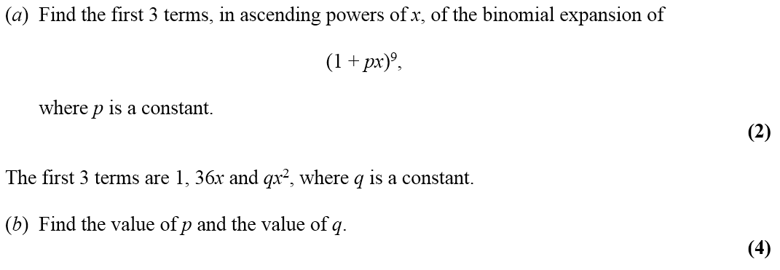
Jan 2006

Slide 6
Jan 2006
A
B

Slide 7
May 2006

Slide 8
May 2006
A

Slide 9
Jan 2007

Slide 10
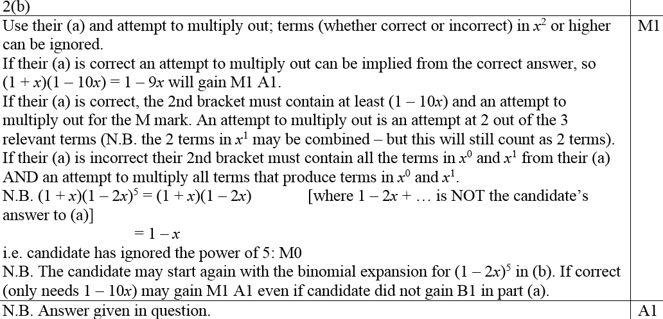
Jan 2007
A
B
B notes

Slide 11
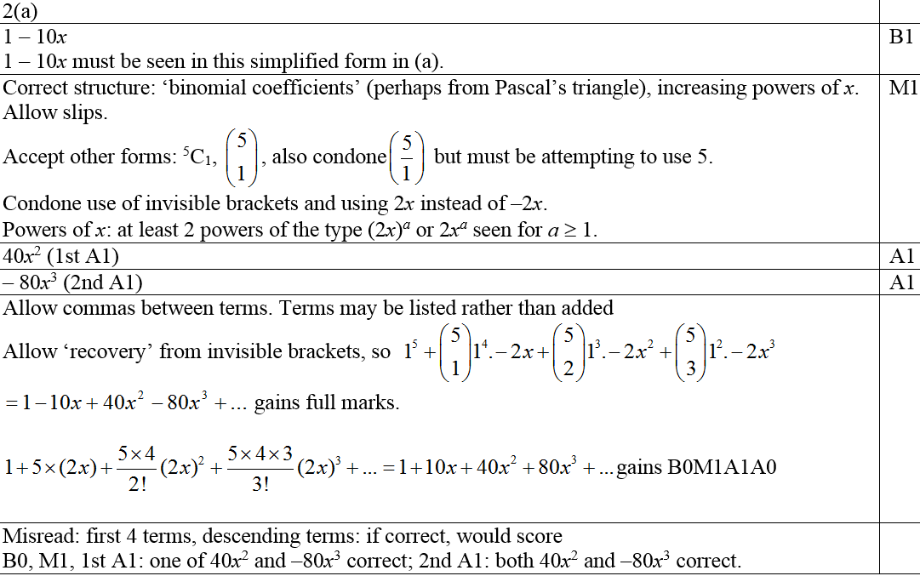
Jan 2007
A notes

Slide 12
May 2007

Slide 13
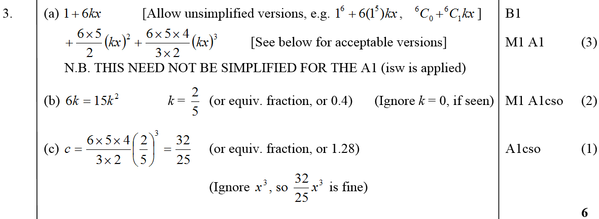
May 2007
A
B
C
B notes

Slide 14
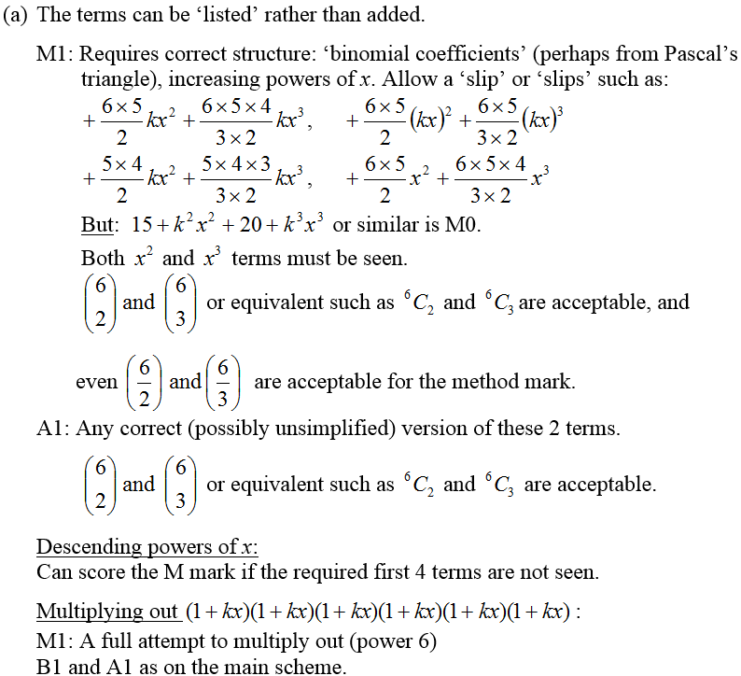
May 2007
A notes

Slide 15
Jan 2008

Slide 16
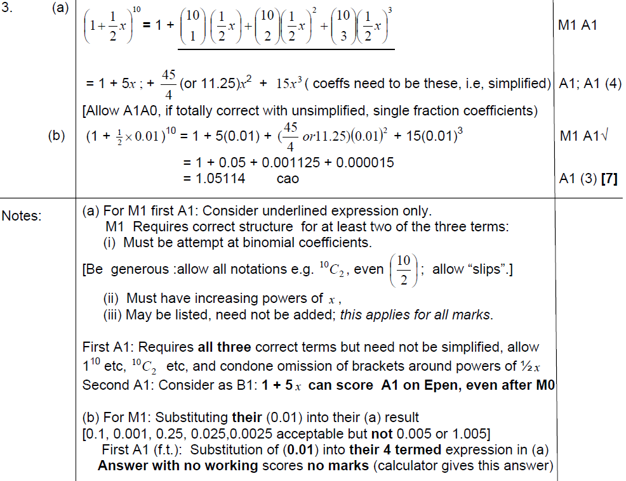
A
Jan 2008
B
A notes
B notes

Slide 17
June 2008

Slide 18
June 2008
A
B

Slide 19
Jan 2009

Slide 20
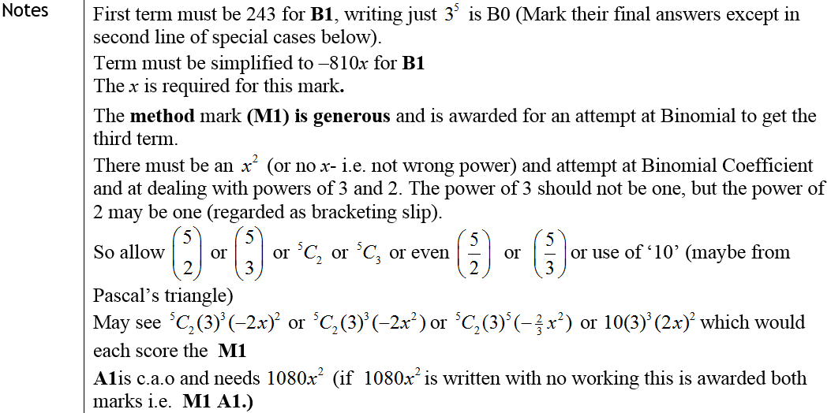
Jan 2009
A
Notes

Slide 21
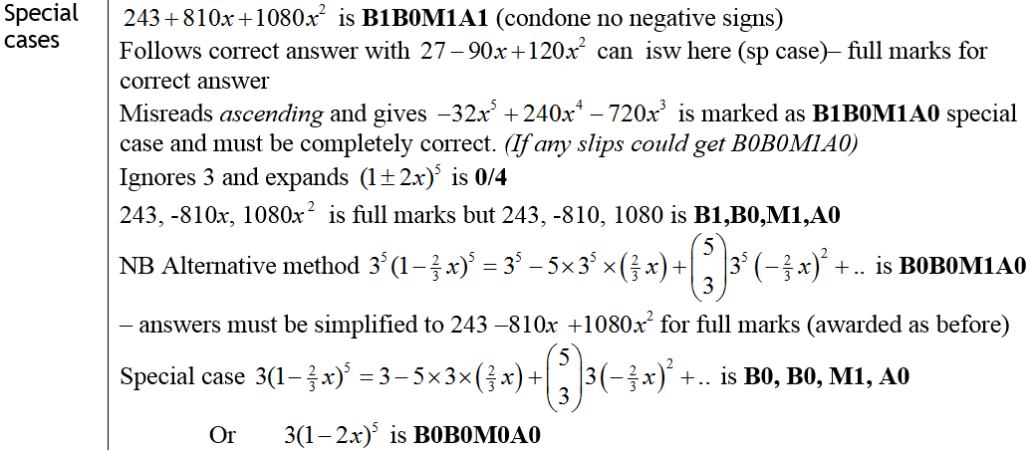
Jan 2009
Special Cases

Slide 22
June 2009

Slide 23
June 2009
A
B

Slide 24
Jan 2010

Slide 25
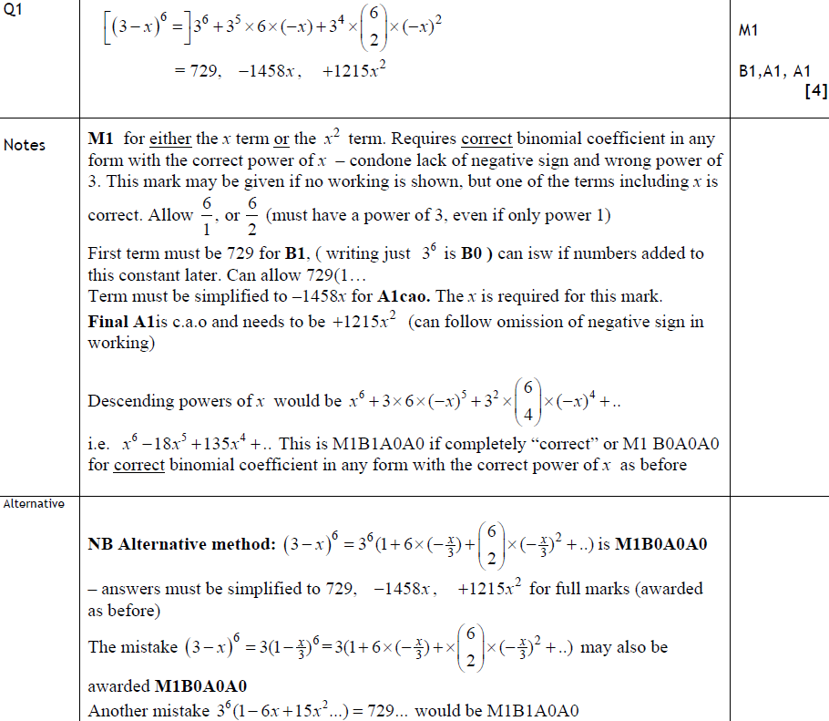
Jan 2010
A
Notes
Alternative Method

Slide 26
June 2010

Slide 27
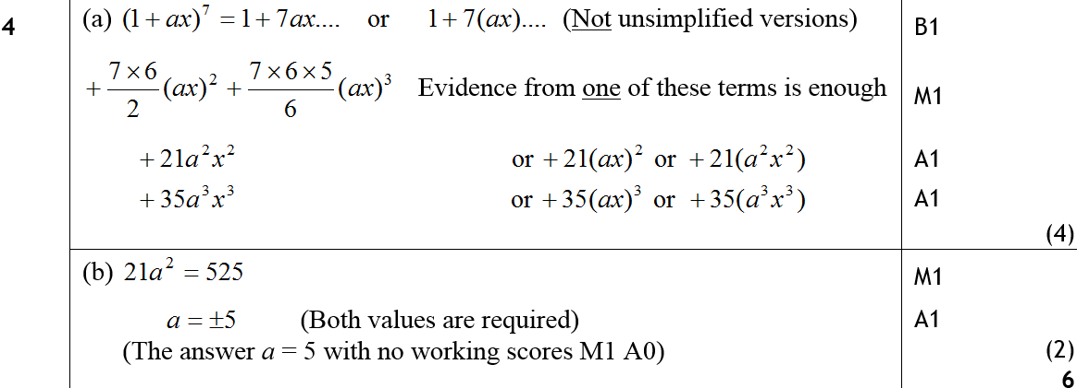
June 2010
A
B

Slide 28
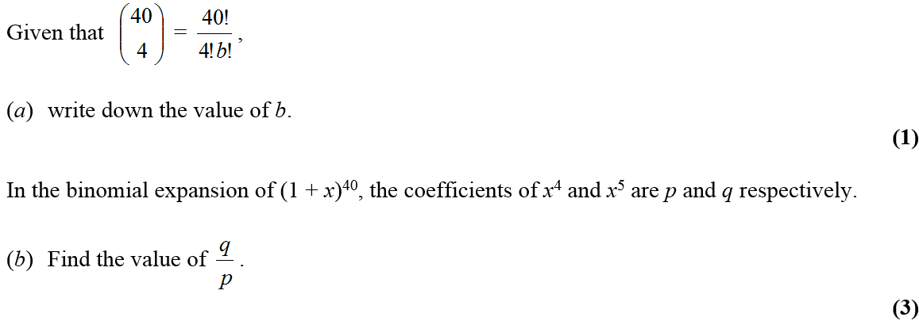
Jan 2011

Slide 29
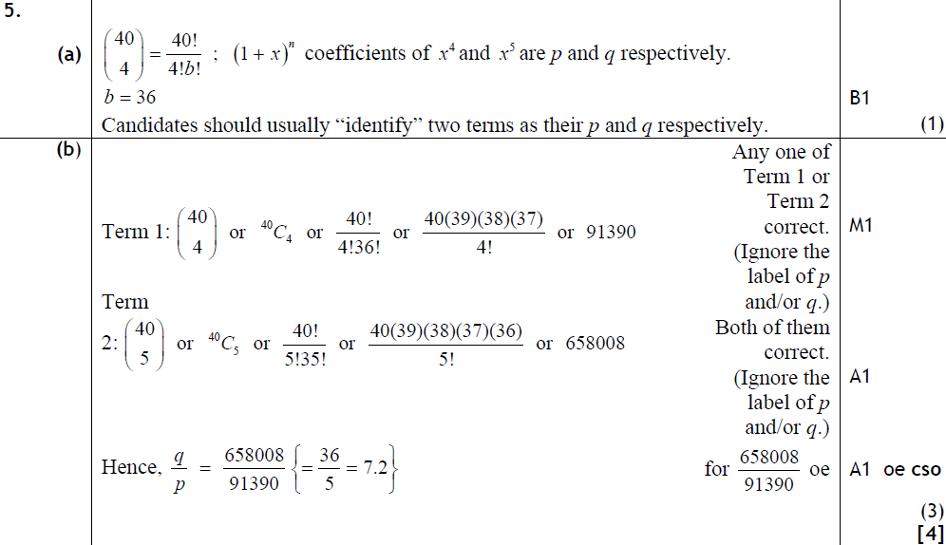
Jan 2011
A
B

Slide 30
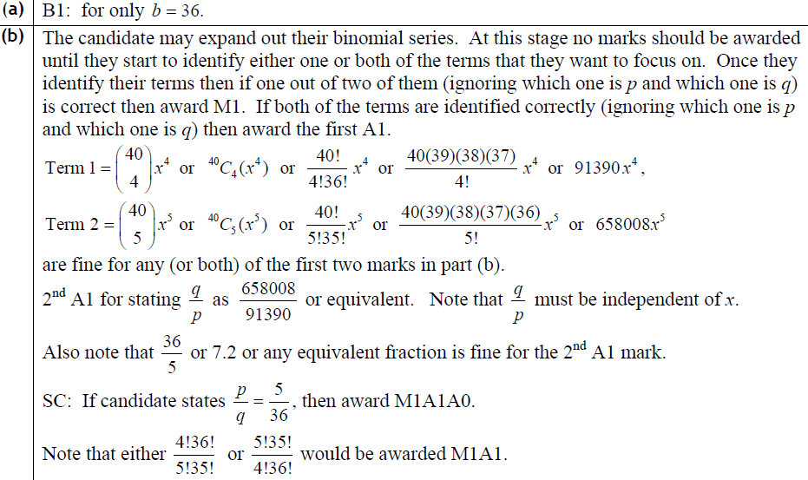
Jan 2011
A
B

Slide 31
May 2011

Slide 32
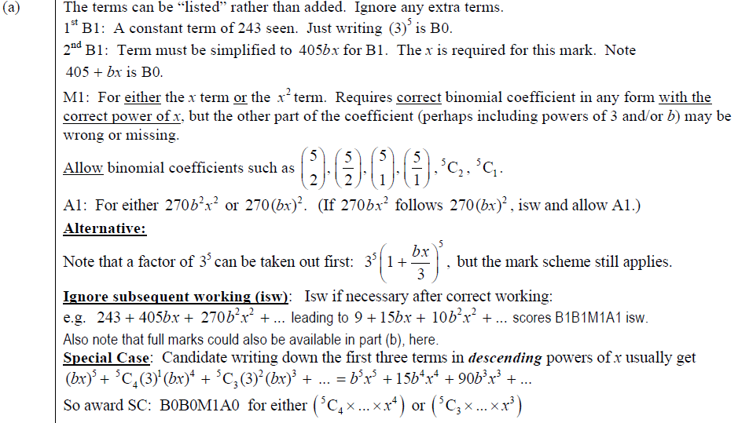
May 2011
A
B
A

Slide 33
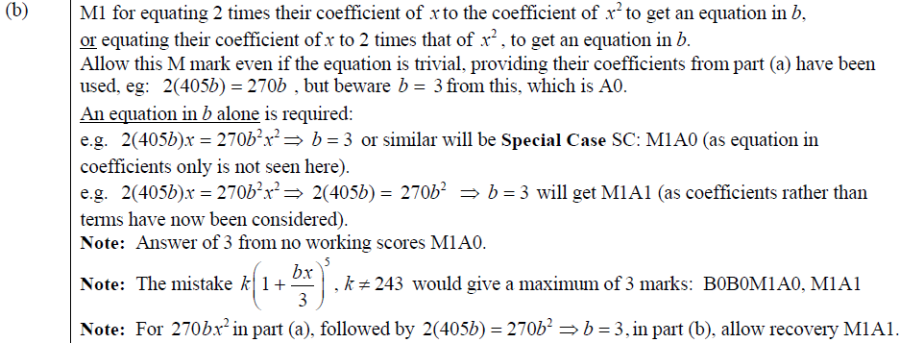
May 2011
B

Slide 34
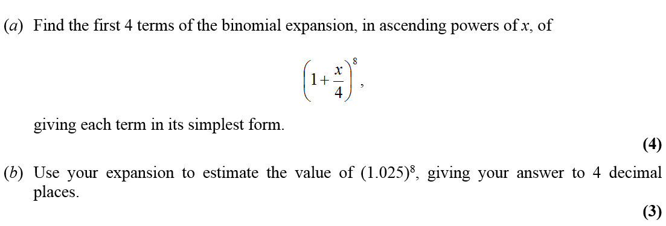
Jan 2012

Slide 35
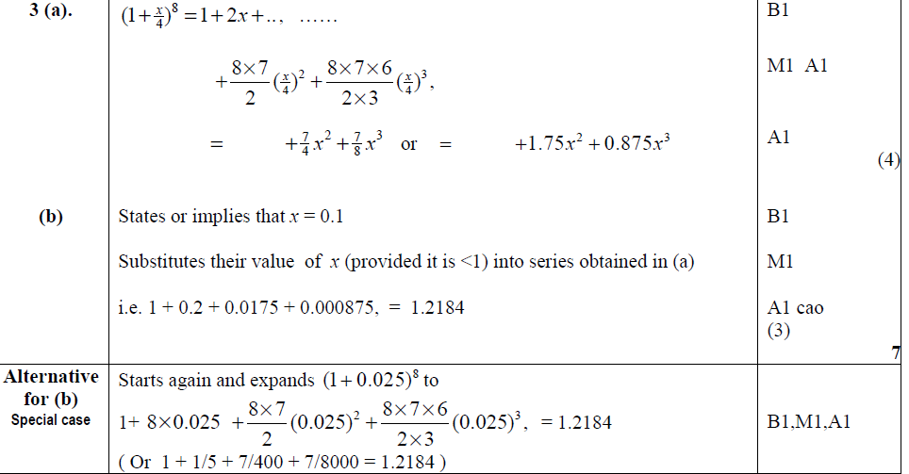
Jan 2012
A
B
Alternative B

Slide 36
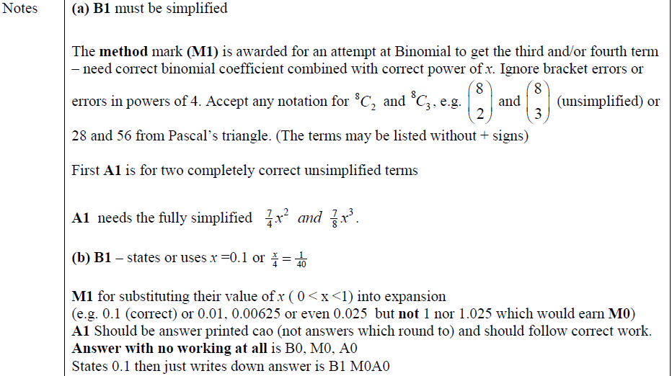
Jan 2012
A
B

Slide 37
May 2012

Slide 38
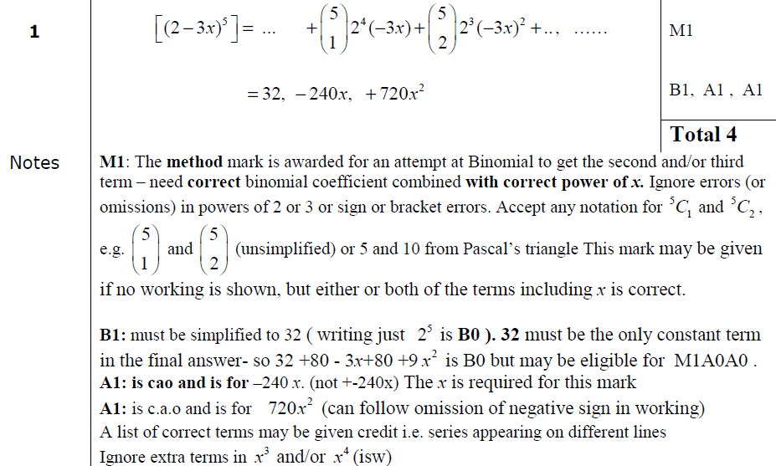
May 2012
A

Slide 39
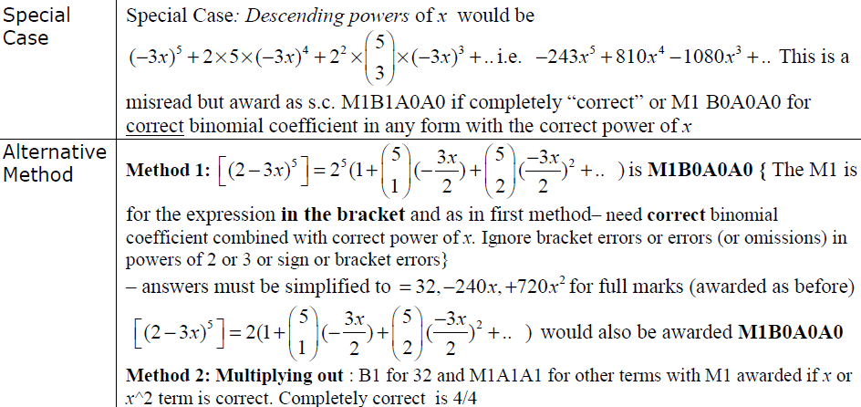
May 2012
Special Case
Alternative Methods

Slide 40
Jan 2013

Slide 41
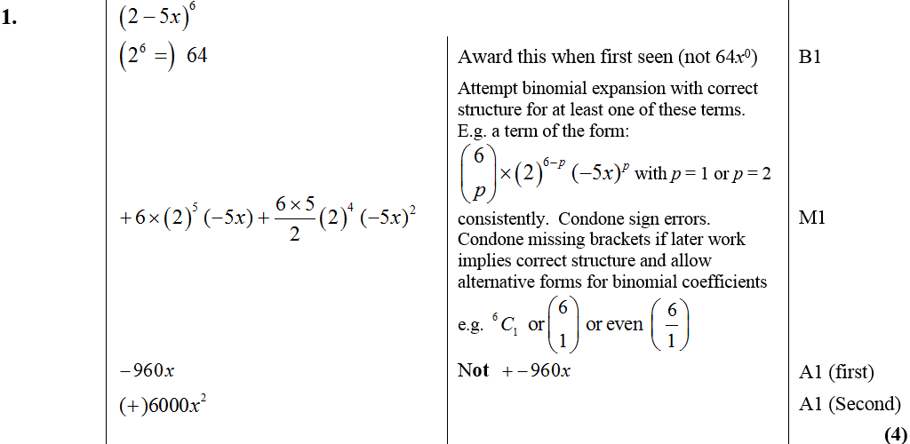
Jan 2013
A

Slide 42
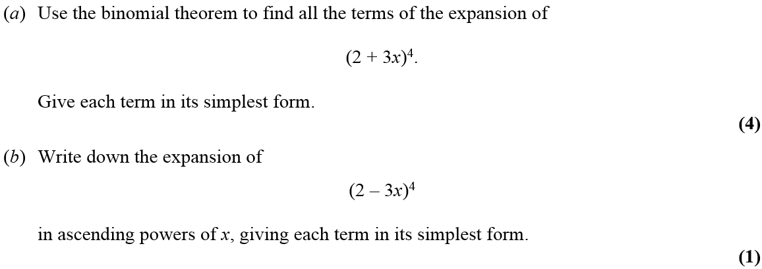
May 2013

Slide 43
May 2013
A
B

Slide 44
Trigonometry
Jan 2006
June 2009
May 2006
Jan 2010
Jan 2007
June 2010
May 2007 (i)
Jan 2011
May 2007 (ii)
May 2011
Jan 2008 (i)
Jan 2012
Jan 2008 (ii)
May 2012
June 2008
Jan 2013
Jan 2009
May 2013

Slide 45
Jan 2006

Slide 46
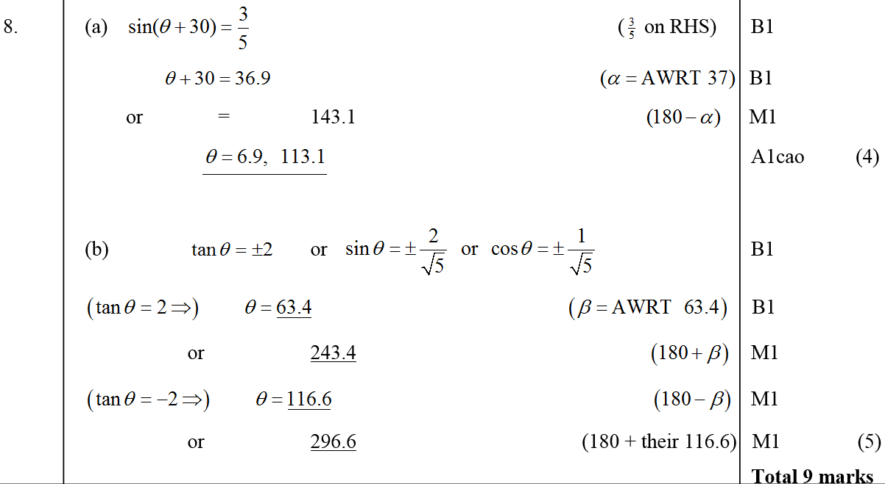
Jan 2006
A
B

Slide 47
May 2006

Slide 48
May 2006
A
B

Slide 49
Jan 2007

Slide 50
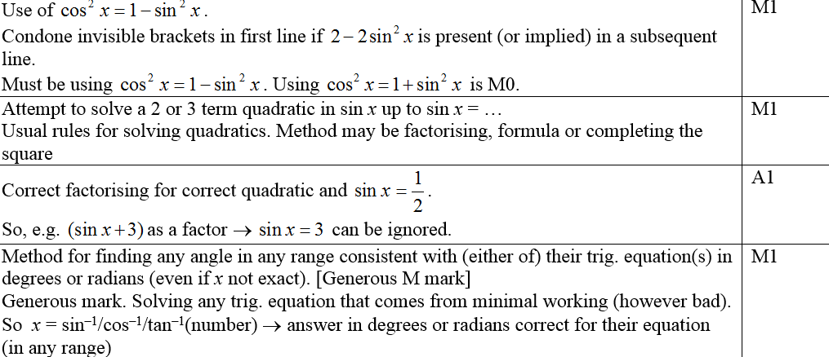
Jan 2007
A
Notes (first 4 marks)

Slide 51
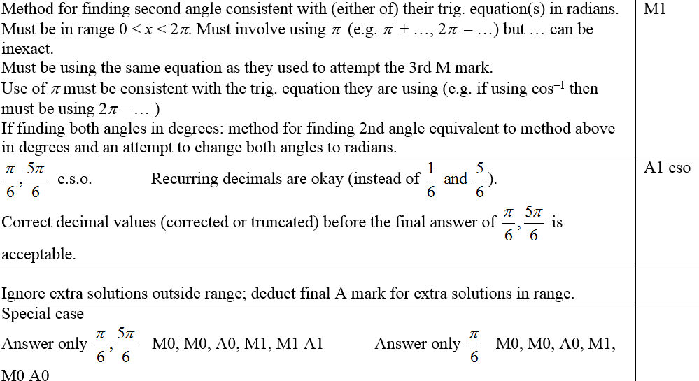
Jan 2007
Notes (last 2 marks and in general)

Slide 52
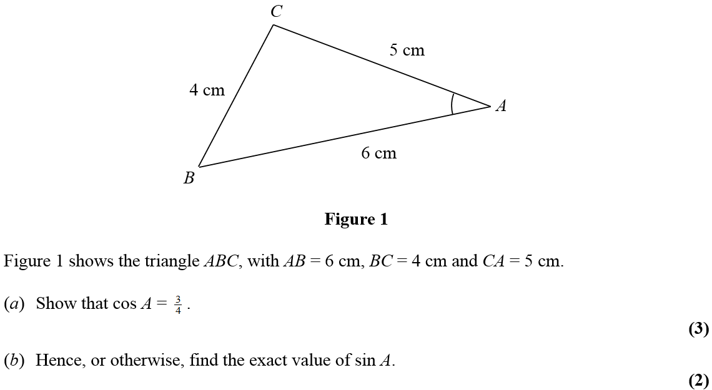
May 2007

Slide 53
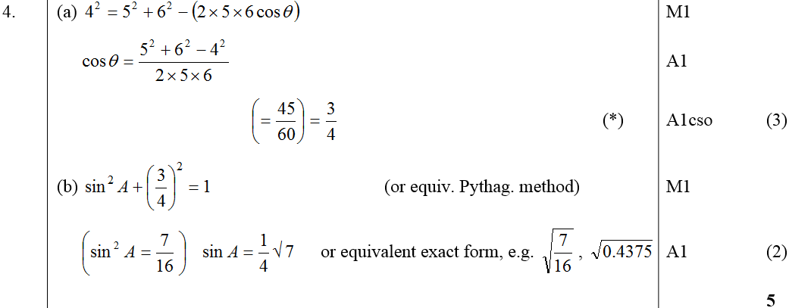
May 2007
A
B

Slide 54
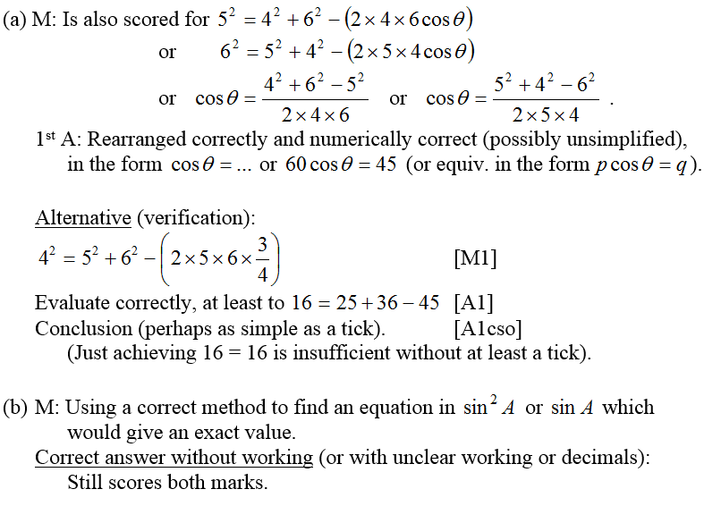
May 2007
A notes
B notes

Slide 55
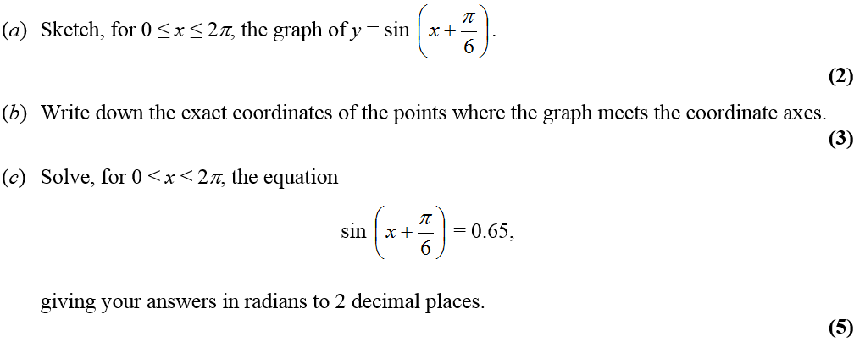
May 2007

Slide 56
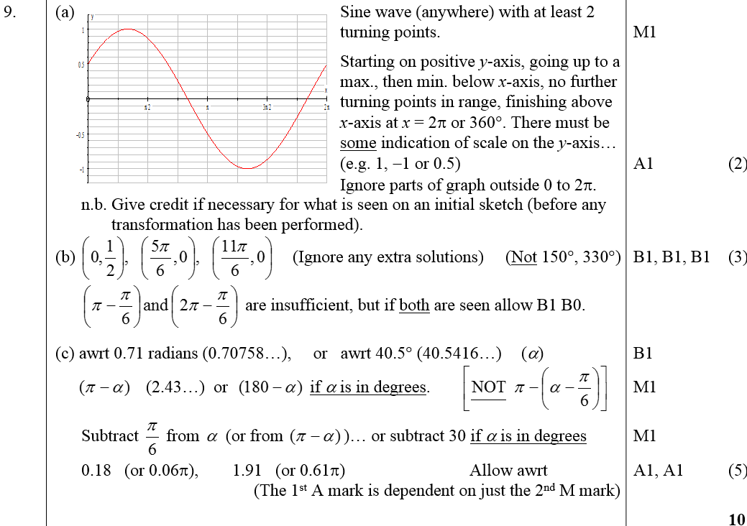
May 2007
A
B
C

Slide 57
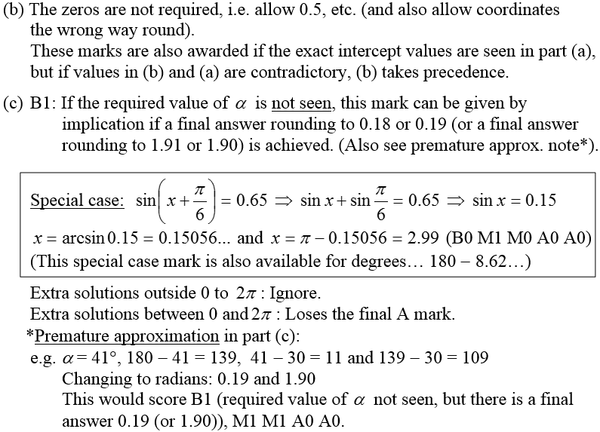
May 2007
B notes
C notes

Slide 58
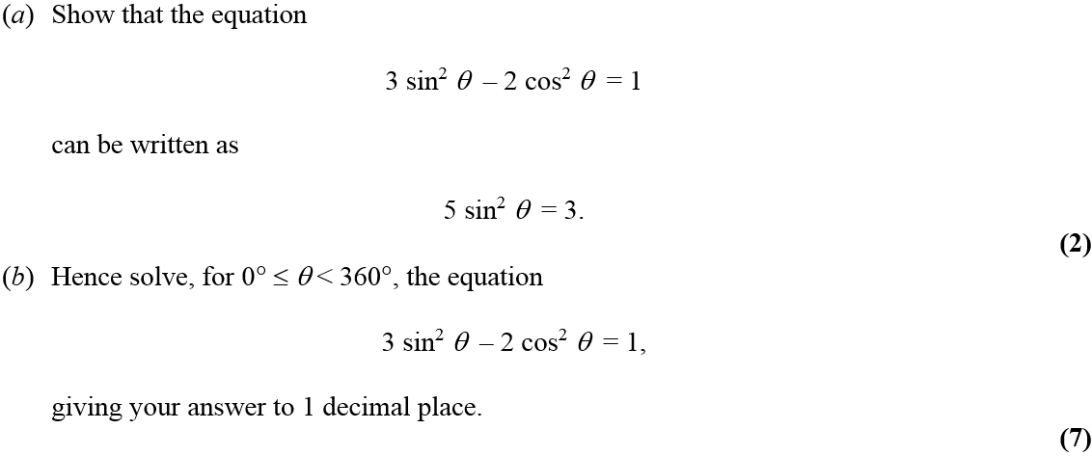
Jan 2008

Slide 59
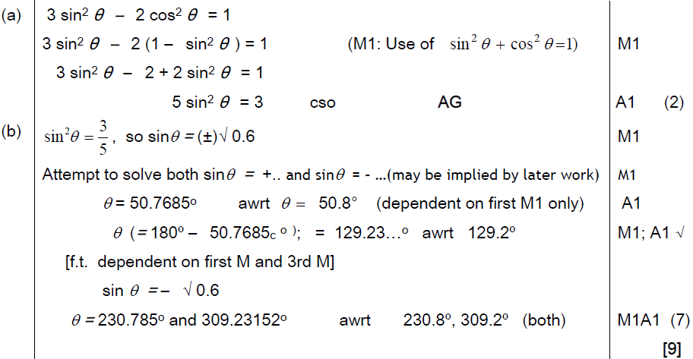
Jan 2008
A
B

Slide 60
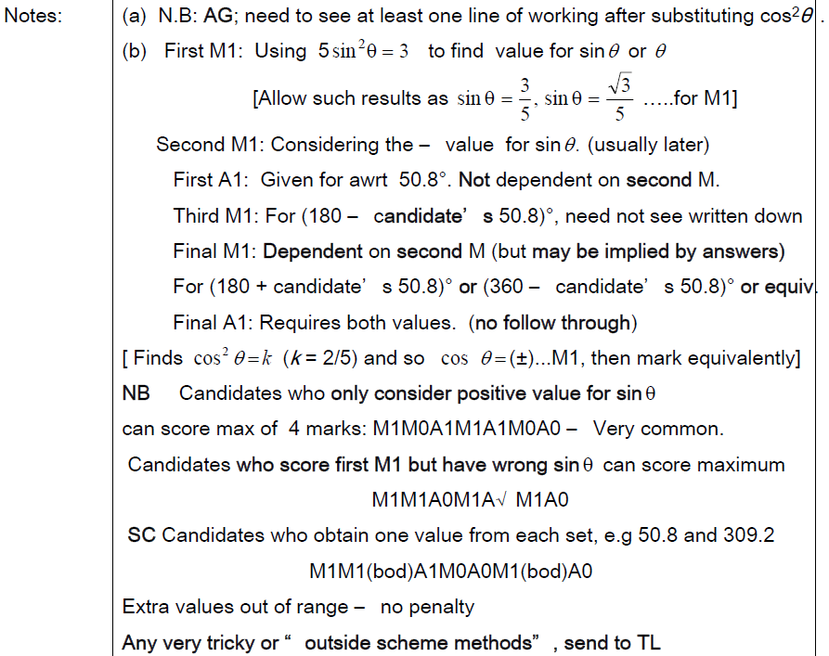
A notes
Jan 2008
B notes

Slide 61
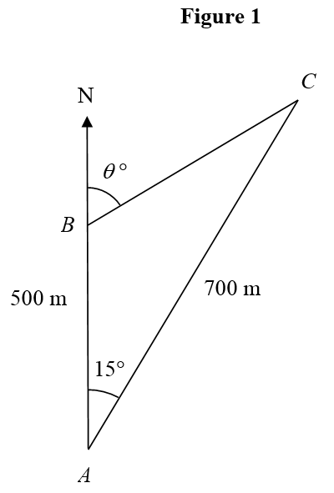
Jan 2008

Slide 62
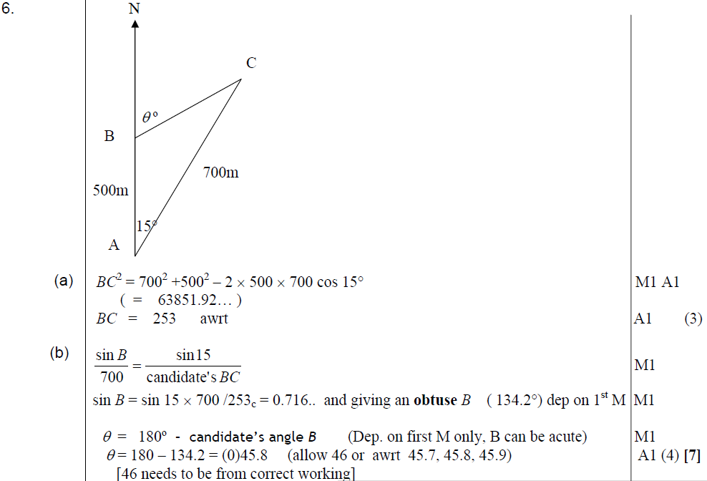
Jan 2008
A
B

Slide 63
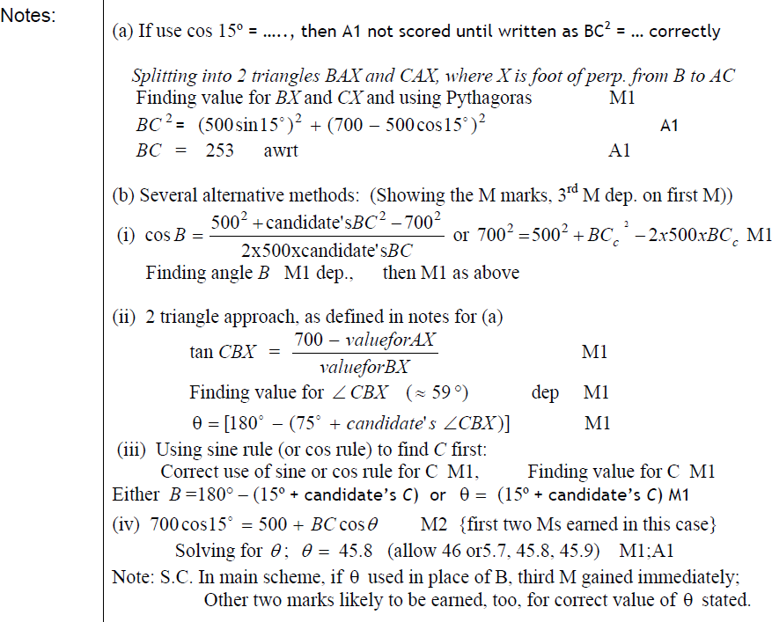
A notes
Jan 2008
B notes (several other methods)

Slide 64
June 2008

Slide 65
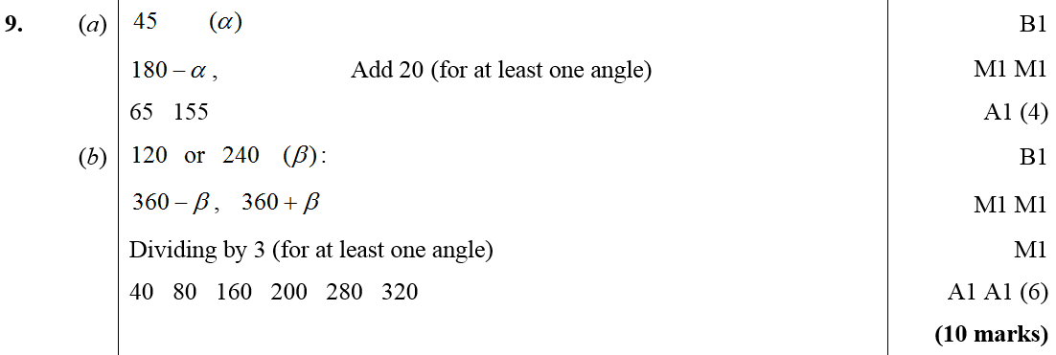
June 2008
A
B

Slide 66
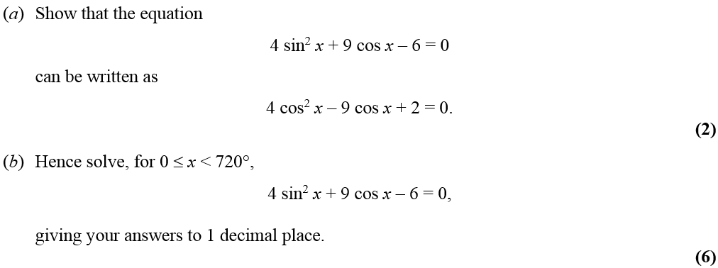
Jan 2009

Slide 67
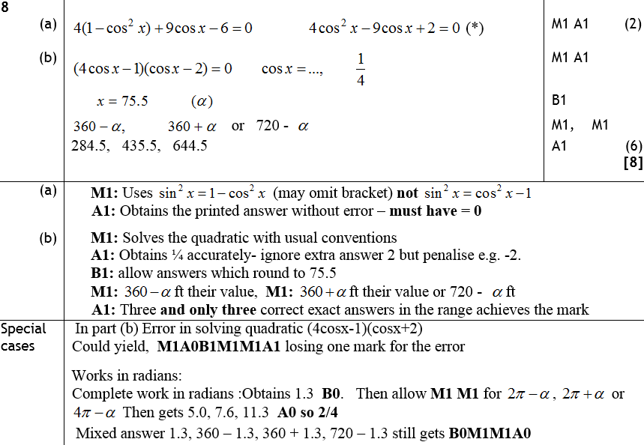
Jan 2009
A
B
A notes
B notes
Special case for B

Slide 68
June 2009

Slide 69
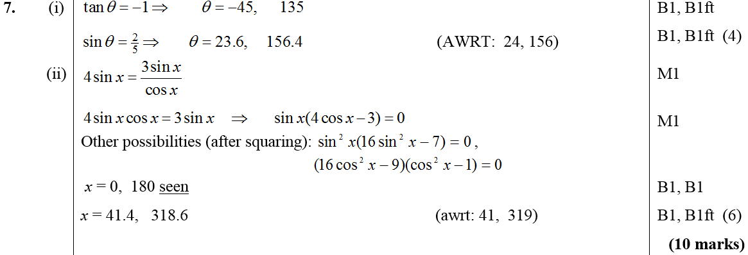
June 2009
(i)
(ii)

Slide 70
Jan 2010

Slide 71
Jan 2010
A
B

Slide 72
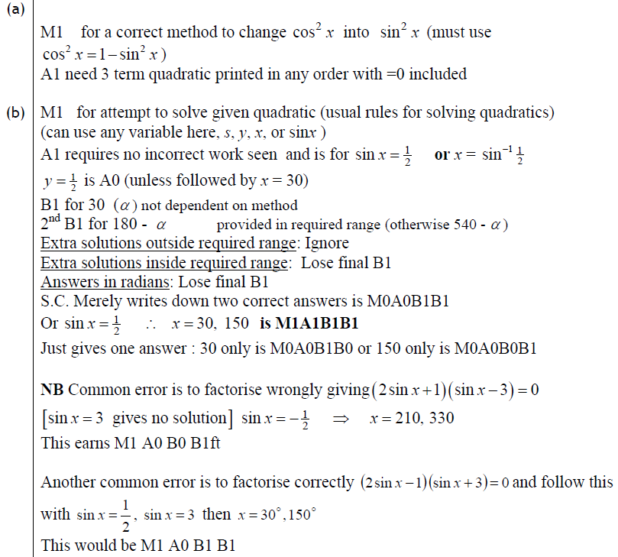
Jan 2010
A
B

Slide 73
June 2010

Slide 74
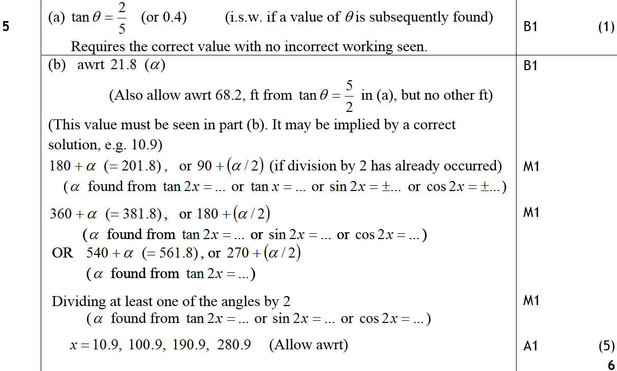
June 2010
A
B

Slide 75
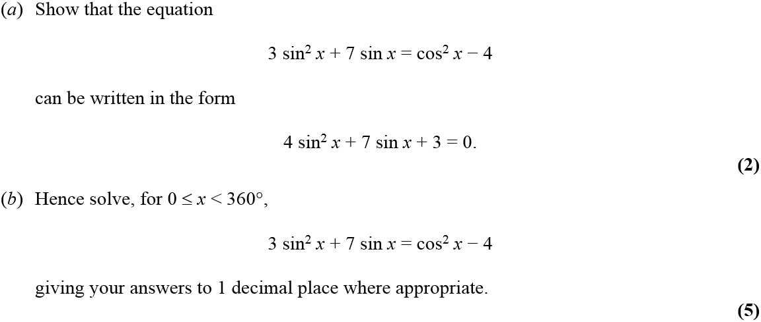
Jan 2011

Slide 76
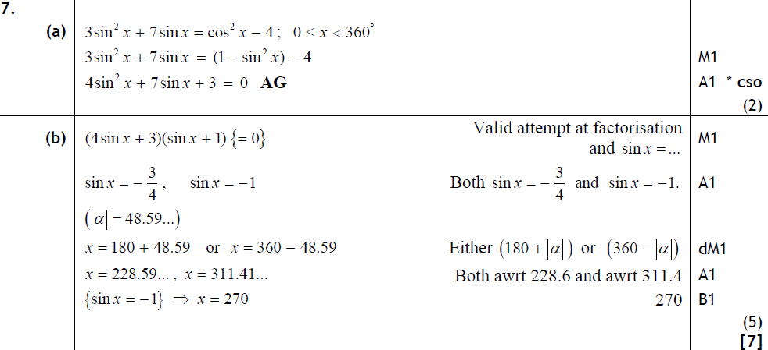
Jan 2011
A
B

Slide 77
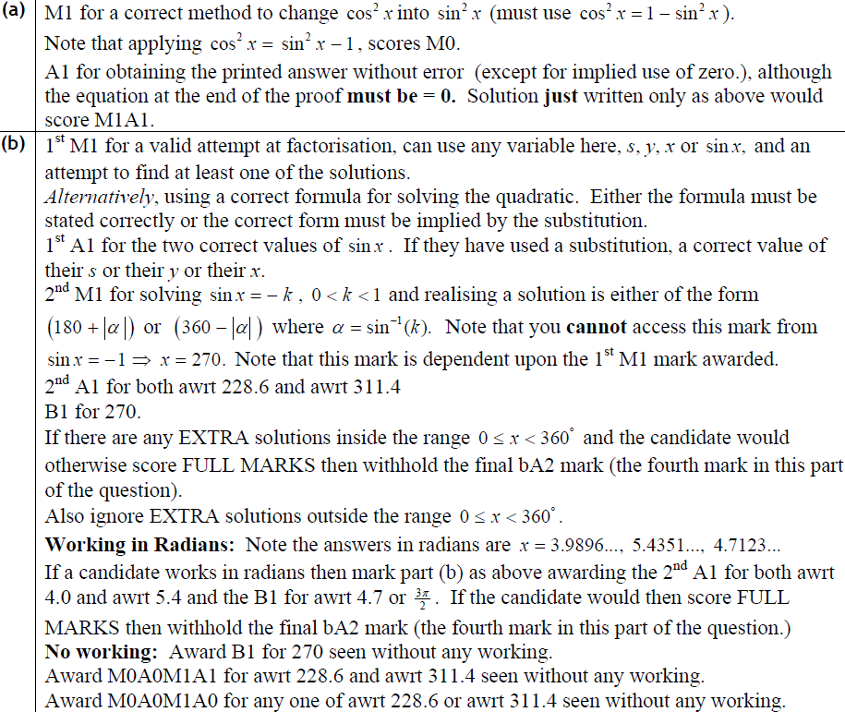
Jan 2011
A
B

Slide 78
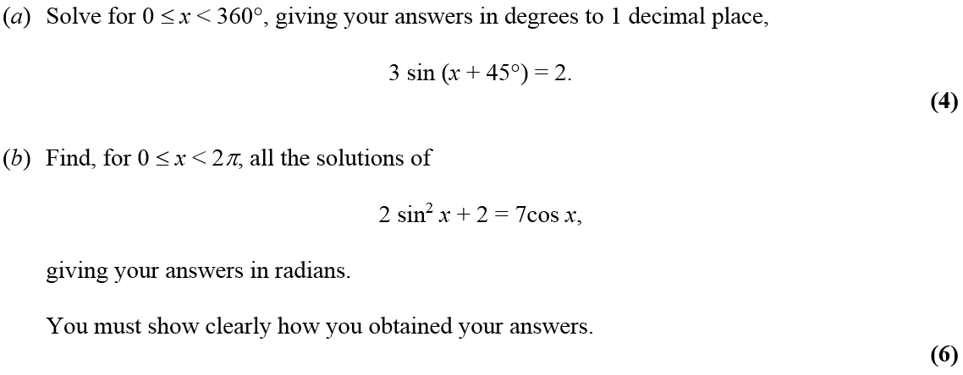
May 2011

Slide 79
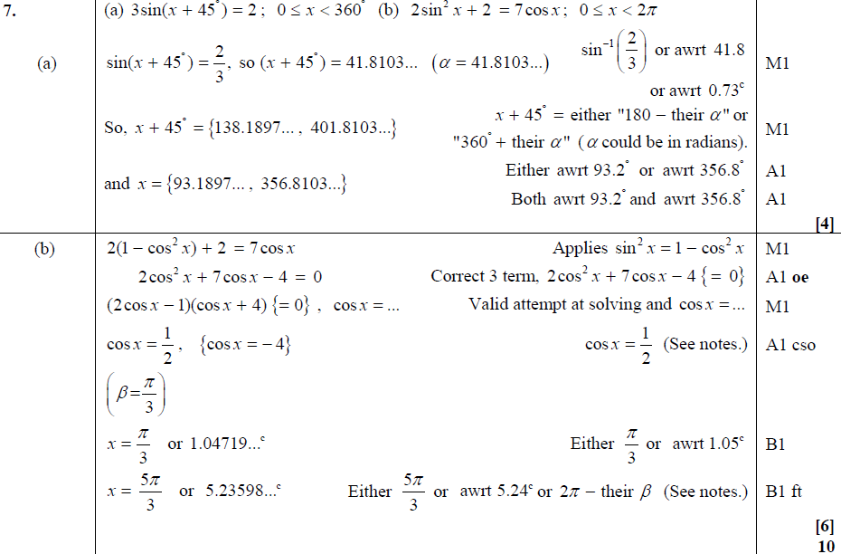
May 2011
A
B

Slide 80
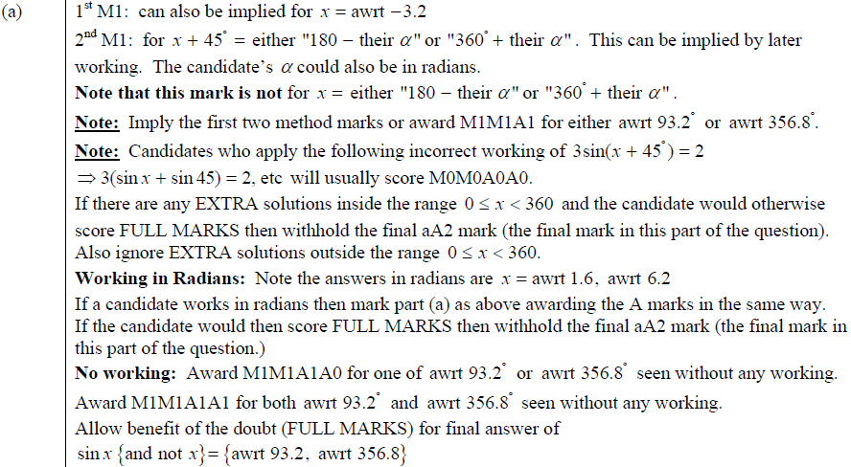
May 2011
A

Slide 81
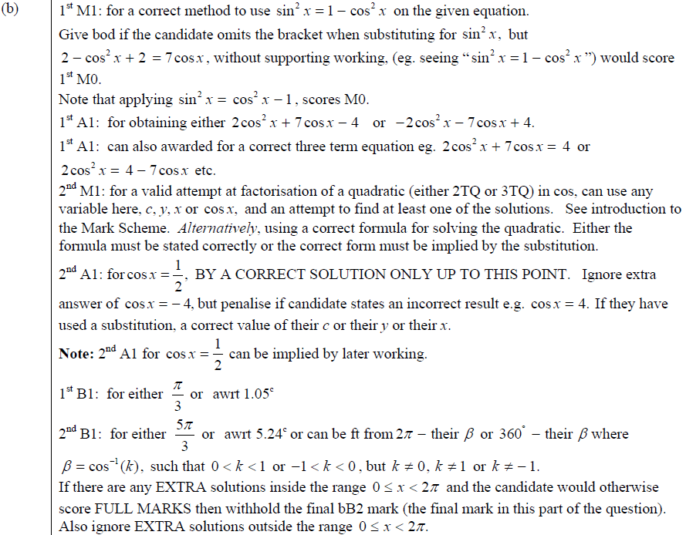
May 2011
B

Slide 82
Jan 2012

Slide 83
i
Jan 2012
ii
Alternative Method

Slide 84
Jan 2012
i
ii

Slide 85
May 2012

Slide 86
May 2012
A
B

Slide 87
May 2012
A
B

Slide 88
Jan 2013

Slide 89
Jan 2013
A

Slide 90
May 2013

Slide 91
May 2013
i
ii (a)
ii (b)

Slide 92
Logarithms
Jan 2010
May 2006
June 2010
Jan 2007
Jan 2011
May 2007
May 2011
Jan 2008
Jan 2012
June 2008
May 2012
Jan 2009
Jan 2013
June 2009
May 2013

Slide 93
May 2006

Slide 94
May 2006
i
ii

Slide 95
Jan 2007

Slide 96
Jan 2007
A
Notes
Possible Ans

Slide 97
May 2007

Slide 98
May 2007
A
B
A notes

Slide 99
May 2007
B notes

Slide 100
Jan 2008

Slide 101
Jan 2008
Method 1
Method 2

Slide 102
Notes
Jan 2008

Slide 103
June 2008

Slide 104
June 2008
A
B

Slide 105
Jan 2009

Slide 106
Jan 2009
A
Notes

Slide 107
Jan 2009
Alternative Methods
Special Cases

Slide 108
June 2009

Slide 109
June 2009
A
B

Slide 110
Jan 2010

Slide 111
Jan 2010
A
B
Alternative A

Slide 112
Jan 2010
A
B

Slide 113
June 2010

Slide 114
June 2010
A
B

Slide 115
Jan 2011

Slide 116
Jan 2011
A
B

Slide 117
Jan 2011
A
B

Slide 118
May 2011

Slide 119
May 2011
A
B

Slide 120
May 2011
A
B

Slide 121
Jan 2012

Slide 122
Jan 2012
A
B
A
B
B

Slide 123
May 2012

Slide 124
May 2012
A
Notes

Slide 125
May 2012
Alternative Method
Common Slips
Special Case

Slide 126
Jan 2013

Slide 127
Jan 2013
A
B

Slide 128
May 2013

Slide 129
May 2013
i
ii

Slide 130
Differentiation
Jan 2006
Jan 2010
May 2006
June 2010 (i)
Jan 2007 (i)
June 2010 (ii)
Jan 2007 (ii)
Jan 2011
May 2007
May 2011
Jan 2008
Jan 2012
June 2008
May 2012
Jan 2009
Jan 2013
June 2009
May 2013

Slide 131
Jan 2006

Slide 132
Jan 2006
A
B
C
D

Slide 133
May 2006

Slide 134
May 2006
A
B
C
D

Slide 135
Jan 2007

Slide 136
Jan 2007
A
B
A notes

Slide 137
Jan 2007
B notes

Slide 138
Jan 2007

Slide 139
Jan 2007
A
B
C

Slide 140
Jan 2007
A notes
A trial and improvement
A graph

Slide 141
Jan 2007
B notes
C notes

Slide 142
May 2007

Slide 143
May 2007
A
B
C
A notes

Slide 144
May 2007
B notes
C notes

Slide 145
Jan 2008

Slide 146
Jan 2008
A
B
C
D

Slide 147
Jan 2008
A
B
C

Slide 148
June 2008

Slide 149
June 2008
A
B

Slide 150
Jan 2009

Slide 151
Jan 2009
A
B
C
Other methods for C

Slide 152
Jan 2009
Alternative A
A notes
B notes
C notes

Slide 153
June 2009

Slide 154
June 2009
A
B
C
D

Slide 155
Jan 2010

Slide 156
Jan 2010
A
B
C

Slide 157
Jan 2010
A
B
C

Slide 158
June 2010

Slide 159
June 2010
A
B

Slide 160
June 2010

Slide 161
June 2010
A
B

Slide 162
Jan 2011

Slide 163
Jan 2011
A
B
C

Slide 164
Jan 2011
A
B
C

Slide 165
May 2011

Slide 166
May 2011
A
B
C

Slide 167
May 2011
A
B
C

Slide 168
Jan 2012

Slide 169
A
Jan 2012
B
C
D

Slide 170
Jan 2012
A
B
C
D

Slide 171
May 2012

Slide 172
A
May 2012
B
C
D
E

Slide 173
May 2012
A
B
C
D
E

Slide 174
Jan 2013

Slide 175
Jan 2013
A
B
C
D

Slide 176
May 2013

Slide 177
May 2013
A
B

Slide 178
Integration
Jan 2006 (i)
Jan 2006 (ii)
Jan 2008
June 2010 (i)
Jan 2013
May 2006 (i)
June 2008 (i)
June 2010 (ii)
May 2013 (i)
May 2006 (ii)
June 2008 (ii)
Jan 2011 (i)
May 2013 (ii)
May 2006 (iii)
Jan 2009 (i)
Jan 2011 (ii)
Jan 2007 (i)
Jan 2009 (ii)
May 2011
Jan 2007 (ii)
June 2009 (i)
Jan 2012
May 2007 (i)
June 2009 (ii)
May 2012 (i)
May 2007 (ii)
Jan 2010
May 2012 (ii)

Slide 179
Jan 2006

Slide 180
Jan 2006
A
B

Slide 181
Jan 2006

Slide 182
Jan 2006
A
B

Slide 183
May 2006

Slide 184
May 2006
A

Slide 185
May 2006

Slide 186
May 2006
A
B
C

Slide 187
May 2006

Slide 188
May 2006
A
B
C
D

Slide 189
Jan 2007

Slide 190
Jan 2007
A
B
A notes

Slide 191
Jan 2007
B notes

Slide 192
Jan 2007

Slide 193
Jan 2007
A
Notes for first 4 marks

Slide 194
Jan 2007
Notes for last 5 marks

Slide 195
May 2007

Slide 196
May 2007
A

Slide 197
May 2007
A notes

Slide 198
May 2007

Slide 199
May 2007
A
B
C

Slide 200
May 2007
A notes
B notes
C notes

Slide 201
Jan 2008

Slide 202
Jan 2008
A
B
C

Slide 203
Jan 2008
B notes
C notes and alternative method

Slide 204
June 2008

Slide 205
June 2008
A
B

Slide 206
June 2008

Slide 207
June 2008
A
B

Slide 208
Jan 2009

Slide 209
A
Jan 2009
Notes
Special Cases

Slide 210
Jan 2009

Slide 211
Jan 2009
A
B
A notes
B notes
Special Cases

Slide 212
June 2009

Slide 213
June 2009
A

Slide 214
June 2009

Slide 215
June 2009
A
B
C

Slide 216
Jan 2010

Slide 217
Jan 2010
A
B
C
D
Alternative D (i)

Slide 218
Jan 2010
A
B
C
D
Alternative D (ii)
Alternative D (iii)

Slide 219
June 2010

Slide 220
June 2010
A
B

Slide 221
June 2010

Slide 222
June 2010
A
B

Slide 223
Jan 2011

Slide 224
Jan 2011
A
B

Slide 225
Jan 2011
A
B

Slide 226
Jan 2011

Slide 227
Jan 2011
A
B
C

Slide 228
Jan 2011
B
C

Slide 229
May 2011

Slide 230
May 2011
A
B

Slide 231
May 2011
A
B

Slide 232
May 2011
Alternative B

Slide 233
May 2011
Notes on Alternative B

Slide 234
May 2011
2 more methods for B

Slide 235
Jan 2012

Slide 236
Jan 2012
A
B
C

Slide 237
Jan 2012
A
B
C
B

Slide 238
May 2012

Slide 239
May 2012
A
Method 1
B

Slide 240
May 2012
Method 1
Notes
A
B

Slide 241
May 2012
B
Method 2
Special case for above method

Slide 242
May 2012
Method 2
Special Case 2
Notes
Notes

Slide 243
May 2012

Slide 244
May 2012
A
B
A
B

Slide 245
Jan 2013

Slide 246
Jan 2013
A
B
C

Slide 247
May 2013

Slide 248
May 2013
A
B
C

Slide 249
May 2013

Slide 250
May 2013
A
B

Slide 251
Factors
Jan 2006
Jan 2010
May 2006
June 2010
Jan 2007
Jan 2011
May 2007
May 2011
Jan 2008
Jan 2012
June 2008
May 2012
Jan 2009
Jan 2013
June 2009
May 2013

Slide 252
Jan 2006

Slide 253
Jan 2006
A
B
C

Slide 254
May 2006

Slide 255
May 2006
A
B
C
A
B

Slide 256
May 2006
C

Slide 257
Jan 2007

Slide 258
Jan 2007
A
B
C
A notes

Slide 259
Jan 2007
B notes (i)
B notes (comparing coefficents)

Slide 260
Jan 2007
B notes (factor theorem)
C notes

Slide 261
May 2007

Slide 262
May 2007
A
B
A notes

Slide 263
May 2007
B notes

Slide 264
Jan 2008

Slide 265
Jan 2008
A (i)
A (ii)
B
A notes

Slide 266
Jan 2008
B

Slide 267
June 2008

Slide 268
June 2008
A
B

Slide 269
Jan 2009

Slide 270
Jan 2009
A
B
Alternative A
Alternative B

Slide 271
Jan 2009
A notes
B notes
Alternative A
Alternative B
Beware

Slide 272
June 2009

Slide 273
June 2009
A
B
C

Slide 274
Jan 2010

Slide 275
Jan 2010
A
B
Alternative A
Alternative B

Slide 276
Jan 2010
A
B

Slide 277
June 2010

Slide 278
June 2010
A
B

Slide 279
Jan 2011

Slide 280
Jan 2011
A
B

Slide 281
Jan 2011
A
B
A (long division)
B (long division)

Slide 282
May 2011

Slide 283
May 2011
A
B
C
A
B

Slide 284
May 2011
C

Slide 285
Jan 2012

Slide 286
Jan 2012
A
B
Long Division

Slide 287
Jan 2012
A
B

Slide 288
May 2012

Slide 289
May 2012
A
B
A
B

Slide 290
Jan 2013

Slide 291
Jan 2013
A
B

Slide 292
May 2013

Slide 293
May 2013
A
B
C

Slide 294
Geometric Sequences and Series
Jan 2006
Jan 2010
May 2006
June 2010
Jan 2007
Jan 2011
May 2007
May 2011
Jan 2008
Jan 2012
June 2008
May 2012
Jan 2009
Jan 2013
June 2009
May 2013

Slide 295
Jan 2006

Slide 296
A
Jan 2006
B
C
D

Slide 297
May 2006

Slide 298
May 2006
A
B
C
D
E

Slide 299
Jan 2007

Slide 300
Jan 2007
A
B
C
D

Slide 301
Jan 2007
A
A slight alternate

Slide 302
Jan 2007
B
Alternative B (adding 10 terms)

Slide 303
Jan 2007
C
D

Slide 304
May 2007

Slide 305
May 2007
A
B
C
D

Slide 306
May 2007
B notes
C notes
D notes

Slide 307
Jan 2008

Slide 308
Jan 2008
A
B
C
A notes
B notes
C notes

Slide 309
June 2008

Slide 310
June 2008
A
B
C
D

Slide 311
Jan 2009

Slide 312
Jan 2009
A
B
C
D

Slide 313
Jan 2009
A notes
B notes
C notes
D notes

Slide 314
June 2009

Slide 315
June 2009
A
B
C
D

Slide 316
Jan 2010

Slide 317
Jan 2010
A
B
C
D
Alternative B
Alternative C
Alternative D

Slide 318
Jan 2010
A
B
C
D

Slide 319
June 2010

Slide 320
June 2010
A
B
C
D
E

Slide 321
Jan 2011

Slide 322
Jan 2011
A
B
C

Slide 323
Jan 2011
A
B
C

Slide 324
May 2011

Slide 325
A
May 2011
B
C
D

Slide 326
May 2011
A
B

Slide 327
C
May 2011
D

Slide 328
May 2011
D…

Slide 329
Jan 2012

Slide 330
Jan 2012
A
B
C
A
B
C
A
B

Slide 331
May 2012

Slide 332
May 2012
A
B
C
D

Slide 333
May 2012
A
B
C
D
COMMON ERRORS

Slide 334
Jan 2013

Slide 335
Jan 2013
A
B
C

Slide 336
May 2013

Slide 337
May 2013
A
B
C

Slide 338
Radians
Jan 2006
Jan 2010
May 2006
June 2010
Jan 2007
Jan 2011
May 2007
May 2011
Jan 2008
Jan 2012
June 2008
May 2012
Jan 2009
Jan 2013
June 2009
May 2013

Slide 339
Jan 2006

Slide 340
Jan 2006
A
B
C
D

Slide 341
May 2006

Slide 342
May 2006
A
B
C
D

Slide 343
Jan 2007

Slide 344
Jan 2007
A
B
C
D
E

Slide 345
Jan 2007
A
A alternative

Slide 346
Jan 2007
B
C

Slide 347
Jan 2007
Alternative C
D
E

Slide 348
May 2007

Slide 349
May 2007
A
B
C

Slide 350
May 2007
B notes
C notes

Slide 351
Jan 2008

Slide 352
A
Jan 2008
B
C

Slide 353
Jan 2008
A notes
B notes
C notes

Slide 354
June 2008

Slide 355
June 2008
A
B
C
D

Slide 356
Jan 2009

Slide 357
A
Jan 2009
B
C
A notes
B notes
C notes

Slide 358
June 2009

Slide 359
June 2009
A
B
C
D

Slide 360
Jan 2010

Slide 361
Jan 2010
A
B

Slide 362
Jan 2010
A
B
Special Case A

Slide 363
June 2010

Slide 364
June 2010
A
B
C
D

Slide 365
Jan 2011

Slide 366
Jan 2011
A
B

Slide 367
Jan 2011
A
B

Slide 368
May 2011

Slide 369
May 2011
A
B
C
A

Slide 370
May 2011
B
C

Slide 371
Jan 2012

Slide 372
Jan 2012
A
B
C
D
E

Slide 373
Jan 2012
A
B
C
D
E
E

Slide 374
May 2012

Slide 375
May 2012
A
B
C
D

Slide 376
May 2012
A
B
C
A
B
D

Slide 377
Jan 2013

Slide 378
Jan 2013
A
B
C
D

Slide 379
May 2013

Slide 380
May 2013
A
B

Slide 381
Circles
Jan 2006
Jan 2010
May 2006
Jan 2011
Jan 2007
May 2011
May 2007
Jan 2012
June 2008
May 2012
Jan 2009
Jan 2013
June 2009
May 2013

Slide 382
Jan 2006

Slide 383
Jan 2006
A
B
C

Slide 384
May 2006

Slide 385
May 2006
A
B
C

Slide 386
Jan 2007

Slide 387
Jan 2007
A
Notes

Slide 388
May 2007

Slide 389
May 2007
A
B
C

Slide 390
May 2007
A notes
C notes

Slide 391
June 2008

Slide 392
June 2008
A
B

Slide 393
Jan 2009

Slide 394
Jan 2009
A
B
Alternative A
Alternative B

Slide 395
Jan 2009
Further Alternatives

Slide 396
Jan 2009
A notes
B notes

Slide 397
June 2009

Slide 398
June 2009
A
B
C

Slide 399
Jan 2010

Slide 400
Jan 2010
A
B
C
D
E

Slide 401
Jan 2010
A
B
C
D
E

Slide 402
Jan 2011

Slide 403
Jan 2011
A
B
C
D

Slide 404
Jan 2011
A
B
C
D

Slide 405
May 2011

Slide 406
May 2011
A
B
C

Slide 407
May 2011
A
B
C

Slide 408
Jan 2012

Slide 409
Jan 2012
A
Notes
Alternative Method

Slide 410
May 2012

Slide 411
May 2012
A
B
C
D

Slide 412
May 2012
A
B
C
A
B
D

Slide 413
Jan 2013

Slide 414
A (i)
Jan 2013
A (ii)
B
C

Slide 415
May 2013

Slide 416
May 2013
A
B

