Slide 1
Core 1
Revision Past Paper Questions
(Edexcel)
Go back to home screen to select a topic
Go back to topic screen to select a question
Go to the mark scheme for that question
Go back to the question from the mark scheme
Or see more solutions
Or go back to first solutions
Next

Slide 2
Notes on operating this resource
When creating this, I used and to quickly navigate between slides directly before or after the slide in question.
As some mark schemes give additional notes, you can continue to see answers by clicking but you will not return to the original question with one click of .
To view the original question again, continue to click which should take you back.
Next

Slide 3
Notes on this resource and the C1 exam
A lot of Questions in Core 1 contain parts from different topics.
For this resource I have duplicated questions to appear in different topics for this reason.
Most of these mixed C1 questions involve
- Sketching graphs (linear and curves)
Working with quadratics
Algebraic manipulation

Slide 4
Cheat sheet example
Home
Inequalities
Factors
Simultaneous Equations
Indices
Surds
Sketching & Transforming Graphs
Differentiation
Integration
Linear Graphs
Sequences and Series
Quadratics and the Discriminant

Slide 5
Indices
May 2007
Jan 2011
Jan 2008
May 2011 (i)
June 2008
May 2011 (ii)
Jan 2009 (i)
May 2012
Jan 2009 (ii)
Jan 2013
June 2009 (i)
May 2013 (i)
June 2009 (ii)
May 2013 (ii)

Slide 6
May 2007

Slide 7
May 2007
A
B
A notes

Slide 8
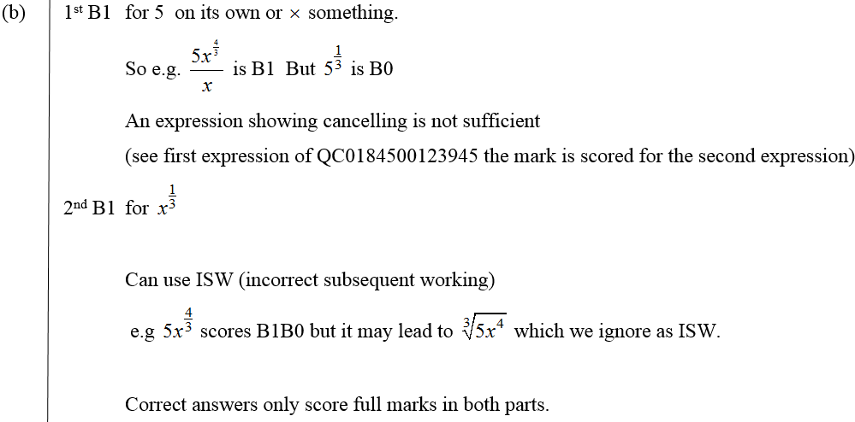
May 2007
B notes

Slide 9
Jan 2008

Slide 10
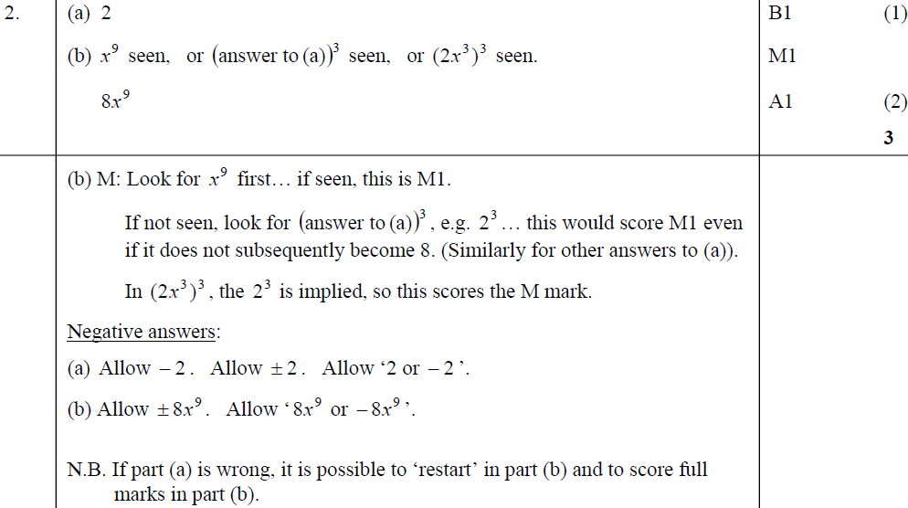
Jan 2008
A
B
B notes
Negative answers (A)
Negative answers (B)

Slide 11
June 2008

Slide 12
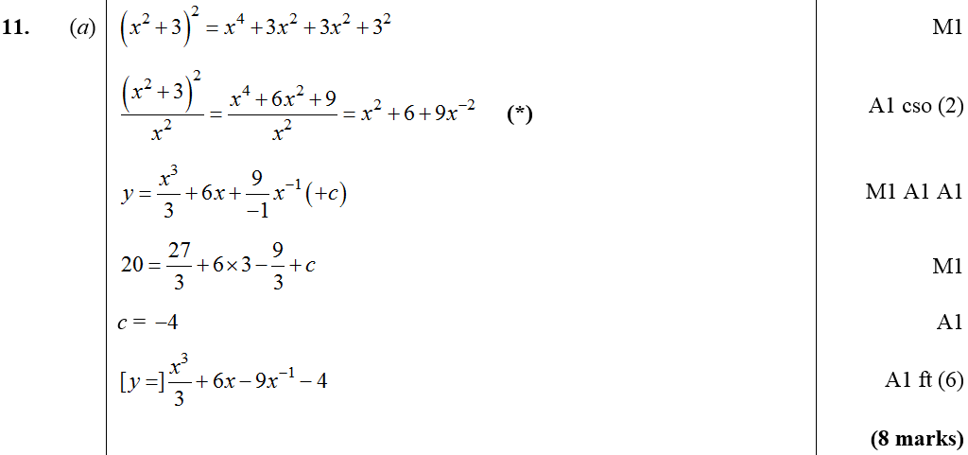
June 2008
A
B

Slide 13
Jan 2009

Slide 14
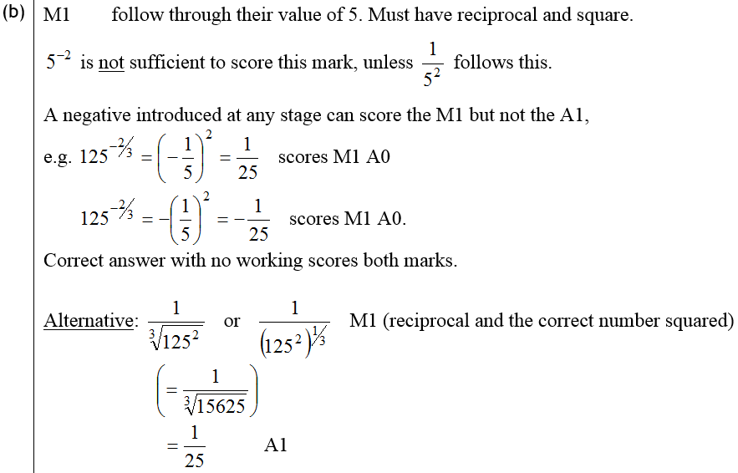
Jan 2009
A
B
B notes

Slide 15
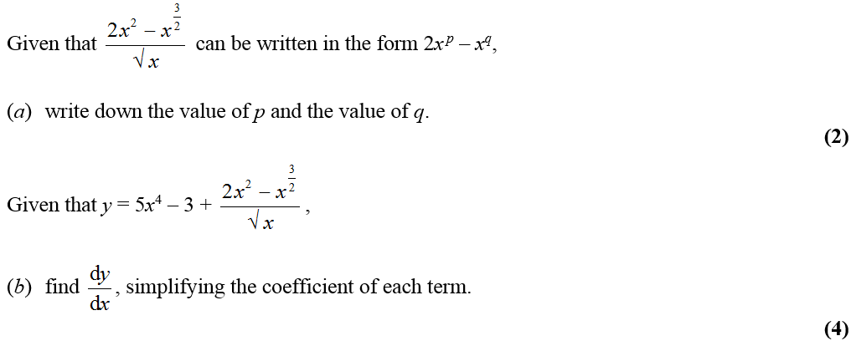
Jan 2009

Slide 16
Jan 2009
A
B
A notes

Slide 17
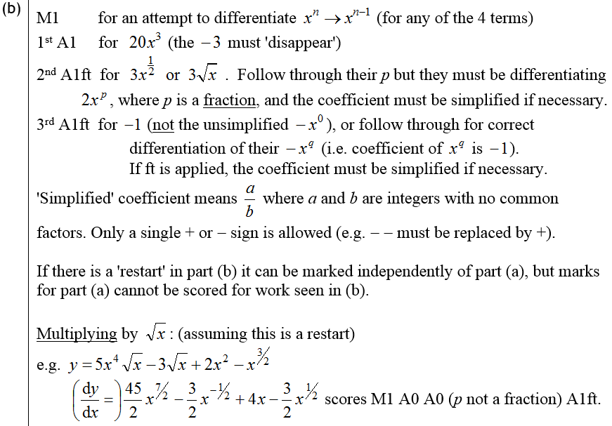
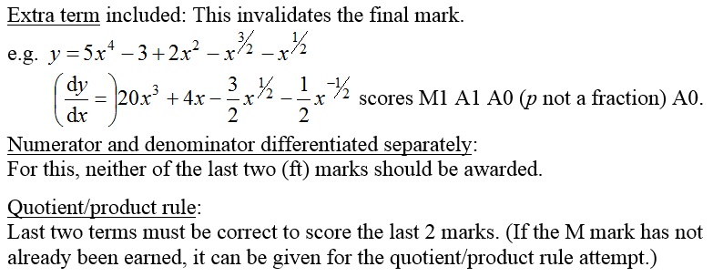
Jan 2009
B notes

Slide 18
June 2009

Slide 19
June 2009
A

Slide 20
June 2009

Slide 21
June 2009
A
B
C

Slide 22
Jan 2011

Slide 23
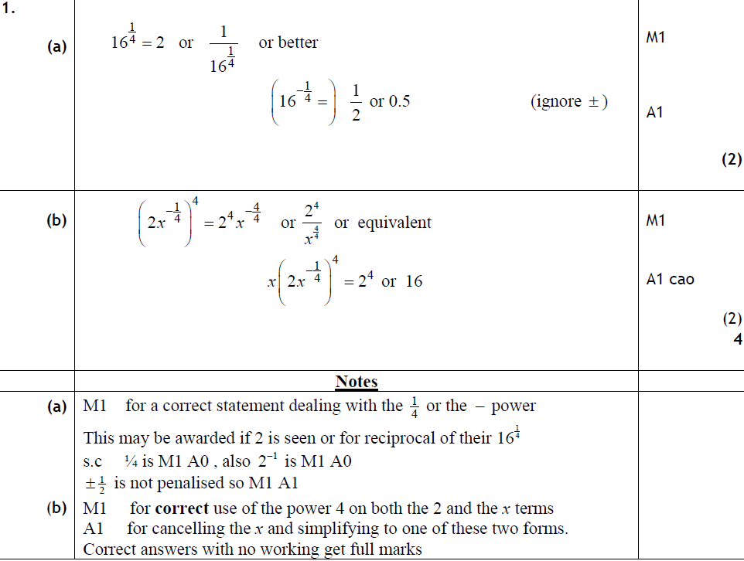
Jan 2011
A
B
A notes
B notes

Slide 24
May 2011

Slide 25
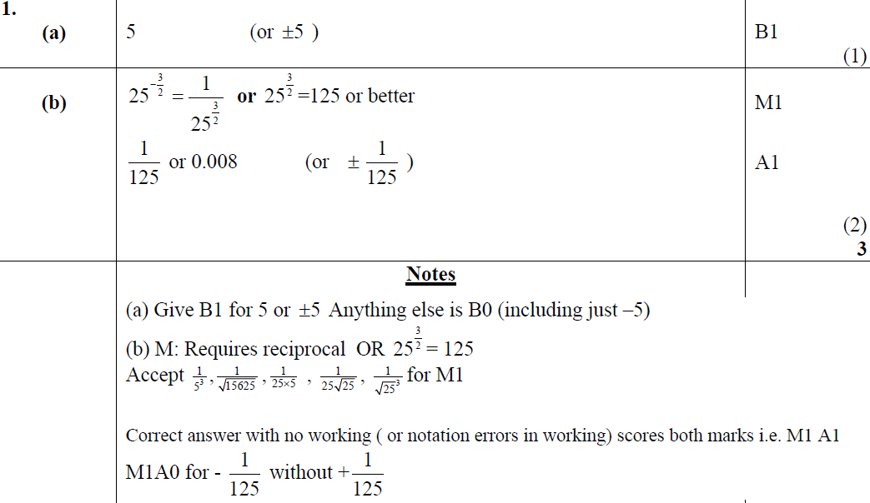
May 2011
A
B
A notes
B notes

Slide 26
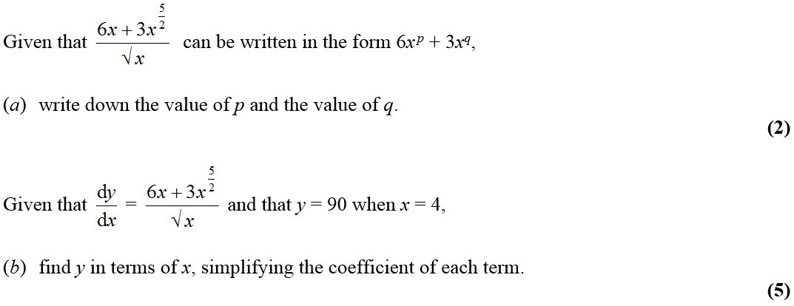
May 2011

Slide 27
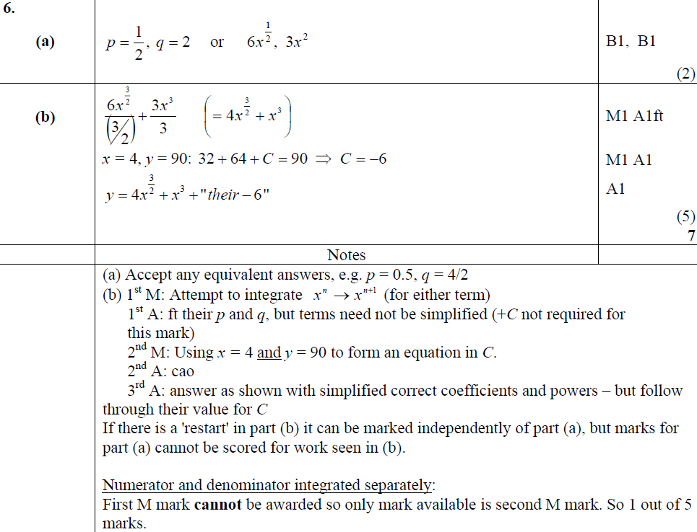
May 2011
A
B
A notes
B notes

Slide 28
May 2012

Slide 29
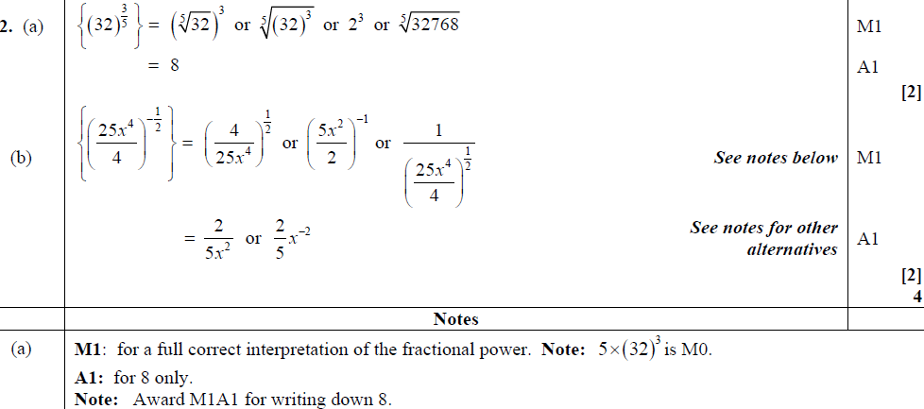
May 2012
A
B
A notes

Slide 30
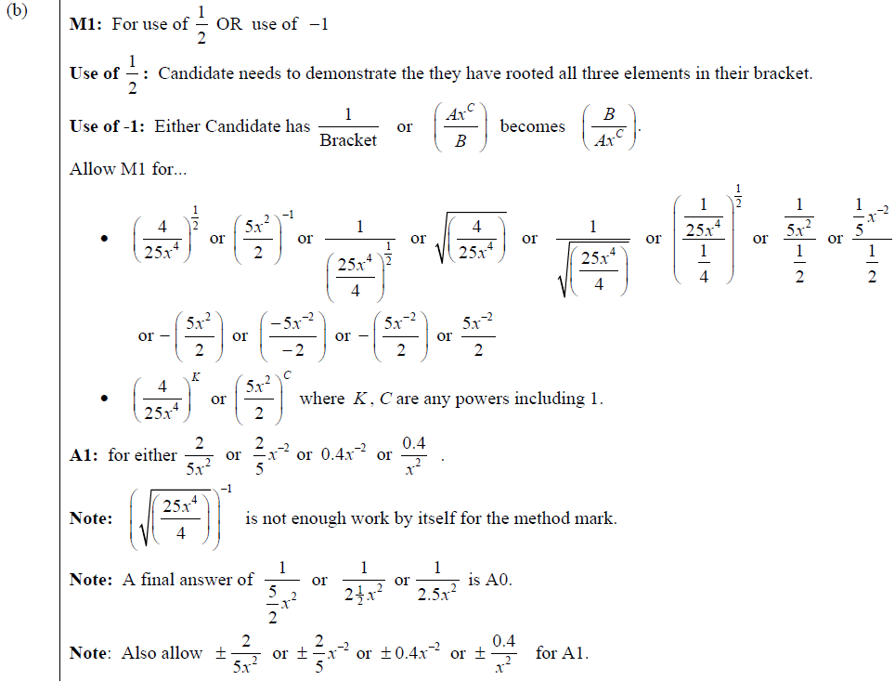
May 2012
B notes

Slide 31
Jan 2013

Slide 32
Jan 2013
A

Slide 33
May 2013

Slide 34
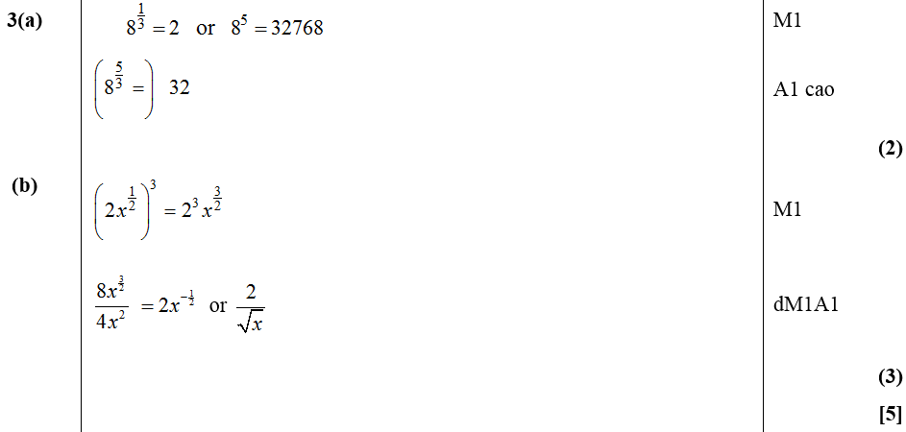
May 2013
A
B

Slide 35
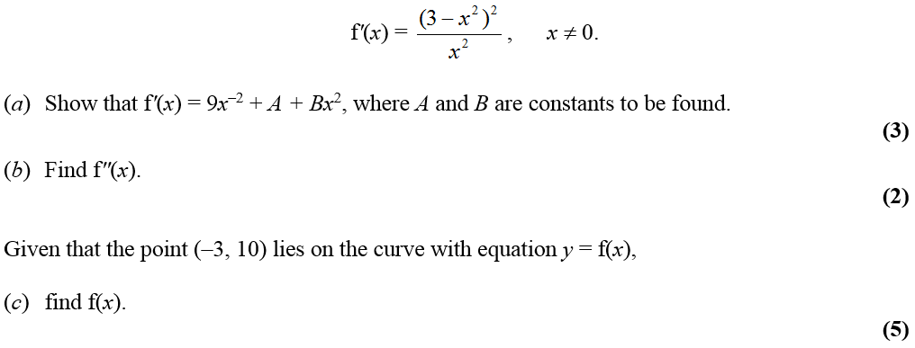
May 2013

Slide 36
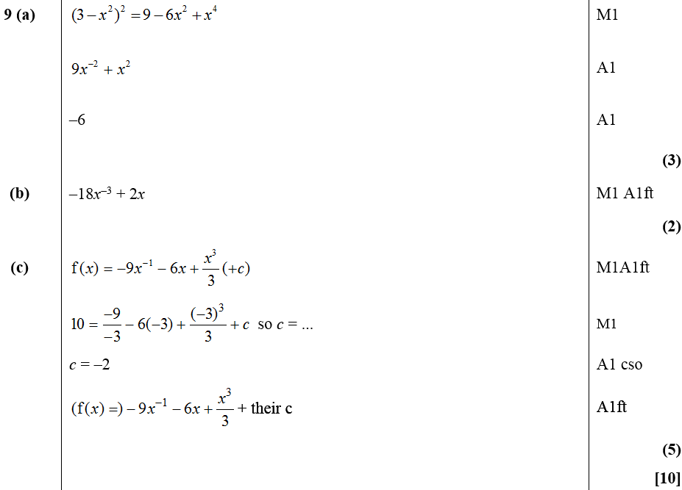
May 2013
A
B
C

Slide 37
Sketching & Transforming Graphs
Jan 2006
Jan 2009 (i)
May 2011 (i)
May 2006 (i)
Jan 2009 (ii)
May 2011 (ii)
May 2006 (ii)
June 2009
Jan 2012 (i)
Jan 2007 (i)
Jan 2010 (i)
Jan 2012 (ii)
Jan 2007 (ii)
Jan 2010 (ii)
May 2012 (i)
May 2007 (i)
Jan 2010 (iii)
May 2012 (ii)
May 2007 (ii)
June 2010 (i)
Jan 2013 (i)
Jan 2008 (i)
June 2010 (ii)
Jan 2013 (ii)
Jan 2008 (ii)
June 2010 (iii)
May 2013
June 2008 (i)
Jan 2011 (i)
June 2008 (ii)
Jan 2011 (ii)

Slide 38
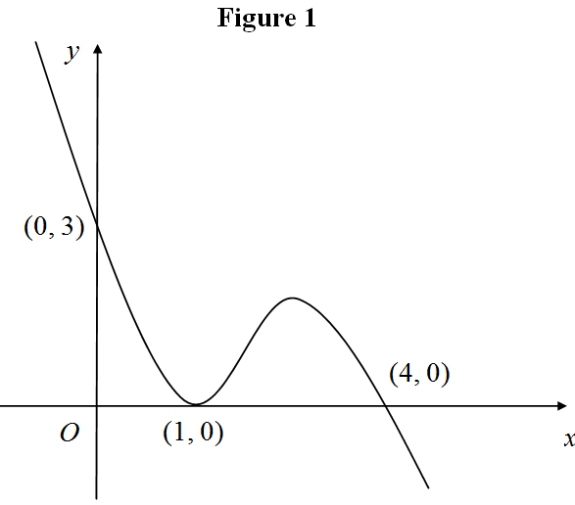
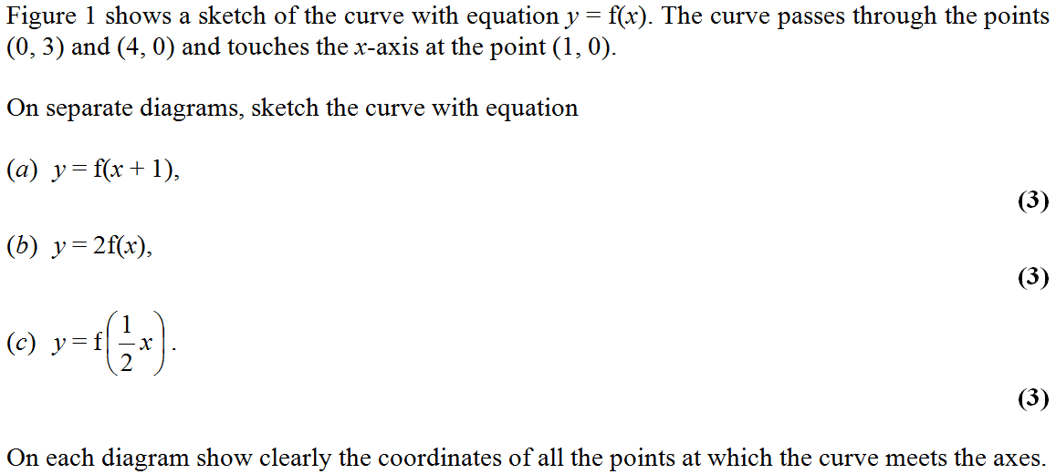
Jan 2006

Slide 39
Jan 2006
A
B
C

Slide 40
May 2006

Slide 41
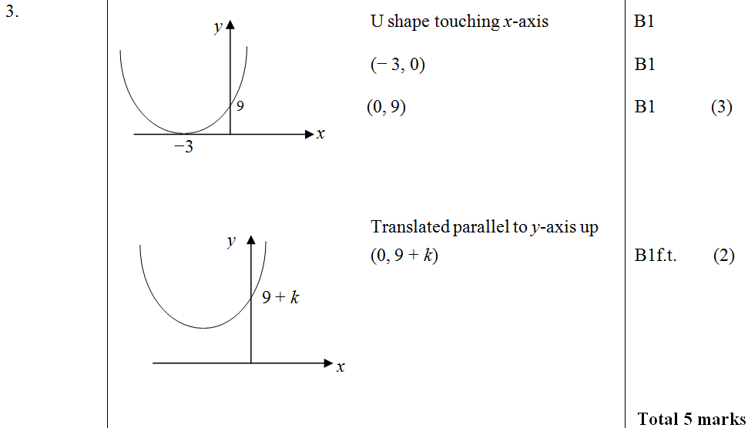
May 2006
A
B

Slide 42
May 2006

Slide 43
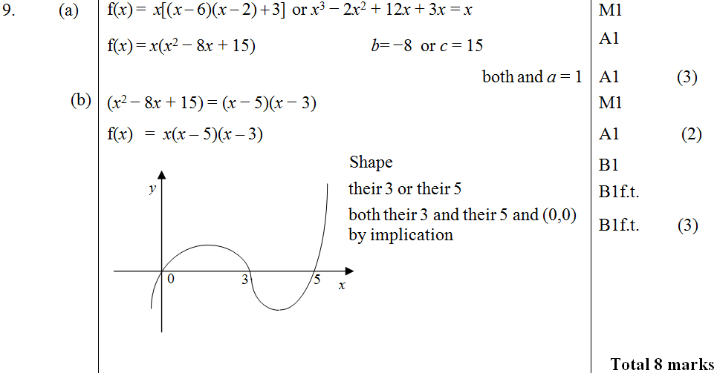
May 2006
A
B
C

Slide 44
Jan 2007

Slide 45
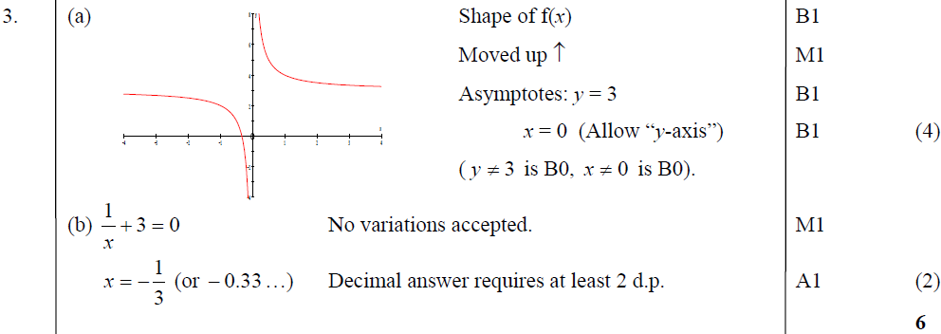
Jan 2007
A
B

Slide 46
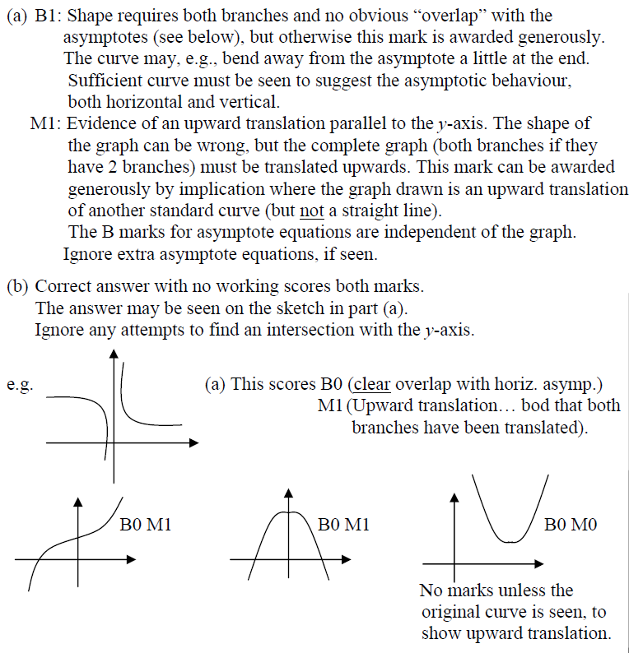
Jan 2007
A notes
B notes

Slide 47
Jan 2007

Slide 48
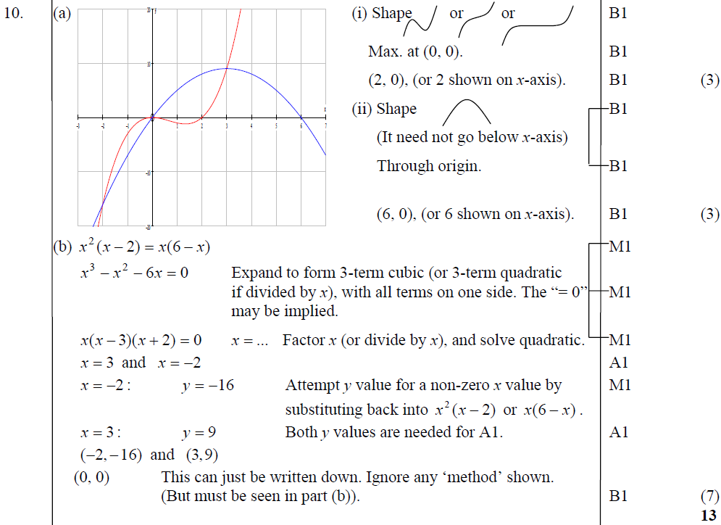
Jan 2007
A
B

Slide 49
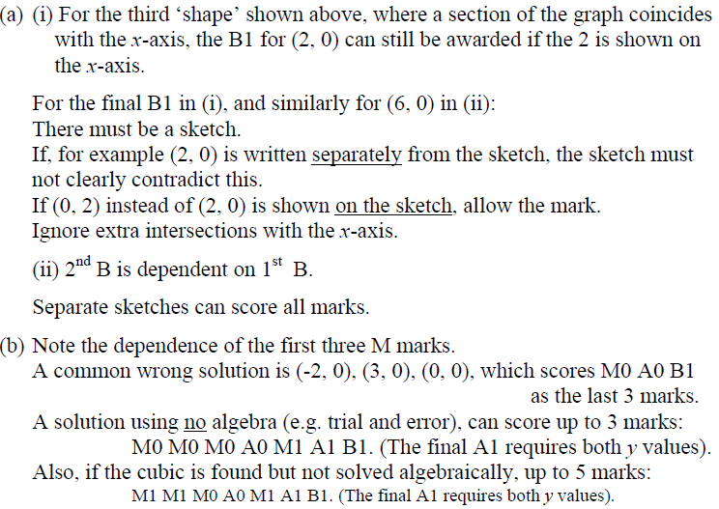
Jan 2007
A notes
B notes

Slide 50
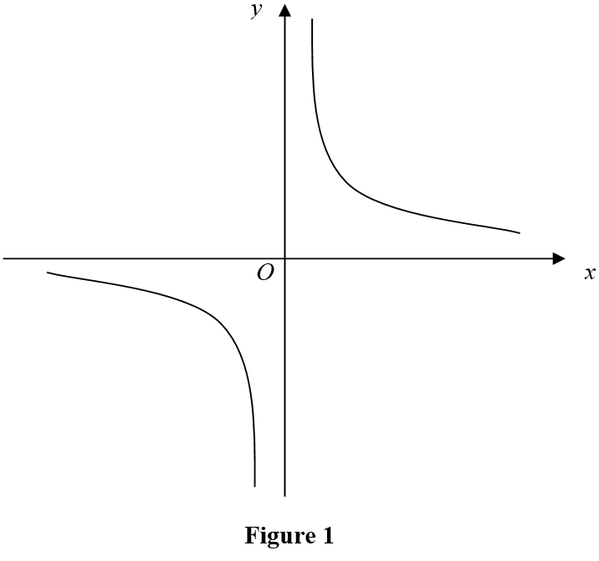
May 2007

Slide 51
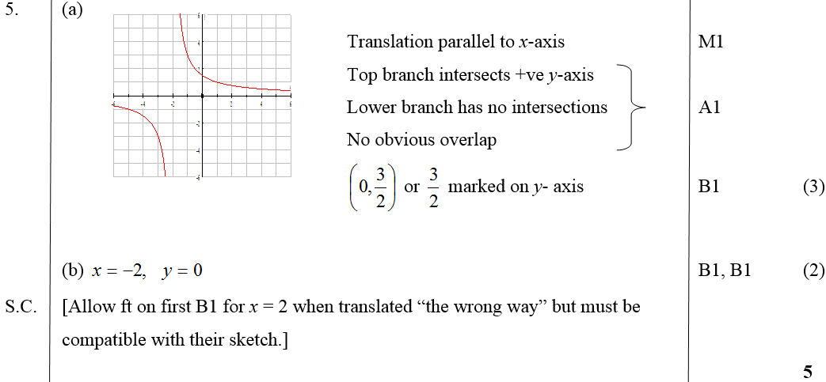
May 2007
A
B

Slide 52
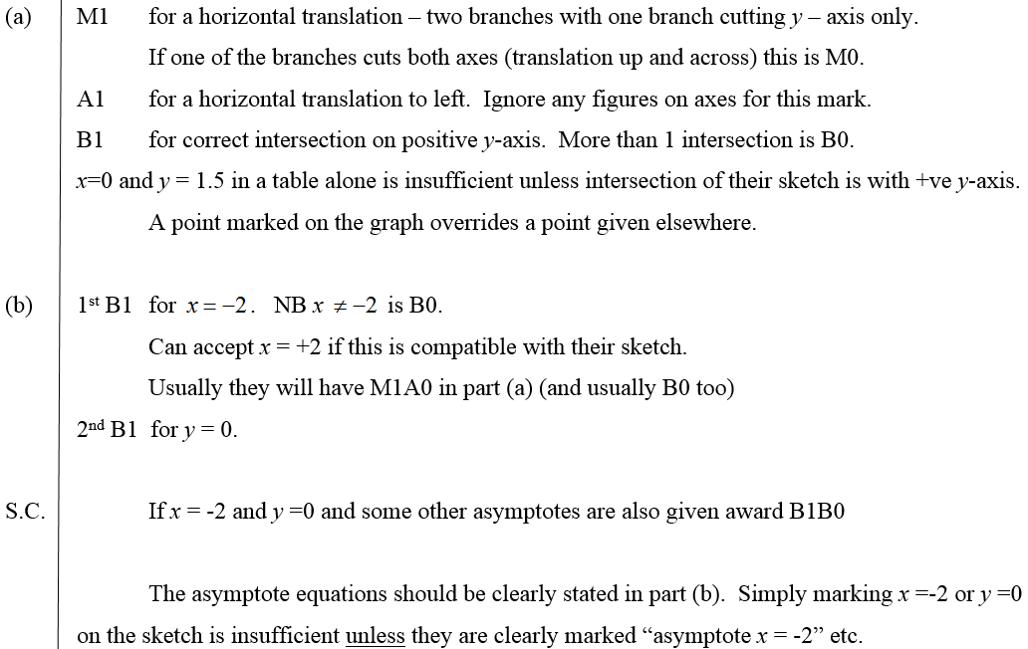
May 2007
A notes
B notes

Slide 53
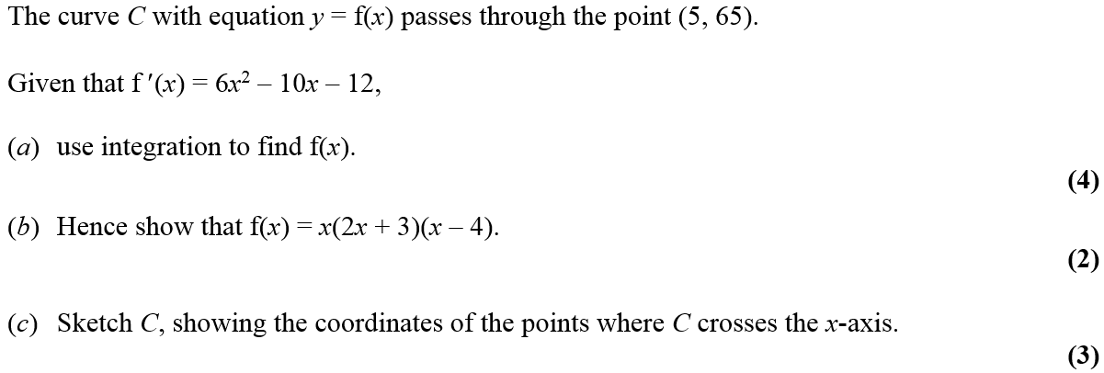
May 2007

Slide 54
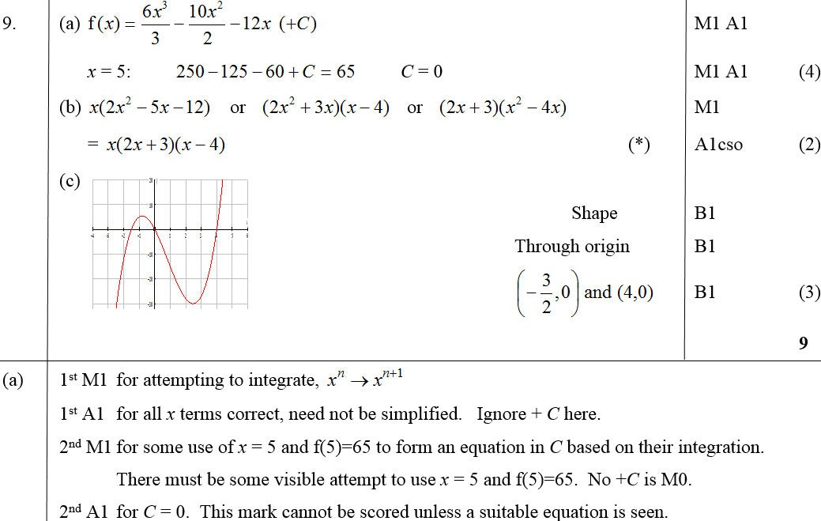
May 2007
A
B
C
A notes

Slide 55
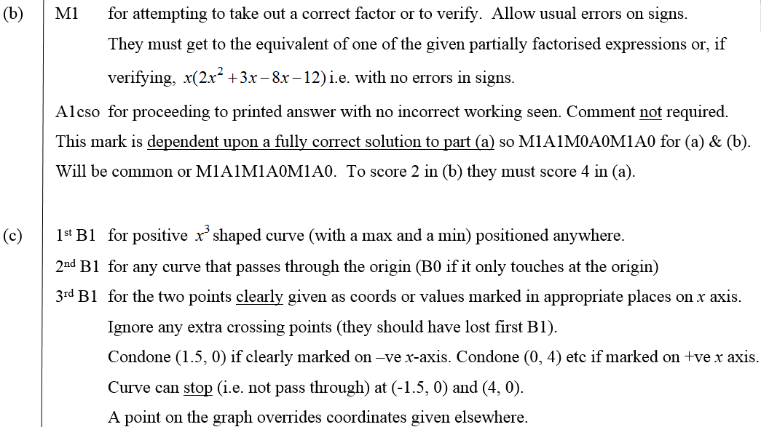
May 2007
B notes
C notes

Slide 56
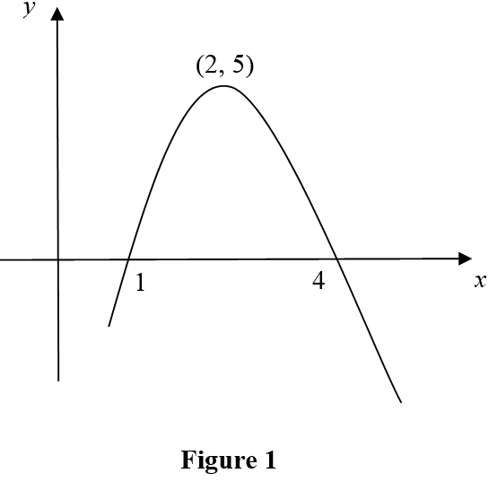
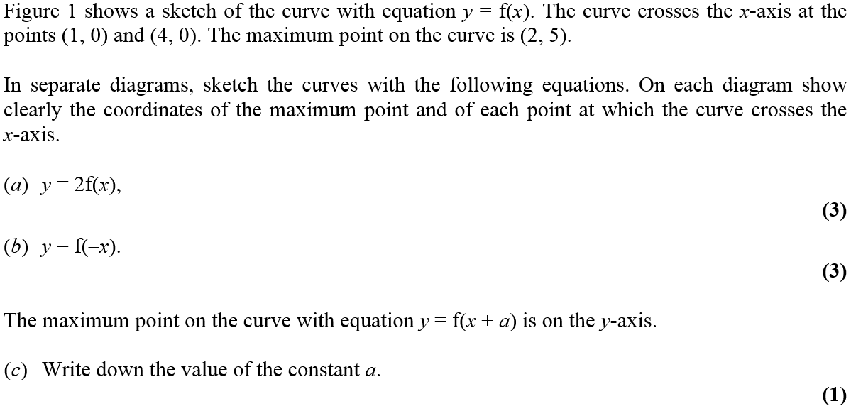
Jan 2008

Slide 57
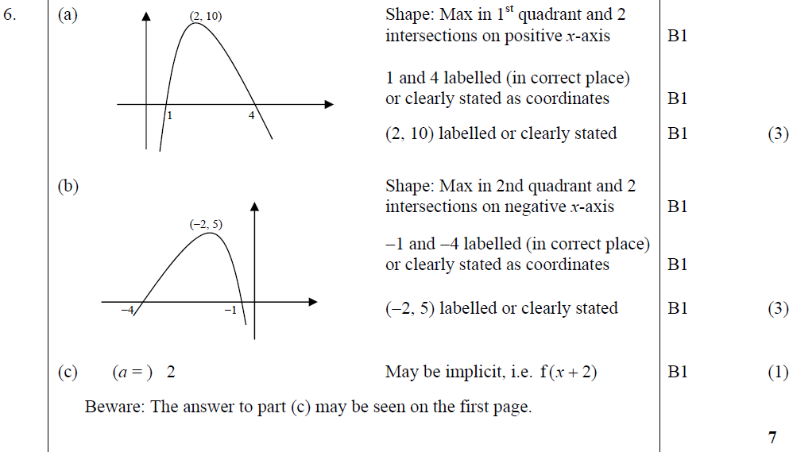
Jan 2008
A
B
C

Slide 58
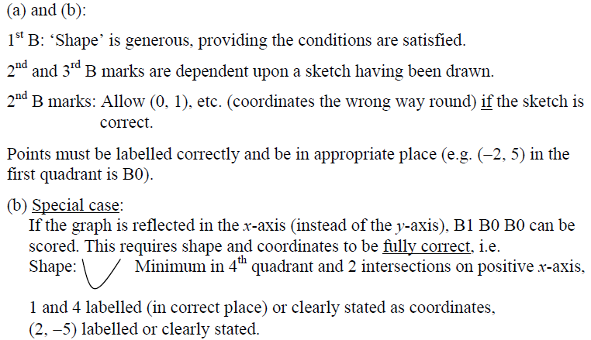
Jan 2008
A & B notes
B Special Case

Slide 59
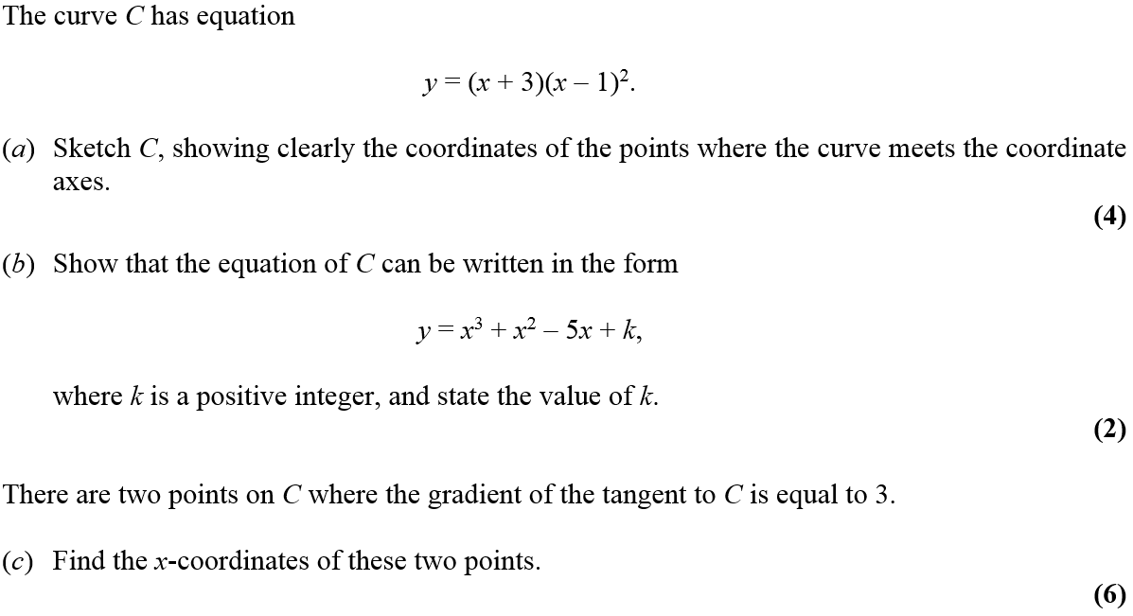
Jan 2008

Slide 60
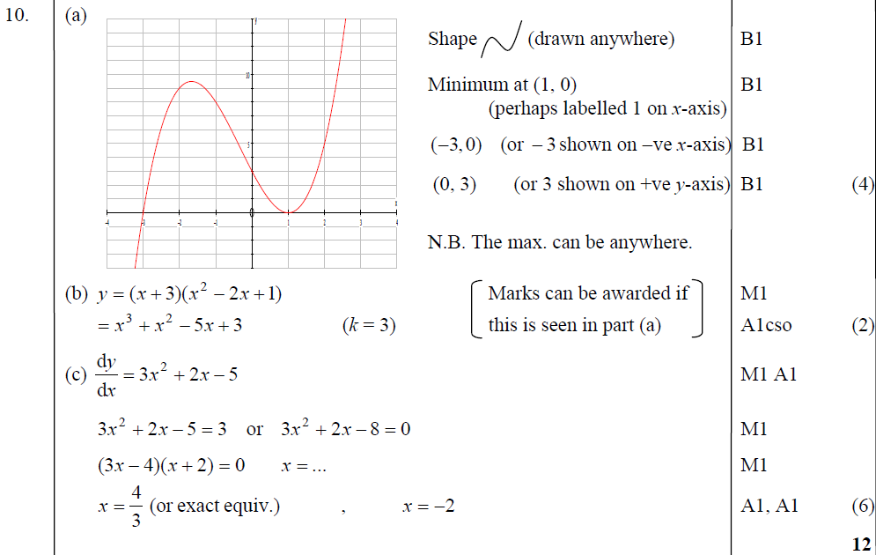
Jan 2008
A
B
C

Slide 61
Jan 2008
A notes
B notes
C notes

Slide 62
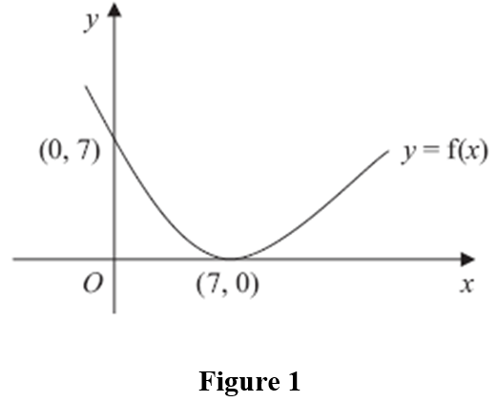
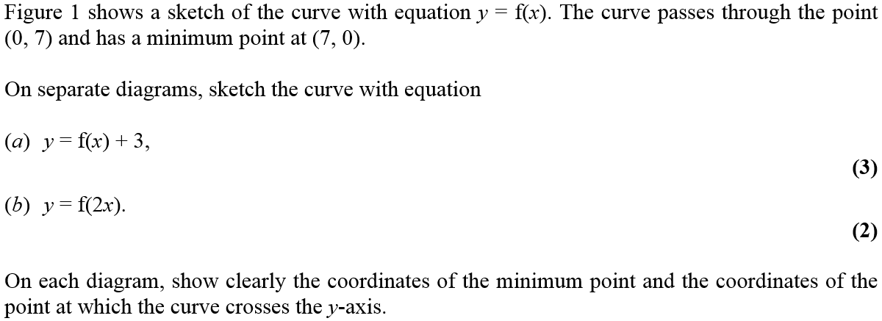
June 2008

Slide 63
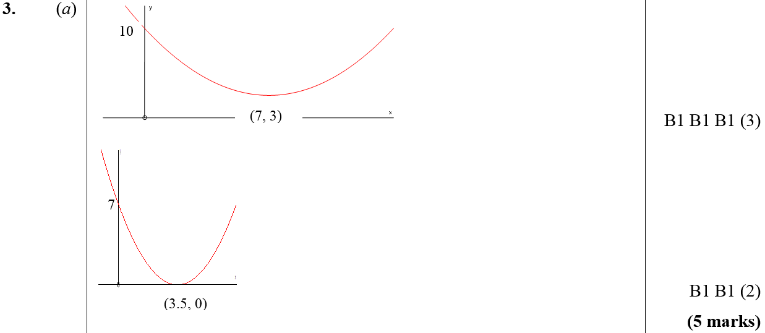
June 2008
A
B

Slide 64
June 2008

Slide 65
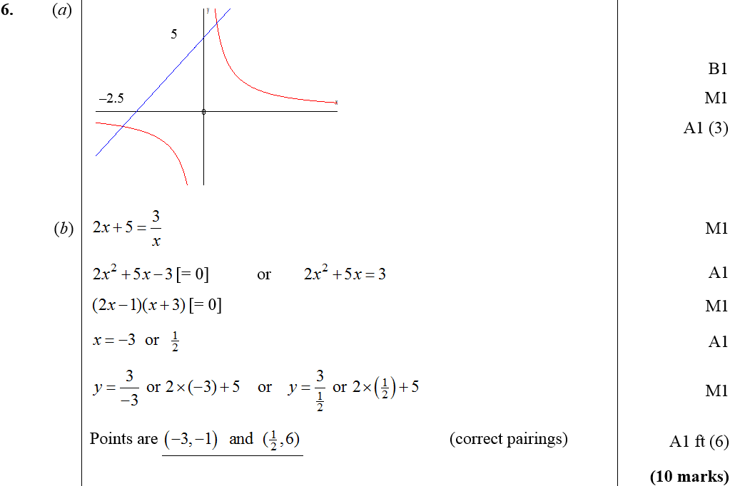
June 2008
A
B

Slide 66
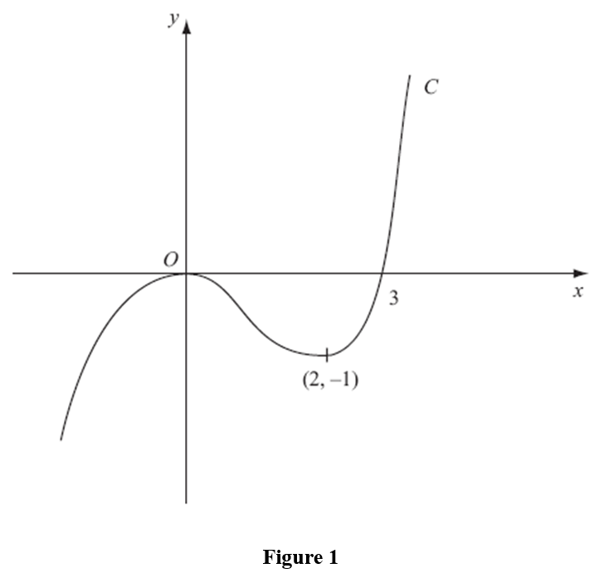
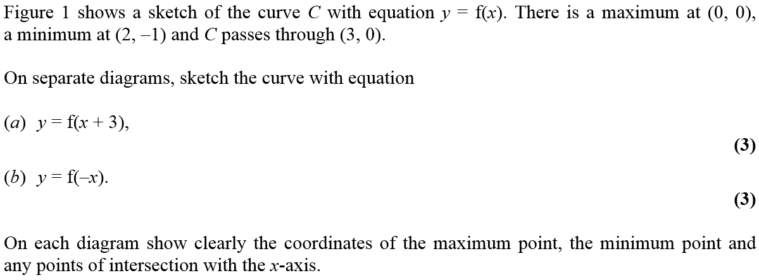
Jan 2009

Slide 67
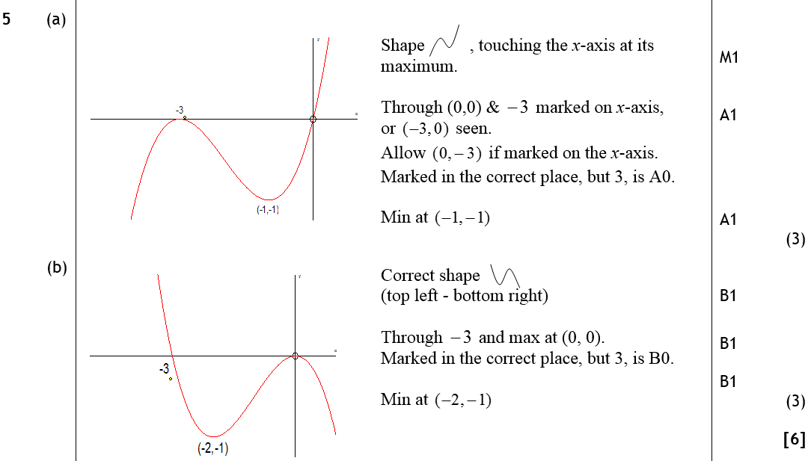
Jan 2009
A
B

Slide 68
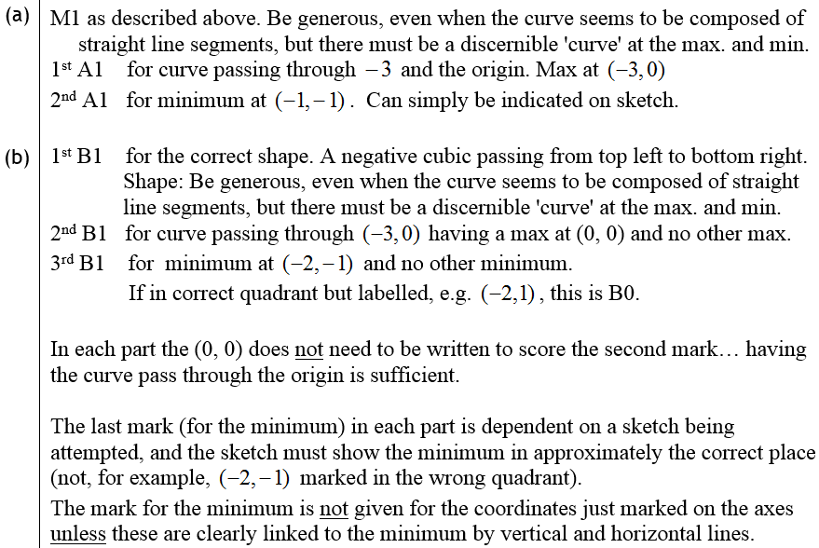
Jan 2009
A notes
B notes

Slide 69
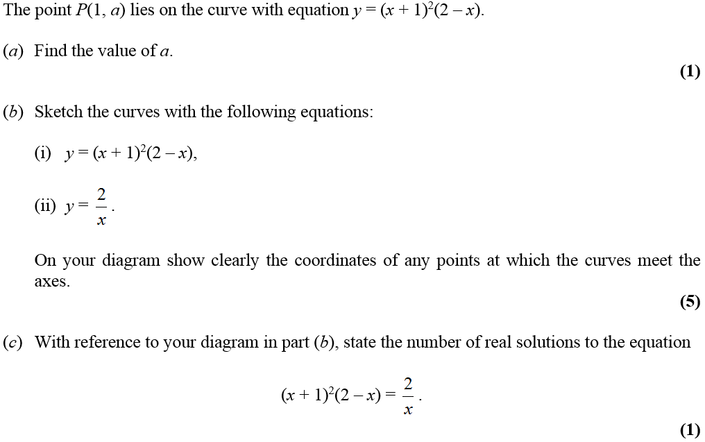
Jan 2009

Slide 70
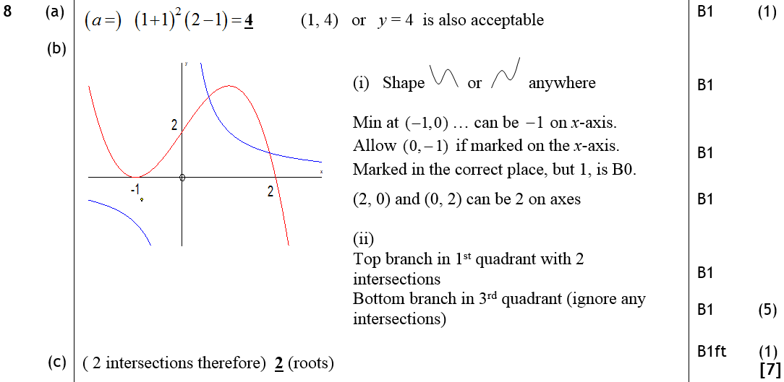
Jan 2009
A
B
C

Slide 71
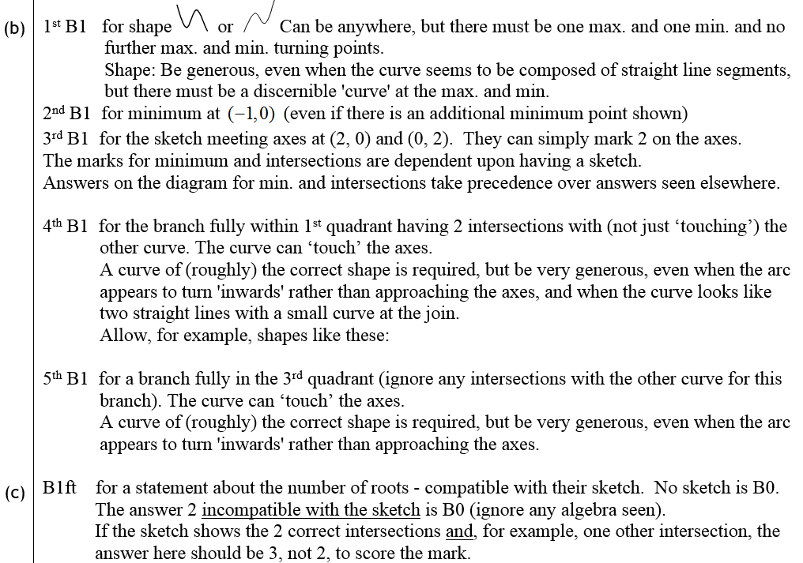
Jan 2009
B notes
C notes

Slide 72
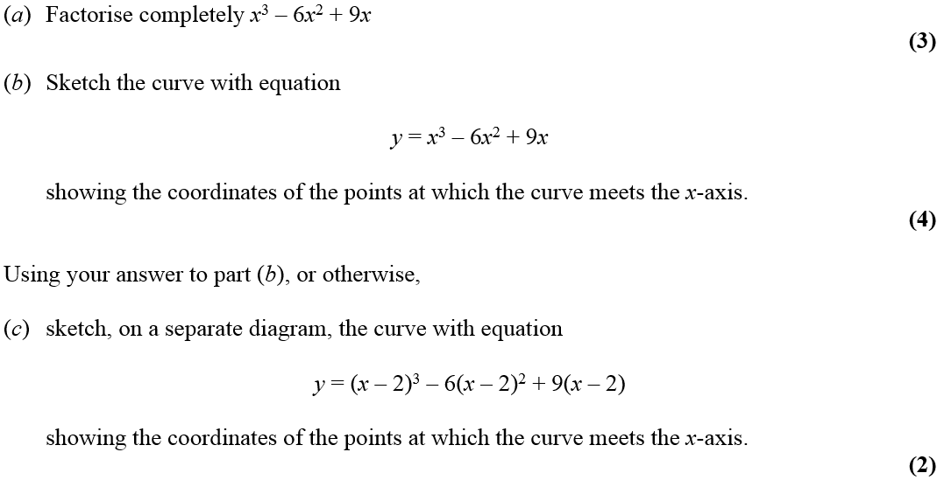
June 2009

Slide 73
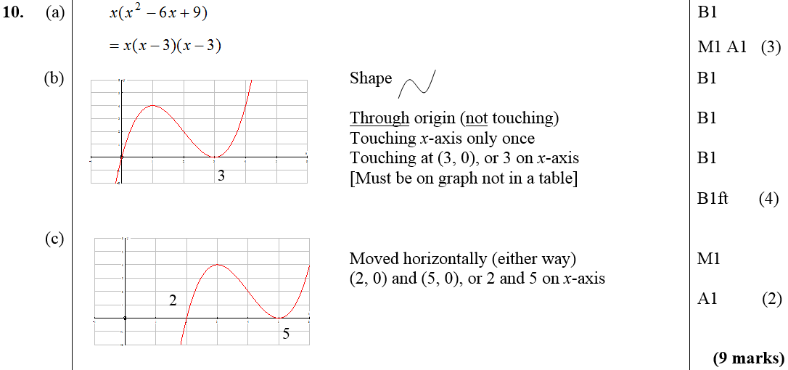
June 2009
A
B
C

Slide 74
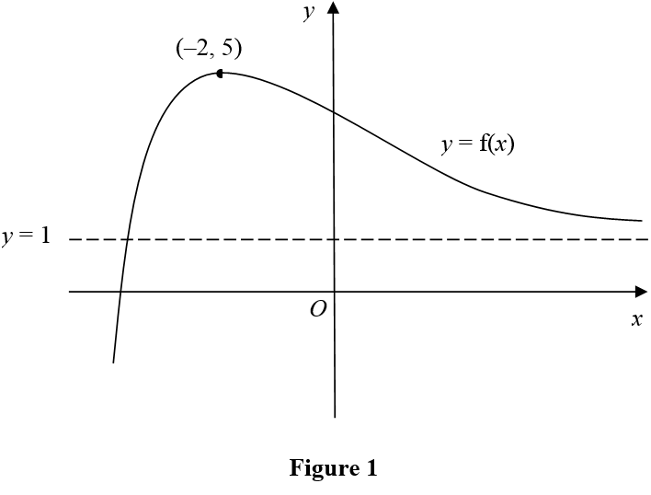
Jan 2010

Slide 75
Jan 2010
A
B
C
A
B
C

Slide 76
Jan 2010

Slide 77
Jan 2010
A
B
C
D

Slide 78
Jan 2010

Slide 79
A
Jan 2010
B
C

Slide 80
June 2010

Slide 81
June 2010
A
B
C

Slide 82
June 2010

Slide 83
June 2010
A
B
C

Slide 84
June 2010

Slide 85
June 2010
A
B
C

Slide 86
Jan 2011

Slide 87
Jan 2011
A
B

Slide 88
Jan 2011
B notes

Slide 89
Jan 2011

Slide 90
Jan 2011
A
B
B notes

Slide 91
May 2011

Slide 92
May 2011
A
B
C

Slide 93
May 2011
A
B
C

Slide 94
May 2011

Slide 95
May 2011
A
B
C
D

Slide 96
May 2011
A notes
B notes
C notes
D notes

Slide 97
Jan 2012

Slide 98
Jan 2012
A
B

Slide 99
Jan 2012

Slide 100
Jan 2012
A
B
C
D

Slide 101
May 2012

Slide 102
May 2012
A
B
C

Slide 103
May 2012
A notes
Alternative A (i)
Alternative A (ii)
Alternative A (iii)
Special Case A

Slide 104
May 2012
B notes
C notes

Slide 105
May 2012

Slide 106
May 2012
A
B (i)
B (ii)
C

Slide 107
May 2012
A notes
B (i) notes
B (ii) notes
C notes

Slide 108
Jan 2013

Slide 109
Jan 2013
A
B
C

Slide 110
Jan 2013

Slide 111
Jan 2013
A
B

Slide 112
May 2013

Slide 113
May 2013
A
B
C

Slide 114
Quadratics and the Discriminant
Jan 2006
Jan 2010
May 2013
May 2006
June 2010
Jan 2007
Jan 2011
May 2007
May 2011
Jan 2008
Jan 2012
June 2008
May 2012
Jan 2009
Jan 2013 (i)
June 2009
Jan 2013 (ii)

Slide 115
Jan 2006

Slide 116
Jan 2006
A
B
C
D

Slide 117
May 2006

Slide 118
May 2006
A
B

Slide 119
Jan 2007

Slide 120
A
Jan 2007
Notes

Slide 121
May 2007

Slide 122
May 2007
A
B

Slide 123
May 2007
A notes
B notes

Slide 124
Jan 2008

Slide 125
Jan 2008
A
B
B notes

Slide 126
Jan 2008
A notes

Slide 127
June 2008

Slide 128
June 2008
A
B

Slide 129
Jan 2009

Slide 130
Jan 2009
A
B
A notes

Slide 131
Jan 2009
B notes

Slide 132
June 2009

Slide 133
June 2009
A

Slide 134
Jan 2010

Slide 135
A
Jan 2010
B
C

Slide 136
June 2010

Slide 137
June 2010
A
B
C

Slide 138
Jan 2011

Slide 139
Jan 2011
A
B
A notes
B notes

Slide 140
May 2011

Slide 141
May 2011
A
B
C
A notes
B notes
C notes

Slide 142
Jan 2012

Slide 143
Jan 2012
A
B

Slide 144
May 2012

Slide 145
May 2012
A
B
C

Slide 146
May 2012
A notes
Alternative A (i)
Alternative A (ii)
Alternative A (iii)
Special Case A

Slide 147
May 2012
B notes
C notes

Slide 148
Jan 2013

Slide 149
Jan 2013
A Method 1
A Method 2
B

Slide 150
Jan 2013

Slide 151
Jan 2013
A
B

Slide 152
May 2013

Slide 153
May 2013
A
B
C

Slide 154
Differentiation
Jan 2006 (i)
June 2008 (i)
June 2010
May 2013 (i)
Jan 2006 (ii)
June 2008 (ii)
Jan 2011
May 2013 (ii)
May 2006
Jan 2009 (i)
May 2011 (i)
Jan 2007 (i)
Jan 2009 (ii)
May 2011 (ii)
Jan 2007 (ii)
June 2009 (i)
Jan 2012 (i)
May 2007 (i)
June 2009 (ii)
Jan 2012 (ii)
May 2007 (ii)
June 2009 (iii)
Jan 2012 (iii)
Jan 2008 (i)
Jan 2010 (i)
May 2012
Jan 2008 (ii)
Jan 2010 (ii)
Jan 2013

Slide 155
Jan 2006

Slide 156
Jan 2006
A
B

Slide 157
Jan 2006

Slide 158
Jan 2006
A
B
C
D

Slide 159
May 2006

Slide 160
May 2006
A
B

Slide 161
Jan 2007

Slide 162
Jan 2007
A
A notes

Slide 163
Jan 2007

Slide 164
Jan 2007
A
B
C
D

Slide 165
Jan 2007
A notes
B notes
C notes
D notes

Slide 166
May 2007

Slide 167
May 2007
A
B
C
A notes

Slide 168
May 2007
B notes
C notes

Slide 169
May 2007

Slide 170
May 2007
A
B
C

Slide 171
May 2007
A notes
B notes
C notes

Slide 172
Jan 2008

Slide 173
Jan 2008
A
B

Slide 174
Jan 2008
B notes

Slide 175
Jan 2008

Slide 176
Jan 2008
A
B
C

Slide 177
Jan 2008
A notes
B notes
C notes

Slide 178
June 2008

Slide 179
June 2008
A
B

Slide 180
June 2008

Slide 181
June 2008
A
B
C

Slide 182
Jan 2009

Slide 183
Jan 2009
A
B
A notes

Slide 184
Jan 2009
B notes

Slide 185
Jan 2009

Slide 186
Jan 2009
A
B
C
A notes

Slide 187
Jan 2009
B notes
C notes

Slide 188
June 2009

Slide 189
June 2009
A
B

Slide 190
June 2009

Slide 191
June 2009
A
B
C

Slide 192
June 2009

Slide 193
June 2009
A
B
C

Slide 194
Jan 2010

Slide 195
Jan 2010
A

Slide 196
Jan 2010

Slide 197
Jan 2010
A
B

Slide 198
June 2010

Slide 199
June 2010
A

Slide 200
Jan 2011

Slide 201
Jan 2011
A
B
C

Slide 202
Jan 2011
A notes
B notes
C notes

Slide 203
May 2011

Slide 204
May 2011
A
B
A notes
B notes

Slide 205
May 2011

Slide 206
May 2011
A
B
C
D

Slide 207
May 2011
A notes
B notes
C notes
D notes

Slide 208
Jan 2012

Slide 209
Jan 2012
A
B

Slide 210
Jan 2012

Slide 211
Jan 2012
A
B
C
D

Slide 212
Jan 2012

Slide 213
Jan 2012
A
B
C

Slide 214
May 2012

Slide 215
May 2012
A
B
A notes

Slide 216
May 2012
B notes

Slide 217
Jan 2013

Slide 218
Jan 2013
A
B
C

Slide 219
May 2013

Slide 220
May 2013
A
B
C

Slide 221
May 2013

Slide 222
May 2013
A
B
C
D

Slide 223
Integration
Jan 2006 (i)
Jan 2008 (i)
June 2010 (i)
May 2012 (i)
Jan 2006 (ii)
Jan 2008 (ii)
June 2010 (ii)
May 2012 (ii)
May 2006 (i)
June 2008 (i)
Jan 2011 (i)
Jan 2013
May 2006 (ii)
June 2008 (ii)
Jan 2011 (ii)
May 2013 (i)
Jan 2007 (i)
Jan 2009 (i)
May 2011 (i)
May 2013 (ii)
Jan 2007 (ii)
Jan 2009 (ii)
May 2011(ii)
May 2007 (i)
June 2009
Jan 2012 (i)
May 2007 (ii)
Jan 2010
Jan 2012 (ii)

Slide 224
Jan 2006

Slide 225
Jan 2006
A
B

Slide 226
Jan 2006

Slide 227
Jan 2006
A

Slide 228
May 2006

Slide 229
May 2006
A

Slide 230
May 2006

Slide 231
May 2006
A
B
C

Slide 232
Jan 2007

Slide 233
Jan 2007
A
B

Slide 234
Jan 2007
A notes
B notes

Slide 235
Jan 2007

Slide 236
Jan 2007
A
B

Slide 237
Jan 2007
A notes
B notes

Slide 238
May 2007

Slide 239
May 2007
A
B
C
A notes

Slide 240
May 2007
B notes
C notes

Slide 241
May 2007

Slide 242
May 2007
A
B
C
A notes

Slide 243
May 2007
B notes
C notes

Slide 244
Jan 2008

Slide 245
Jan 2008
A
A notes

Slide 246
Jan 2008

Slide 247
Jan 2008
A
B

Slide 248
Jan 2008
A notes
B notes

Slide 249
June 2008

Slide 250
June 2008
A

Slide 251
June 2008

Slide 252
June 2008
A
B

Slide 253
Jan 2009

Slide 254
Jan 2009
A
A notes

Slide 255
Jan 2009

Slide 256
Jan 2009
A
A notes

Slide 257
June 2009

Slide 258
June 2009
A
B

Slide 259
Jan 2010

Slide 260
Jan 2010
A

Slide 261
June 2010

Slide 262
June 2010
A

Slide 263
June 2010

Slide 264
June 2010
A
B

Slide 265
Jan 2011

Slide 266
Jan 2011
A
A notes

Slide 267
Jan 2011

Slide 268
Jan 2011
A
A notes

Slide 269
May 2011

Slide 270
May 2011
A
B
A notes
B notes

Slide 271
May 2011

Slide 272
May 2011
A
B
A notes
B notes

Slide 273
Jan 2012

Slide 274
Jan 2012
A
B

Slide 275
Jan 2012

Slide 276
Jan 2012
A

Slide 277
May 2012

Slide 278
May 2012
A
A notes

Slide 279
May 2012

Slide 280
May 2012
A
B

Slide 281
May 2012
A notes
B notes

Slide 282
Jan 2013

Slide 283
Jan 2013
A

Slide 284
May 2013

Slide 285
May 2013
A

Slide 286
May 2013

Slide 287
May 2013
A
B
C

Slide 288
Factors
Jan 2006
May 2006
May 2007
June 2008
June 2009
Jan 2010
Jan 2013

Slide 289
Jan 2006

Slide 290
Jan 2006
A

Slide 291
May 2006

Slide 292
May 2006
A
B
C

Slide 293
May 2007

Slide 294
May 2007
A
B
C
A notes

Slide 295
May 2007
B notes
C notes

Slide 296
June 2008

Slide 297
June 2008
A

Slide 298
June 2009

Slide 299
June 2009
A
B
C

Slide 300
Jan 2010

Slide 301
Jan 2010
A
B
C
D

Slide 302
Jan 2013

Slide 303
Jan 2013
A

Slide 304
Sequences and Series
Jan 2006 (r)
Jan 2009 (a)
Jan 2012 (a)
Jan 2006 (a)
June 2009 (a)
May 2012 (r)
May 2006 (r)
June 2009 (r)
May 2012 (a)
May 2006 (a)
Jan 2010 (a)
Jan 2013 (r)
Jan 2007 (a)
June 2010 (r)
Jan 2013 (a)
May 2007 (a)
June 2010 (a)
May 2013 (r)
May 2007 (r)
Jan 2011 (r)
May 2013 (a)
Jan 2008 (r)
Jan 2011 (a)
Jan 2008 (a)
May 2011 (r)
a = arithmetic sequence
r =recurrence relationship
June 2008 (r)
May 2011 (a)
June 2008 (a)
Jan 2012 (r)

Slide 305
Jan 2006

Slide 306
Jan 2006
A
B

Slide 307
Jan 2006

Slide 308
Jan 2006
A
B
C
D

Slide 309
May 2006

Slide 310
May 2006
A
B

Slide 311
May 2006

Slide 312
May 2006
A
Alternative method

Slide 313
Jan 2007

Slide 314
Jan 2007
A
B
C
D

Slide 315
Jan 2007
A notes
B notes
C notes
D notes

Slide 316
May 2007

Slide 317
May 2007
A
B
Alternative A
Alternative B

Slide 318
May 2007
A notes
B notes

Slide 319
May 2007

Slide 320
May 2007
A
B
C

Slide 321
May 2007
B notes
C notes

Slide 322
Jan 2008

Slide 323
Jan 2008
A
B
C
D

Slide 324
Jan 2008
B
C
D

Slide 325
Jan 2008

Slide 326
Jan 2008
A
B
C
A notes
B notes
C notes

Slide 327
Jan 2008
Alternative A
Alternative B
Alternative C

Slide 328
June 2008

Slide 329
June 2008
A
B
C

Slide 330
June 2008

Slide 331
June 2008
A
B
C
D
E

Slide 332
Jan 2009

Slide 333
Jan 2009
A
B
C
D
A notes

Slide 334
Jan 2009
B notes
C notes
D notes

Slide 335
June 2009

Slide 336
June 2009
A
B
C

Slide 337
June 2009

Slide 338
June 2009
A
B
C

Slide 339
Jan 2010

Slide 340
Jan 2010
A
B
C

Slide 341
Jan 2010
A
B
C
D

Slide 342
June 2010

Slide 343
June 2010
A
B

Slide 344
June 2010

Slide 345
June 2010
A
B
C

Slide 346
Jan 2011

Slide 347
Jan 2011
A
B
A notes

Slide 348
Jan 2011

Slide 349
Jan 2011
A
B
C
A notes
C notes

Slide 350
May 2011

Slide 351
A
May 2011
B
C (i)
C (ii)
A notes
B notes
C (i) notes
C (ii) notes

Slide 352
May 2011

Slide 353
A
May 2011
B (i)
B (ii)
C
A notes
B (ii) notes
C notes

Slide 354
Jan 2012

Slide 355
Jan 2012
A
B
C

Slide 356
Jan 2012

Slide 357
Jan 2012
A
B
C

Slide 358
May 2012

Slide 359
May 2012
A
B
C

Slide 360
May 2012
A notes
B notes
C notes

Slide 361
May 2012

Slide 362
May 2012
A
B
C
D

Slide 363
May 2012
A notes
B notes

Slide 364
May 2012
C notes
D notes

Slide 365
Jan 2013

Slide 366
Jan 2013
A
B

Slide 367
Jan 2013

Slide 368
Jan 2013
A
B
C

Slide 369
May 2013

Slide 370
May 2013
A
B

Slide 371
May 2013

Slide 372
May 2013
A
B

Slide 373
Linear Graphs
Jan 2006
Jan 2010 (ii)
May 2006
June 2010
May 2007
Jan 2011
Jan 2008
May 2011
June 2008
Jan 2012
Jan 2009
May 2012
June 2009
Jan 2013
Jan 2010 (i)
May 2013

Slide 374
Jan 2006

Slide 375
Jan 2006
A
B

Slide 376
May 2006

Slide 377
May 2006
A
B
C
D

Slide 378
May 2007

Slide 379
May 2007
A
B
C

Slide 380
May 2007
A notes
B notes
C notes

Slide 381
Jan 2008

Slide 382
Jan 2008
A
B

Slide 383
Jan 2008
A notes
B notes

Slide 384
June 2008

Slide 385
June 2008
A
B
C
D

Slide 386
Jan 2009

Slide 387
Jan 2009
A
B
C
D
A notes

Slide 388
Jan 2009
B notes
C notes
D notes

Slide 389
June 2009

Slide 390
June 2009
A
B
C

Slide 391
Jan 2010

Slide 392
Jan 2010
A
B

Slide 393
Jan 2010

Slide 394
Jan 2010
A
B
C
D

Slide 395
June 2010

Slide 396
June 2010
A
B
C
D

Slide 397
Jan 2011

Slide 398
Jan 2011
A
B
C
D
E

Slide 399
Jan 2011
B notes
C notes
D notes
E notes

Slide 400
May 2011

Slide 401
May 2011
A
A notes

Slide 402
Jan 2012

Slide 403
Jan 2012
A
B
C

Slide 404
May 2012

Slide 405
May 2012
A
B
C
D
E

Slide 406
May 2012
A notes
B notes
C notes

Slide 407
May 2012
D notes
E notes
Alternative E (i)

Slide 408
May 2012
Alternative E (ii)
Alternative E (iii)

Slide 409
Jan 2013

Slide 410
Jan 2013
A
B
C

Slide 411
May 2013

Slide 412
May 2013
A
B

Slide 413
Surds
Jan 2006
Jan 2010
May 2006
June 2010
Jan 2007
Jan 2011
May 2007
Jan 2012
Jan 2008
May 2012
Jan 2009
Jan 2013
June 2009 (i)
May 2013
June 2009 (ii)

Slide 414
Jan 2006

Slide 415
Jan 2006
A
B

Slide 416
May 2006

Slide 417
May 2006
A
B

Slide 418
Jan 2007

Slide 419
Jan 2007
A
B
A Notes
B Notes

Slide 420
May 2007

Slide 421
May 2007
A
A notes

Slide 422
Jan 2008

Slide 423
Jan 2008
A

Slide 424
Jan 2008
A notes

Slide 425
Jan 2009

Slide 426
Jan 2009
A
A notes

Slide 427
June 2009

Slide 428
June 2009
A
B

Slide 429
June 2009

Slide 430
June 2009
A

Slide 431
Jan 2010

Slide 432
Jan 2010
A
B

Slide 433
June 2010

Slide 434
June 2010
A

Slide 435
Jan 2011

Slide 436
Jan 2011
A
Alternative A
A notes

Slide 437
Jan 2012

Slide 438
Jan 2012
A
B

Slide 439
May 2012

Slide 440
May 2012
A

Slide 441
May 2012
A notes

Slide 442
Jan 2013

Slide 443
Jan 2013
(i)
(ii)

Slide 444
May 2013

Slide 445
May 2013
A

Slide 446
Inequalities
May 2006
June 2009
June 2010
Jan 2012
May 2013

Slide 447
May 2006

Slide 448
May 2006
A

Slide 449
June 2009

Slide 450
June 2009
A
B
C

Slide 451
June 2010

Slide 452
June 2010
A
B
C

Slide 453
Jan 2012

Slide 454
Jan 2012
A
B

Slide 455
May 2013

Slide 456
May 2013
A
B

Slide 457
Simultaneous Equations
Jan 2007 (i)
Jan 2007 (ii)
May 2007
June 2008
Jan 2010
June 2010
May 2011
Jan 2012
May 2013

Slide 458
Jan 2007

Slide 459
Jan 2007
A

Slide 460
Jan 2007
A notes

Slide 461
Jan 2007

Slide 462
Jan 2007
A
B

Slide 463
Jan 2007
A notes
B notes

Slide 464
May 2007

Slide 465
May 2007
A
B

Slide 466
May 2007
A notes
B notes

Slide 467
June 2008

Slide 468
June 2008
A
B

Slide 469
Jan 2010

Slide 470
Jan 2010
A

Slide 471
June 2010

Slide 472
June 2010
A
B
C

Slide 473
May 2011

Slide 474
May 2011
A

Slide 475
May 2011
A notes

Slide 476
Jan 2012

Slide 477
Jan 2012
A
B

Slide 478
May 2013

Slide 479
May 2013
A
B
C

