Slide 1
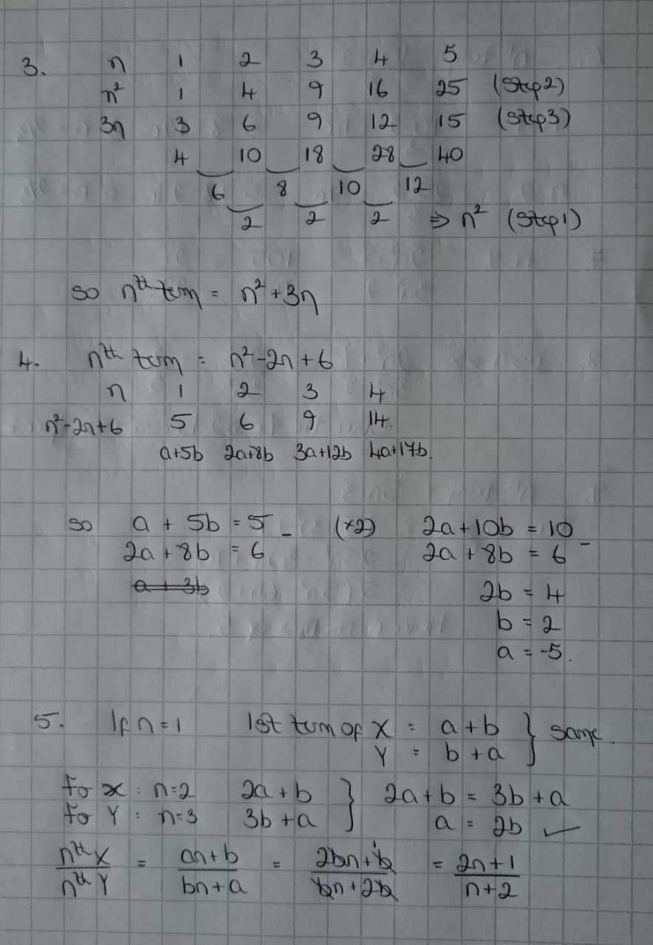
Further Maths GCSE Sequences Answers

