Slide 1
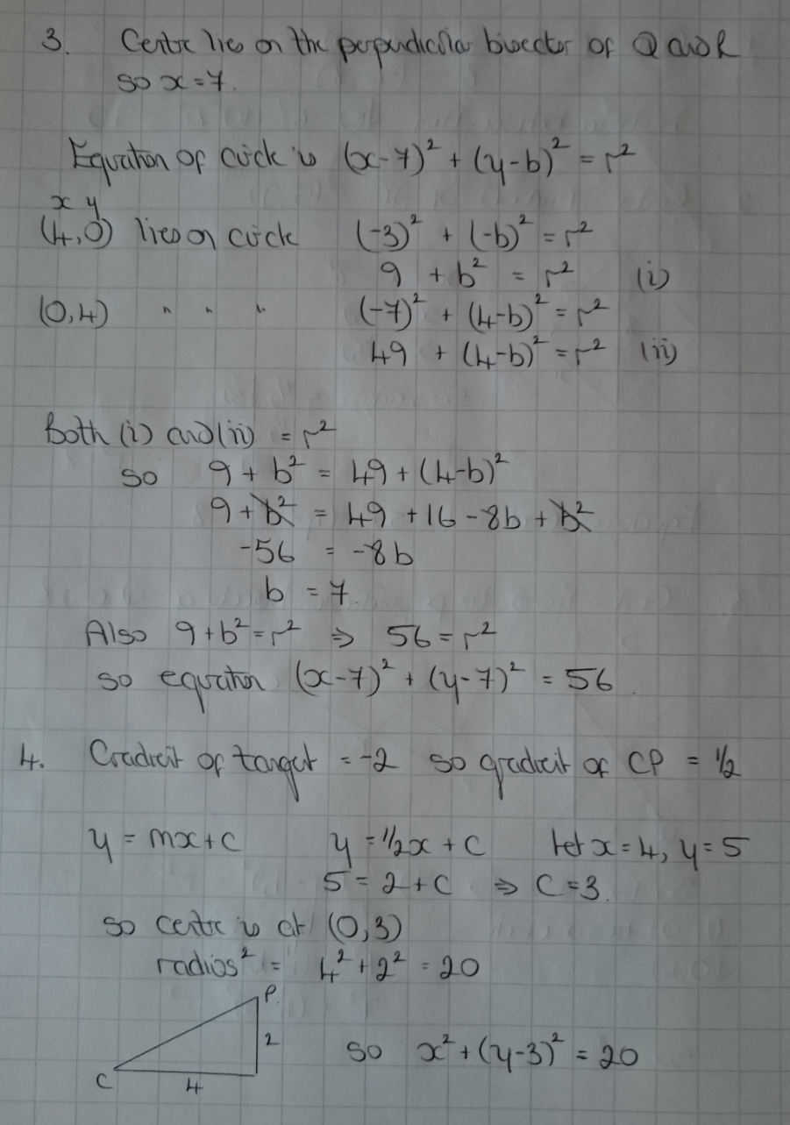
Further Maths GCSE Circles Answers

Slide 2
