Slide 1
Number Sorts
Timed Questions
Easter School 2015

Slide 2
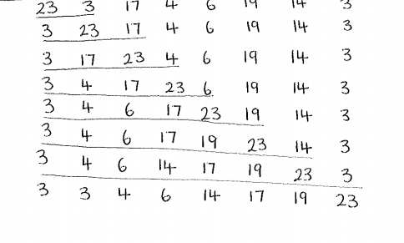
5 mins

Slide 3
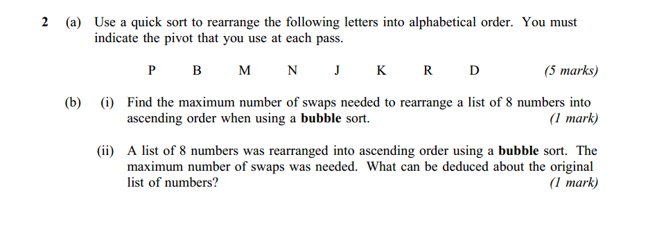
7 mins

Slide 5
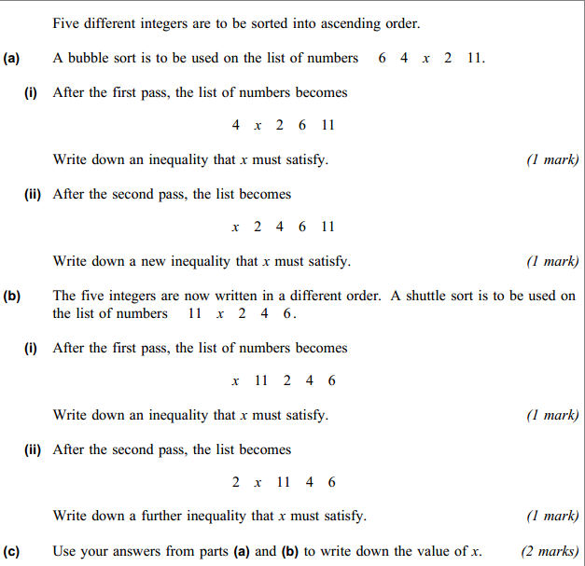
7 mins
3.

