Slide 1
Dijkstra’s Algorithm
Timed Questions
Easter School 2015

Slide 2
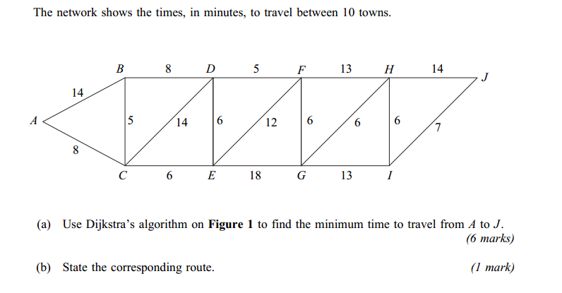
6 mins
1.

Slide 3
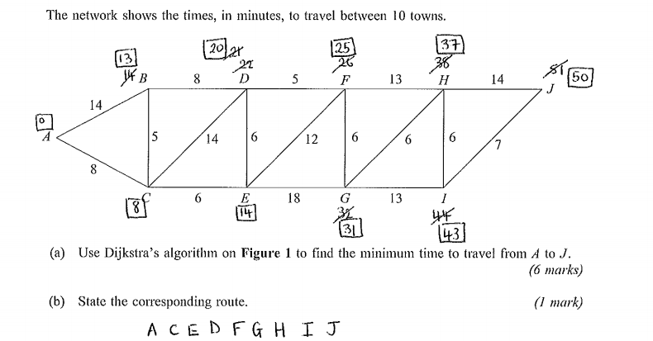

Slide 4
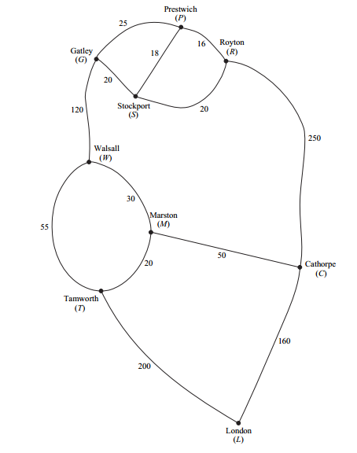
2.
10 mins

Slide 5
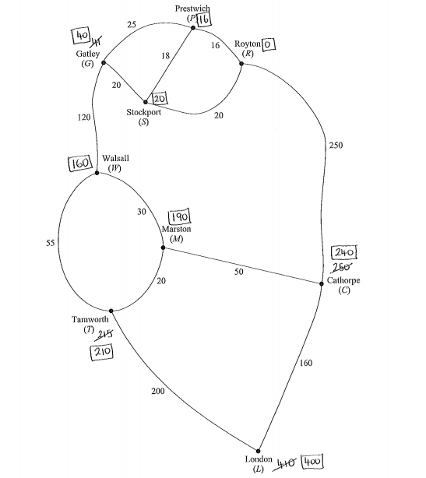
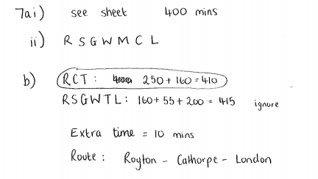

Slide 6
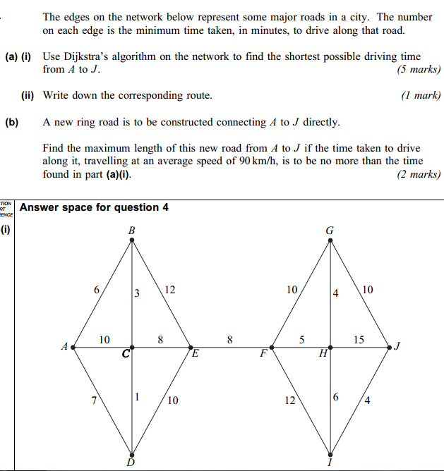
3.
8 mins

Slide 7
