Slide 1
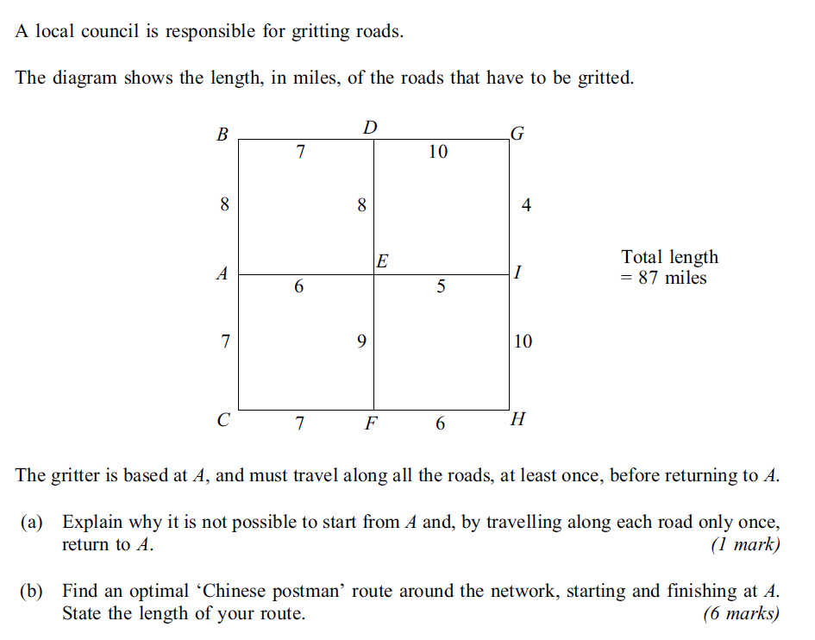
Chinese Postman
7 mins
1.

Slide 3
2.
10 mins

Slide 7
3.
10 mins

