Slide 1
Trapezium Rule and
Transformation of Functions
Timed Questions
Easter School 2015

Slide 2
6 mins
1.

Slide 3
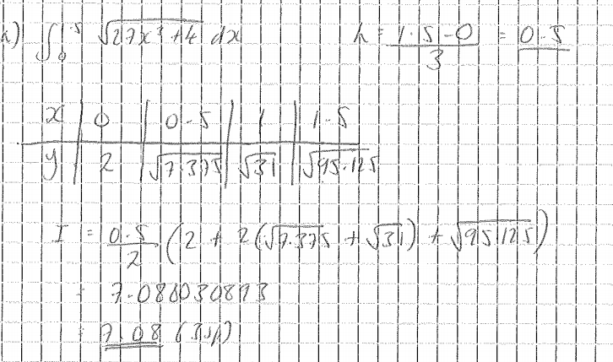
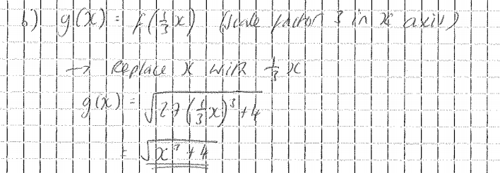

Slide 4
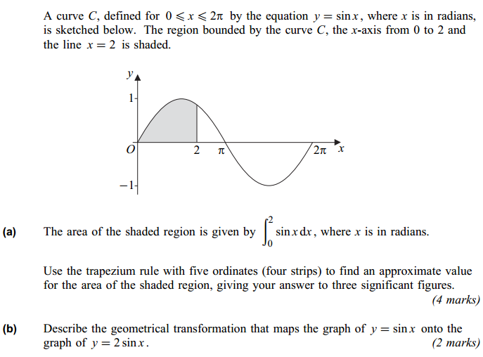
6 mins
2.

Slide 5
