Slide 1
Indices and Logarithms
Timed Questions
Easter School 2015

Slide 2
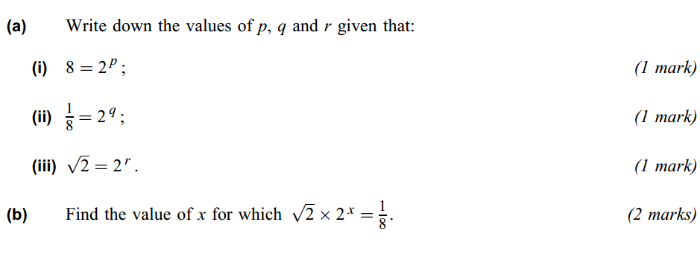
5 mins
1.

Slide 3
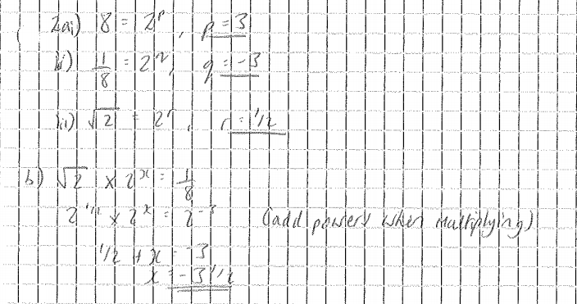

Slide 4
3 mins
2.

Slide 5
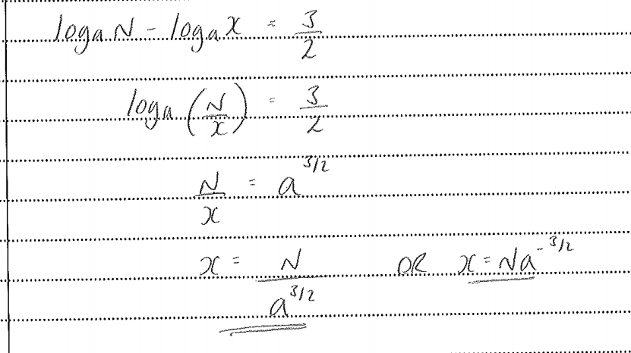

Slide 6
9 mins
3.

Slide 7
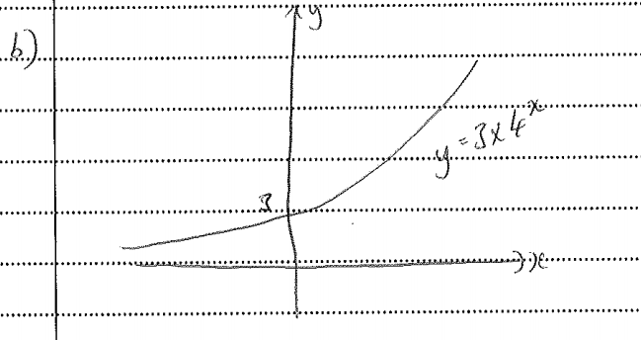
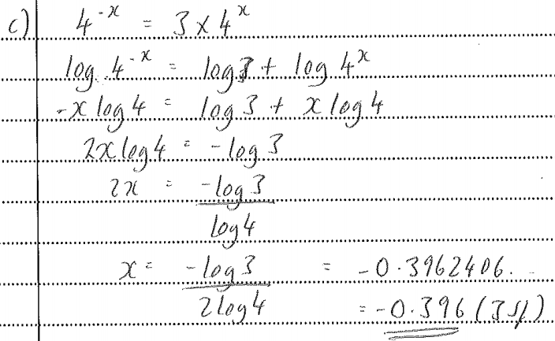

Slide 8
4.
7 mins

Slide 9
