Slide 1

Beat the nation!
Week 8

Slide 2
Beat the Nation:
Week 8
Overview
SATs – Week 8
GCSE Foundation – Week 8
GCSE Higher – Week 8
How to find the data
The Revision Schemes of Work

Slide 3
Beat the Nation: Overview
Beat the Nation is a structure I like to use for revision lessons
I use data from the 1000s of students across the nation who have answered questions from the Revision Collection to find the most troublesome questions
I then present these questions to students in class, challenging them to:
  Get the questions correct (hence, Beat the Nation!)
  Predict which is the worst answered question
  Predict the most popular choice of wrong answer for each question
  Explain why a student may choose these answers
  Think how they would help them
I can then reveal the answers (in reverse order, for drama), showcasing actual students explanations for the most popular wrong answers
My aim in doing this is to:
  Expose students to questions other students find difficult and support my students with them
  Help my students develop their ability to consider and explain other students’ misconceptions – a key skill required for those exam questions that require students to explain, describe, discuss, etc
If find that setting this up as “Beat the Nation” provides those students with a competitive edge a nice incentive, and also takes the pressure off a little – “well, the rest of the country is struggling with these questions, so it is no surprise I find them tough, but I might as well give them a go…”
Feel free to play around with the structure to make it work for you.
I hope you and your students enjoy this and find it useful.

Slide 4
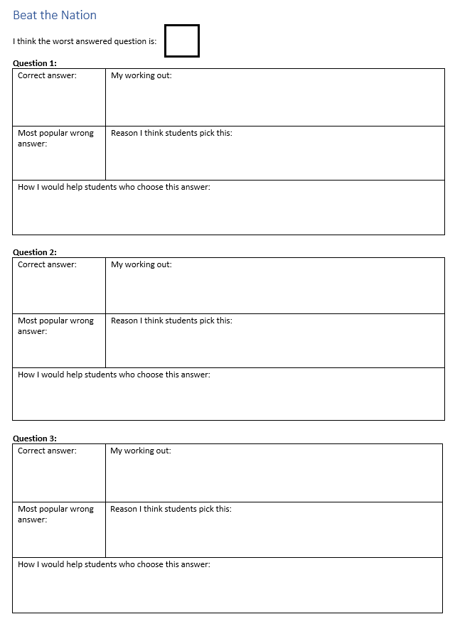

Slide 5
Beat the nation!
SATs
Week 8

Slide 6
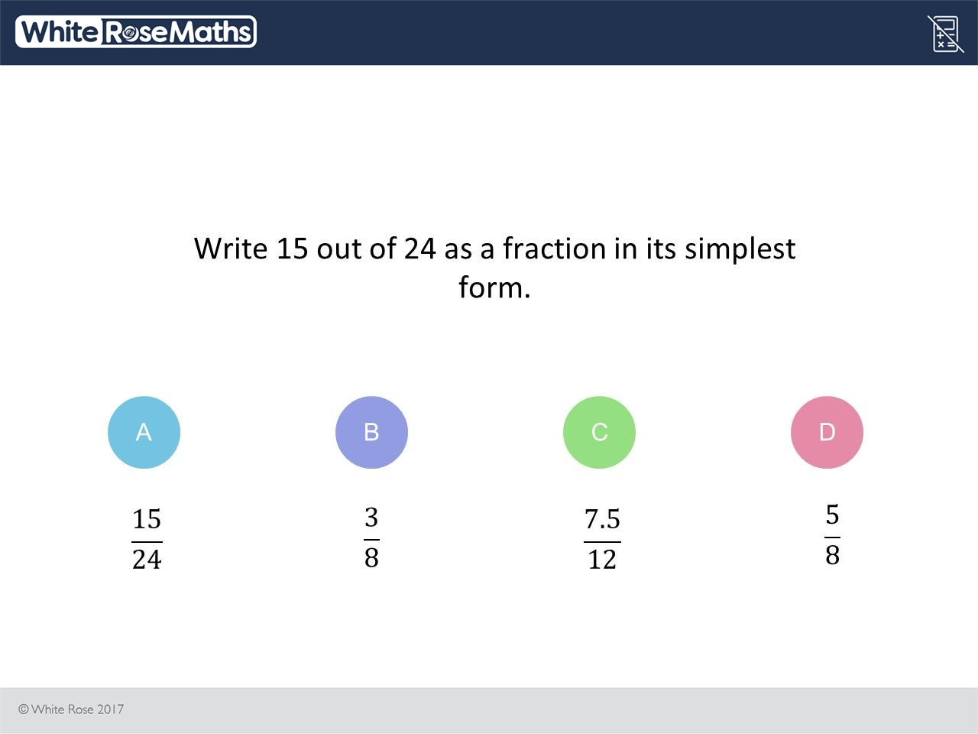
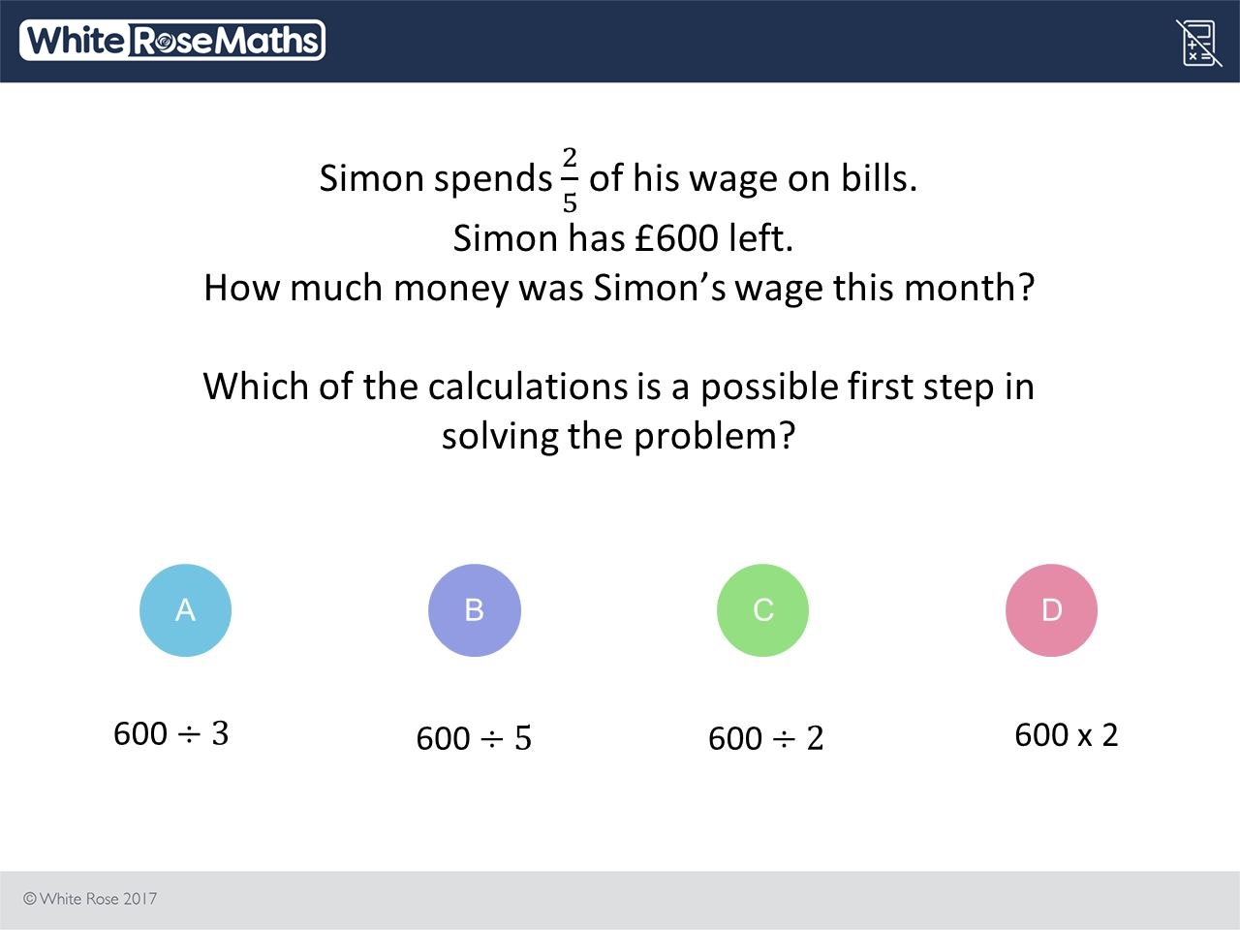
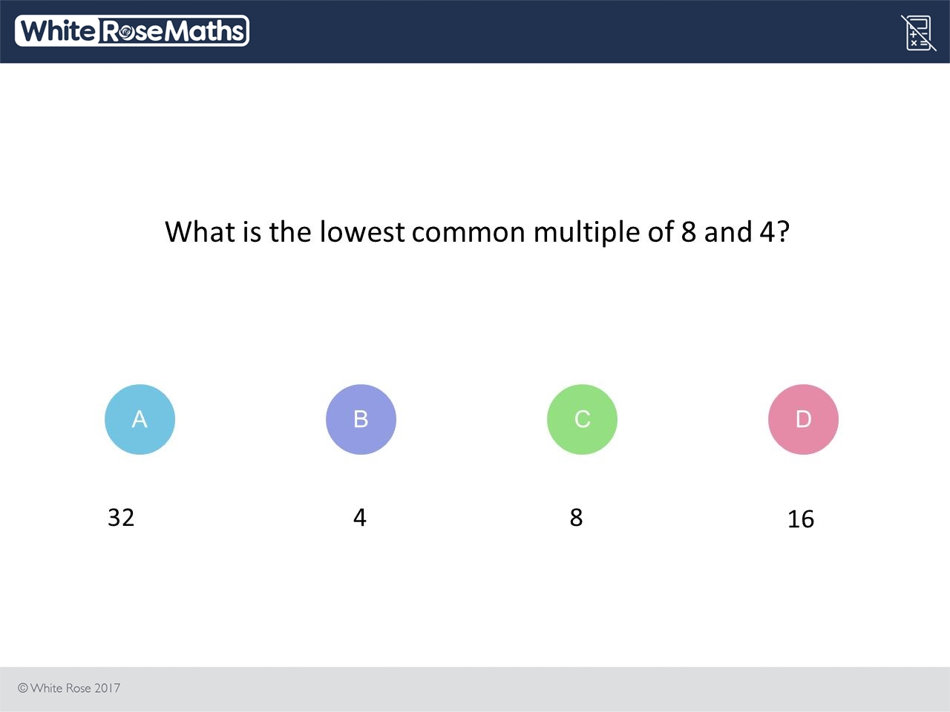
1000s of students are struggling with these three questions
1. Can you get each question right?
2. Which do you think is the worst answered question?
3. What do you think is the most popular choice of wrong answer for each question?
4. Can you explain why other students might choose these wrong answers?
5. How would you help them?

Slide 7
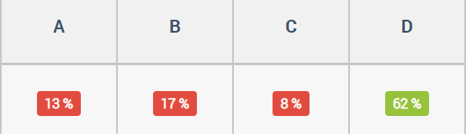
I think this because if you find the fraction 15/24, you then have to divided by 3. Place these in the numerator and denominator positions and this becomes a simplified fraction. 3/8
B
Notes:
https://diagnosticquestions.com/Data/Question/35391#/All///////

Slide 8
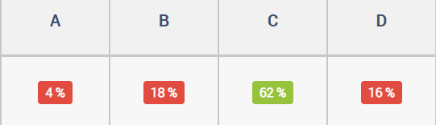
I think the answer is 4 because 4 can go into itself and it can go into 8, but it is the answer because it was the lowest number that went into both of them. I could of got it wrong if one of the answers were 2
B
Notes:
https://diagnosticquestions.com/Data/Question/35399#/All///////

Slide 9
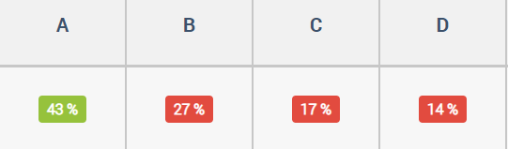
I think this is the answer because you need to first find out the amount he spends.he spends 2/5 of his wage so you have to work out what 2/5 is.The first step to finding 2/5 is dividing 600 by 5 hence why I put B :)
B
Notes:
https://diagnosticquestions.com/Data/Question/35393#/All///////

Slide 10
Beat the nation!
GCSE Foundation
Week 8

Slide 11
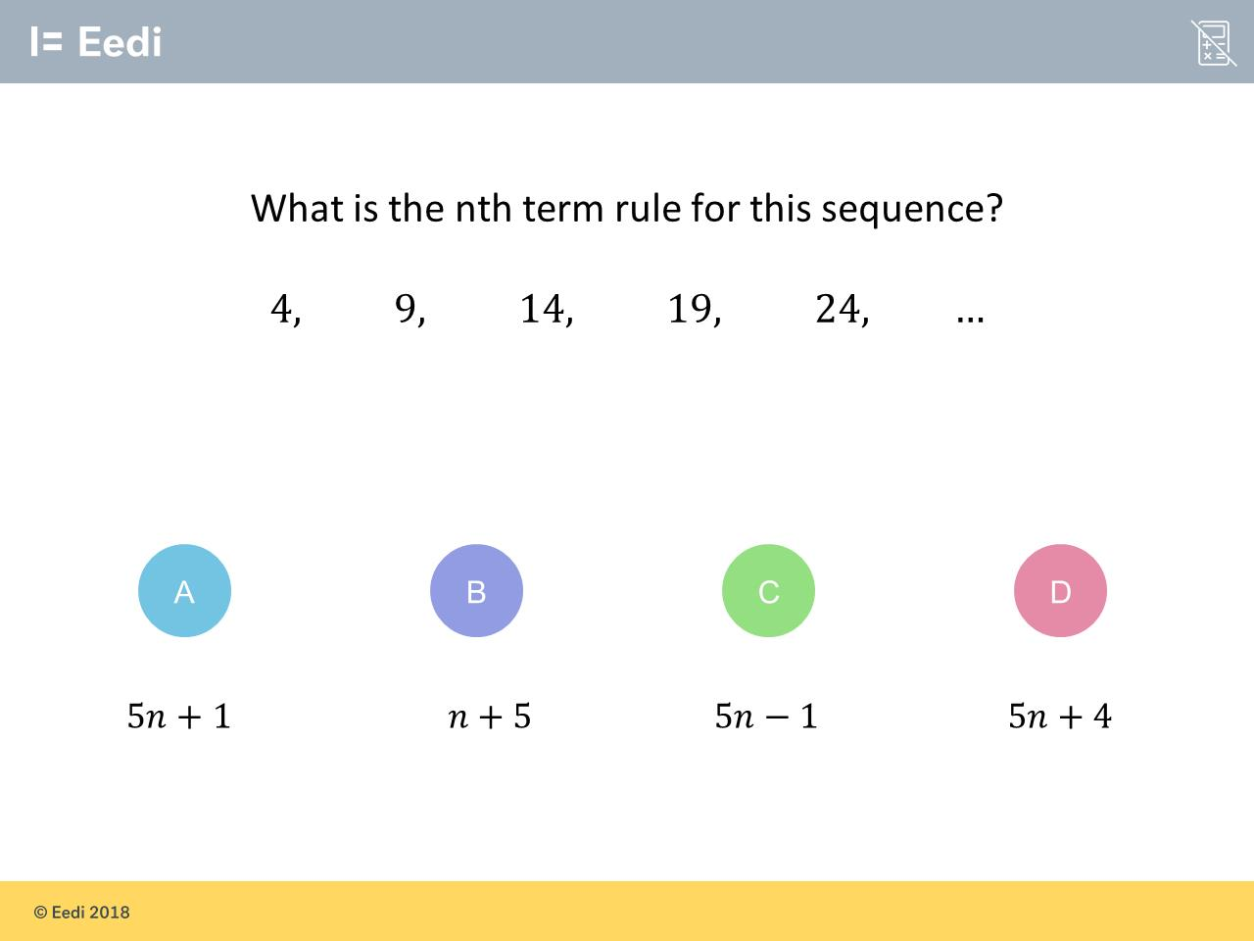
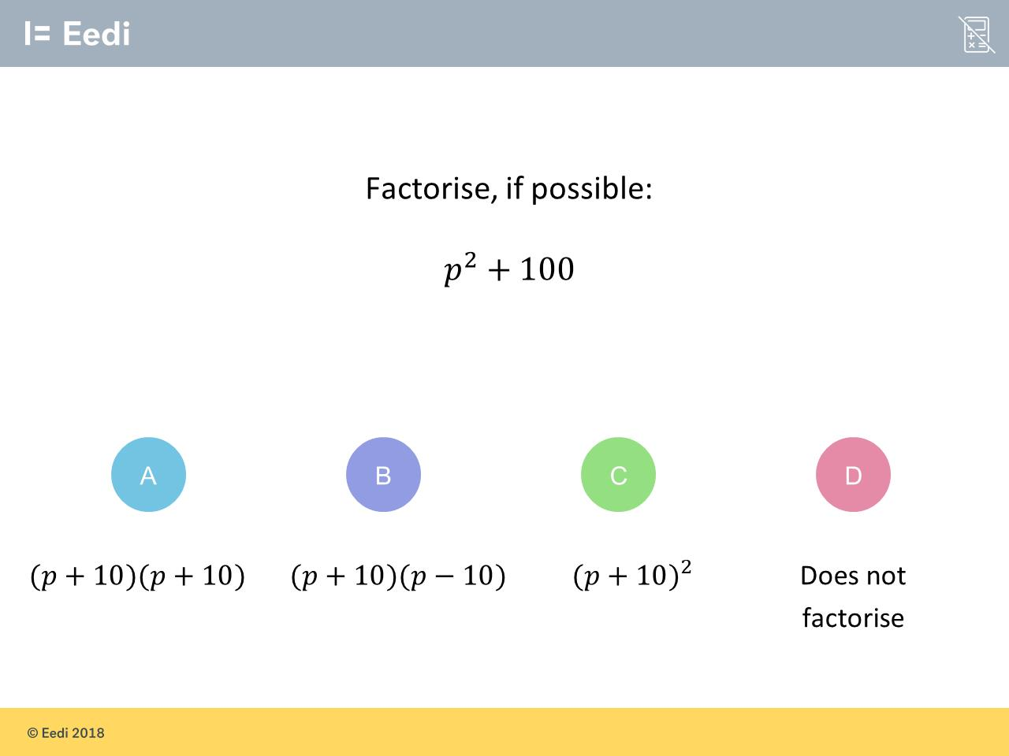
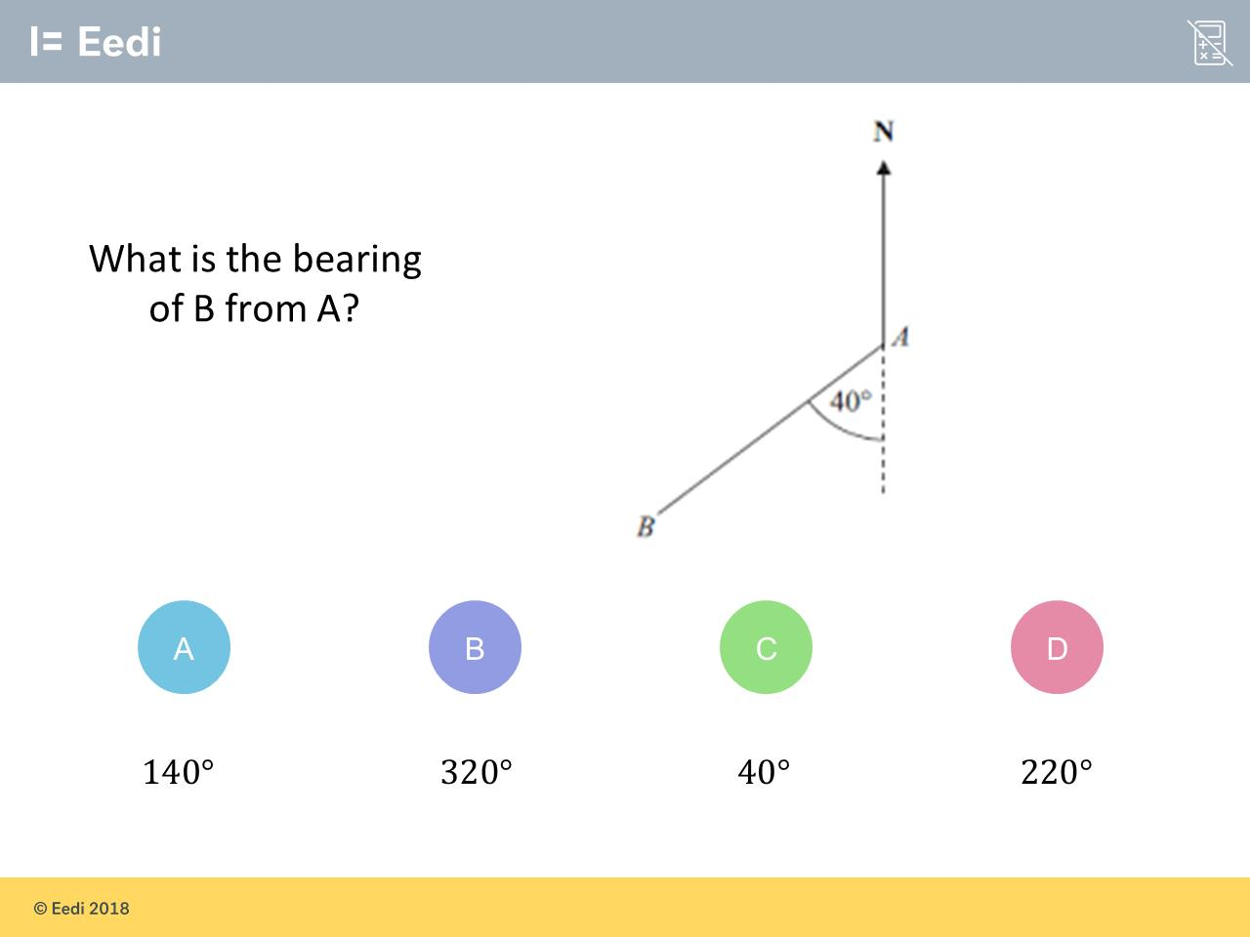
1000s of students are struggling with these three questions
1. Can you get each question right?
2. Which do you think is the worst answered question?
3. What do you think is the most popular choice of wrong answer for each question?
4. Can you explain why other students might choose these wrong answers?
5. How would you help them?

Slide 12
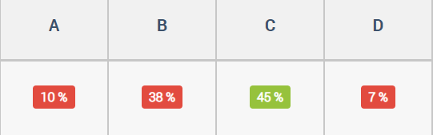
B
the difference between the numbers is 5. Because the difference is the same between all the numbers it would be n+5.
Notes:
https://diagnosticquestions.com/Data/Question/82820#/All///////

Slide 13
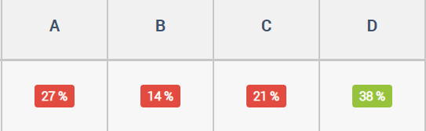
A
angles on a straight line add up to 180 so if there's an angle that 40 then the rest of the straight line needs to be 140
C
because the angle between the 2 points is 40 degrees
Notes:
https://diagnosticquestions.com/Data/Question/82825#/All///////

Slide 14
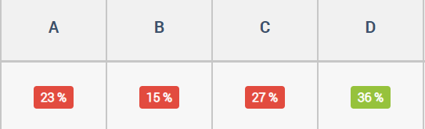
C
(p+10) squared equals that answer as you sqaure the whole bracket. 10 squared is 100. The letter P squared is P squared.
A
(P+10)(P+10)= p squared + (10) squared Answer= p squared + 100
Notes:
https://diagnosticquestions.com/Data/Question/82828#/All///////

Slide 15
Beat the nation!
GCSE Higher
Week 8

Slide 16
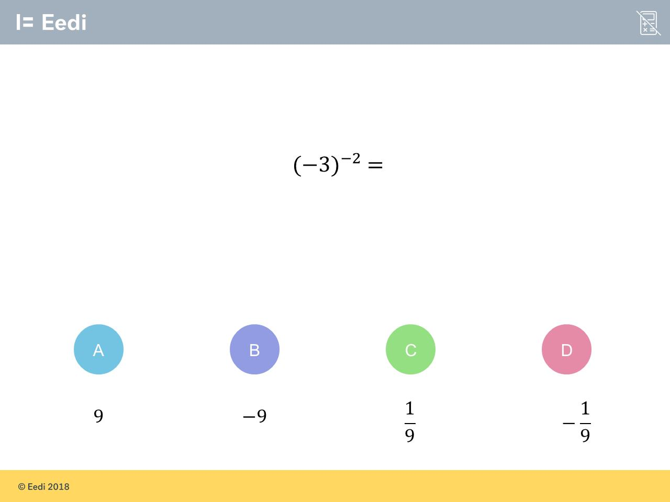
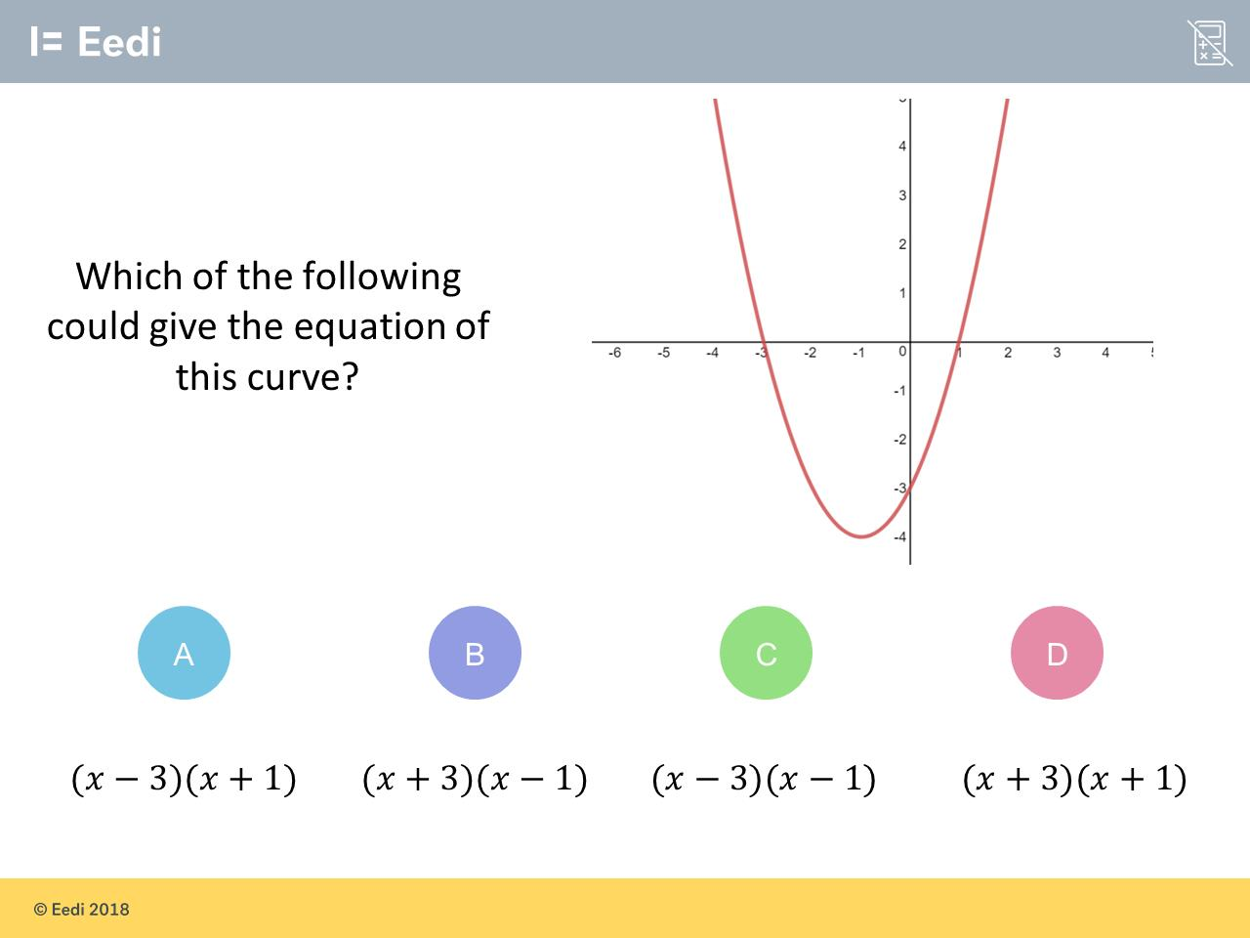
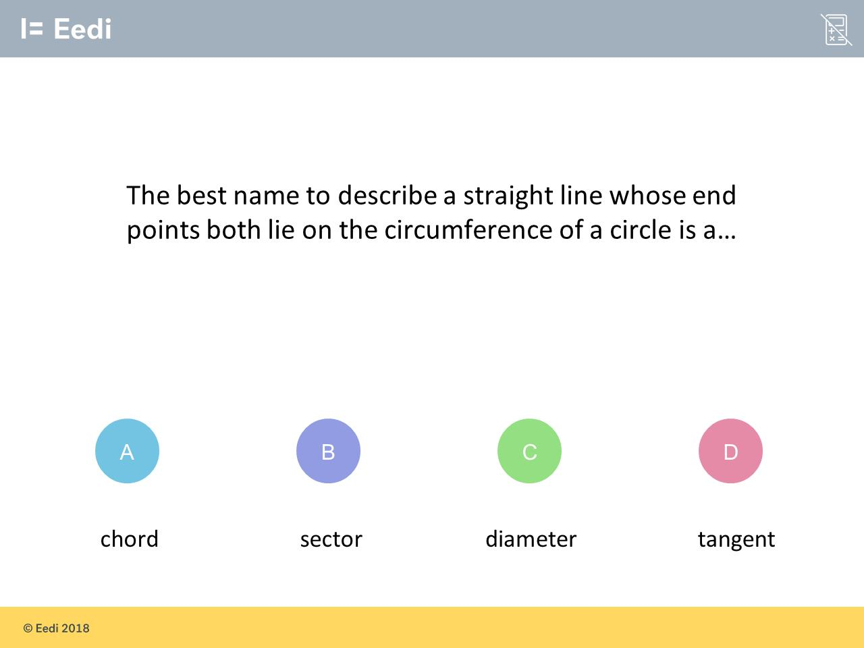
1000s of students are struggling with these three questions
1. Can you get each question right?
2. Which do you think is the worst answered question?
3. What do you think is the most popular choice of wrong answer for each question?
4. Can you explain why other students might choose these wrong answers?
5. How would you help them?

Slide 17
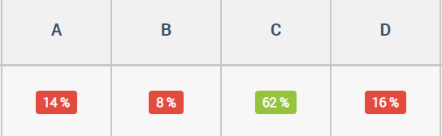
I think this because as the power is a negative number the answer will be a number below 1, so a fraction. But the number being multiplied by the power is negative making the answer a negative fraction
D
D
i am going to be brutally honest and say i just saw a minus
Notes:
https://diagnosticquestions.com/Data/Question/82388#/All///////

Slide 18
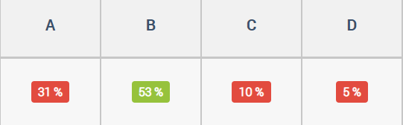
A
-3 and +1 is where both points of the curve fall on the x-axis
Notes:
https://diagnosticquestions.com/Data/Question/82386#/All///////

Slide 19
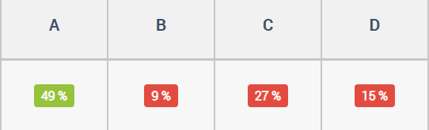
C
The diameter is a straight line and both ends of the line touch opposite ends of the circumference
Notes:
https://diagnosticquestions.com/Data/Question/82385#/All///////

Slide 20
Beat the Nation: How to find the data
You can find poorly answered questions, the data on these, and sample student explanations for any quiz on Diagnostic Questions.
Just follow the steps in the next slides

Slide 21

Visit the Collections page

Slide 22

Choose a Collection

Slide 23
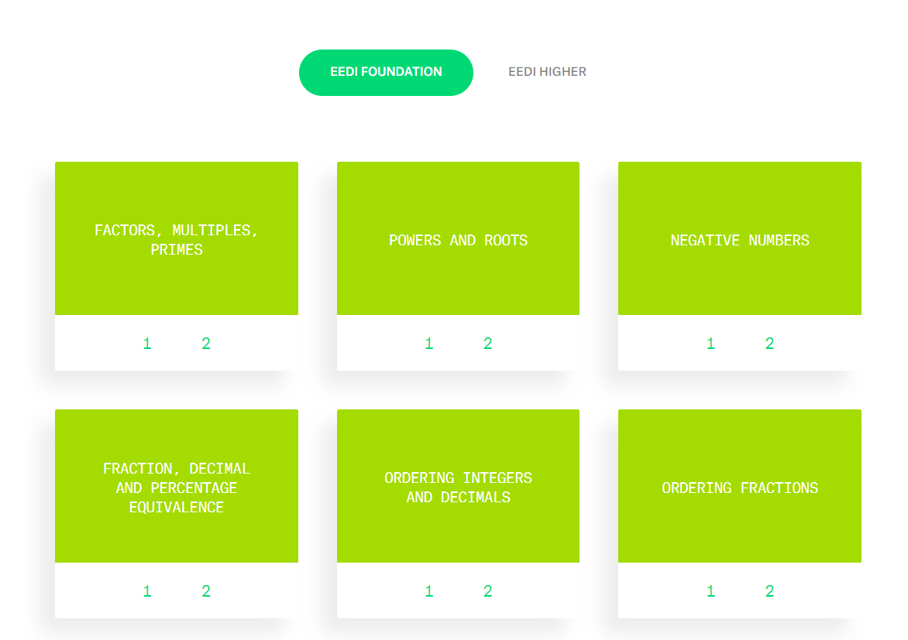
Find a topic you like

Slide 24
Always choose Quiz 1 from that topic (it has most data)

Slide 25
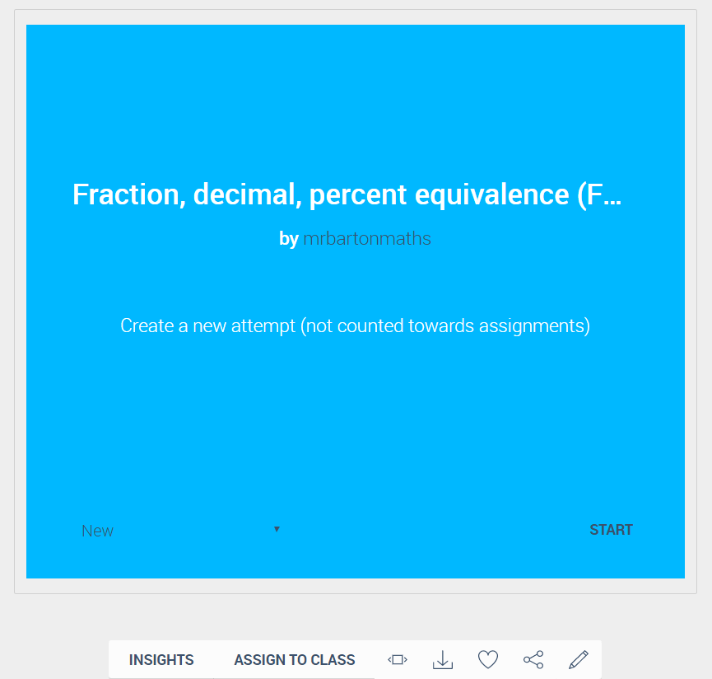
Click on Insights

Slide 26
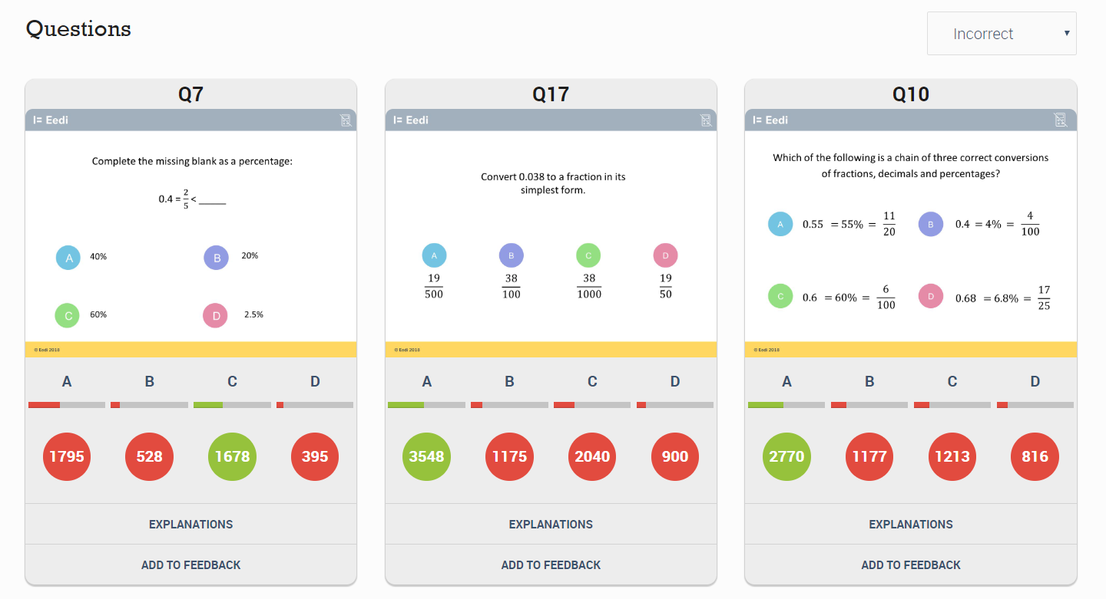
Scroll down the page to see the 3 worst answered questions

Slide 27
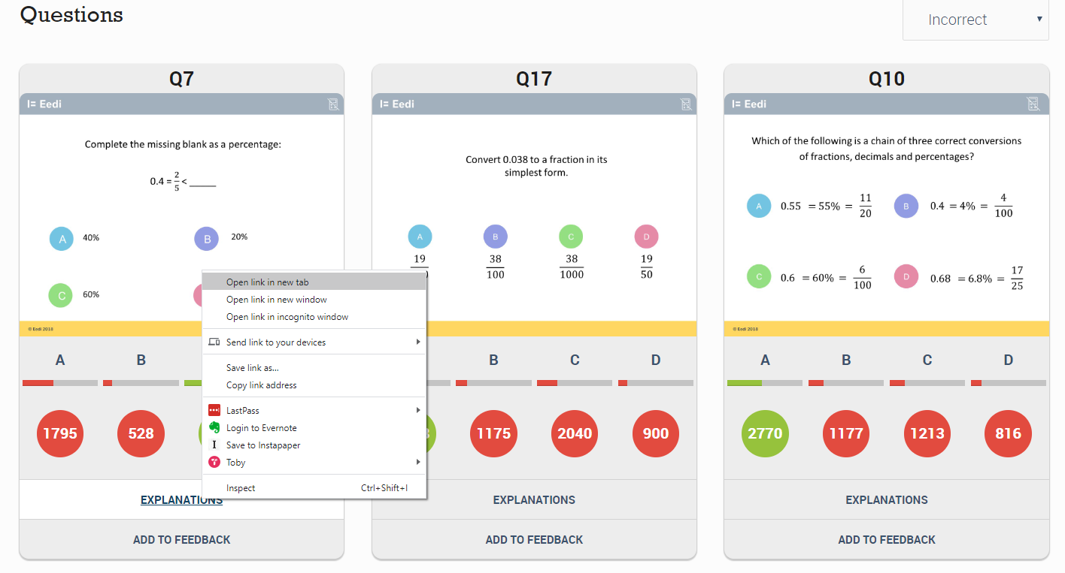
For each question, right-click on Explanations and choose
“Open link in a new tab”

Slide 28
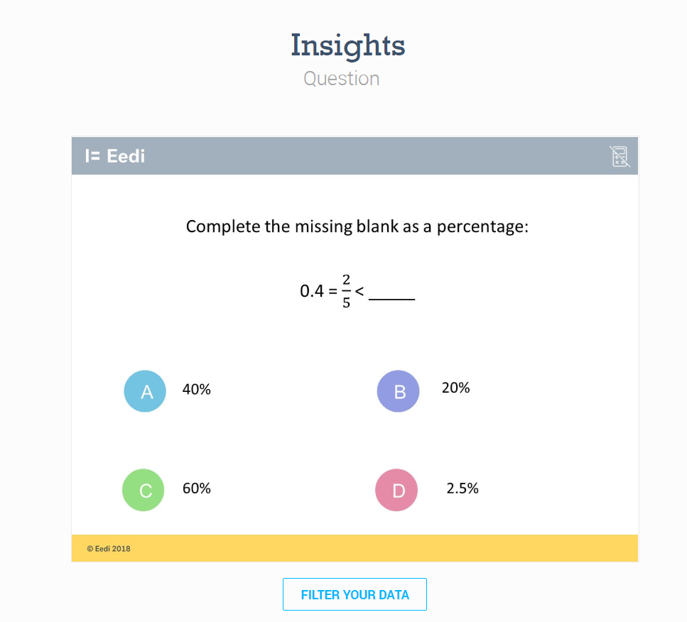
Now you are on a page where you can access more data and explanations for each question

Slide 29
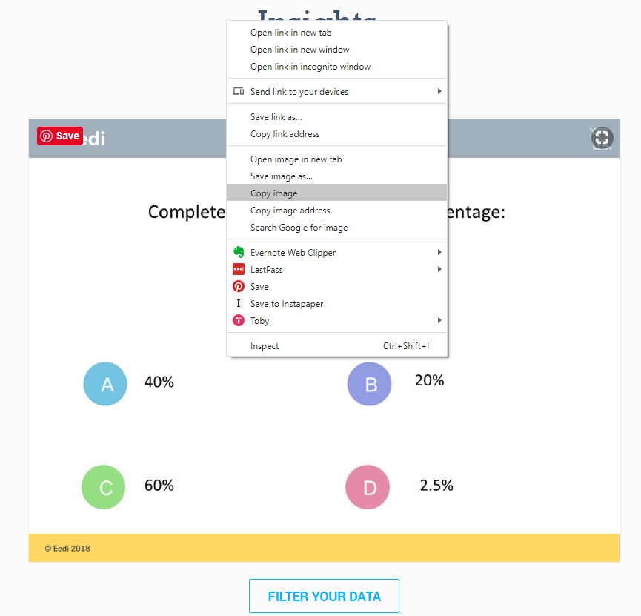
First, copy the image of the question (right-click: “copy image”) and paste it into a blank PowerPoint slide

Slide 30
Next click on Filter your data

Slide 31
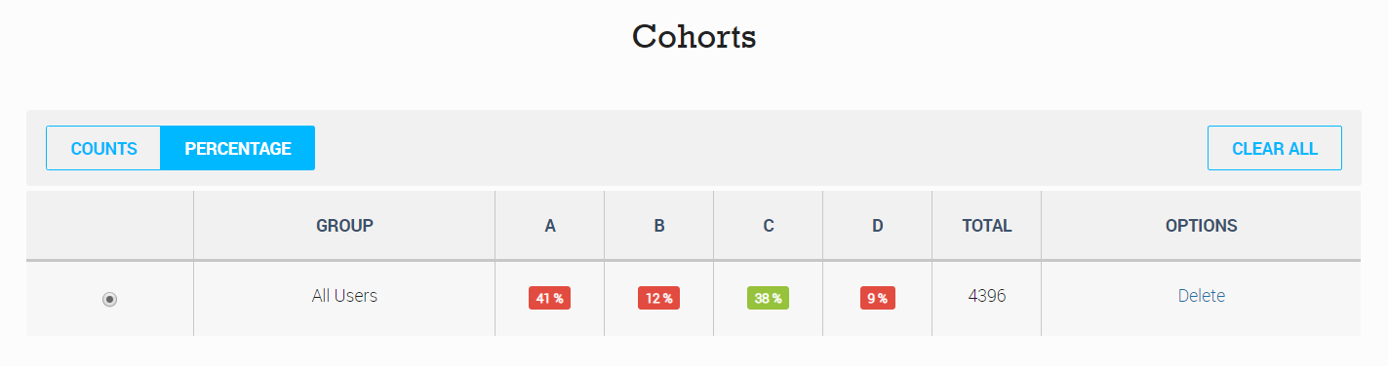
Scroll down the page and change Cohorts to Percentage

Slide 32
You can then take a screen shot of this table so you have the relevant figures for each answer and paste them into your PowerPoint

Slide 33
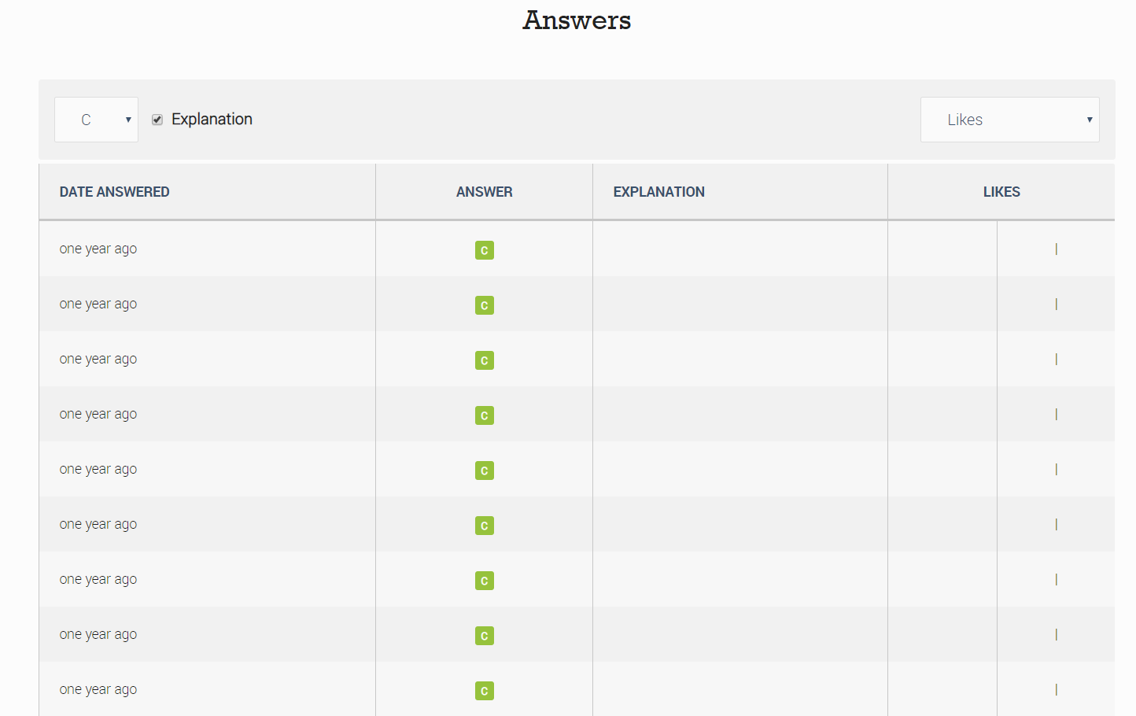
Scroll further down the page to get to the Answers

Slide 34
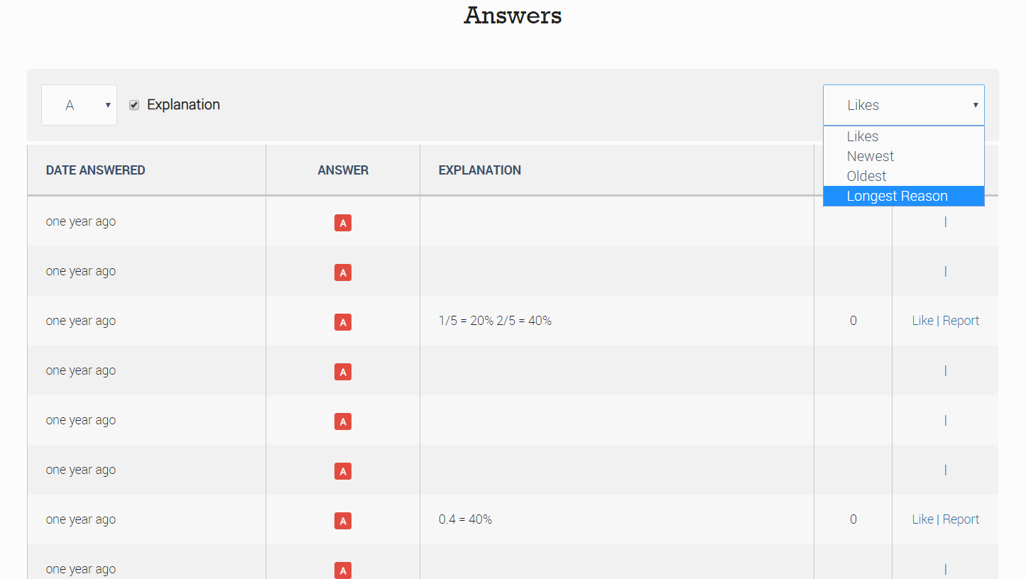
Choose the most popular wrong answer (in this case A), and change Likes to Longest reason (this tends to get better thought out answers)

Slide 35
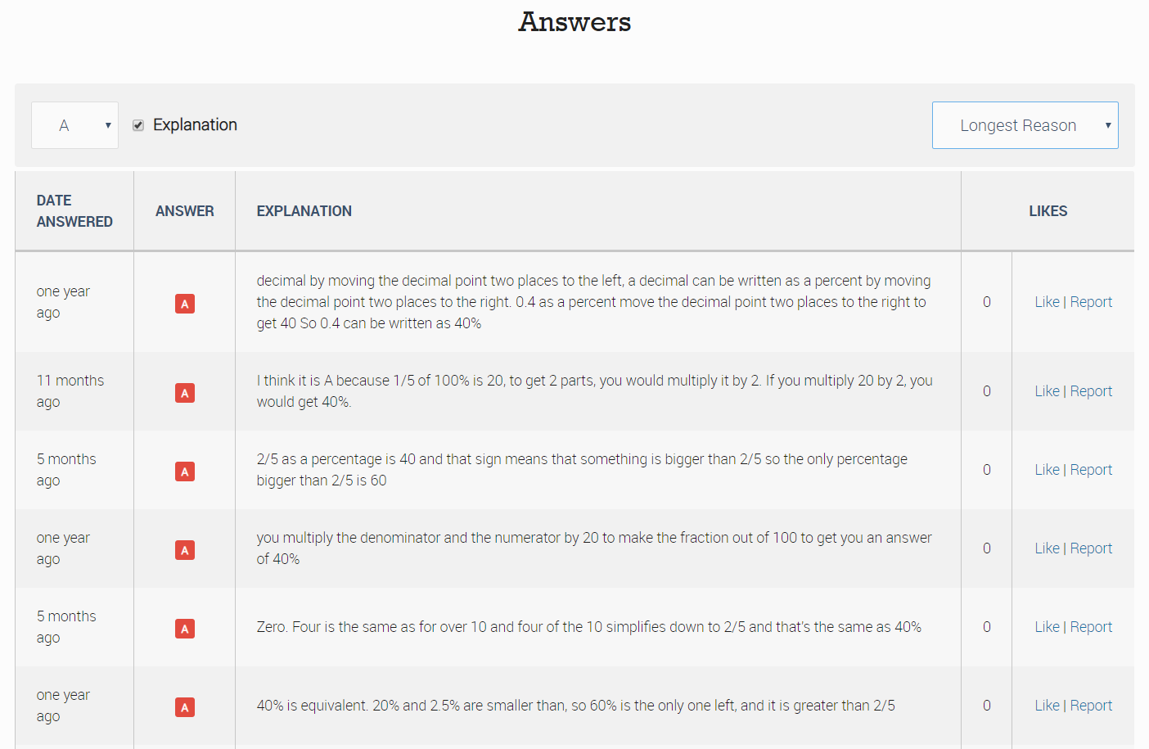
Read through the answers to find interesting ones

Slide 36
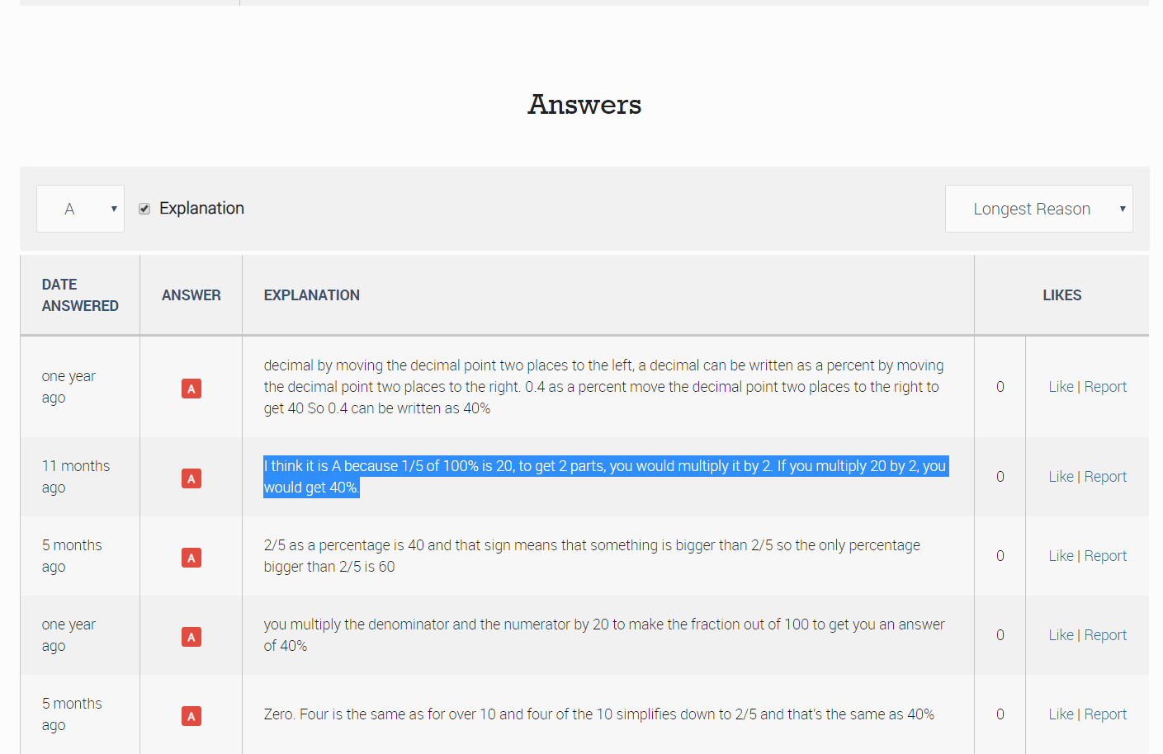
Copy and paste the text of the explanation and add it to your PowerPoint

Slide 37
Repeat this for the other two questions

Slide 38

And you are done!

Slide 39
The Revision Schemes of Work
You can access all the revision quizzes for SATs, GCSE Foundation and GCSE Higher here
You can also set these up as a free Revision Scheme of Work so your students receive a new quiz each week (or whatever frequency you choose), which is automatically marked for you
To get started on this, just visit Eedi
For help getting your students on the system, send an email to hello@eedi.co.uk attaching your students’ names and class-names in a spreadsheet

