Slide 1
Beat the nation! Week 5

Slide 2
Beat the Nation: Week 5
Overview
SATs – Week 5
GCSE Foundation – Week 5
GCSE Higher – Week 5
How to find the data
The Revision Schemes of Work

Slide 3
Beat the Nation: Overview
Beat the Nation is a structure I like to use for revision lessons
I use data from the 1000s of students across the nation who have answered questions from the Revision Collection to find the most troublesome questions
I then present these questions to students in class, challenging them to:
Get the questions correct (hence, Beat the Nation!)
Predict which is the worst answered question
Predict the most popular choice of wrong answer for each question
Explain why a student may choose these answers
Think how they would help them
I can then reveal the answers (in reverse order, for drama), showcasing actual students explanations for the most popular wrong answers
My aim in doing this is to:
Expose students to questions other students find difficult and support my students with them
Help my students develop their ability to consider and explain other students’ misconceptions – a key skill required for those exam questions that require students to explain, describe, discuss, etc
If find that setting this up as “Beat the Nation” provides those students with a competitive edge a nice incentive, and also takes the pressure off a little – “well, the rest of the country is struggling with these questions, so it is no surprise I find them tough, but I might as well give them a go…”
Feel free to play around with the structure to make it work for you.
I hope you and your students enjoy this and find it useful.

Slide 4
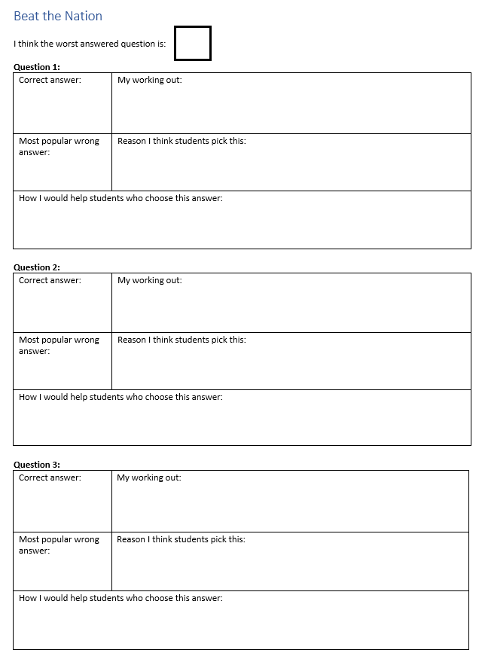

Slide 5
Beat the nation! SATs Week 5

Slide 6
1000s of students are struggling with these three questions
1. Can you get each question right?
2. Which do you think is the worst answered question?
3. What do you think is the most popular choice of wrong answer for each question?
4. Can you explain why other students might choose these wrong answers?
5. How would you help them?

Slide 7
I think this because 1 x 1 = 1, so that would be the numerator and 2 x 2 = 4 and that would be the denominator, so the fraction would be 1/4. Also, I don't think any of the others are going to make 1/4
B
Notes:
https://diagnosticquestions.com/Data/Question/33939#/All///////

Slide 8
A
because it goes Units Tens Hundreds Thousands Ten Thousand and it the fourth digit and thousands is the fourth digit..
Notes:
https://diagnosticquestions.com/Data/Question/33935#/All///////

Slide 9
I got 40 because I know that perimeter is the outside of a shape so I added 5cm and 5cm together to get 10cm then I added 11cm and 7cm to get 28cm and finally I added 12 to 28 to get 40 cm, so that is my answer.
B
Notes:
https://diagnosticquestions.com/Data/Question/33936#/All///////

Slide 10
Beat the nation! GCSE Foundation Week 5

Slide 11
1000s of students are struggling with these three questions
1. Can you get each question right?
2. Which do you think is the worst answered question?
3. What do you think is the most popular choice of wrong answer for each question?
4. Can you explain why other students might choose these wrong answers?
5. How would you help them?

Slide 12
A
because the plan will need to be a t shape with an extra block as it has another block onto it
A
If it’s looked at from the front you would not be able to see the extra block
Notes:
https://diagnosticquestions.com/Data/Question/82794#/All///////

Slide 13
A
if dani has 30 pieces and it is shared in the ratio 2:3, then 1=10 meaning jo recieves 20 as she gets 2 of the 2:3
B
So to share the ratio you do 2 + 3 = 5 and then do 30 divided by 5 = 6 so then Jo’s part is 2 so you do 2 x 6 =12 so Jo receives 12 pieces
Notes:
https://diagnosticquestions.com/Data/Question/82798#/All///////

Slide 14
C
The scale factor is two therefore you times both coordinates by 2 to get (4,4)
Notes:
https://diagnosticquestions.com/Data/Question/82800#/All///////

Slide 15
Beat the nation! GCSE Higher Week 5

Slide 16
1000s of students are struggling with these three questions
1. Can you get each question right?
2. Which do you think is the worst answered question?
3. What do you think is the most popular choice of wrong answer for each question?
4. Can you explain why other students might choose these wrong answers?
5. How would you help them?

Slide 17
C
I think this because on the graph it goes across 4 on the x axis and up 3 on the y axis. Therefore it 4/3
Notes:
https://diagnosticquestions.com/Data/Question/82360#/All///////

Slide 18
C
Because he moves 3boxes and the boxes and one box represents one km.
Notes:
https://diagnosticquestions.com/Data/Question/82354#/All///////

Slide 19
If the centres of both circles is the centre of each tower, the place in the middle is the locus (location) of the plane. You could measure the distance looking at the diameters of each circle if they both end right where the plane is.
C
Notes:
https://diagnosticquestions.com/Data/Question/82357#/All///////

Slide 20
Beat the Nation: How to find the data
You can find poorly answered questions, the data on these, and sample student explanations for any quiz on Diagnostic Questions.
Just follow the steps in the next slides

Slide 21
Visit the Collections page

Slide 22
Choose a Collection

Slide 23
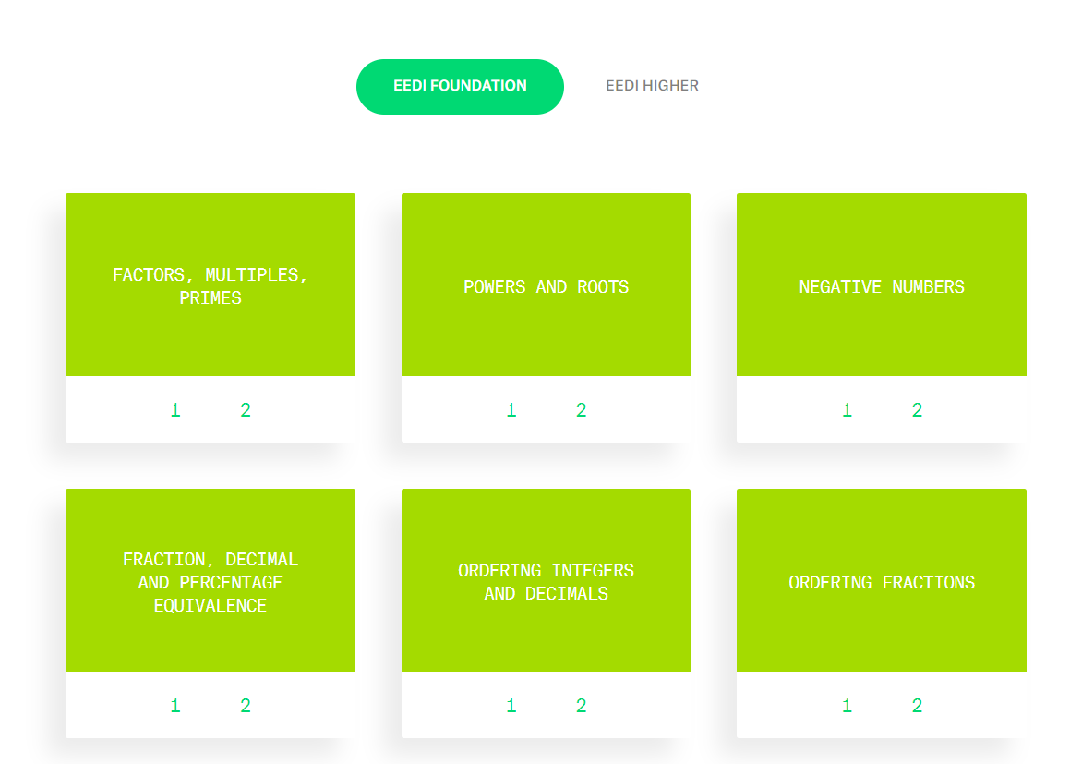
Find a topic you like

Slide 24
Always choose Quiz 1 from that topic (it has most data)

Slide 25
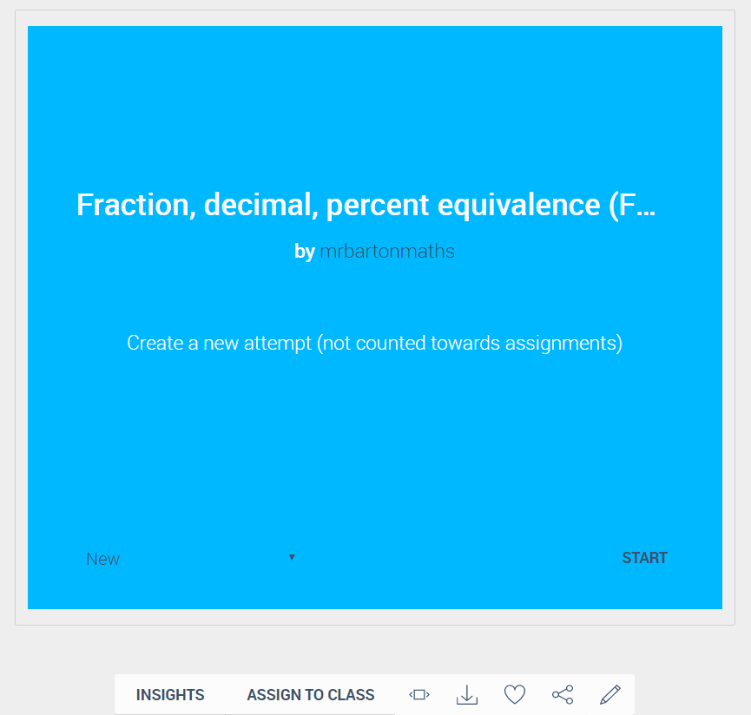
Click on Insights

Slide 26
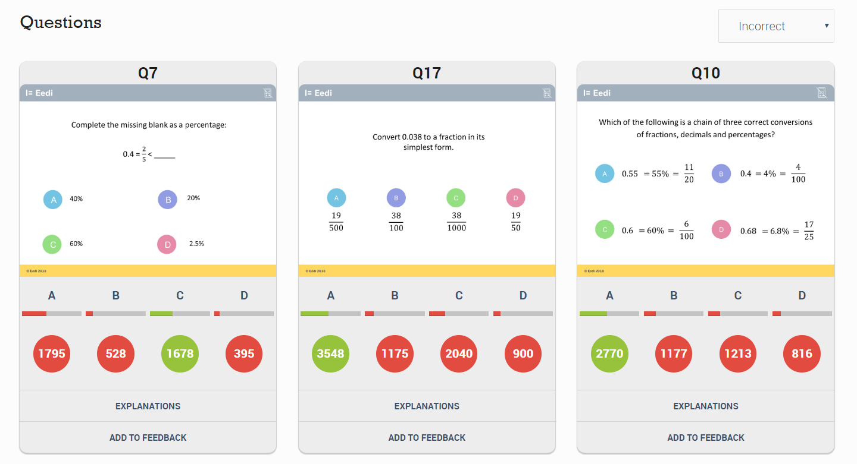
Scroll down the page to see the 3 worst answered questions

Slide 27
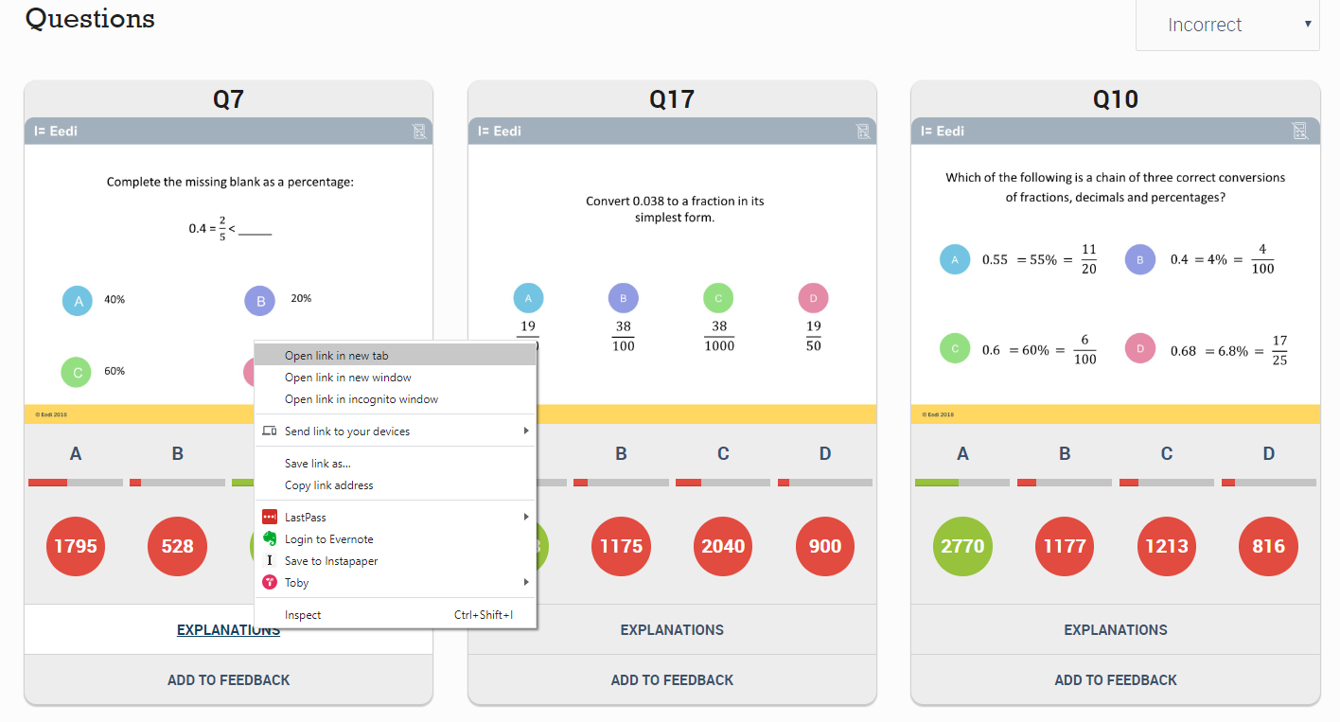
For each question, right-click on Explanations and choose
“Open link in a new tab”

Slide 28
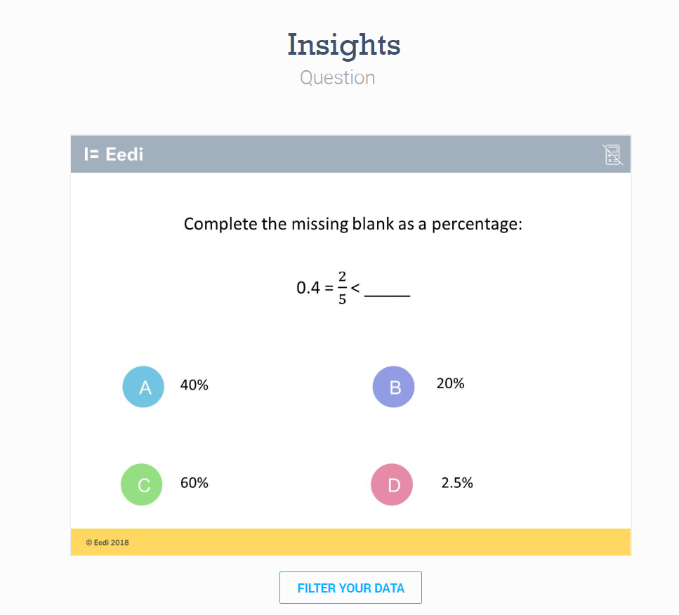
Now you are on a page where you can access more data and explanations for each question

Slide 29
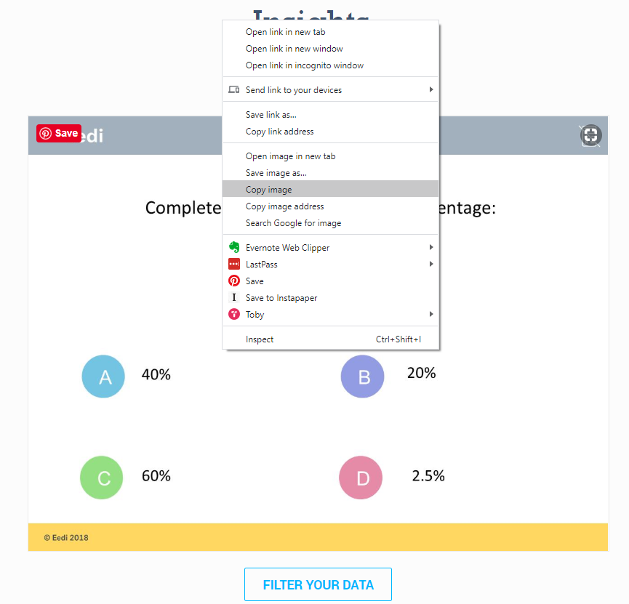
First, copy the image of the question (right-click: “copy image”) and paste it into a blank PowerPoint slide

Slide 30
Next click on Filter your data

Slide 31
Scroll down the page and change Cohorts to Percentage

Slide 32
You can then take a screen shot of this table so you have the relevant figures for each answer and paste them into your PowerPoint

Slide 33
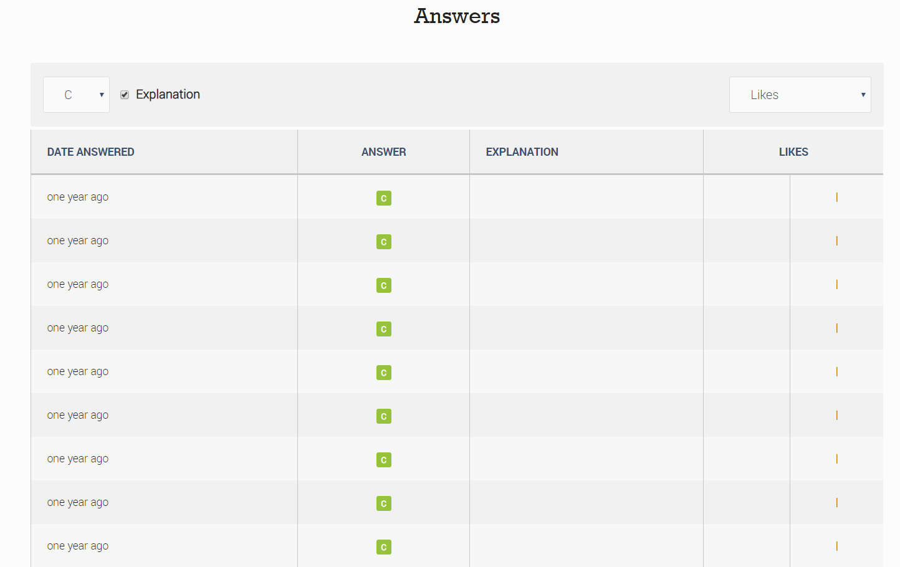
Scroll further down the page to get to the Answers

Slide 34
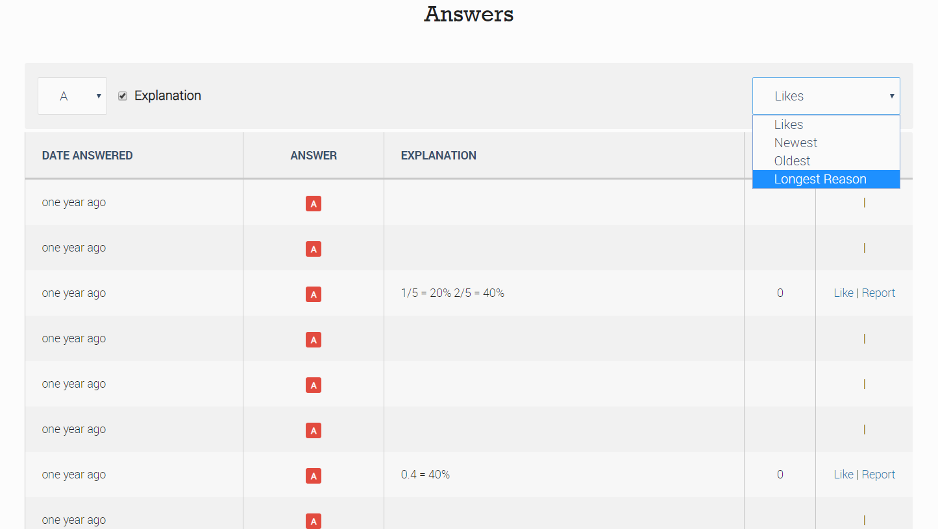
Choose the most popular wrong answer (in this case A), and change Likes to Longest reason (this tends to get better thought out answers)

Slide 35
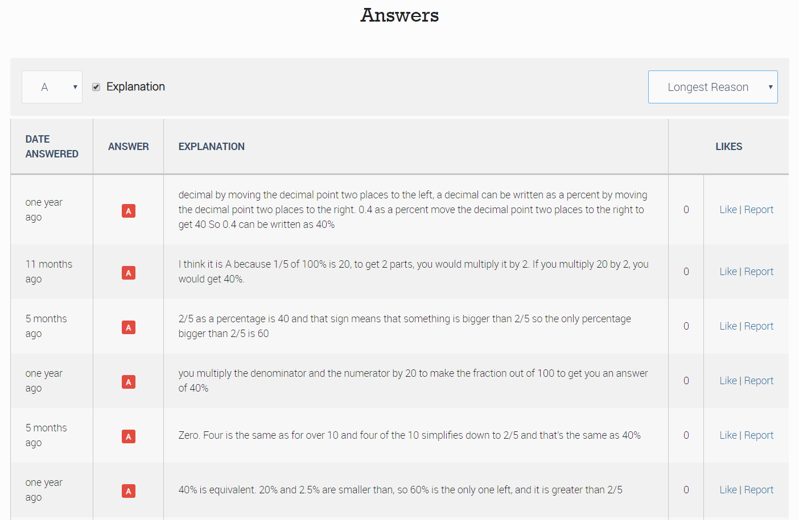
Read through the answers to find interesting ones

Slide 36
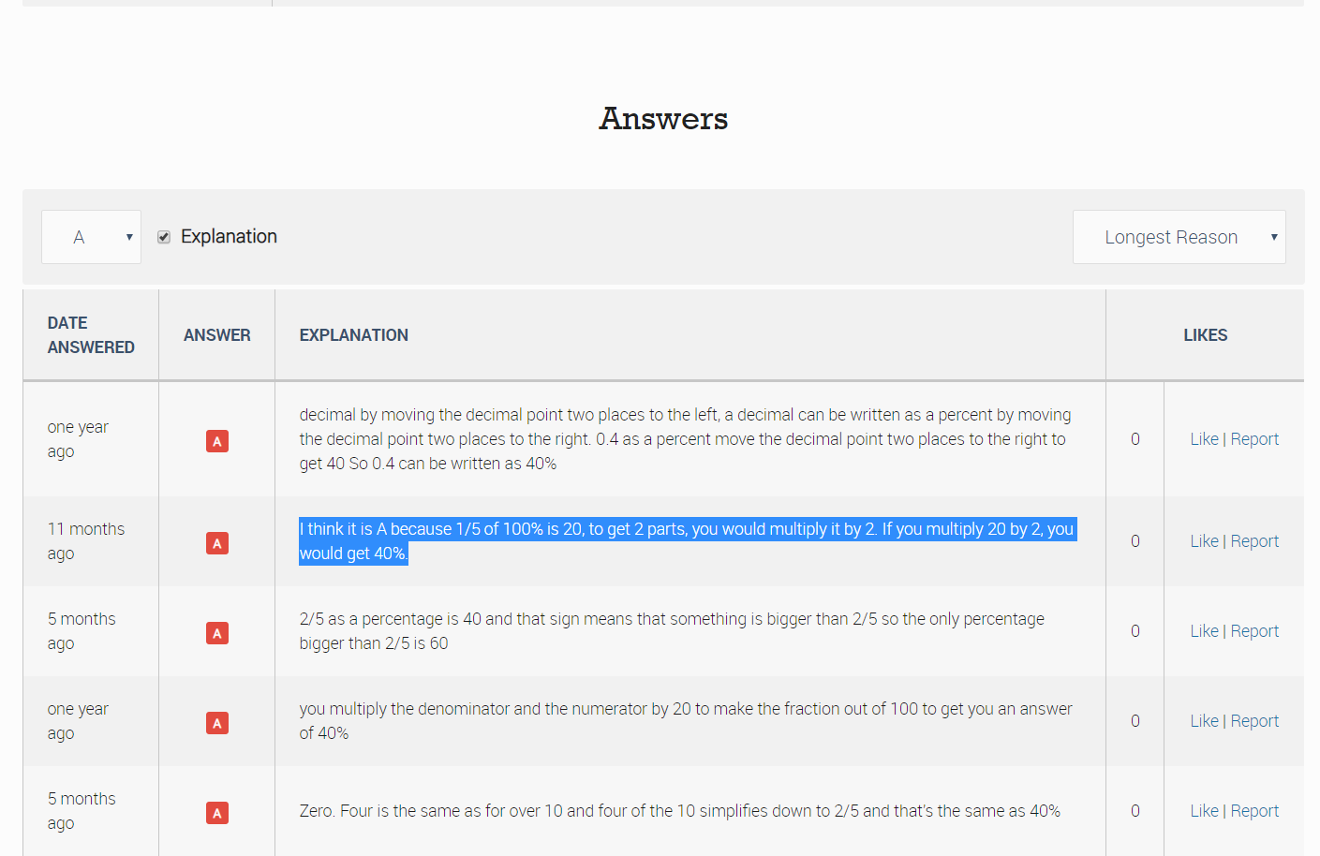
Copy and paste the text of the explanation and add it to your PowerPoint

Slide 37
Repeat this for the other two questions

Slide 38
And you are done!

Slide 39
The Revision Schemes of Work
You can access all the revision quizzes for SATs, GCSE Foundation and GCSE Higher here
You can also set these up as a free Revision Scheme of Work so your students receive a new quiz each week (or whatever frequency you choose), which is automatically marked for you
To get started on this, just visit Eedi
For help getting your students on the system, send an email to hello@eedi.co.uk attaching your students’ names and class-names in a spreadsheet

