Slide 1

Beat the nation!
Week 1

Slide 2
Beat the Nation:
Week 1
Overview
SATs – Week 1
GCSE Foundation – Week 1
GCSE Higher – Week 1
How to find the data
The Revision Schemes of Work

Slide 3
Beat the Nation: Overview
Beat the Nation is a structure I like to use for revision lessons
I use data from the 1000s of students across the nation who have answered questions from the Revision Collection to find the most troublesome questions
I then present these questions to students in class, challenging them to:
  Get the questions correct (hence, Beat the Nation!)
  Predict which is the worst answered question
  Predict the most popular choice of wrong answer for each question
  Explain why a student may choose these answers
  Think how they would help them
I can then reveal the answers (in reverse order, for drama), showcasing actual students explanations for the most popular wrong answers
My aim in doing this is to:
  Expose students to questions other students find difficult and support my students with them
  Help my students develop their ability to consider and explain other students’ misconceptions – a key skill required for those exam questions that require students to explain, describe, discuss, etc
If find that setting this up as “Beat the Nation” provides those students with a competitive edge a nice incentive, and also takes the pressure off a little – “well, the rest of the country is struggling with these questions, so it is no surprise I find them tough, but I might as well give them a go…”
Feel free to play around with the structure to make it work for you.
I hope you and your students enjoy this and find it useful.

Slide 4
Beat the nation!
SATs
Week 1

Slide 5
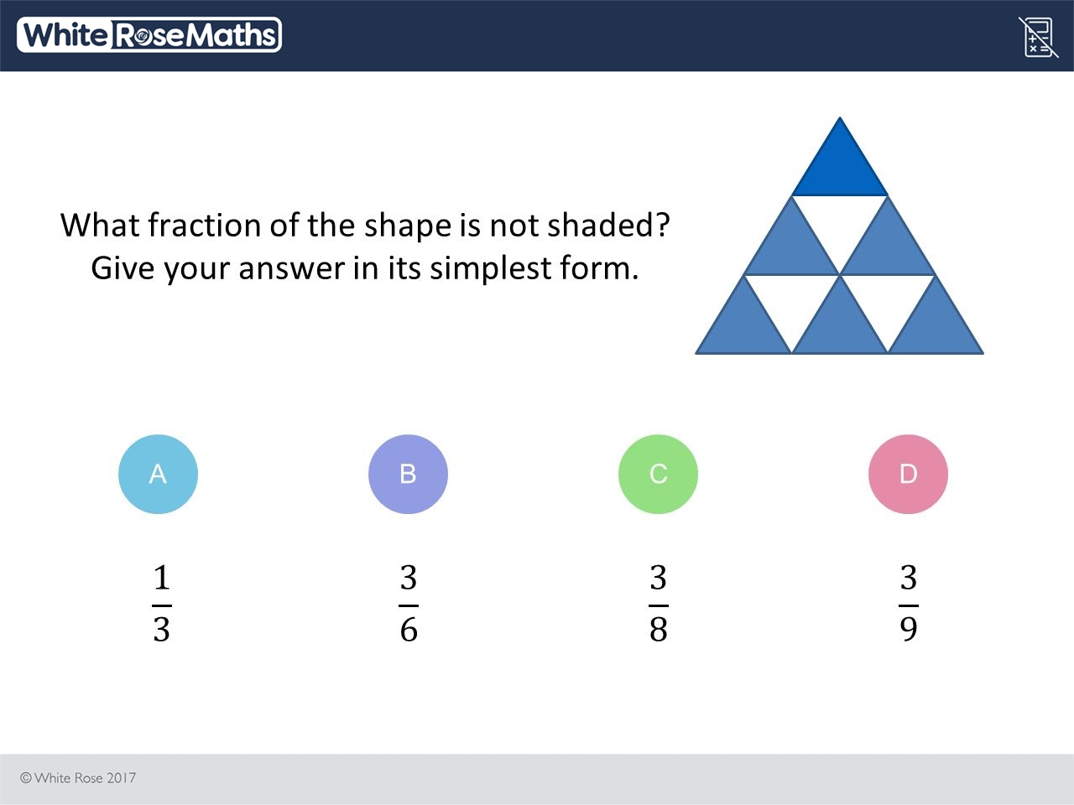
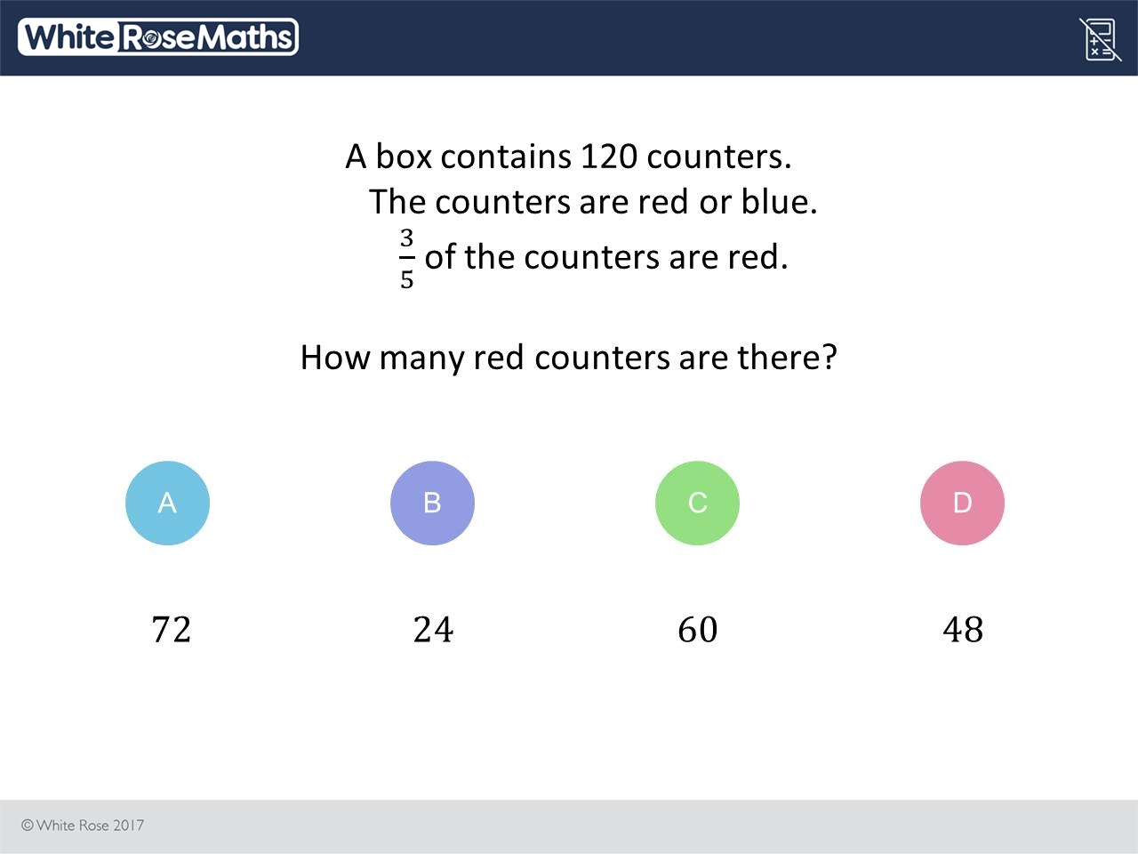
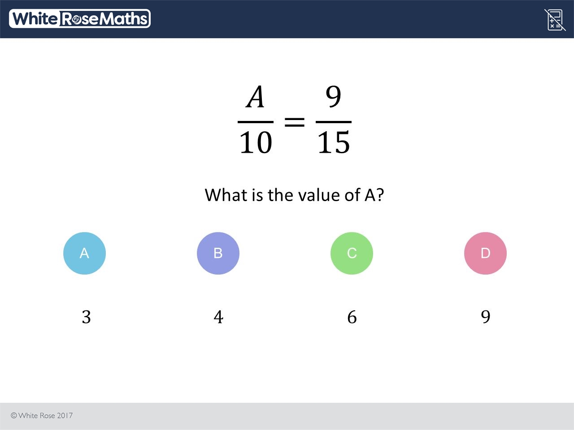
1000s of students are struggling with these three questions
1. Can you get each question right?
2. Which do you think is the worst answered question?
3. What do you think is the most popular choice of wrong answer for each question?
4. Can you explain why other students might choose these wrong answers?
5. How would you help them?

Slide 6
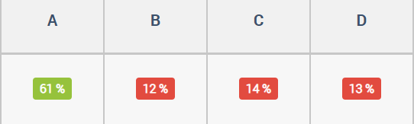
I think the answer is C because 1/5 is 20 percent and 2/5 is 40 percent so all you do is add another 20 which is C 60 . I also know that 3/5 is 60 percent as a percentage but as a whole number it is 60 which is C
C

Slide 7
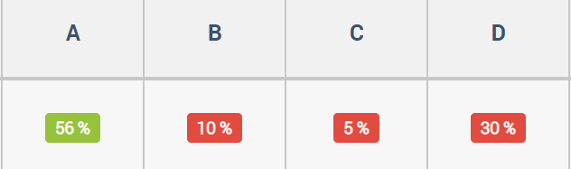
i think this, because the colored triangles, refer to the shaded area. In total, there are 9 squares overall, and 6 of them are shaded in. The question though, asks which portion IS NOT shaded, which is the three squares. so 3 out of 9 squares are not shaded
D

Slide 8
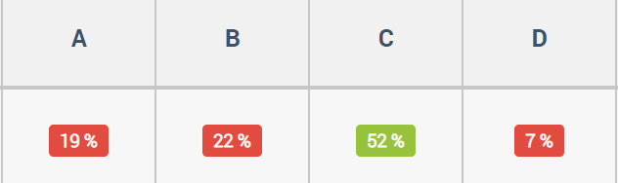
I think it is 4 because whatever you do to the top you do to the bottom. So on the bottom you added 5 from 10 to get to 15. You have to work out how what number you 5 to to get to 9. So I took away 5 from it and got 4
B

Slide 9
Beat the nation!
GCSE Foundation
Week 1

Slide 10
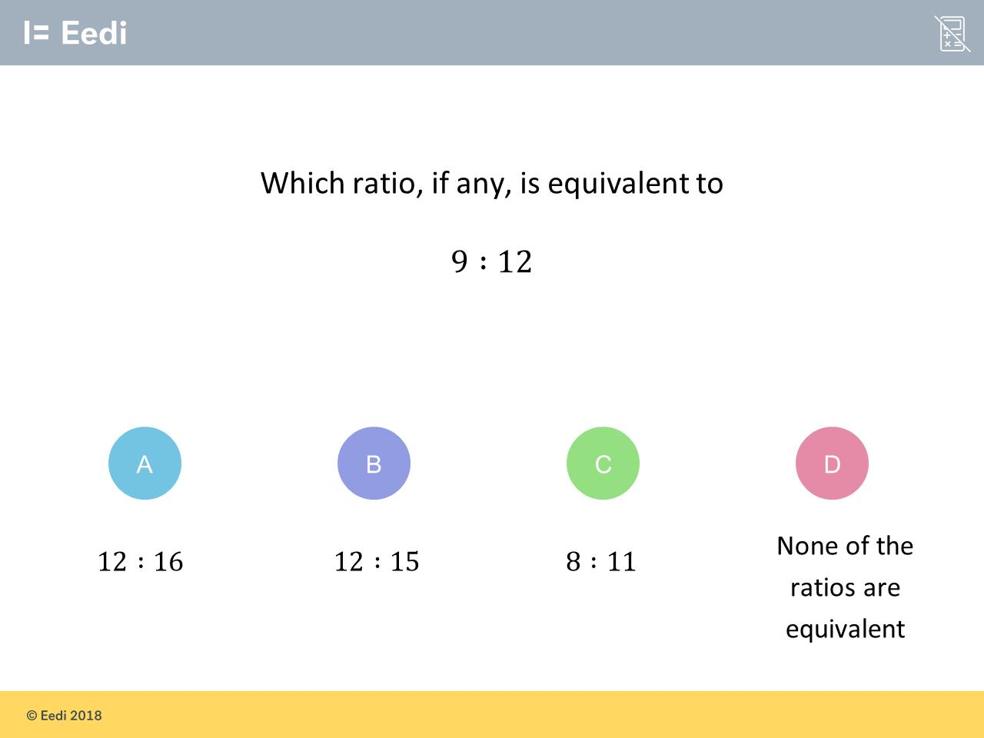
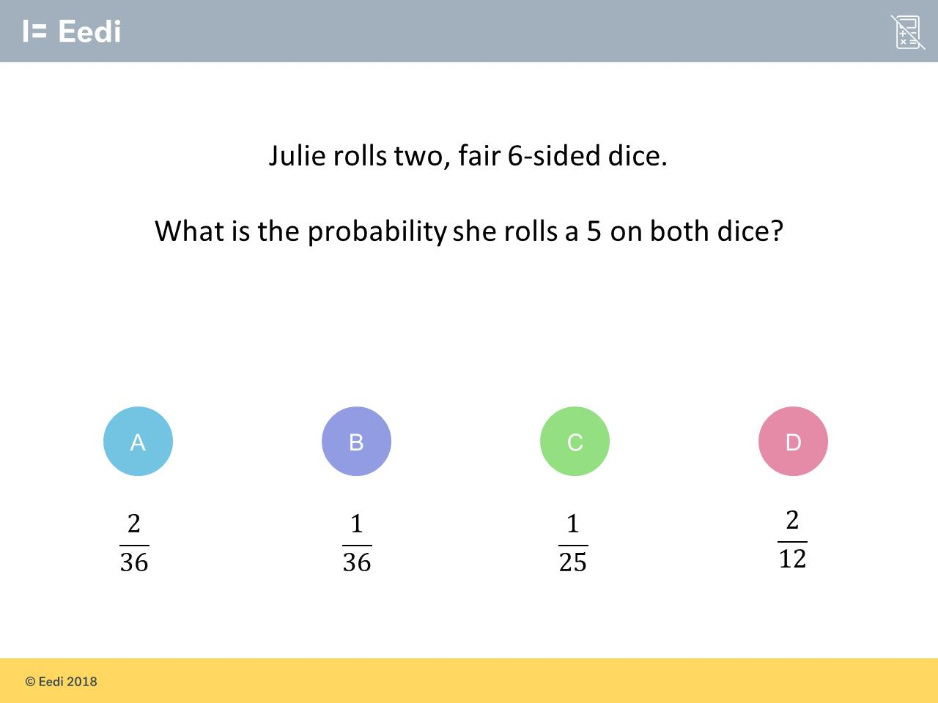
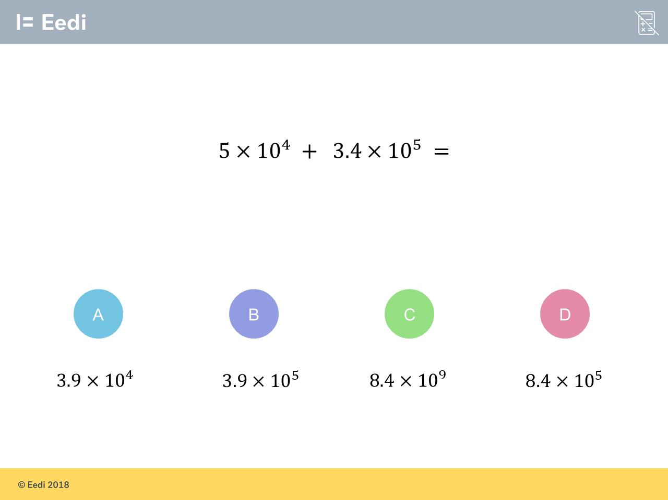
1000s of students are struggling with these three questions
1. Can you get each question right?
2. Which do you think is the worst answered question?
3. What do you think is the most popular choice of wrong answer for each question?
4. Can you explain why other students might choose these wrong answers?
5. How would you help them?

Slide 11
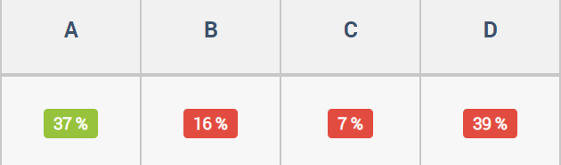
None of these are equivalent because if you were to divide by 3 it would be 3:4 and if you double it, it would be 18:24, and none of these are on there and therefore aren't equivalent
D

Slide 12
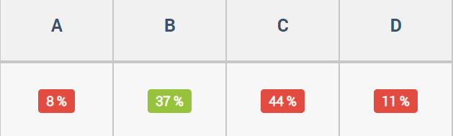
You have to add the integers first because it has the plus sign in the middle to get 5+3.4=8.4 Then you add the powers keeping the 10 in the sum so it becomes 5+4=9 So it is 8.4x10 to the power of 9
C

Slide 13
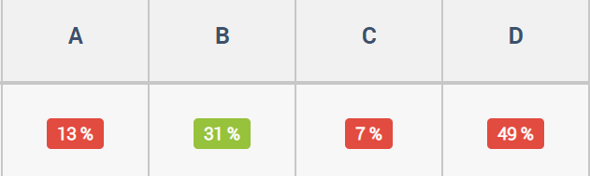
I think the answer is D because if you are using 2 two sided dice that means there is 12 numbers and there is one five on each die meaning you have two chances to get 5 which means you have a 2/12 chance
D

Slide 14
Beat the nation!
GCSE Higher
Week 1

Slide 15
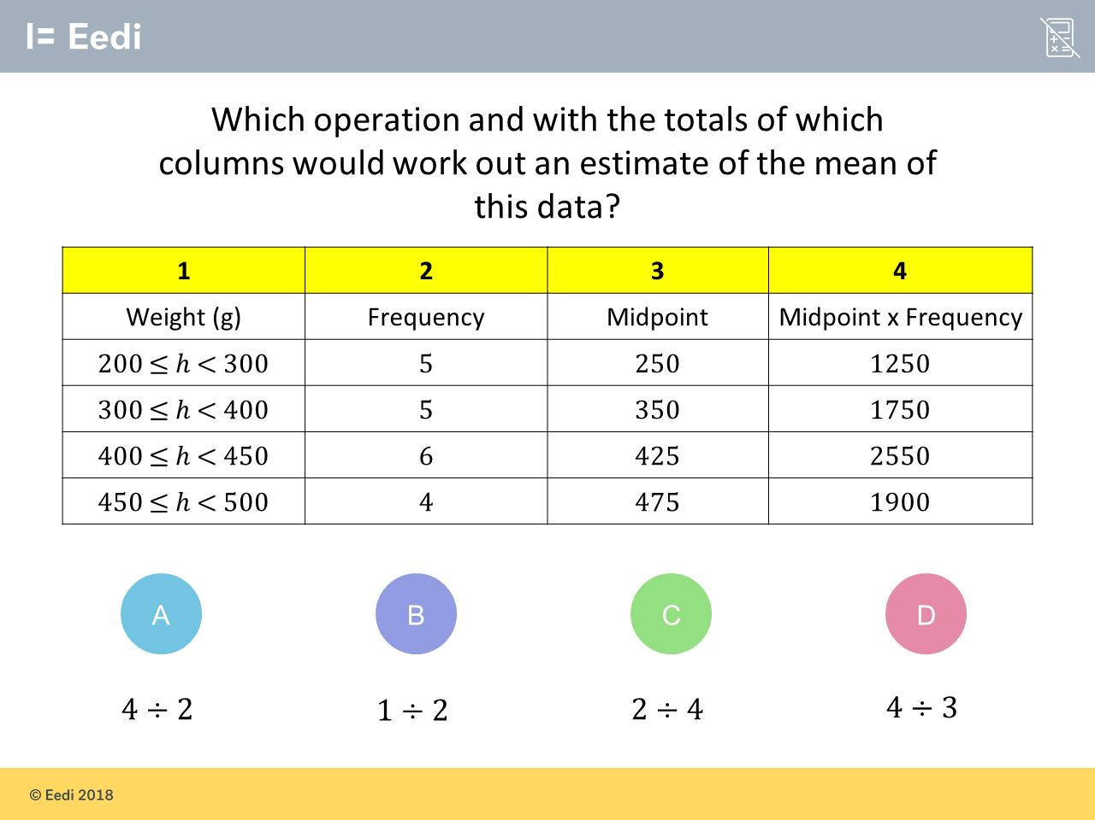
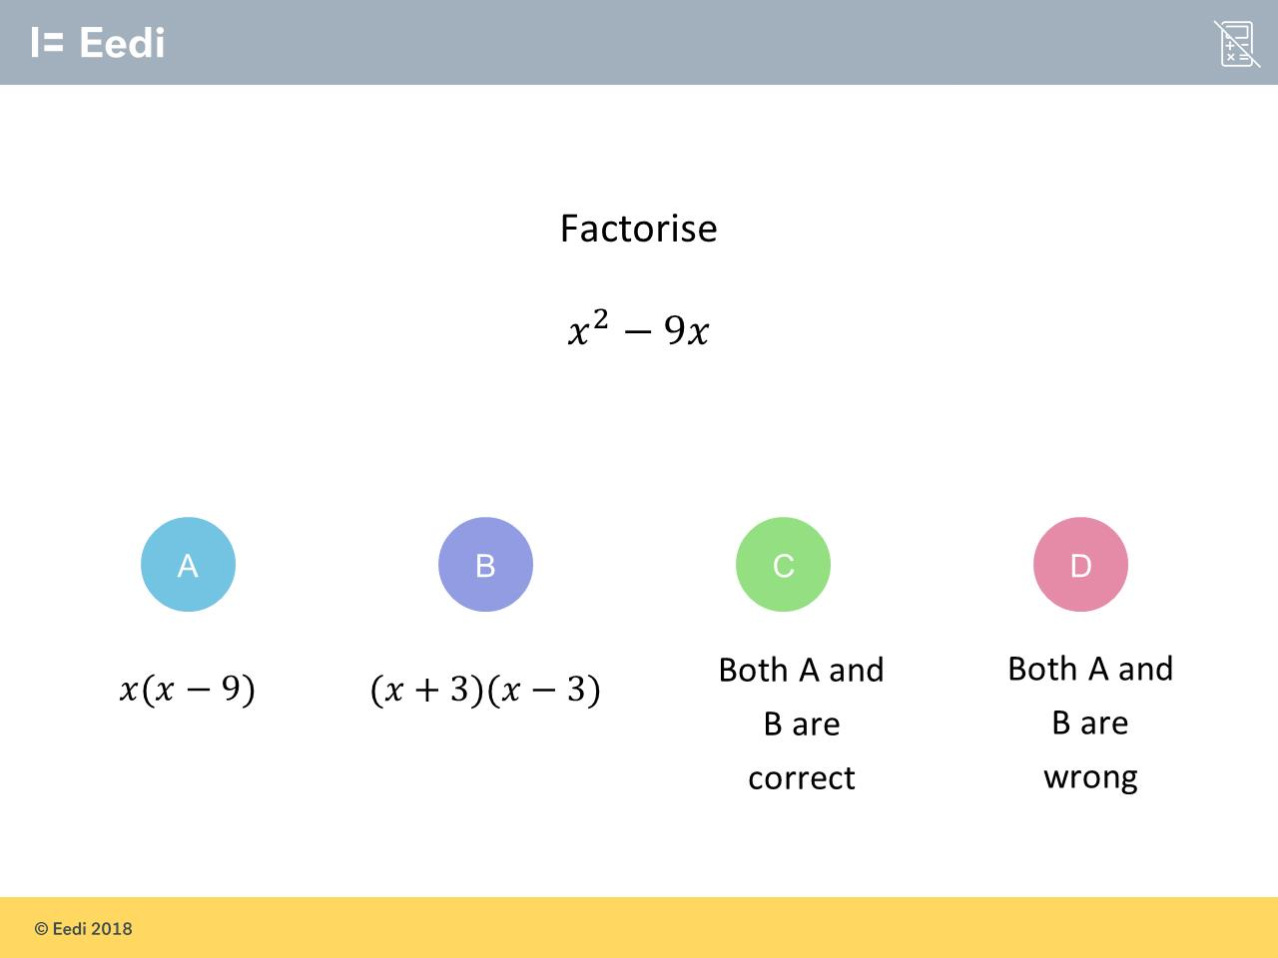
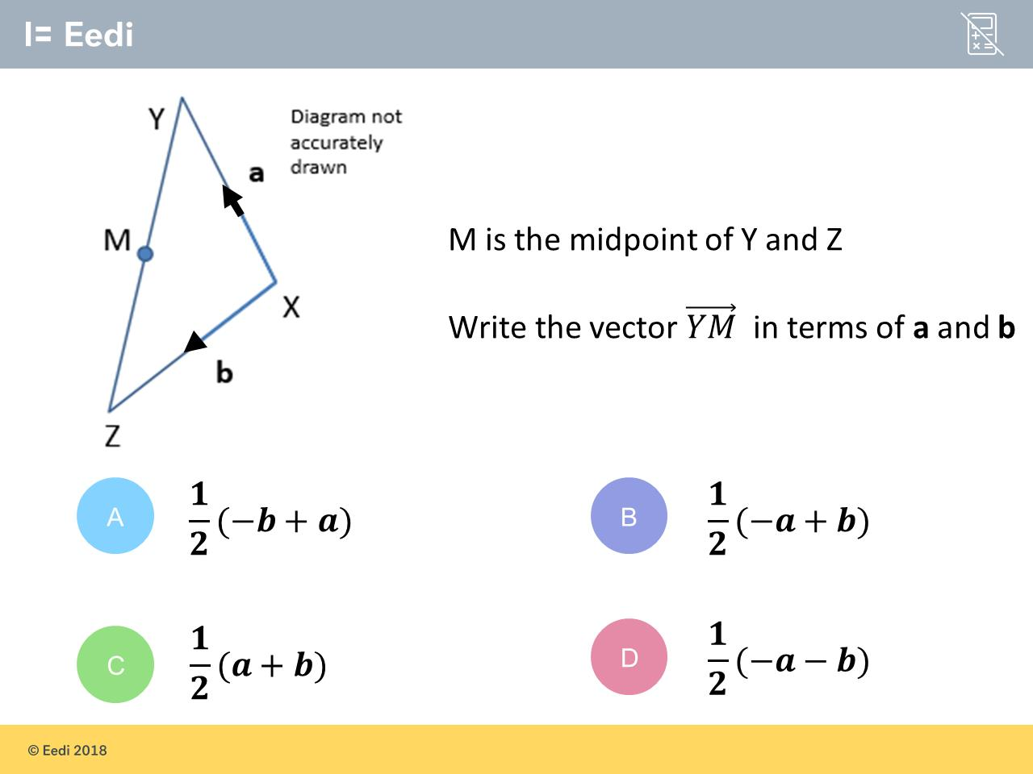
1000s of students are struggling with these three questions
1. Can you get each question right?
2. Which do you think is the worst answered question?
3. What do you think is the most popular choice of wrong answer for each question?
4. Can you explain why other students might choose these wrong answers?
5. How would you help them?

Slide 16
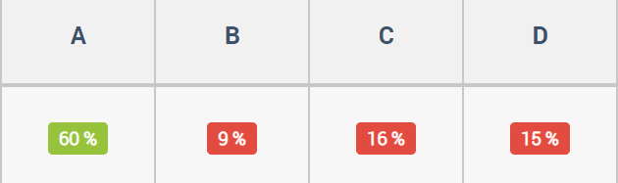
C
because to work out the mean of all the data you need to divide the frequency and the midpoint and frequency

Slide 17
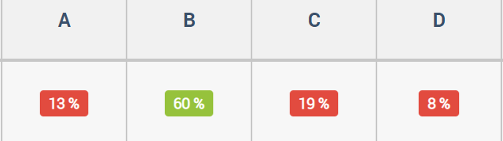
Taking a guess, I assume its C because to work out the mid point its obvious there is a half involved, but the distance of A and B have to be added together then multiplied by 0.5 to find the midpoin
C

Slide 18
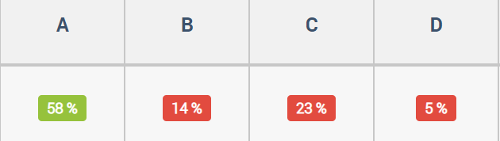
A is correct because x times x is equal to x squared and x times negative 9 is equal to negative 9x. B is correct because it is the difference of two squares
C

Slide 19
Beat the Nation: How to find the data
You can find poorly answered questions, the data on these, and sample student explanations for any quiz on Diagnostic Questions.
Just follow the steps in the next slides

Slide 20

Visit the Collections page

Slide 21
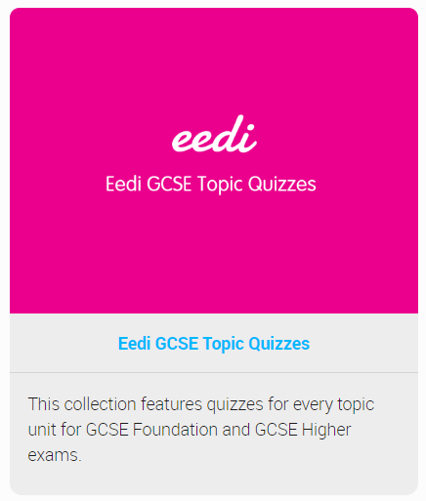
Choose a Collection

Slide 22
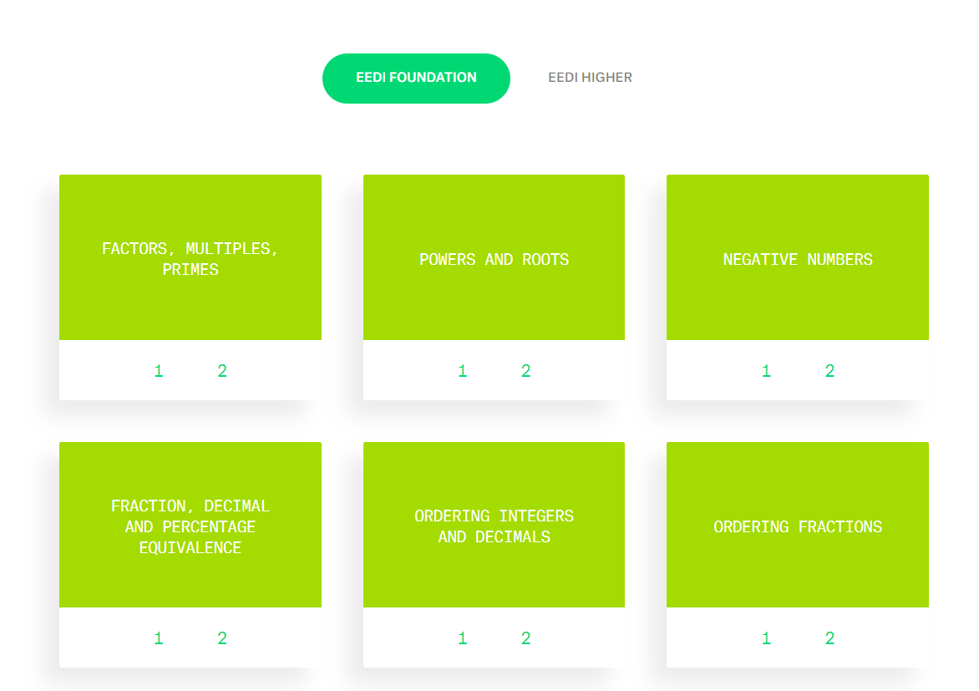
Find a topic you like

Slide 23
Always choose Quiz 1 from that topic (it has most data)

Slide 24
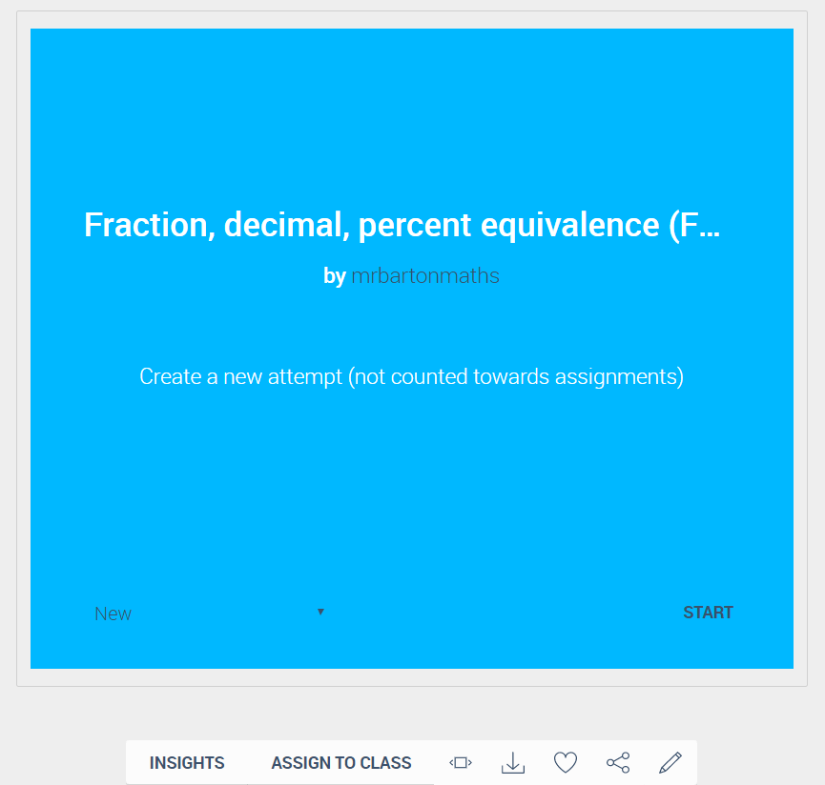
Click on Insights

Slide 25
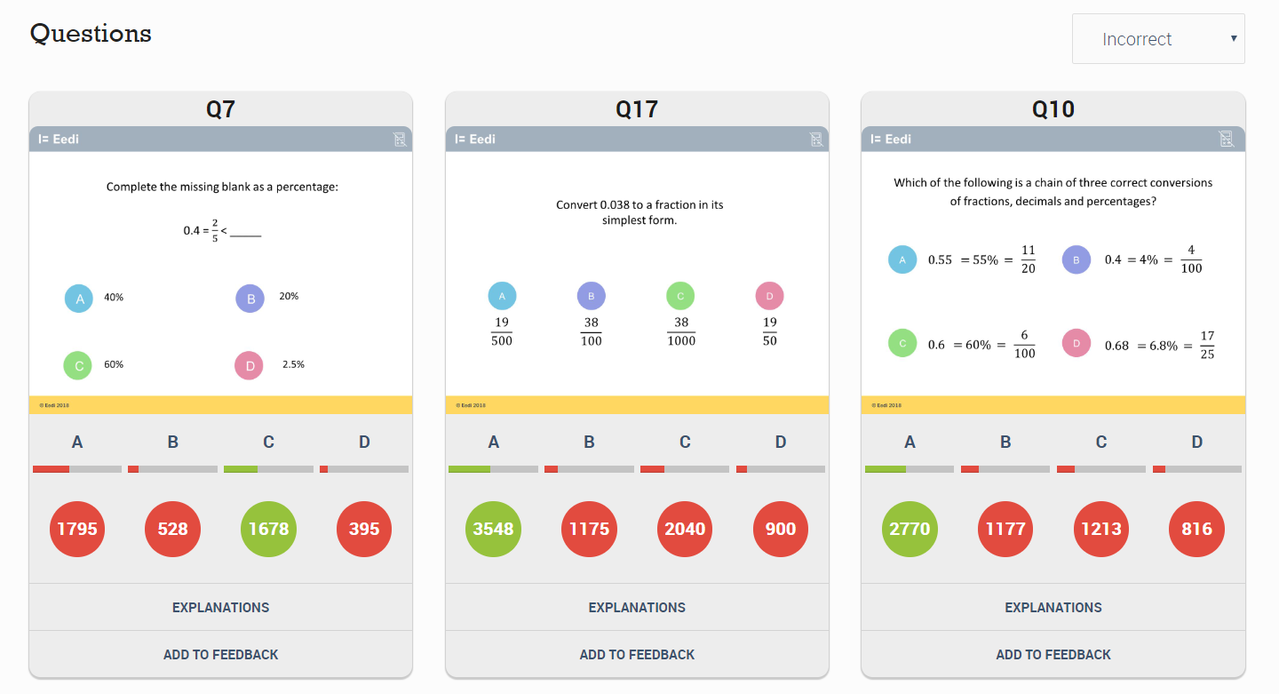
Scroll down the page to see the 3 worst answered questions

Slide 26
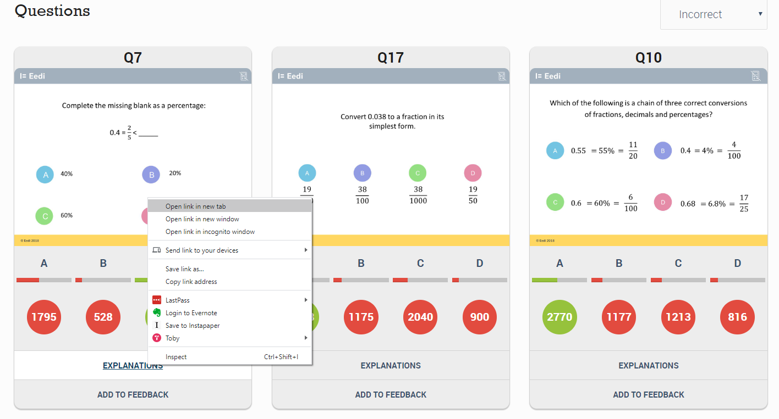
For each question, right-click on Explanations and choose
“Open link in a new tab”

Slide 27
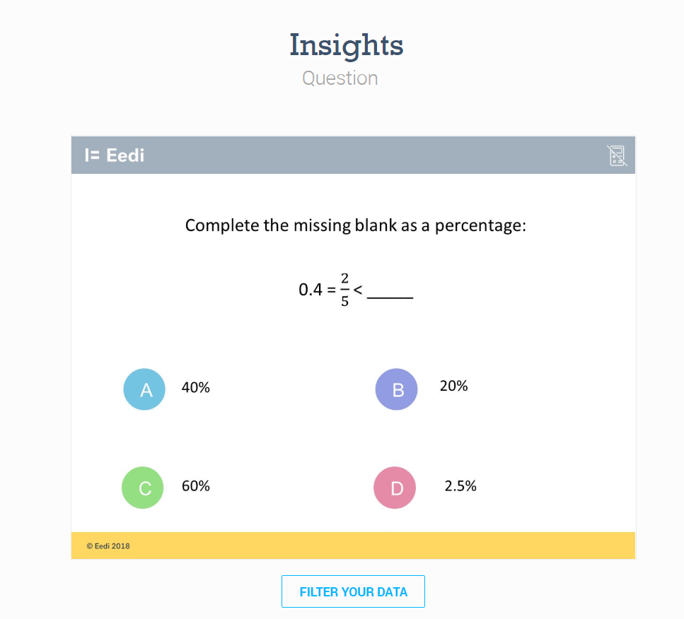
Now you are on a page where you can access more data and explanations for each question

Slide 28
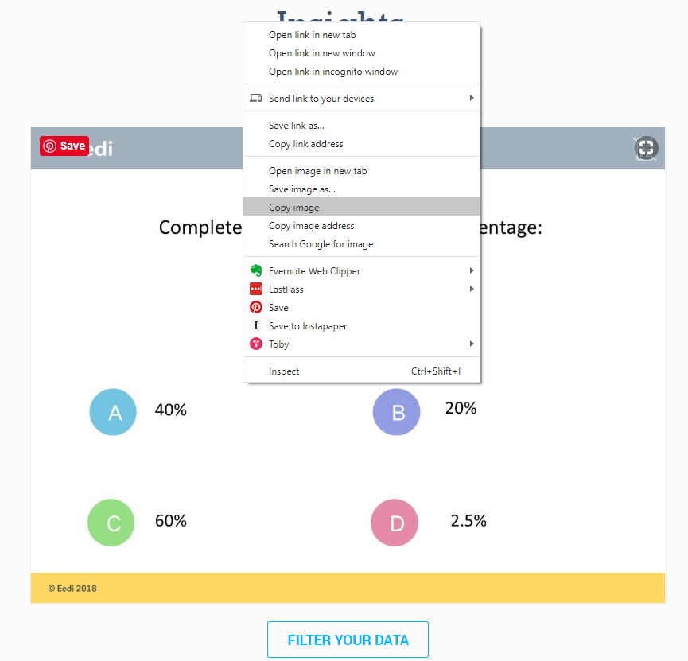
First, copy the image of the question (right-click: “copy image”) and paste it into a blank PowerPoint slide

Slide 29
Next click on Filter your data

Slide 30
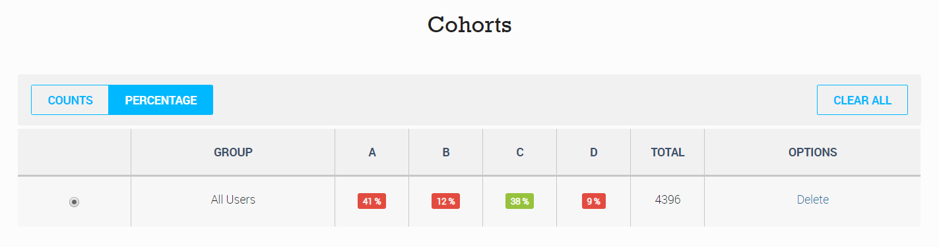
Scroll down the page and change Cohorts to Percentage

Slide 31
You can then take a screen shot of this table so you have the relevant figures for each answer and paste them into your PowerPoint

Slide 32
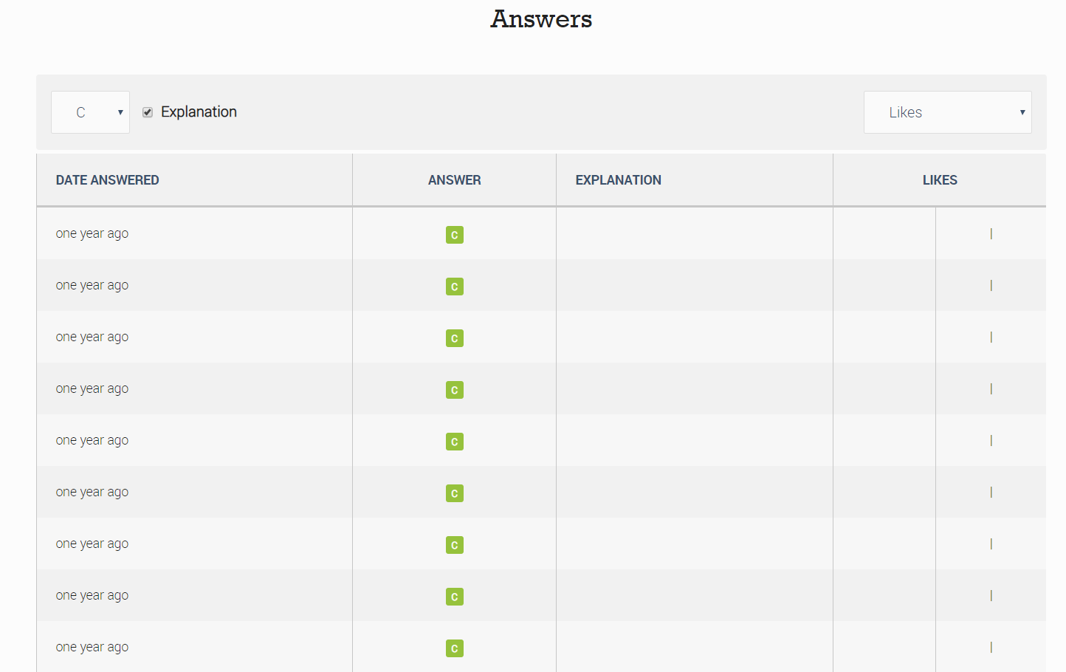
Scroll further down the page to get to the Answers

Slide 33
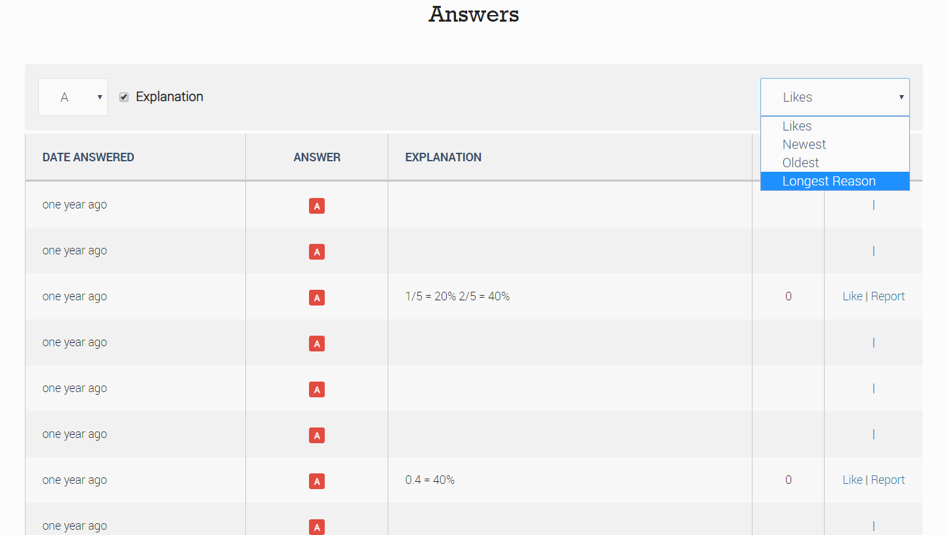
Choose the most popular wrong answer (in this case A), and change Likes to Longest reason (this tends to get better thought out answers)

Slide 34
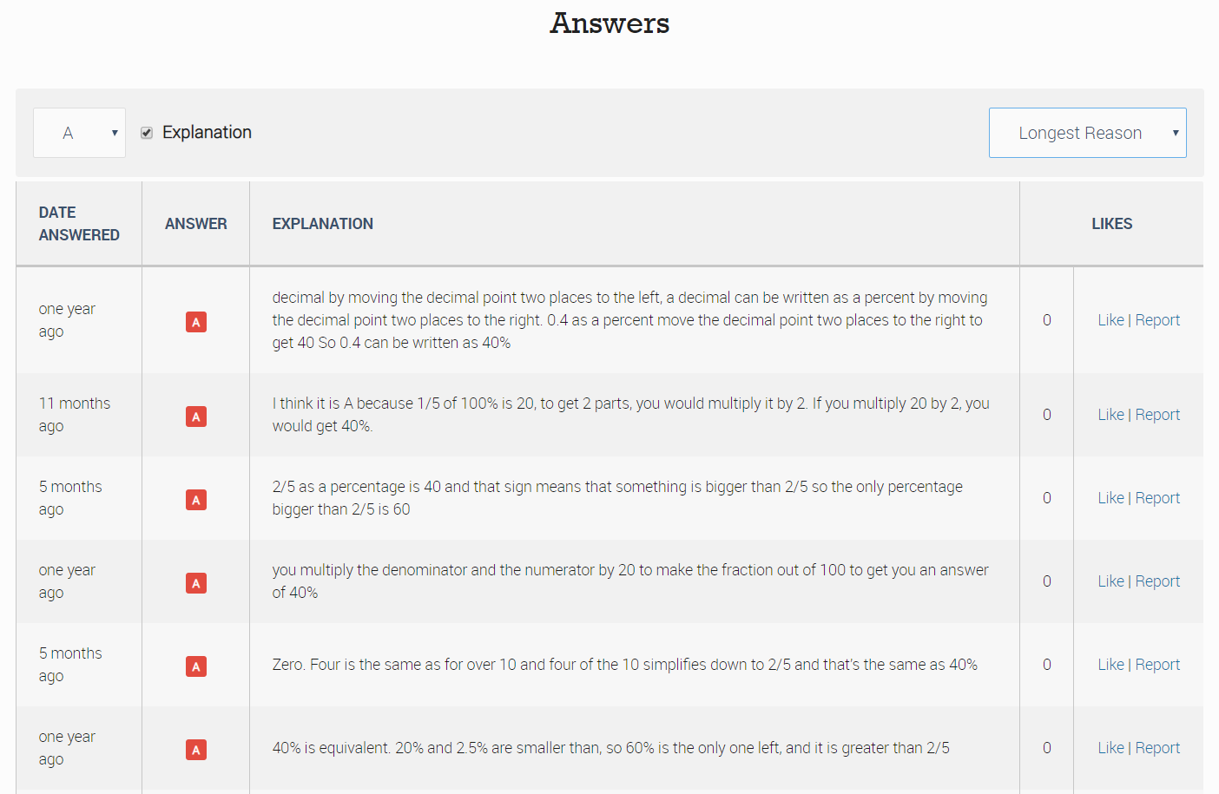
Read through the answers to find interesting ones

Slide 35
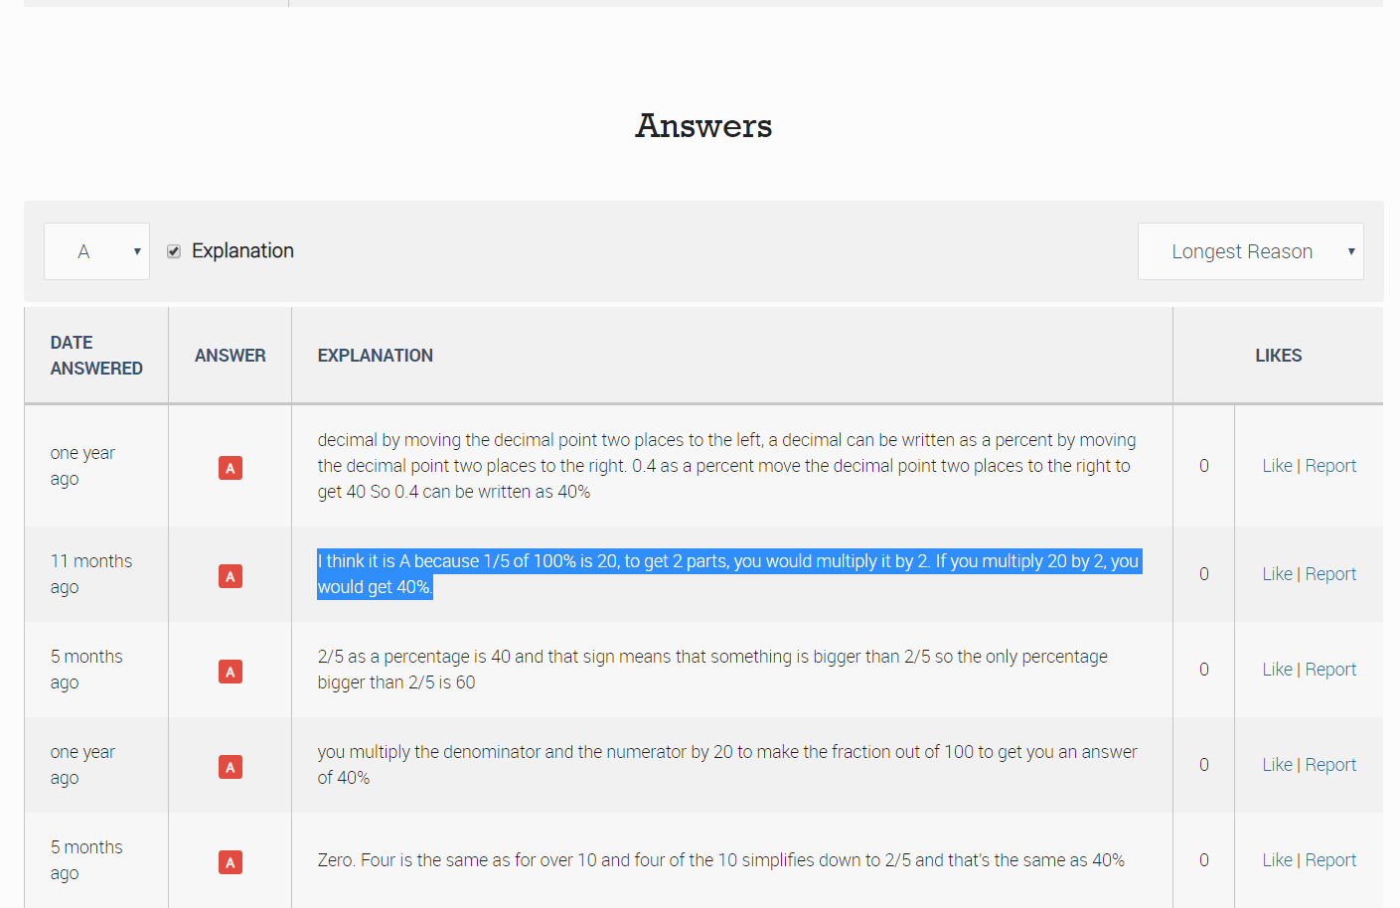
Copy and paste the text of the explanation and add it to your PowerPoint

Slide 36
Repeat this for the other two questions

Slide 37

And you are done!

Slide 38
The Revision Schemes of Work
You can access all the revision quizzes for SATs, GCSE Foundation and GCSE Higher here
You can also set these up as a free Revision Scheme of Work so your students receive a new quiz each week (or whatever frequency you choose), which is automatically marked for you
To get started on this, just visit Eedi
For help getting your students on the system, send an email to hello@eedi.co.uk attaching your students’ names and class-names in a spreadsheet

