Slide 1
Average Student

Slide 2
Rough Lesson PLan

Slide 3
What type of information would we want to know?

Slide 4
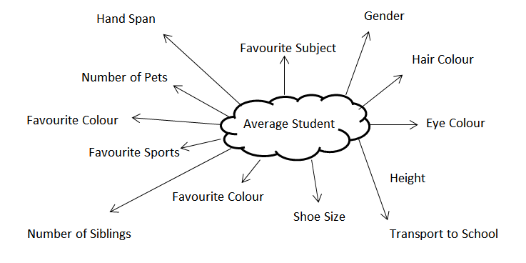
Possible Suggestion

Slide 5
Things to Investigate
What 3 questions are you going to choose?
  What different information could you collect?
    Quantitative/ qualitative
    Continuous / Discrete

Slide 6
Example
1. Do taller people wear larger shoes?
I choose this question because this is comparing two types of quantitative data
2. Are boys taller than girls or do girls have smaller shoes than boys?
This allows us to compare two sets of data depending on the persons gender.
3. Is brown the most popular eye colour?
This will allow me to look at a qualitative data.

Slide 7
Ways of Collecting Data
How could you possibly record your data?

Slide 8
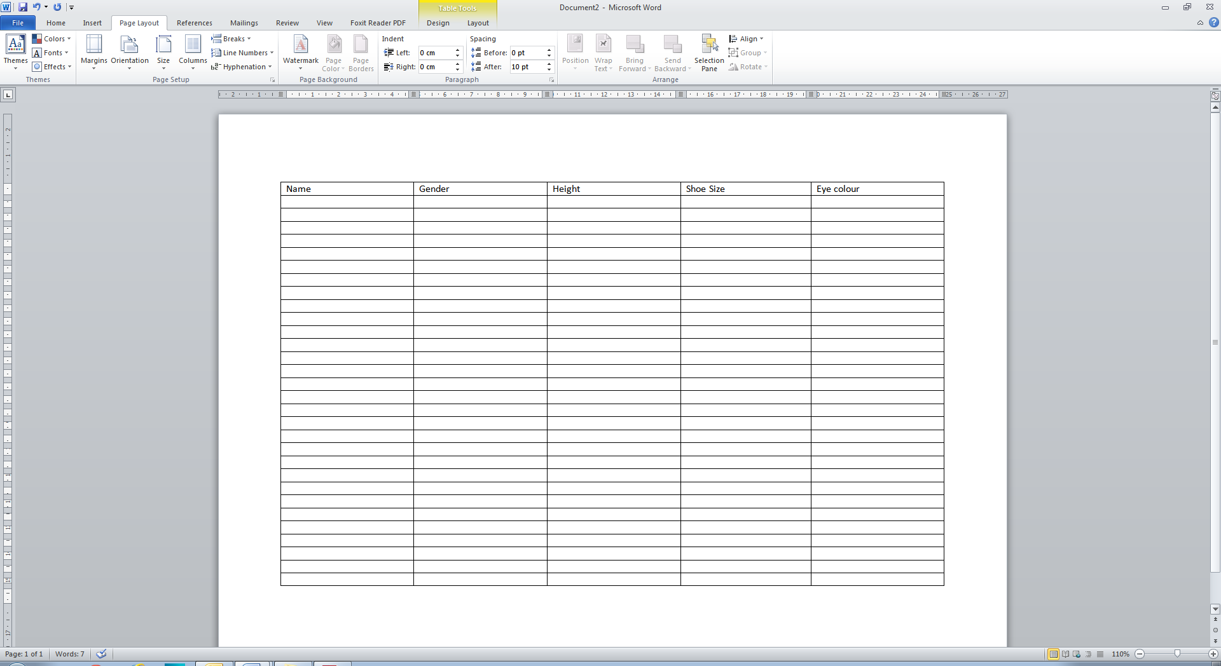
Example

Slide 9
Average
What are the different averages?
How can you use these to compare your data?

Slide 10
Example

