Slide 1
Average Student

Slide 2
Suggested Lesson Order
Give out wordsearch for homework
Discuss key words, what data pupils could gather, decide on three questions to investigate
Set pupils homework to gather data on themselves to share with class next lesson
Averages
Charts – Pupils to Choose which charts would be appropriate
Interpretation

Slide 3
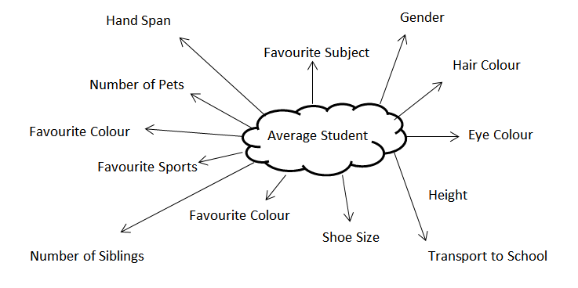
Possible Suggestion

Slide 4
Things to Investigate
What 3 questions are you going to choose?
What different information could you collect?
Qualitative
Quantitative
Data for a Comparison

Slide 5
Things to Investigate
e.g.
Is brown the most popular eye colour in the class?
- Collects qualitative data
Do taller people wear larger shoes?
-Allows for comparison between quantitative data

Slide 6
Ways of Collecting Data
How could you possibly record your data?

Slide 7
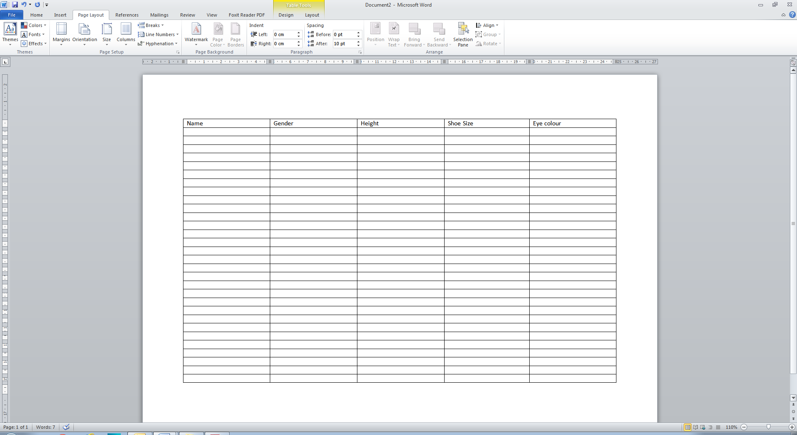
Example

Slide 8
Average
What are the different averages?
How can you use these to compare your data?

Slide 9
Charts
Pictogram
Bar Chart
Pie Chart
Stem and Leaf
Scattergraph
Cumulative Frequency
Box Plot

Slide 10
Possible Extensions
Ideas for Support
Pre-drawn charts and axis
Ensure there is a nice number of data values (e.g. for pie chart)
Comparison of boys and girls in the class
Give pupils additional data on a different group of people (could use Mayfield)

