Slide 1
Quadrilaterals

Slide 2
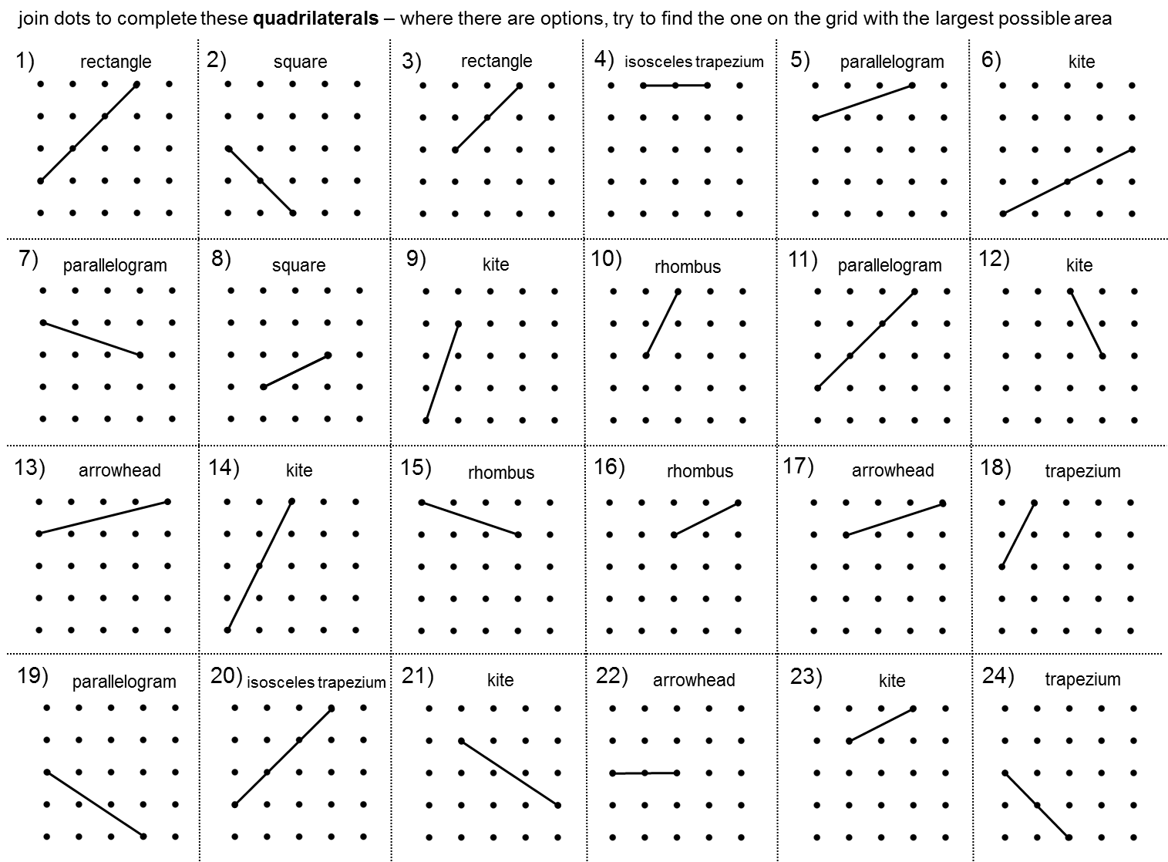

Slide 3
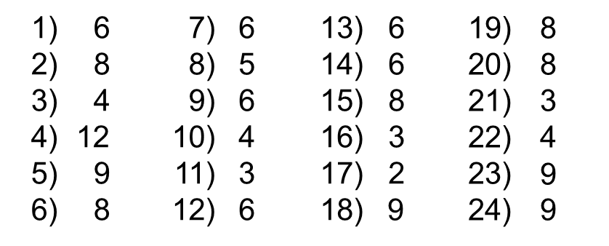

Slide 4
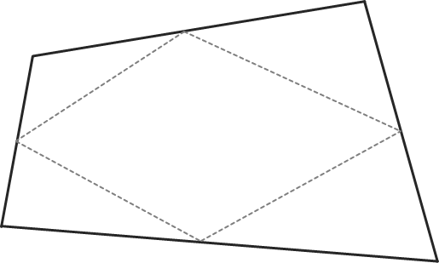
what shape do you get when you join the mid-points of any quadrilateral?
when do you get a rectangle?

Slide 5
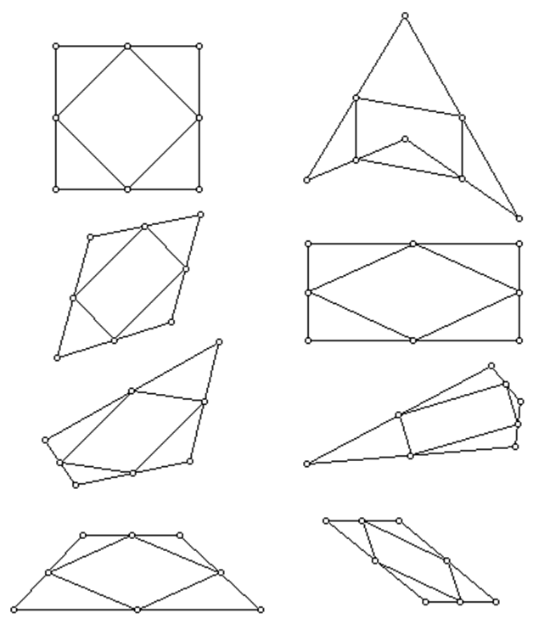

Slide 6
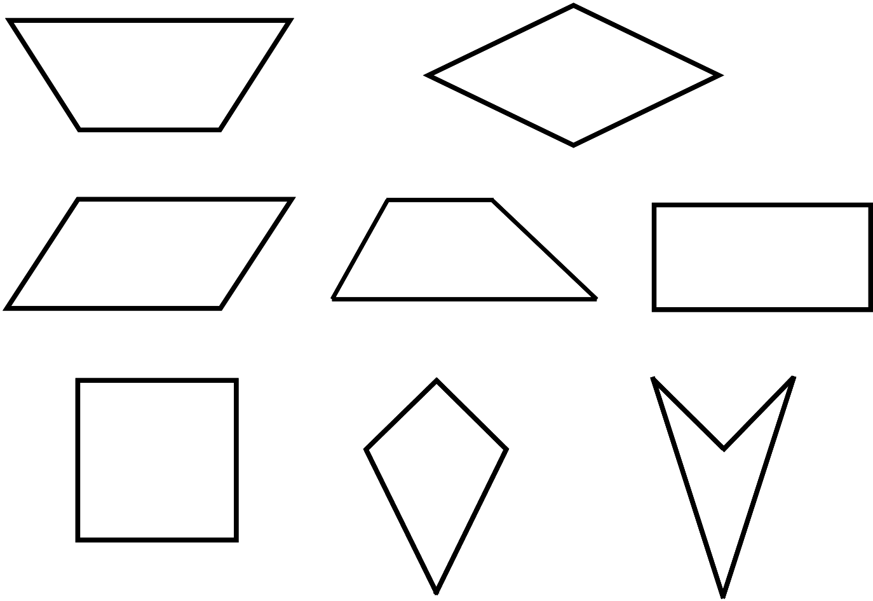
I'm thinking of one of these shapes. You ask me questions to which I can only reply "yes" or "no". You can firmly identify my shape in at most three questions, What would your first question be? Are there alternatives?

Slide 7
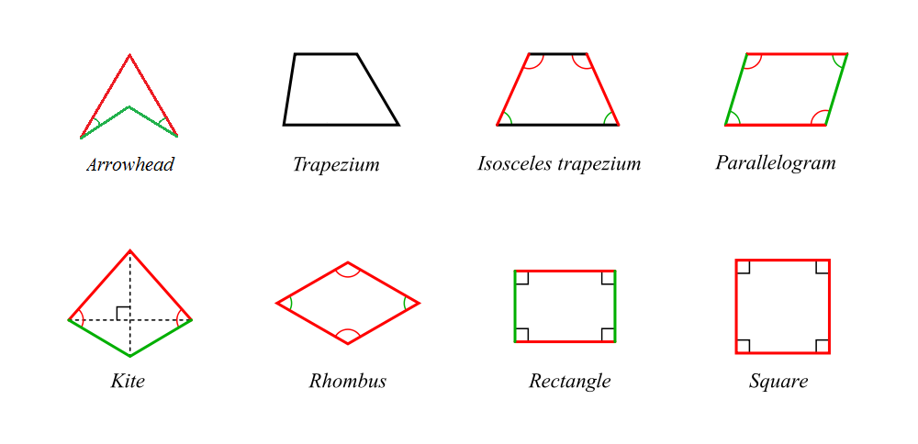
Can you string the eight special quadrilaterals in a line with just one difference between them? I like to include the 'arrowhead' and isosceles trapezium (trapezoid) in the 'specials' collection:

