Slide 1
Differences

Slide 2
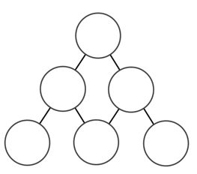

Slide 3
5
8
1

Slide 4
4
3
7
5
8
1

Slide 5
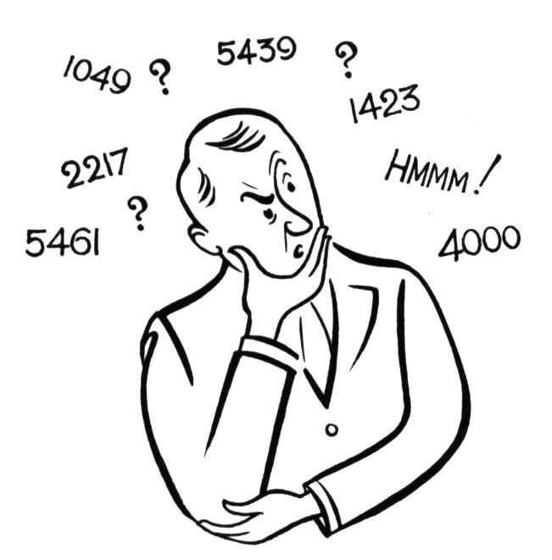
What questions would a mathematician ask?

Slide 6
Possible questions to think about…
How can you get 0 at the top?
How about 2 at the top?
Can you spot any patterns in the bottom numbers and the top numbers (e.g. “you always get 2 at the top if the numbers at the bottom are…”)
Can you explain why these patterns work?
Using 1-6 only, can you fit them into the grid?
Is the order of numbers important, and if so why?
Are their any digits you can’t get at the top? Maybe limit your starting numbers to between 1 and 10

Slide 7
Possible questions to think about…
Is there any difference in results if it is odd and even?
If the bottom numbers are multiples of 5, is the top number a multiple of 5? How about for other multiples?
Can you get all the whole numbers between 1-10 at the top?
If you could do any operation, how could you get the number at the top bigger than all the numbers at the bottom?
How many levels would you need to guarantee a 0 in the top level (starting numbers 1-9)?
Given a completed triangle, how many possibilities for a 4th row are there?
What effect does repeating the numbers have?

Slide 8
Possible questions to think about…
What happens with 2 ,3 or 4 digits numbers?
If you use consecutive numbers on the bottom, what happens on the top?
Largest number on the top of you start with 1-9 on the bottom?
Given the top number, how many different combos for the other numbers?
Any patterns with squares or primes?
What conditions would you need for the number on the top to be bigger than the numbers on the bottom?
What happens if you take the large number away from the small?
What happens if you use square numbers?

Slide 9
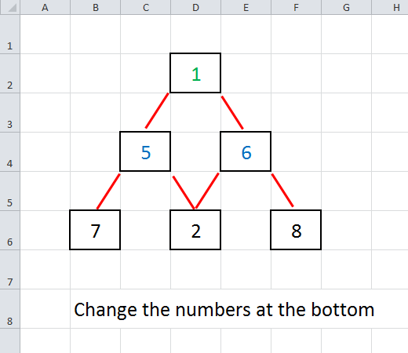

Slide 10
