Slide 1
Multiplication Reduction

Slide 2
The Rules
Choose any 3 digit number
Multiply the digits together to get a new number
Multiply the digits of the new number together
Keep doing this until you are left with a single number
This is your “root”

Slide 3
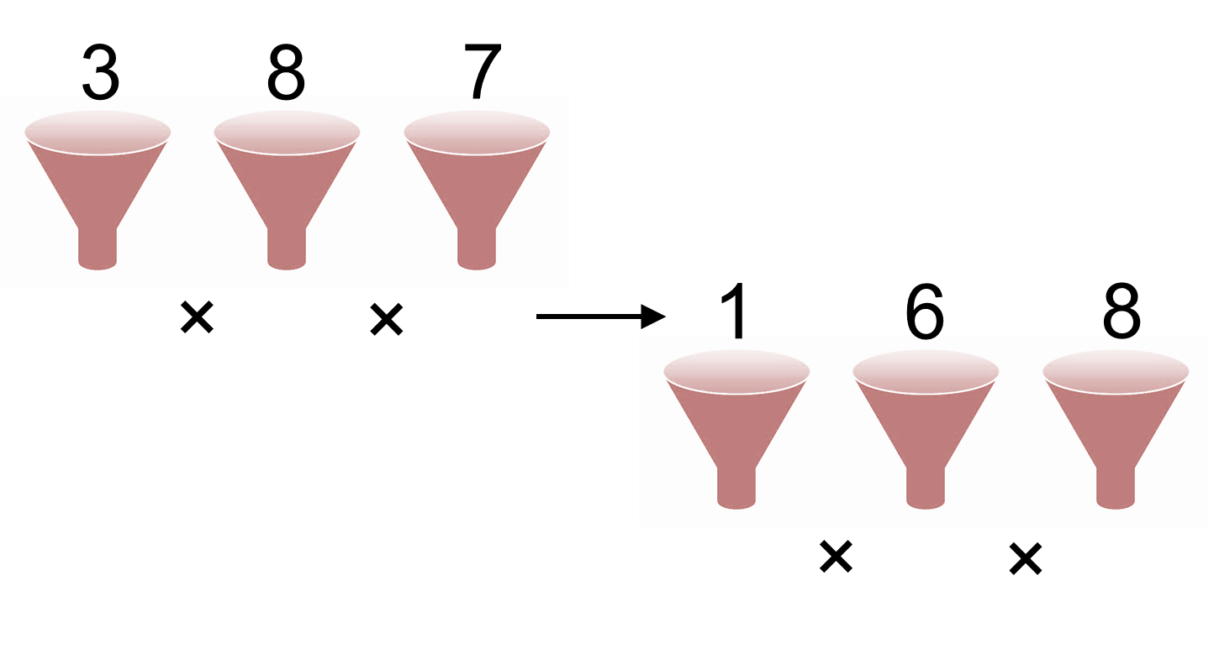

Slide 4
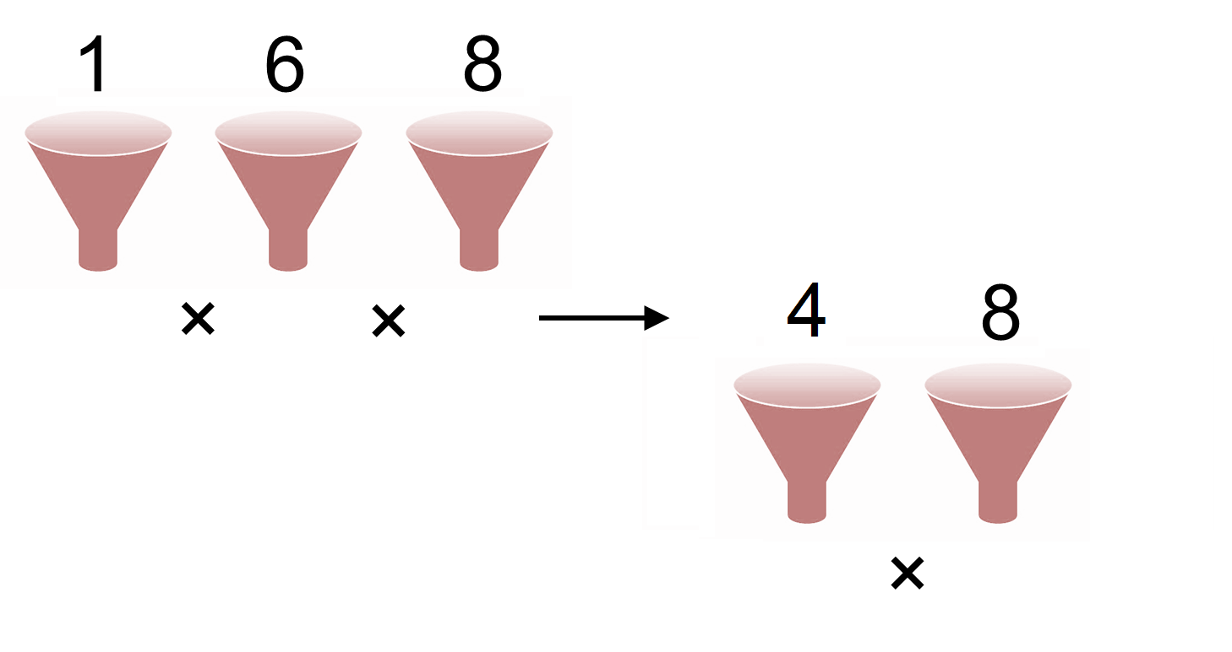
Can you finish this off?...

Slide 5
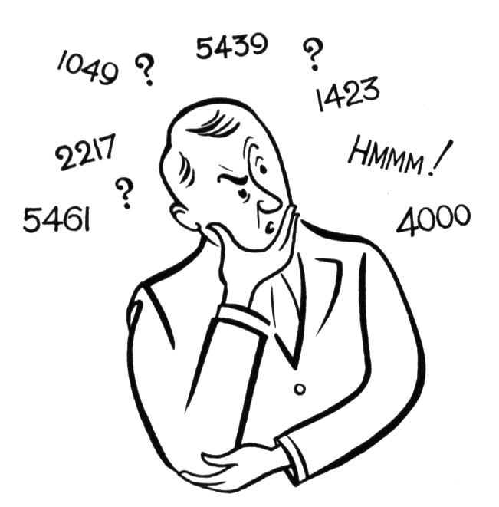
What questions would a mathematician ask?

Slide 6
Possible questions to think about…
What numbers take the most steps to reach a root? How about the least steps?
Why?
When does a number have a root of 0?
Why?
What is the largest 3 digit number that has a root of:
4
6
5
Find all the options that have roots of 7 and 9
Explain your strategy?
How do you know you have them all?
How many numbers have a root of 2?
How do you know you have them all?

Slide 7
Further Questions to think about…
What is the largest number with an odd number root?
What is the common property of numbers that give an odd number root and why?
How many numbers are there with an odd root?
How can you obtain a root of 9?
What happens to numbers with a 5 in them?
By working backwards, find all of the 33 numbers that have a root of 5.
Think of your own question to investigate

Slide 8
