Slide 1


The design of the new schemes of work
Helping you put the bounce back
into maths teaching

Slide 2
Session 2:
The Kangaroo Maths Solution:
Phase 2

Slide 3
Our thinking ….
A mastery curriculum
Involve ‘deliberate practice’
Inspired by the work of Wiliam and Hattie
Respond to Ofsted’s comments about schemes of work in ‘Understanding the Score’ and ‘Made to Measure’ reports
Support ‘outstanding’ teaching and mathematics curriculum (Ofsted: Subject Survey Visits for Mathematics)
A framework for assessing without levels
Revolution not evolution

Slide 4
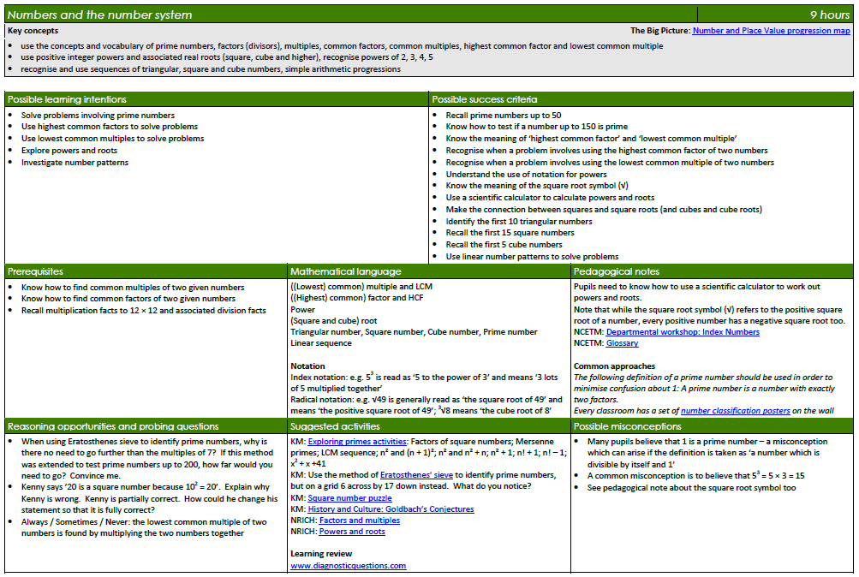
‘Key concepts’ taken from the Programme of Study and then grouped. Stages 1 to 6 already arranged by year. Stages 7 to 11 needed to be chosen to create medium term plans. Progression maps built to show the big picture from Years 1 to 11

Slide 5
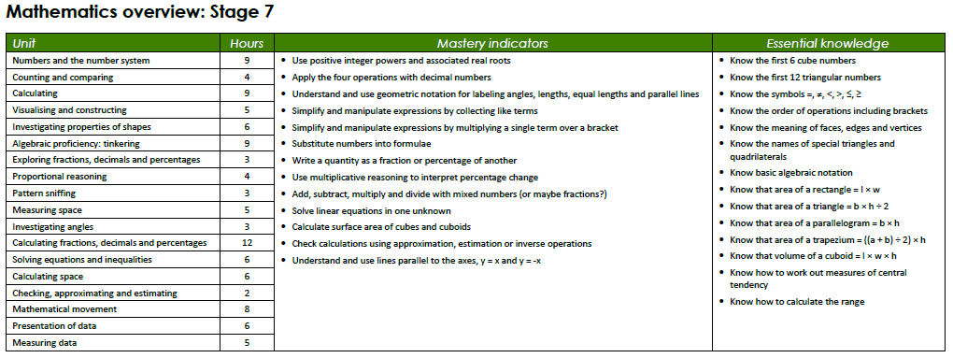
Unit names chosen based on mathematical habits of mind (Cuoco, 1996). Organised to ensure any instances of prerequisite knowledge within a year are covered in the first term. All stages align closely throughout the year.

Slide 6
Potential learning intentions identified that describe the process of learning. They are examples of what the teacher might select for their class. Learning intentions could also be thought of as learning objectives.
Potential success criteria identified that describe the steps to success and outcomes of learning. They are examples, and should not be seen as an exhaustive set. Success criteria could also be thought of as learning outcomes
See Embedding Formative Assessment, Wiliam, 2011 and Visible Learning for Teachers, Hattie, 2011

Slide 7
Prerequisites for the example success criteria

Slide 8
The mathematical language section includes key vocabulary for the unit and information about the notation that students need to understand

Slide 9
Pedagogical notes are relevant for all, but particularly beneficial for non-specialists and inexperienced teachers. Common approaches are shown in italics as they should be noted in a scheme of work but could be personalised to a school.

Slide 10
Suggested activities include links to carefully chosen resources on www.kangaroomaths.com and nrich.maths.org

Slide 11
Possible misconceptions highlight some incorrect thinking that students might demonstrate (not mistakes). Thought should be given as to how to exploit these.
See Embedding Formative Assessment, Wiliam, 2011 and Learning from Mistakes and Misconceptions, (Standards Unit box)

Slide 12
Reasoning opportunities and probing questions utilise questions stems suggested as particularly effective following research by John Mason and Anne Watson
See Questions and Prompts for Mathematical Thinking , Watson & Mason, 1998, (ATM)

Slide 13
The first part of a framework for assessing without levels: a maximum of 13 mastery indicators each year are chosen to represent the most important skills that students need to acquire in order to make progress in their mathematics

Slide 14
Alongside the mastery indicators, essential knowledge lists the facts that students need to know in order to make progress in their mathematics

Slide 15
The number of hours for a unit. However, the curriculum model in your school, the place of deliberate practice, and the time it takes students to master concepts will all influence the reality.

Slide 17
