Slide 1
G “see” SE & The New Dream Scheme

Slide 2
What does the new GCSE look like?...

Slide 3
Requirements for all GCSEs in Mathematics
Written papers only
Linear assessment – all exams must be taken in the same series
Summer exams for all
November opportunity for students who were 16 on 31 August in that year
Minimum assessment time of 4$\frac{1}{2}$ hours
33$\frac{1}{3}$ - 50% non-calculator assessment
Foundation and Higher tiers
New grading structure 1-9, with 9 being the highest
Foundation tier 1 – 5
Higher tier 4 – 9
Will carry a double weighting in the new accountability measures
Slide 5
Copyright © AQA and its licensors. All rights reserved.

Slide 4
AQA Specification at a glance
Paper 1: non-calculator |  | Paper 2: calculator |  | Paper 3: calculator
Content Content from any part of the specification may be assessed |  | Content Content from any part of the specification may be assessed |  | Content Content from any part of the specification may be assessed
Assessment 1 hour 30 minutes written exam 80 marks 33$\frac{1}{3}$ of GCSE |  | Assessment 1 hour 30 minutes written exam 80 marks 33$\frac{1}{3}$ of GCSE |  | Assessment 1 hour 30 minutes written exam 80 marks 33$\frac{1}{3}$ of GCSE
Students will be required to answer all questions on all papers
The assessment structure will be the same for both foundation and higher tiers
Slide 7
Copyright © AQA and its licensors. All rights reserved.

Slide 5
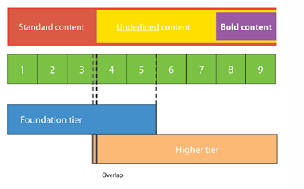
Overview of specification content 1
The DfE has split the subject content into three groups:
content that all students should master
content that should be taught, but higher achieving students should master
content that will be taught only to higher achieving students and mastered by the highest achievers (those likely to go on to A-level study in maths)
Slide 6
Copyright © AQA and its licensors. All rights reserved.

Slide 6
Overview of specification content 2
The mathematical content is defined by the DfE’s GCSE subject content and assessment objectives document.
Subject area | Foundation Tier weighting | Higher Tier weighting
Number | 25% (35%) | 15% (17%)
Algebra | 20% (17%) nMa : Ma | 30% (35%) nMa : Ma No stipulation
Ratio, proportion and rates of change | 25% (subsumed in other areas) | 20% (subsumed in other areas)
Geometry and measures | 15% (28%) | 20% (28%)
Probability and statistics | 15% (20%) | 15% (20%)
Figures in brackets show weightings for the current qualification
Slide 6
Copyright © AQA and its licensors. All rights reserved.

Slide 7
Key changes from the existing specifications
New content
Additional content in the foundation tier
New assessment objectives
Slide 6
Copyright © AQA and its licensors. All rights reserved.

Slide 8
Assessment Objective 1
Use and apply standard techniques
Students should be able to: accurately recall facts, terminology and definitions use and interpret notation correctly accurately carry out routine procedures or set tasks requiring multi-step solutions Weighting: F 50% H 40%
Slide 9
Copyright © AQA and its licensors. All rights reserved.
Notes:
.

Slide 9
Assessment Objective 2
Reason, interpret and communicate mathematically
Students should be able to: make deductions and inferences and draw conclusions from mathematical information construct chains of reasoning to achieve a given result interpret and communicate information accurately present arguments and proofs assess the validity of an argument and critically evaluate a given way of processing information Weighting: F 25% H 30%
Slide 9
Copyright © AQA and its licensors. All rights reserved.

Slide 10
Assessment Objective 3
Solve problems within mathematics in other contexts
Students should be able to: translate problems in mathematical or non-mathematical contexts into a process or a series of mathematical processes make and use connections between different parts of mathematics interpret results in the context of the given problem evaluate methods used and results obtained evaluate solutions to identify how they may have been affected by assumptions made Weighting: F 25% H 30%
Slide 10
Copyright © AQA and its licensors. All rights reserved.
Notes:
.

Slide 11
Higher Tier
Slide 21
Copyright © AQA and its licensors. All rights reserved.

Slide 12
Higher tier structure
120 marks
9
A*
A
B
C
D
Sustained challenge at the top end
53 marks
8
50%
50%
7
Intrinsic structural demands
6
Mastery of the ‘basics’
5
50%
4
50%
Current
GCSE linear 175 marks
New GCSE 240 marks

Slide 13
Structure of Higher Tier Papers
Each paper will start with 4 multiple choice questions
4 further multiple choice questions are spread throughout each paper
Early questions test the additional foundation content in a straightforward way and the basic foundation content in a more complex way
As the paper progresses the higher content is tested in a straightforward way and the additional foundation content is tested in a more complex way
At the end of the paper higher content is tested in both straightforward and more complex ways
Slide 24
Copyright © AQA and its licensors. All rights reserved.
Notes:
.

Slide 14
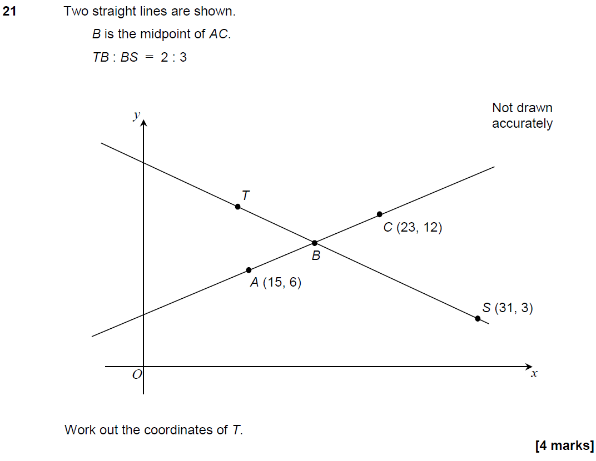
Example of testing results Paper 1H Question 21
Problem solving questions don’t need to be in context or word-heavy
Still a challenge!
10% scored 4 marks
9% scored 3 marks
10% scored 2 marks
22% scored 1 mark
49% did not score

Slide 15
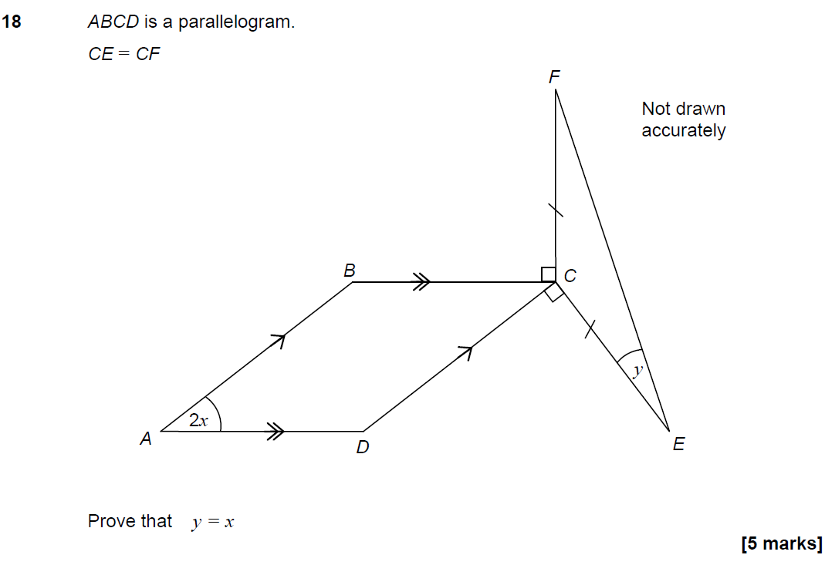
Example of testing results Paper 2H Question 18
Testing helps us focus our support
for you.
Proof at Higher tier.
Good differentiator,
but few can fully
meet the demands.
3% scored 5 marks
15% scored 4 marks
7% scored 3 marks
35% scored 2 marks
18% scored 1 mark
Only 22% scored 0

Slide 16
Foundation Tier
Slide 15
Copyright © AQA and its licensors. All rights reserved.

Slide 17
Foundation tier structure
120 marks
5
Focus on key grades
C
D
E
F
G
53 marks
4
50%
Intrinsic structural demands
50%
3
2
50%
Mastery of the ‘basics’
50%
1
Current
GCSE linear 175 marks
New GCSE 240 marks

Slide 18
Structure of Foundation Tier Papers
Each paper will start with 4 multiple choice questions
4 further multiple choice questions are spread throughout each paper
Early questions test the basic foundation content in a straightforward way
As the paper progresses the basic foundation content is tested in more complex ways
Towards the end of the paper additional foundation content is included, but is tested in a straightforward way
Slide 18
Copyright © AQA and its licensors. All rights reserved.

Slide 19
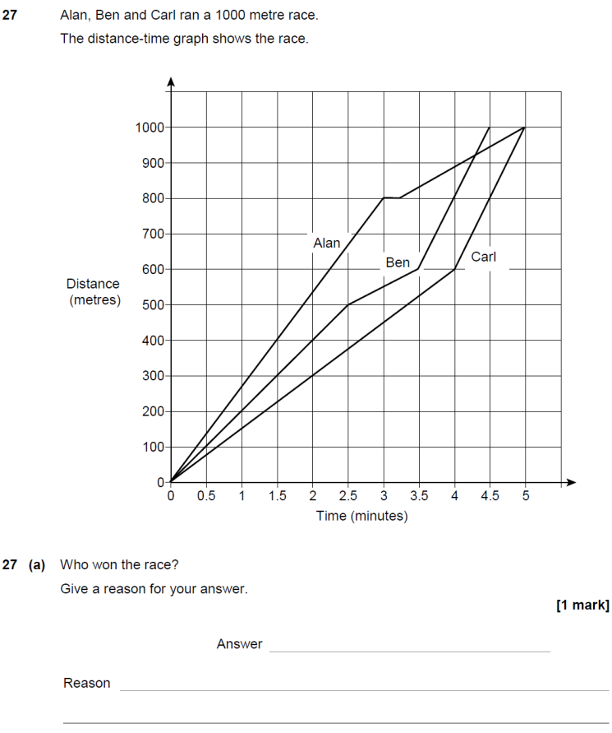
Example of testing results Paper 1F Question 27b
Part (b) 26% scored 4
16% scored 3
13% scored 2
17% scored 1
28% scored 0
Great discrimination and good source of marks on AO2 at the end
of Foundation paper

Slide 20
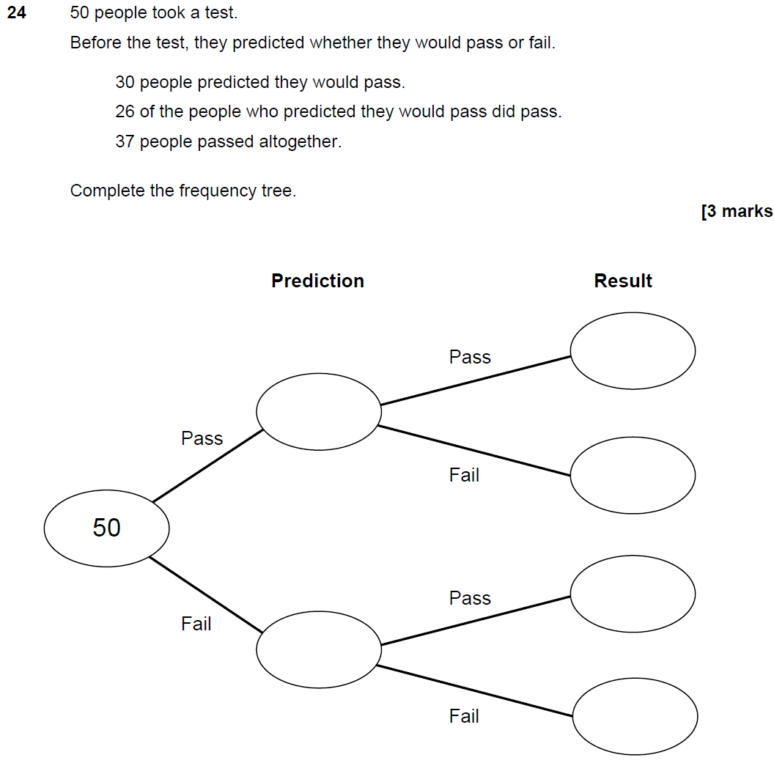
Example of testing results Paper 2F Question 24
Brand new topic from
DfE content.
53% scored 3 marks
19% scored 2 marks
16% scored 1 marks
12% scored 0 marks

Slide 21
Let’s look at 10 of the best questions from the draft specifications…
Click here

Slide 22
What does the new Dream Scheme look like?

Slide 23
Structure
Everyone’s talking about “Topic Units”

Slide 24
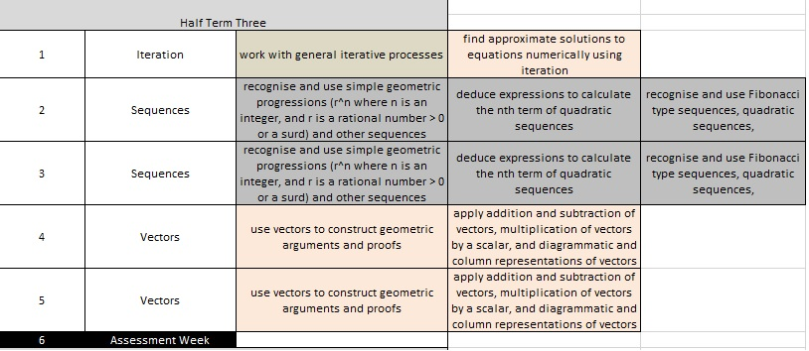
Most of new content left until Year 11…

Slide 25
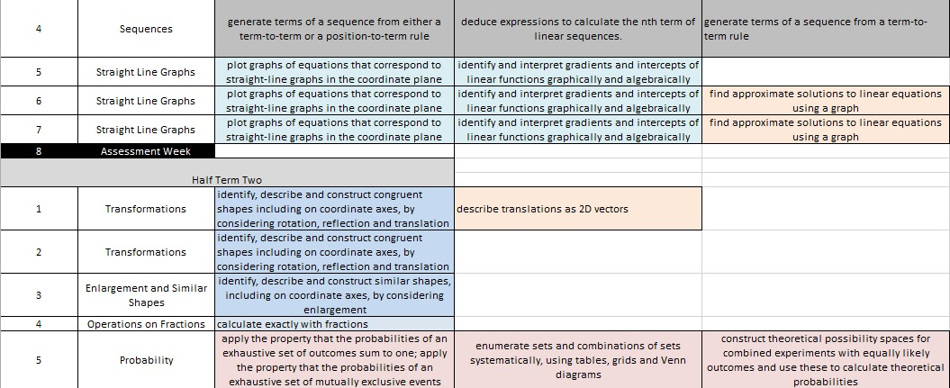
Logical Order of Topics…

Slide 26
Content
Tasks
Homeworks
Assessments
For Homeworks and Assessments, Years 7 to 11 all follow this each same structure ☺

Slide 27
Tasks
Each Topic Unit has one rich tasks that all students will do
This can be done at any point during the Topic Unit
I will run TATALDG sessions about these as we approach them
They do not need to be marked! ☺

Slide 28
Tasks
You will have more time than ever to work through the Topic Units
If you finish teaching the content, there will be additional Rich Tasks, Problems and Numeracy Work for you to do
Everyone moves on to the next topic together

Slide 29
Homeworks
1 compulsory homework per fortnight
This will guide you as to the content you should be teaching
This will be out of 30 marks
10 marks will be reviewing prior knowledge
20 marks will be assessing the current topic
Scores recorded on spreadsheet
Allows us to intervene more effectively

Slide 30
The 4 “Levels” of Homeworks
Fermat – Foundation
Gauss – Skills
Newton – Skills and some applications
Wiles – Extensions

Slide 31
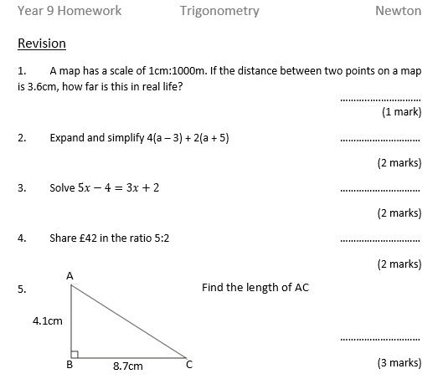

Slide 33
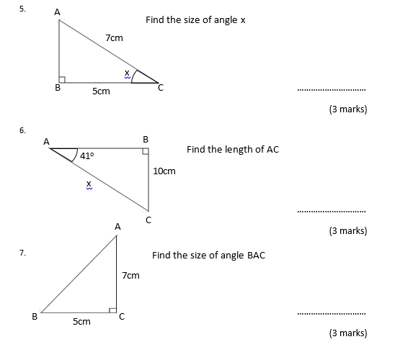

Slide 34
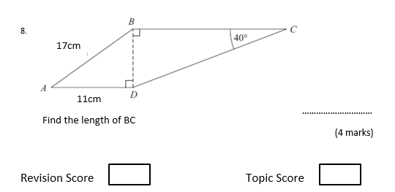

Slide 35
Homeworks
Homeworks are on several single side A4 sheets
Sheets to be trimmed (so no folding) and stuck on the left-hand page of big blue books, with the right-hand page for dedicated working out
Staff use “Feedback” sticker and then write feedback and follow-up work in books
Then use “What have you done?” sticker, where the students responds

Slide 36
Assessments
Less assessments than last year ☺
1 assessment at the end of each half term
Covers content from that half term but also from previous half terms and years

Slide 37
We hope the Scheme will…
Build upon the best features of the Year 7 to 8 SOL
Be easier to follow in terms of your teaching and marking requirements
Give you more time to plan better lessons, teach topics in greater depth, and do rich tasks to promote a higher level of learning and problem solving
Prepare our students for the demands of what will be a pretty tricky new GCSE

