Slide 1
Standards Unit N5: Understanding the laws of arithmetic
Suitable for students at Level 6, or strong 5’s.
Consolidating BIDMAS, compound rectangular areas and square numbers in arithmetic expressions. Excellent preparation for algebraic expressions with divisions. Calculators essential (non-BIDMAS okay too, in order to expose inadequacies).
Groups of 3 largely essential.

Slide 2
Consumable Resources Needed:
Each student needs 1 double-sided ‘
Each student needs 1
I need
Extension / Separate ‘Brackets’ game require ‘worksheets from later in presentation.
Each team needs:
2 A5 copies of Sheet A
4 A5 copies of Sheet B
4 A5 copies of Sheet C
Re-usable Resources Needed:
CAMARA to take photos of team’s sorted cards. Stick in books and/or display.
Each student needs mini-whiteboard
Each group needs Card sets A, B and C.

Slide 3
Notes to start.
Students give initial answers individually on mini-whiteboards.
If they struggle, explain you will return to it later in session.

Slide 4
Consider the area of these shapes…
Which area is: $3+4×2 ?$
How do you know?

Slide 5
Consider the area of these shapes…
If you work out: $\left(3+4\right)×2$ which area are you describing?
How do you know?

Slide 6
Consider the area of these shapes…
What answers does your calculator give for:
$3+4×2=$
and for:
$\left(3+4\right)×2=$

Slide 7
Consider the area of these shapes…
Can you write down an expression for the other area?
What is the difference between:
${(2+3)}^{2}$ and $2^{2}+3^{2}$
Can you draw a diagram to explain the difference?

Slide 8
What is BIDMAS, or BODMAS?
Can anyone explain what it means?
I’ll do one. See if you can spot the mistakes I make.

Slide 9
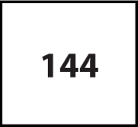
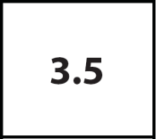
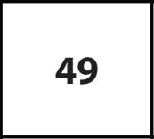
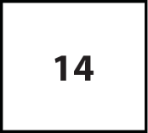
Groupwork: Teams of 3
Step 1: Each take one of the sets of cards, and lay them out in front of you so that they can all be seen.
Student #1
Student #2
Student #3
Card Set A
Calculations
Card Set B
Areas
Card Set C
Solutions

Slide 10
Matching up the cards
Step 2: Take it in turns to pair up any cards, and place them at the top.
Student #1
Student #2
Student #3
Card Set A
Calculations
Card Set B
Areas
Card Set C
Solutions
Properly check that they have correctly matched the cards!

Slide 11
Matching up the cards
Step 2: Take it in turns to pair up any cards, and place them at the top.
Set 2
Set 1
Student #1
Student #2
Student #3
Card Set A
Calculations
Card Set B
Areas
Card Set C
Solutions
Properly check that they have correctly matched the cards!

Slide 12
Matching up the cards
Step 2: Take it in turns to pair up any cards, and place them at the top.
Set 2
Set 1
Student #1
Student #2
Student #3
Card Set A
Calculations
Card Set B
Areas
Card Set C
Solutions

Slide 13
Check: What are you going to do?
Set 2
Set 1
Student #1
Student #2
Student #3
Card Set A
Calculations
Card Set B
Areas
Card Set C
Solutions

Slide 14
Strongly encourage students to explain how they can easily match ‘Calculation’ and ‘Area’ cards without actually working out the answers.
Note:
There are multiple ways the cards can be matched, and there are more ‘Calculation’ cards than others (14 C’s, 8 A’s and only 6 S’s). Use blank cards for students to create their own area shapes, and solution cards to match those.

Slide 15
Neatly replace the cards in their correct wallet.
Check that:
Card Set A (Calculations) has 14 cards.
B (Areas) has 8 cards.
C (Solutions) has 6 cards.
You will each then need mini-whiteboards again.

Slide 16
Let’s reconsider these shapes…
Which area is: $3+4×2 ?$
How do you know?
Which area is $\left(3+4\right)×2$ describing?
How do you know?
Can you write down an expression for the other area?
Draw diagrams to explain the difference between:
${(2+3)}^{2}$ and $2^{2}+3^{2}$

Slide 17
Let’s see if we can do even better!
Draw an area that requires $3×\left(4+5\right)$
Now write a different calculation that gives the same area.
Now draw an area that requires $\frac{6+8}{2}$
And write a different calculation that gives the same area.
Finally, draw an area that requires ${\left(10+5\right)}^{2}$
And again write a different calculation that gives that area.

Slide 18
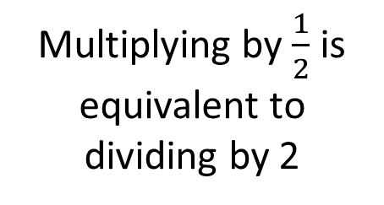
We’ve covered a lot there!
BIDMAS actually means:
Brackets
Indices (or powers)
Multiplication OR Division
Addition OR Subtraction
Multiplying by $\frac{1}{2}$ is equivalent to dividing by 2
$$2×\left(3+4\right)=2×3+2×4$$
In algebra, this is just multiplying out a bracket:
$2\left(x+y\right)=2x+2y$
$${\left(3+4\right)}^{2}=3^{2}+4^{2}+2×3×4$$
In algebra, this will be: ${\left(x+y\right)}^{2}$. We’ll study that another time!

Slide 19
Somewhat separate follow-on whole-class ‘game’ to consolidate what has been learnt before.
It requires use of the following worksheets – and adding brackets in appropriate places.
Probably best covered in a later lesson to review / recap.

Slide 20
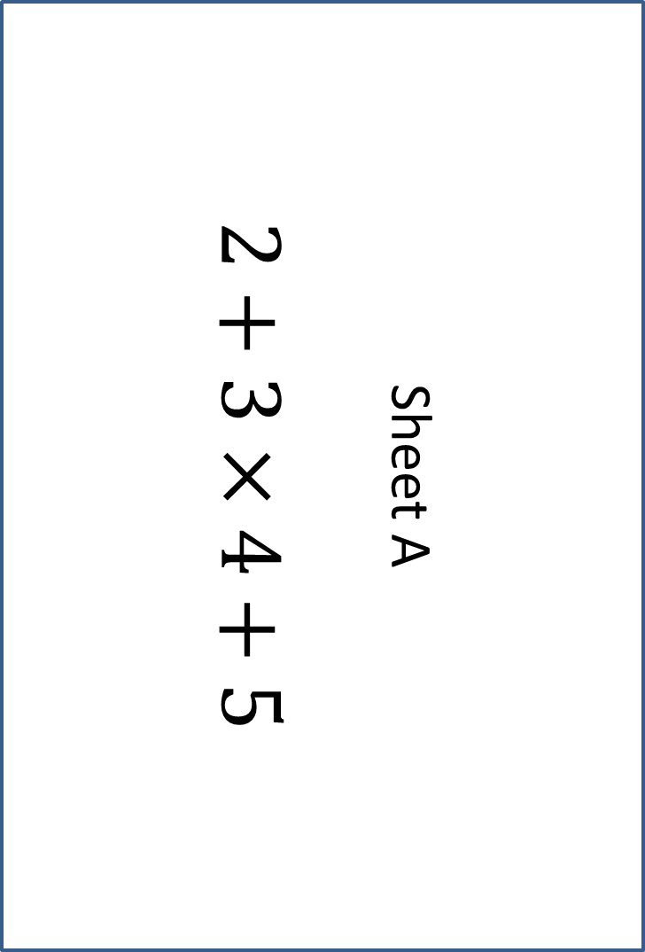
Sheet A
$$2+3×4+5$$
Sheet A
$$2+3×4+5$$

Slide 21
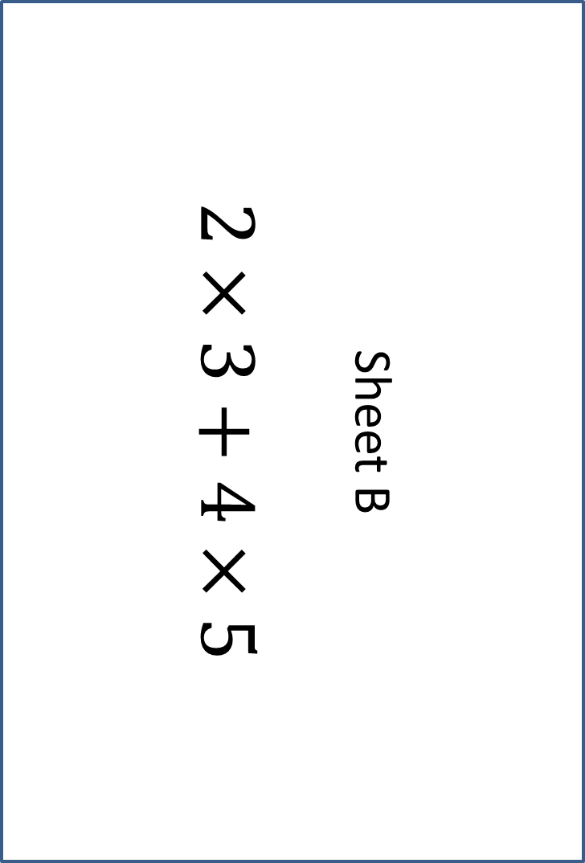
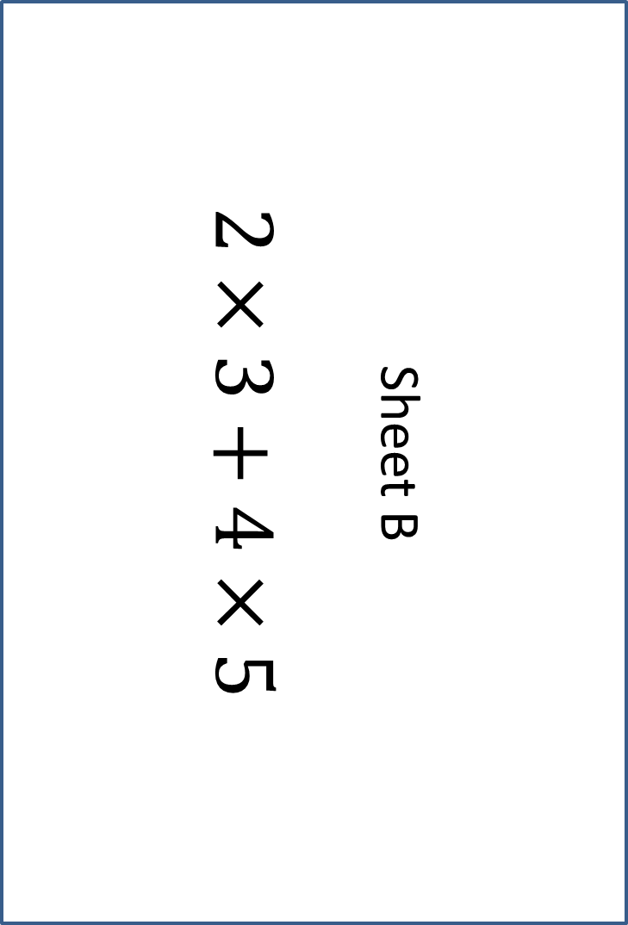
Sheet B
$$2×3+4×5$$
Sheet B
$$2×3+4×5$$

Slide 22

Sheet C
$$2+3×4^{2}$$
Sheet C
$$2+3×4^{2}$$

Slide 23
Brackets activity
Each team of 3 needs:
2 copies of Sheet A
4 copies of Sheet B
4 copies of Sheet C
Have a good look at the similarities and differences between the three sheets
In the game, you will need to add brackets to somewhere on each sheet.
Can you guess what I’ll be asking?

Slide 24
Brackets activity
I will ask 8 different questions.
The first team to show me a correct solution wins that round.
I will tell you which Sheet to use, and a Target Number.
Your task will be to add brackets to your sheet to get the Target Number.
Questions?

Slide 25
Questions
Note: there might be multiple solutions to the same problem

