Slide 2
Parallel and Perpendicular Lines
Objective: To be able to identify Parallel and Perpendicular lines
Lines are parallel if they never intersect and are always the same distance apart (equidistant).
B
D
We write AB//CD.
We show lines are parallel using arrows.
A
C
Lines are perpendicular if they intersect at right angles.
C
We write AB CD.
A
We use this symbol to show a right angle.
B
D

Slide 3
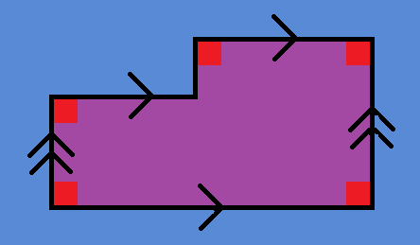
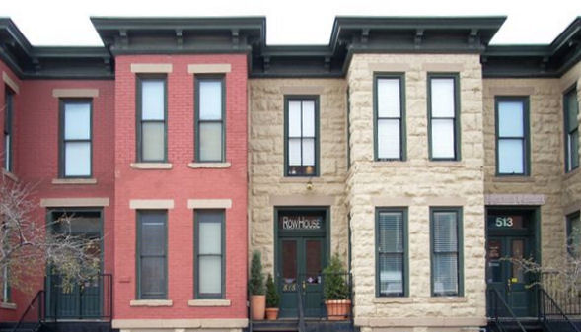
Copy the diagram into your books.
Fill in the gaps with // or .
D
E
H
I
a) DE___HI b) DE___EF
c) GF___DE d) HG___GF
e) EF___DE f) HI ___ID
G
F
Find as many parallel and perpendicular lines as you can in this photograph

Slide 4
Draw a line segment AB on a piece of paper.
A
B
Draw another line segment CD on a piece of tracing paper. Lay it on top of the piece of paper so that AB and CD intersect.
D
Rotate the tracing paper about the point of intersection. You will get diagrams similar to those below.
In each case, what can you find out about the marked angles? Repeat for different angles.
C
a)
b)
c)

Slide 6
What is the size of the marked angle?
p
41°
f
164°
x
31°
40°
a
84°
132°

Slide 7
Find the value of x
x + 20°
68°
68°
x + 20°

Slide 8
Investigate the sizes of the angles in these diagrams.
a
b
b
55°
c
a
c
27°
Can you convince the person next to you?

Slide 10
What is the size of the marked angles? What have you used to work them out?
65°
a
35°
b
c

Slide 11
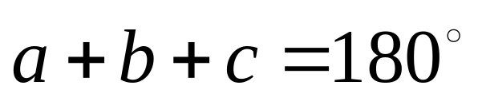
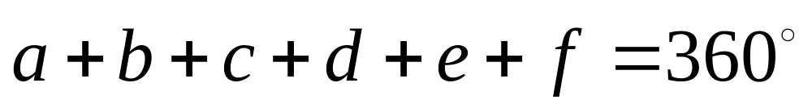
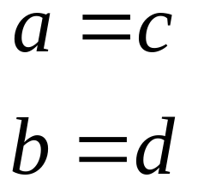
Angles in a line add up to 180°.
a
b
c
Angles around a point add up to 360°.
a
b
f
c
e
d
Vertically Opposite angles are equal.
a
d
b
c

Slide 12
For each, find the size of the marked angle. Give reasons for your answer.
1.
2.
3.
57°
a
57°
b
37°
17°
c
5.
4.
96°
f
57°
e
22°
g
d
43°
h

Slide 13
Angles with Parallel Lines
Given parallel lines,
With a line intersecting them both
The marked angles are called corresponding angles.
Corresponding Angles Are Equal

Slide 14
Given parallel lines,
With a line intersecting them both
The marked angles are called alternating angles.
Alternating Angles Are Equal

Slide 16
On a piece of paper, draw two parallel line segments.
On a piece of tracing paper, draw another line segment.
Place the tracing paper over the paper, so that the line intersects both parallel lines.
Investigate the sizes of the angles.

Slide 17
On a piece of paper, draw two parallel line segments.
On a piece of tracing paper, draw another line segment.
Place the tracing paper over the paper, so that the line intersects both parallel lines.
Investigate the sizes of the angles.

Slide 19
Starter
Which angles are equal? Give reasons.
j
k
n
o
i
l
m
p
b
c
f
g
a
d
e
h

Slide 20
Which lines are parallel, if any? Give reasons.
H
J
A
B
79°
77°
C
D
77°
79°
E
F
G
I

Slide 22
Starter

Slide 23
Make a poster or booklet explaining the rules of angles to next years Year 7 pupils.
Your poster or booklet needs to have:
A title;
A sentence and diagram explaining the terms Angles On A Line, Angles Around A Point, Vertically Opposite Angles, Corresponding Angles and Alternating Angles;
A sentence explaining what we know about these angles;
Lots of colour!

Slide 25
Starter

Slide 26
What is the size of angle x?
80°
65°
35°
x

Slide 27
Proof
Objective: To be able to use angle facts to prove other theorems.

Slide 28
Example
Prove that alternating angles are equal.
a
b
c
We know c is the same size as a, as they are corresponding angles.
We also know that c is the same as b, as they are vertically opposite angles.
So , if a = c and c = b, then we must have a = b.

Slide 29
Prove that the angles in a triangle add up to 180°
x
a
y
b
c
By alternate angles, we know that b = x and c = y.
By angles on a line, we know that x + a + y = 180°.
So we know that b + a + c = 180°.

Slide 30
Angles d, e and f are called exterior angles.
e
a
b
c
d
f

Slide 31
a
45°
80°
d
d
b
55°
c
We know that c + d = 180°, as they are angles on a line.
We know that a + b + c = 180°, as they are angles in a triangle.
So, we know that d = a + b.

