Slide 1
Basic Arithmetic

Slide 2
Addition Activities

Slide 4
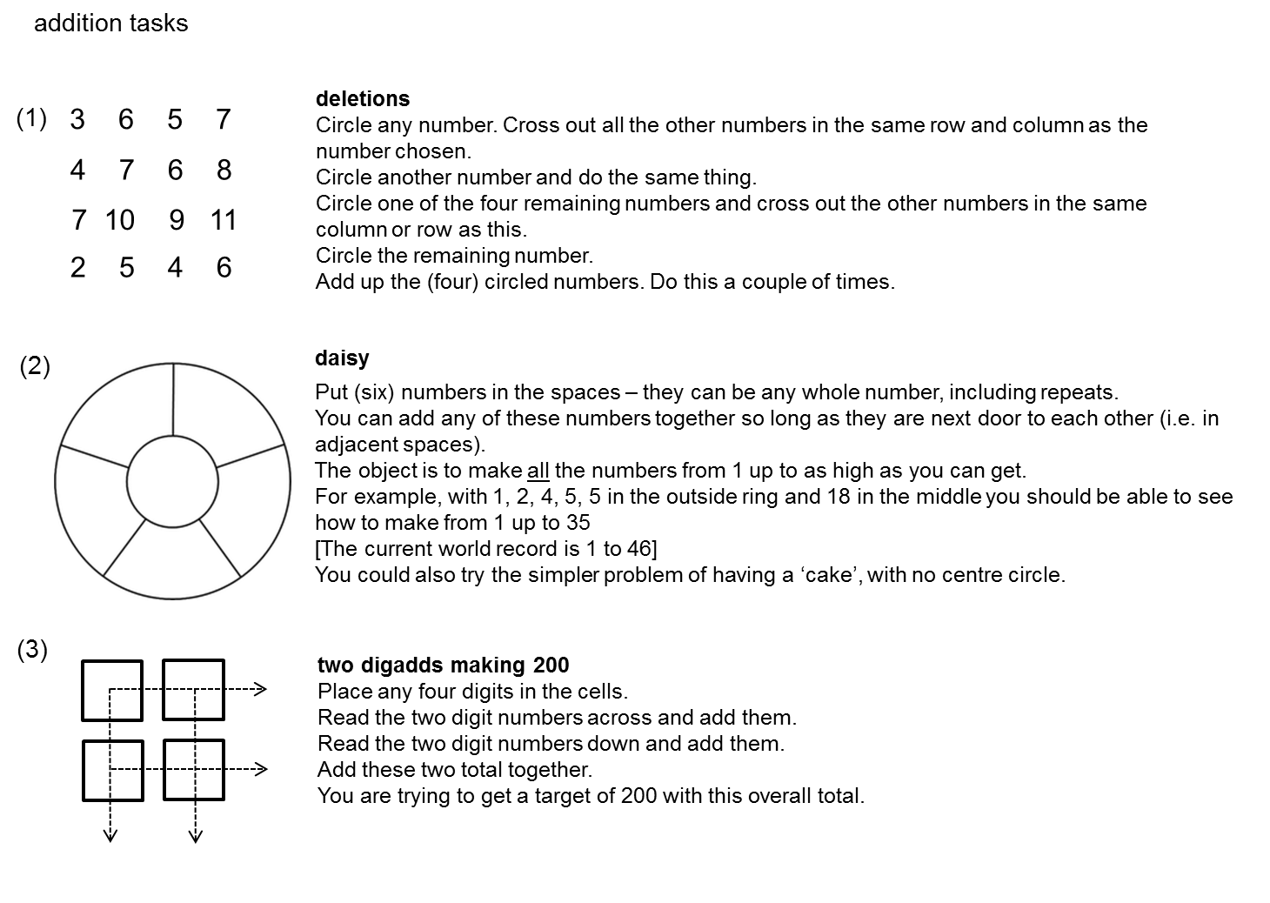

Slide 5
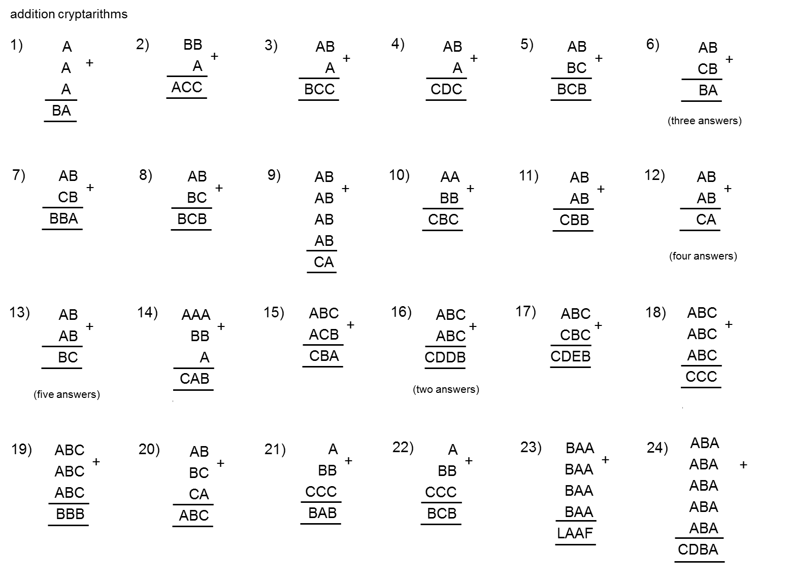

Slide 6
Subtraction Activities

Slide 7
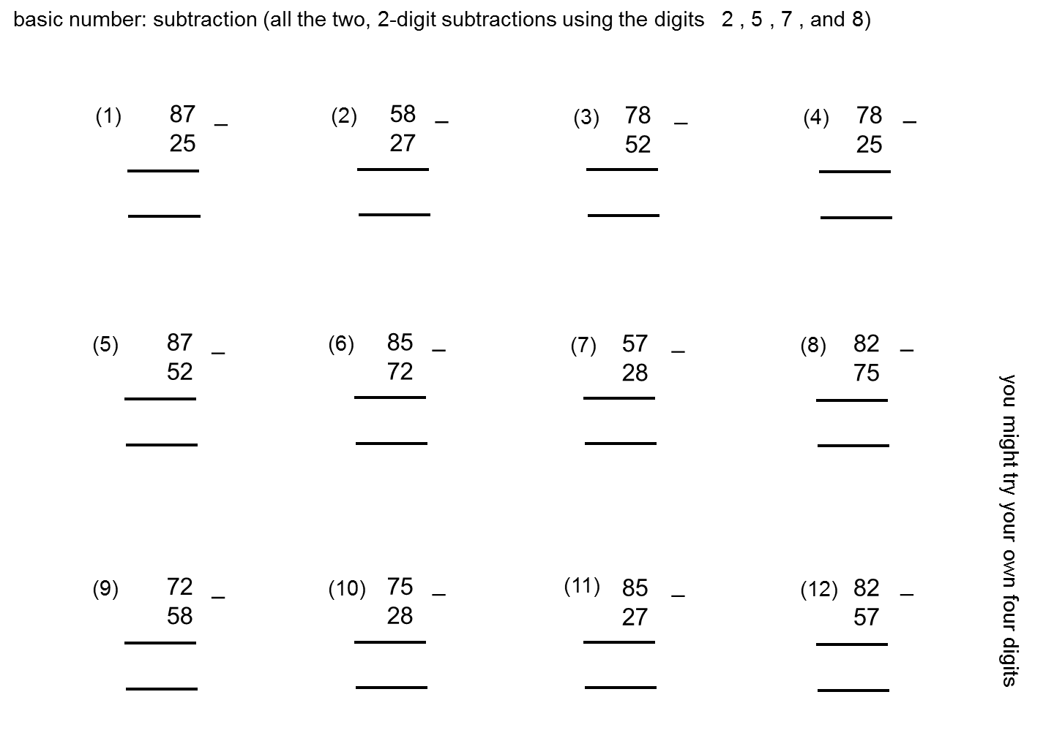

Slide 9
Multiplication Activities

Slide 11
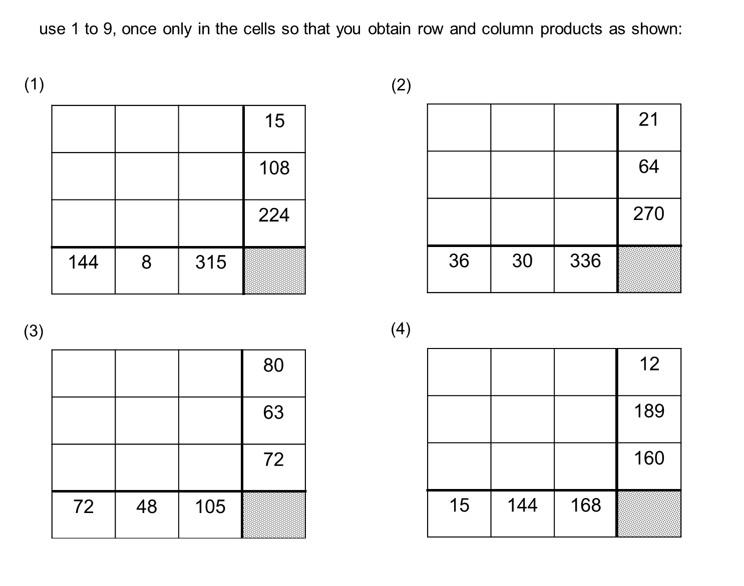

Slide 12
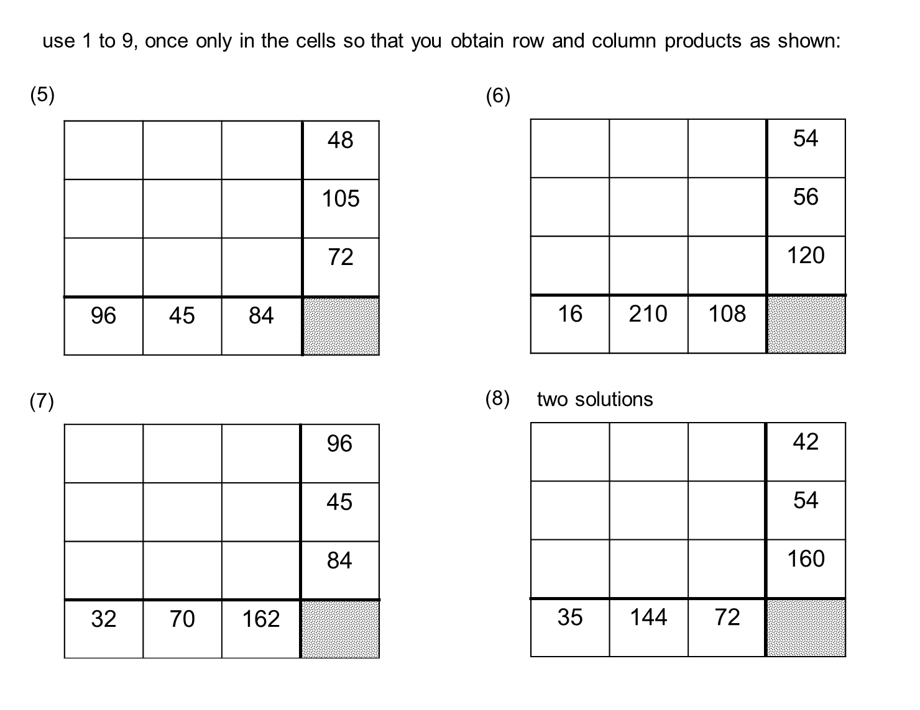

Slide 13
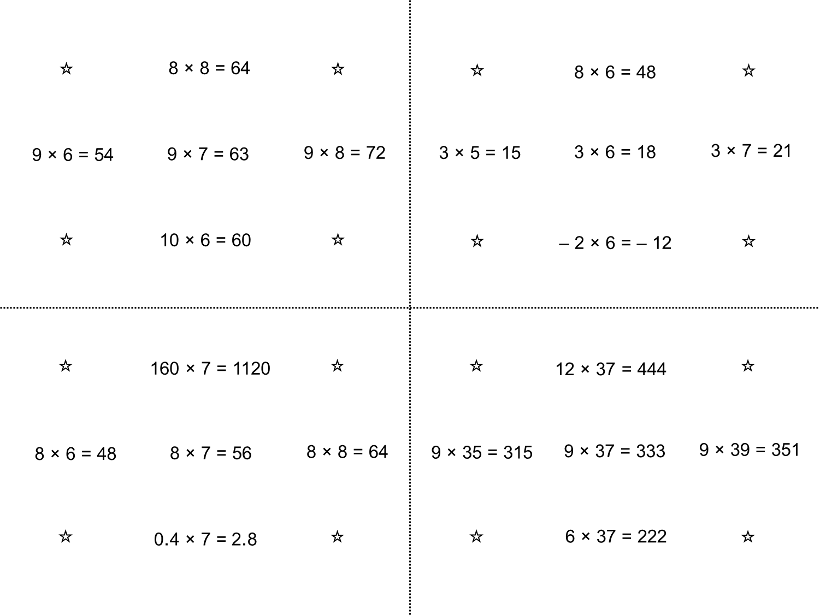

Slide 15
Division Activities

Slide 18
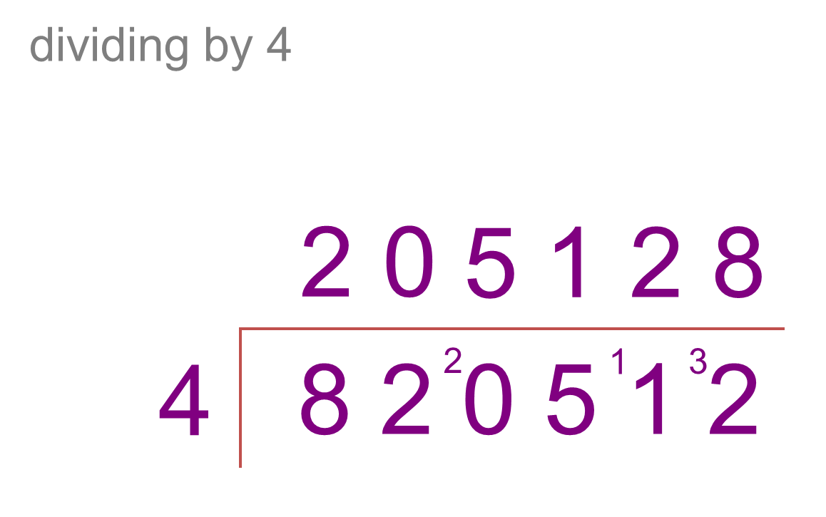

Slide 19
